Slide 1
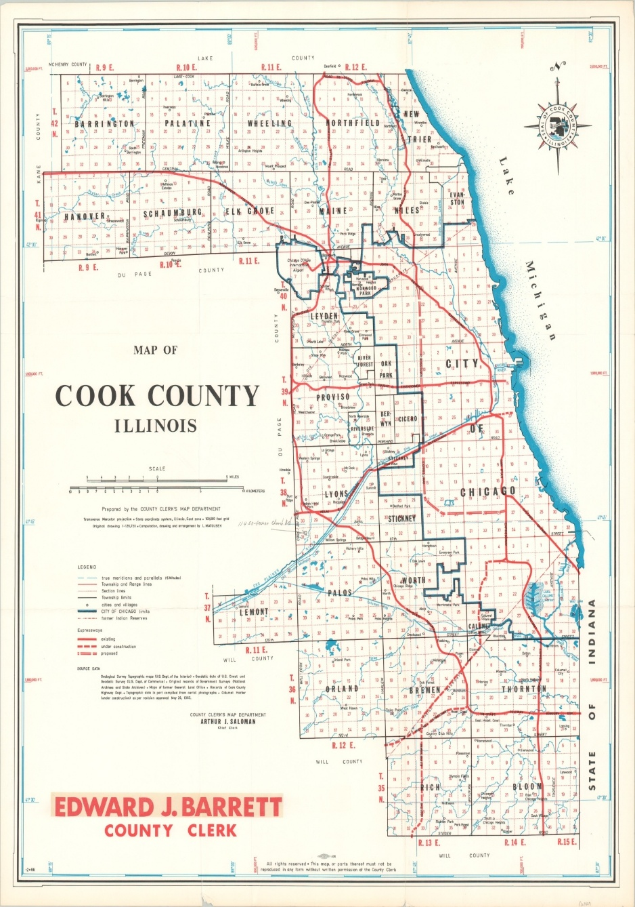
GIS Analysis of Food Access Inequities In Cook County
Name : Omar Sayeed Quadri
Course : GEO – 441
Instructor : C. Scott Smith

Slide 2

Background & Context
Access to healthy and affordable food is a key determinant of public health and quality of life. In large urban regions of Cook County, many low-income neighborhoods face limited access to full-service grocery stores, creating food deserts that contribute to long-term health disparities. Limited food access is associated to high rates of diet - related diseases such as diabetes or heart disease. This project uses GIS spatial analysis to assess food access inequities across the County, identifying which communities are mostly affected by limited supermarket access.

Slide 3

Research Question !
This project investigates food access disparities around Cook County by answering two related research questions that I proposed:
How many residents in each community area live within 0.5 miles of a supermarket?
Which communities with higher social vulnerability and poverty experience the lowest food access coverage?
GIS spatial analysis was used to create service area buffers, calculate percent coverage, and integrate health equity indicators for these to be answered.

Slide 4
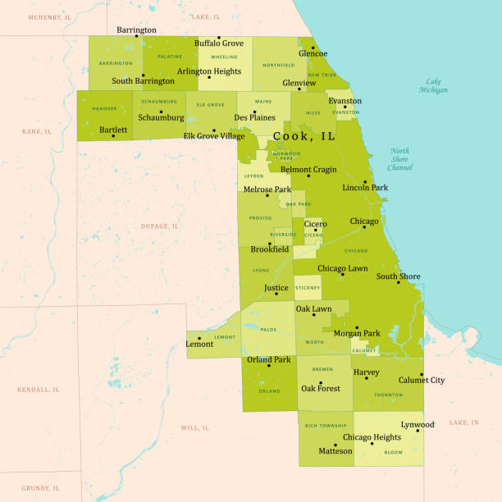
Data Sources
Dataset | Source
Community Area Shapefile | Chicago Data Portal
Supermarket data | City of Chicago
Roads network | US Census Bureau TIGER/Line
Health Indicators (SVI, Poverty) | Chicago Health Atlas

Slide 5
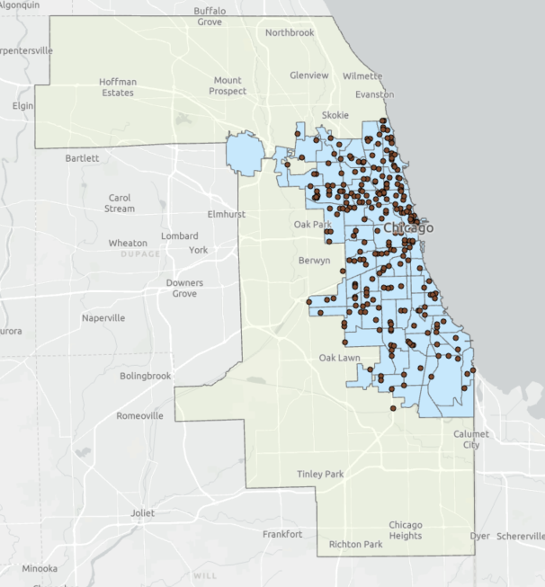
Methods used
Created 0.5 mile service area buffers around supermarket locations.
Performed spatial intersections with community area boundaries.
Calculated the area coverage (%) for each community area.
Joined Chicago Health Atlas data (SVI, Poverty and Fruit/Veg Access).
Conducted attribute joins, field calculations and map visualizations.
Tools used so far : ArcGIS Pro (Buffer, Intersect, Join Field, Field Calculator, Symbology) and Rstudio.

Slide 6
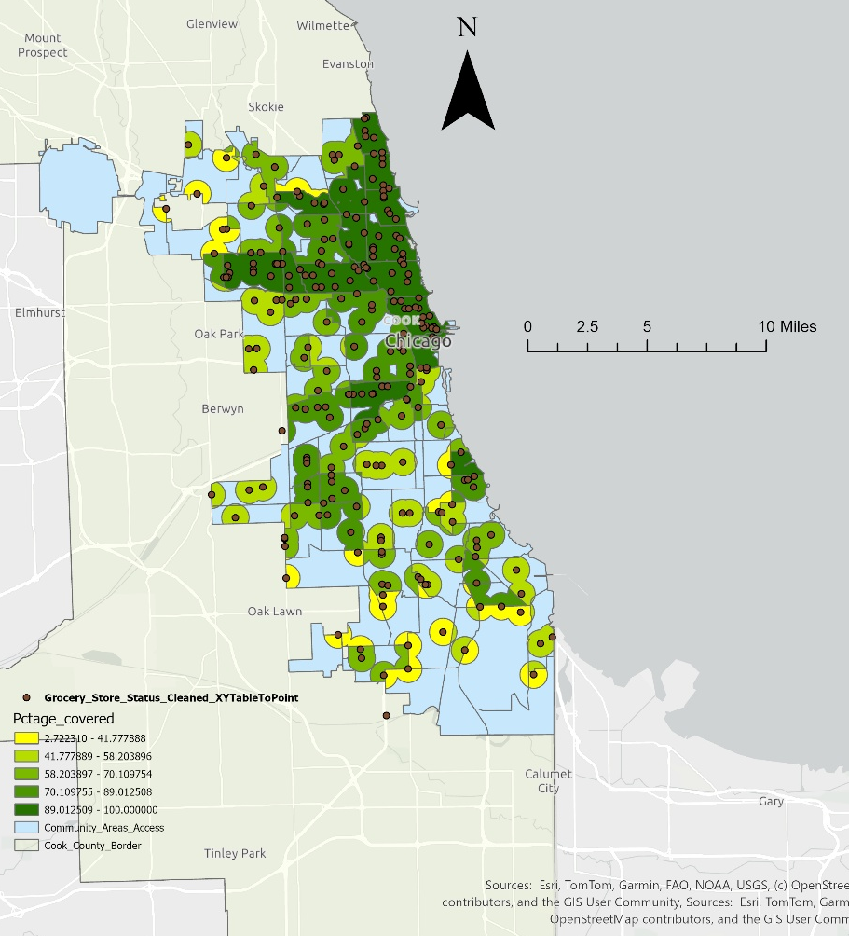
Food Access Coverage : % Community Area within 0.5 miles of Supermarkets.
Most Northern areas in the community show higher access as compared to Southern or Western community areas.
(Pctage_covered = Percentage Covered)

Slide 7
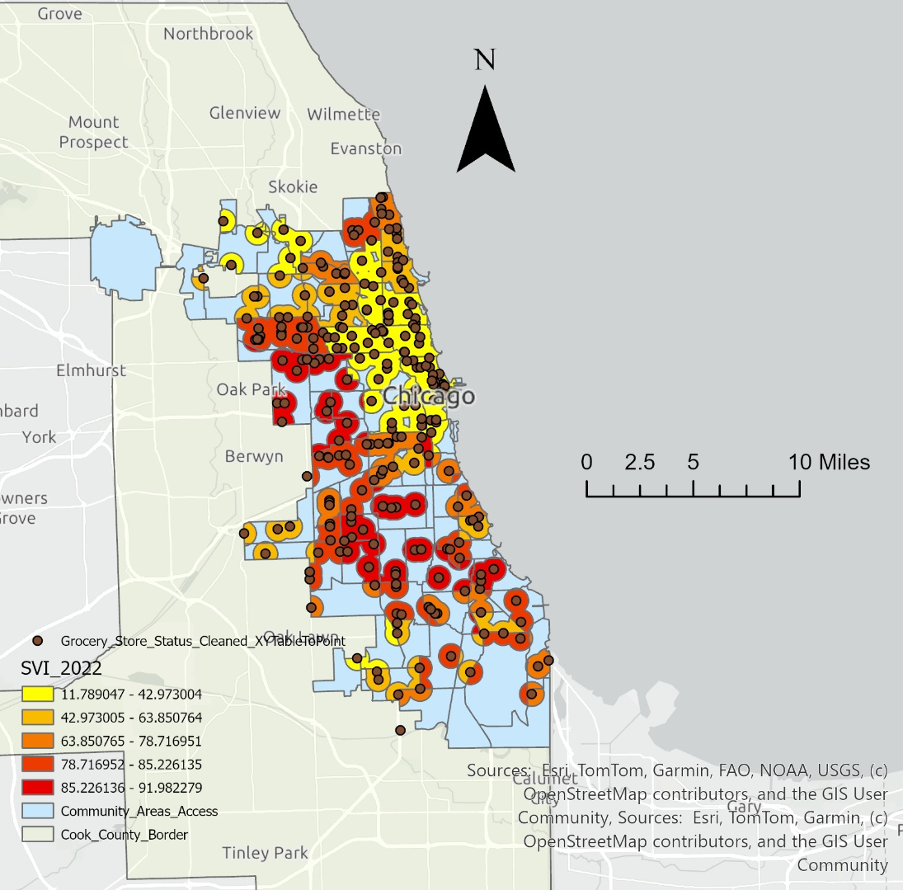
Social Vulnerability Index (SVI 2022)
Areas with higher social vulnerability are concentrated in the southern and western portions of Cook County, overlapping with areas of reduced food access.

Slide 8
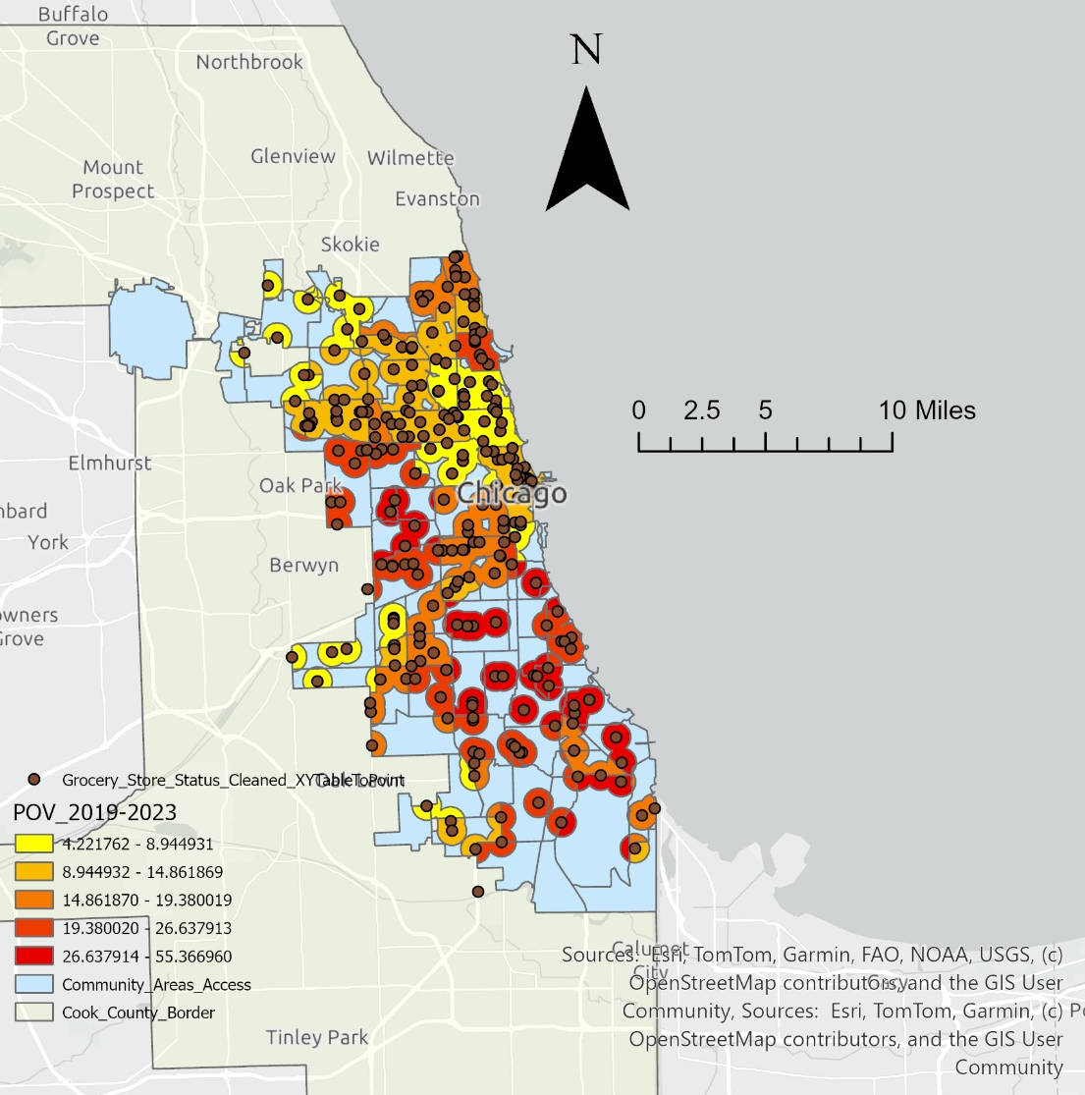
Poverty Rate
Higher poverty rates are concentrated in south and west Cook County.
POV 2019-2023 = Poverty Rate

Slide 9

Summary Results
All detailed results, including percent supermarket access, Social Vulnerability Index, poverty rates and fruit/vegetable access for each community area are provided in the attached analysis table (FoodAccessFinalTable.csv). This table supports the map findings and will assist in future policy planning.

Slide 10

Discussion and Key Takeaways
The GIS analysis reveals significant variation in food access coverage across Cook County. Many community areas in the southern and western parts of the county experience lower access to supermarkets, while these same areas also have higher levels of social vulnerability and poverty. The spatial overlap of limited food access with vulnerable populations sights broader health inequities that might contribute to chronic health issues. These findings demonstrate how GIS can support targeted interventions and policy planning to improve food access for under - served communities.

Slide 11

References
Chicago Data Portal. Community Areas Shapefile.
City of Chicago Open Data Portal. Supermarket Locations.
U.S. Census Bureau TIGER/Line Shapefiles. Road Network.
Chicago Health Atlas. Social Vulnerability, Poverty and Fruit/Veg Access Indicators.
ArcGIS Pro. ESRI GIS Software.

