Slide 1

OOP FINAL PROJECT
Gym Management System
A Python object-oriented application for running a gym: members, trainers,
memberships, payments and attendance — with a Tkinter GUI and JSON storage.
PREPARED BY
Omar Ahmed Hamza Nomeir
Python • Object-Oriented Programming • Tkinter • JSON

Slide 2




THE PROBLEM
Running a gym on paper doesn’t scale
Member records scattered across notebooks and spreadsheets, hard to search or update.
No reliable way to know who’s membership is active, expired, or about to run out.
Payments and attendance are tracked by hand — errors and missed renewals follow.
OBJECTIVE
Build a small, complete desktop application that applies real OOP thinking — classes,
inheritance, encapsulation, polymorphism, abstraction and composition — to a real business:
members, trainers, memberships, payments and attendance, with a working GUI and file storage.
GYM MANAGEMENT SYSTEM
2

Slide 3



ARCHITECTURE
Simple structure, clean separation of concerns
gym.py
RUNTIME FLOW
Every class: models, business rules, validation, and the FileManager that reads / writes JSON.
1
Load gym.json → build Gym object
main.py
2
User acts in the GUI (add, search, pay…)
The Tkinter GUI — six tabs wired to Gym’s methods. No business logic lives here.
3
main.py calls a Gym method
4
Gym validates & applies business rules
data/gym.json
Plain JSON file. Created on first run, loaded on start, saved after every change.
5
FileManager saves the updated state
6
Table & dashboard refresh instantly
GYM MANAGEMENT SYSTEM
3

Slide 4
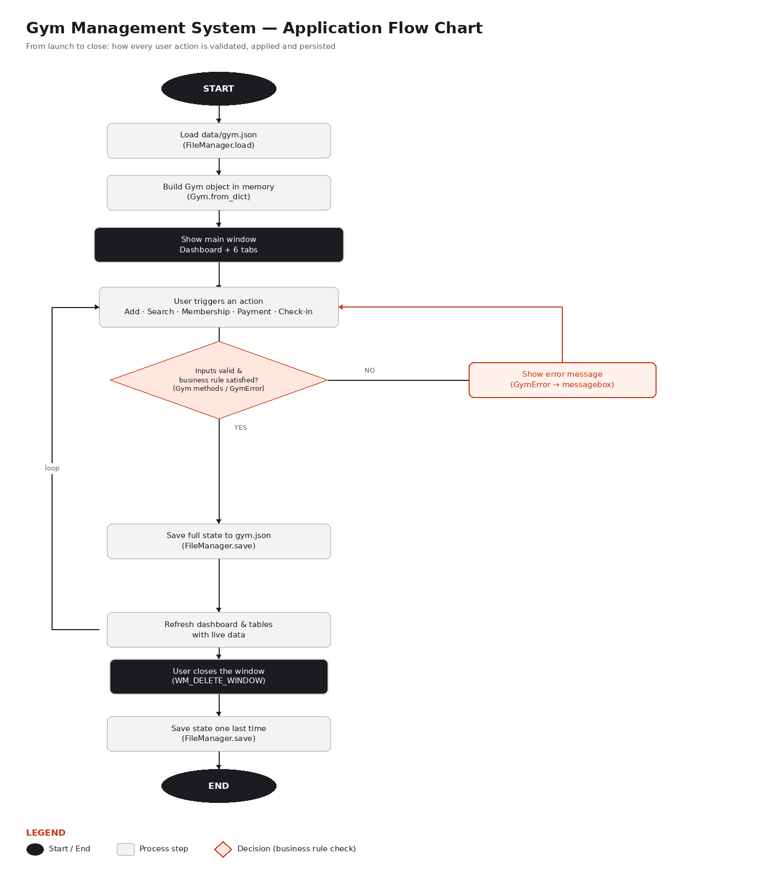
PROCESS FLOW
From launch to close, step by step
GYM MANAGEMENT SYSTEM
4

Slide 5








DATA MODEL
Nine classes, one clear responsibility each
Person
Member
Trainer
Abstract base class — id, name, phone, validation
Join date, assigned trainer, membership history
Specialty, assigned to one or more members
Membership
Payment
Attendance
Plan, start / end date, price, is_active
Amount (validated > 0), date, note
Member check-in record with date
Gym
FileManager
GymError
Main class — owns everything, runs the rules
Reads / writes the JSON data file
Custom exception for validation & rule errors
GYM MANAGEMENT SYSTEM
5

Slide 6





OOP DESIGN
Every core OOP concept, demonstrated
Abstraction
Inheritance
Polymorphism
Encapsulation
Person is an ABC with an abstract label() method
Member and Trainer both extend Person
label() renders differently per subclass
Private fields, validated via @property setters
Composition
Type Hints
Exceptions
File Handling
Gym owns Members, Trainers, Memberships...
Applied throughout gym.py and main.py
One GymError, raised & caught at every edge
FileManager isolates all JSON I/O
GYM MANAGEMENT SYSTEM
6

Slide 7

BUSINESS LOGIC
Rules enforced by Gym, not just CRUD
No attendance without an active membership
A member can’t check in if their membership has expired, or they never had one.
No two active memberships at once
Creating a new membership while one is active is rejected — renew it instead.
Payments must be greater than zero
Payment.amount is validated the moment the object is created.
A member must exist first
Attendance, payments and memberships all check the member exists before acting.
GYM MANAGEMENT SYSTEM
7

Slide 8
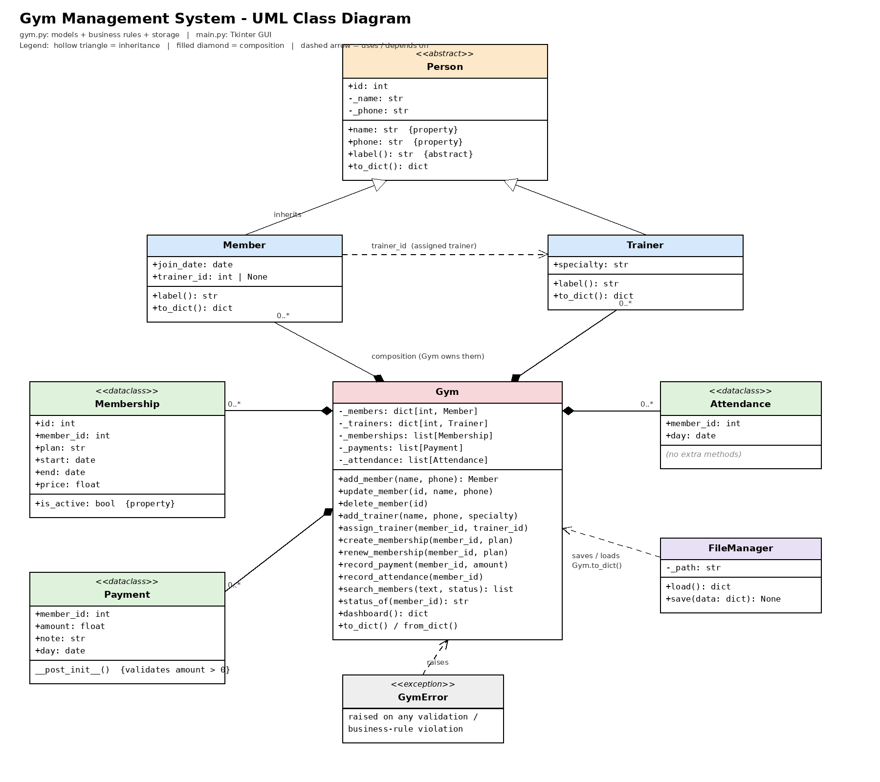
UML CLASS DIAGRAM
How the classes connect
GYM MANAGEMENT SYSTEM
8

Slide 9
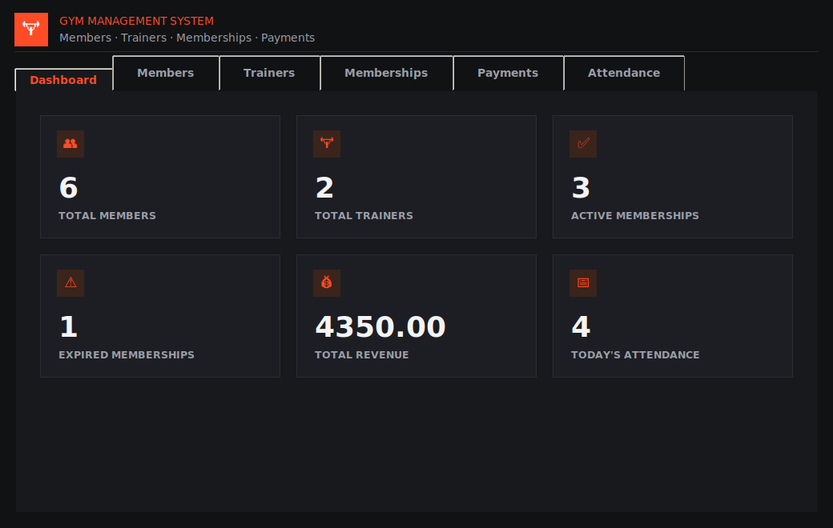

WALKTHROUGH
The dashboard — real numbers, not decoration
Six live metrics
Total members & trainers, active / expired memberships, revenue, today’s check-ins.
Computed, not hard-coded
Every card is derived from Gym.dashboard() on the live data.
Always current
Refreshes after every add, payment, renewal or check-in.
GYM MANAGEMENT SYSTEM
9

Slide 10

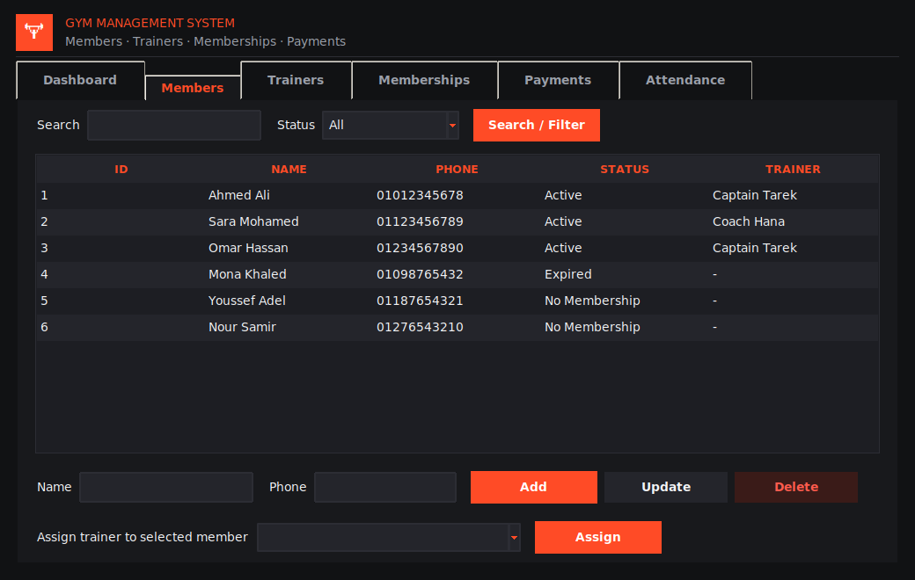

WALKTHROUGH
Members — CRUD, search and filtering
Search
By ID, name or phone — filters the table live.
Filter
Active / Expired / No Membership status.
Add & update
Validated name and phone before saving.
Guarded delete
Confirms, then removes the member’s full history.
GYM MANAGEMENT SYSTEM
10

Slide 11



QUALITY
Ten scenarios, every one automated
3
3
2
2
Successful
scenarios
Invalid input
scenarios
Business-rule
violations
Edge
cases
13 pytest cases — all passing
tests/test_gym.py automates the 10 required scenarios plus 2 extra checks (unknown member,
save/load round-trip). Documented list also kept in tests/test_scenarios.txt for manual walk-through.
pytest tests
GYM MANAGEMENT SYSTEM
11

Slide 12

THANK YOU
Live demo — Gym Management System
Ready to demonstrate: object creation & constructors, encapsulation, inheritance and
polymorphism through Member / Trainer, abstraction via Person, composition inside Gym,
file loading & saving, at least three business rules, and graceful error handling.
Omar Ahmed Hamza Nomeir
Python • OOP Final Project

