Slide 1
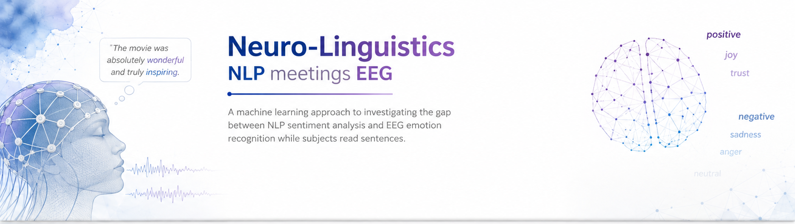














Neuro-Linguistics
NLP meets EEG
CSE 389: Natural Language Processing
Omar Ahmed Ahmed AbdAlAal 18P2998
Presented to Dr. Alaa Mahmoud Hamdy

Slide 2
SYSTEM OVERVIEW
SST
NLP Engine
Machine Sentiment
Statistical Analysis
EEG
DSP Engine
Human Sentiment

Slide 3
INPUTS
SST
200k human-labeled phrases
Syntactic parse trees
Ground truth labels
EEG
128-channel EEG recording
12 Subjects recorded while reading SST
Notes:
The "SST" Stanford Sentiment Treebank was introduced at Stanford in 2013
Before that, sentiment analysis was mostly treated as a "bag of words." Models would just count how many positive or negative words were in a sentence and guess the overall vibe.
SST revolutionized this by introducing the concept of Compositionality—how the meaning of a sentence is built from the ground up.
Every sentence is broken down into a syntactic parse tree, and every node is given a sentiment score.
Humans labeled 200,000+ phrases across 12,000 movie reviews.

Slide 4
NLP Engine
Preprocessing
Cleaning & Tokenization
Stop Word Removal
Lemmatization
DistilBERT
Transformer Encoder
Knowledge Distillation
Sentence Embedding
Notes:
Bidirectional + Self Attention
BERT-Base 110M parameters 12 layers -> knowledge distillation -> DistilBERT 6 layers 40M parameters
When DistilBert processes a sentence, it adds a special classification token at the beginning.
Pre-trained on wikipedia + BookCorupus, fine-tuned for binary sentiment on SST-2 dataset.

Slide 5
Machine Sentiment
Binary valence score predicted via DistilBERT softmax head.
91% F1 Score on the SST validation set.

Slide 6
DSP Engine
4-40Hz Bandpass Filter + 50 Hz Notch Filter
ICA-Based Artifact Rejection
Welch PSD Estimation
Affective Analysis: FAA & Global Alpha Suppression

Slide 7
Human Sentiment
Binary valence score
80% F1 Score on the DEAP dataset

Slide 8
Correlation
Spearman Correlation between AI Valence and EEG FAA
Subject ZGW: Rho = -0.195, p = 0.00007 (Significant)
Subject ZDN: Arousal r = -0.140, p = 0.005 (Significant)
Subject-level Z-scoring applied to normalize biological variance
Alignment Score = AI Valence (Z) × EEG FAA (Z)

Slide 9
Interesting Findings
SST-2 Training Bias: DistilBERT tags neutral biographical facts as negative (e.g. "He joined the Foreign Service...")
Irony & Humor: AI misses cultural references (e.g. Homer Simpson "working" at the nuclear plant)
Scandal "Juiciness": Humans show high engagement (curiosity) for scandal-related text, while AI only sees negativity
Award-heavy sentences: AI predicts positive, but the human brain shows negative FAA — cognitive overload from long enumerations

Slide 10
Conclusion
AI achieves 91% accuracy on literal text — but struggles with context, irony, and pragmatics
Human EEG reveals cognitive dimensions invisible to NLP models
Cross-modal validation exposes the limits of training-domain-specific models
Future Work: Use EEG-derived features as training signal to improve NLP sentiment models

Slide 11
THANK YOU

