Slide 1








Title: Stroke-Type & Quality Classification for Competitive Swimming
Name:
Omar Samh ID: 231969 – Major: Software Engineering
Khaled Amr ID: 237857 – Major: Software Engineering
June 2026

Slide 2
Table of content
01. | 02. | 03. | 04. | 05. | 06.
Introduction & Background | Problem statement | Motivation | Challenges | Objective | Literature Review
07. | 08. | 09. | 10. | 11. | 12.
System Architecture | Datasets | Methodology | Demo Results | Expected Outcome | Roles & Contributions
2

Slide 3
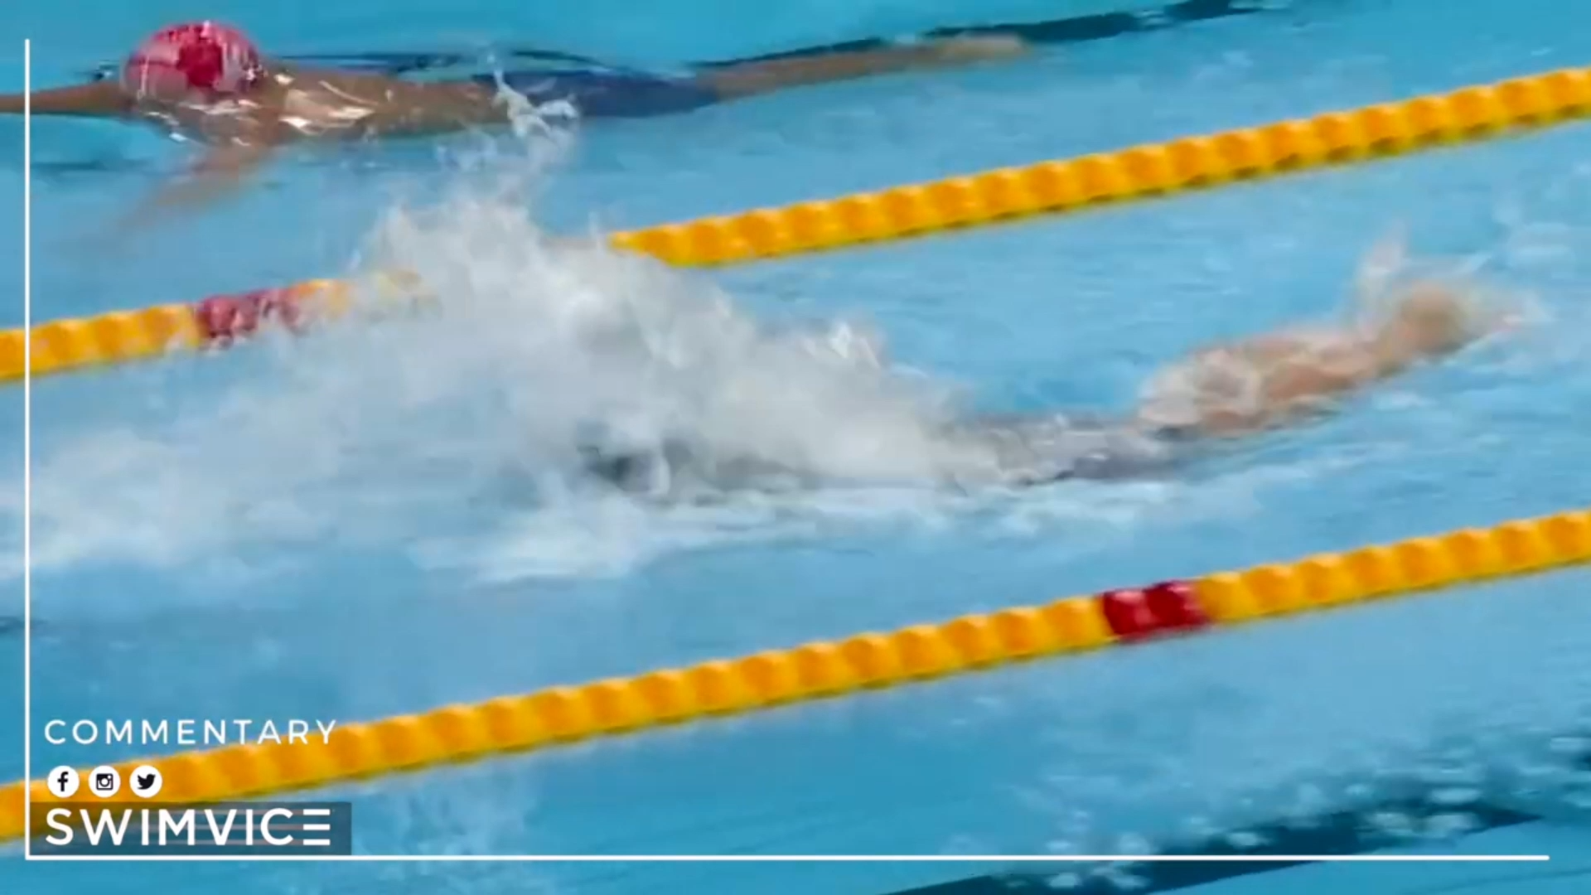
Introduction
Swimming is a popular low-impact sport. However, poor technique in freestyle, butterfly, and breaststroke often causes shoulder, elbow, and lower-back injuries.
Traditional coaching relies on visual observation, limited by water refraction, poor underwater visibility, and inability to monitor multiple swimmers simultaneously. Wearable IMU sensors offer a privacy-aware, low-cost alternative enabling automated, objective feedback in real training conditions.
3
Notes:
sowar

Slide 4
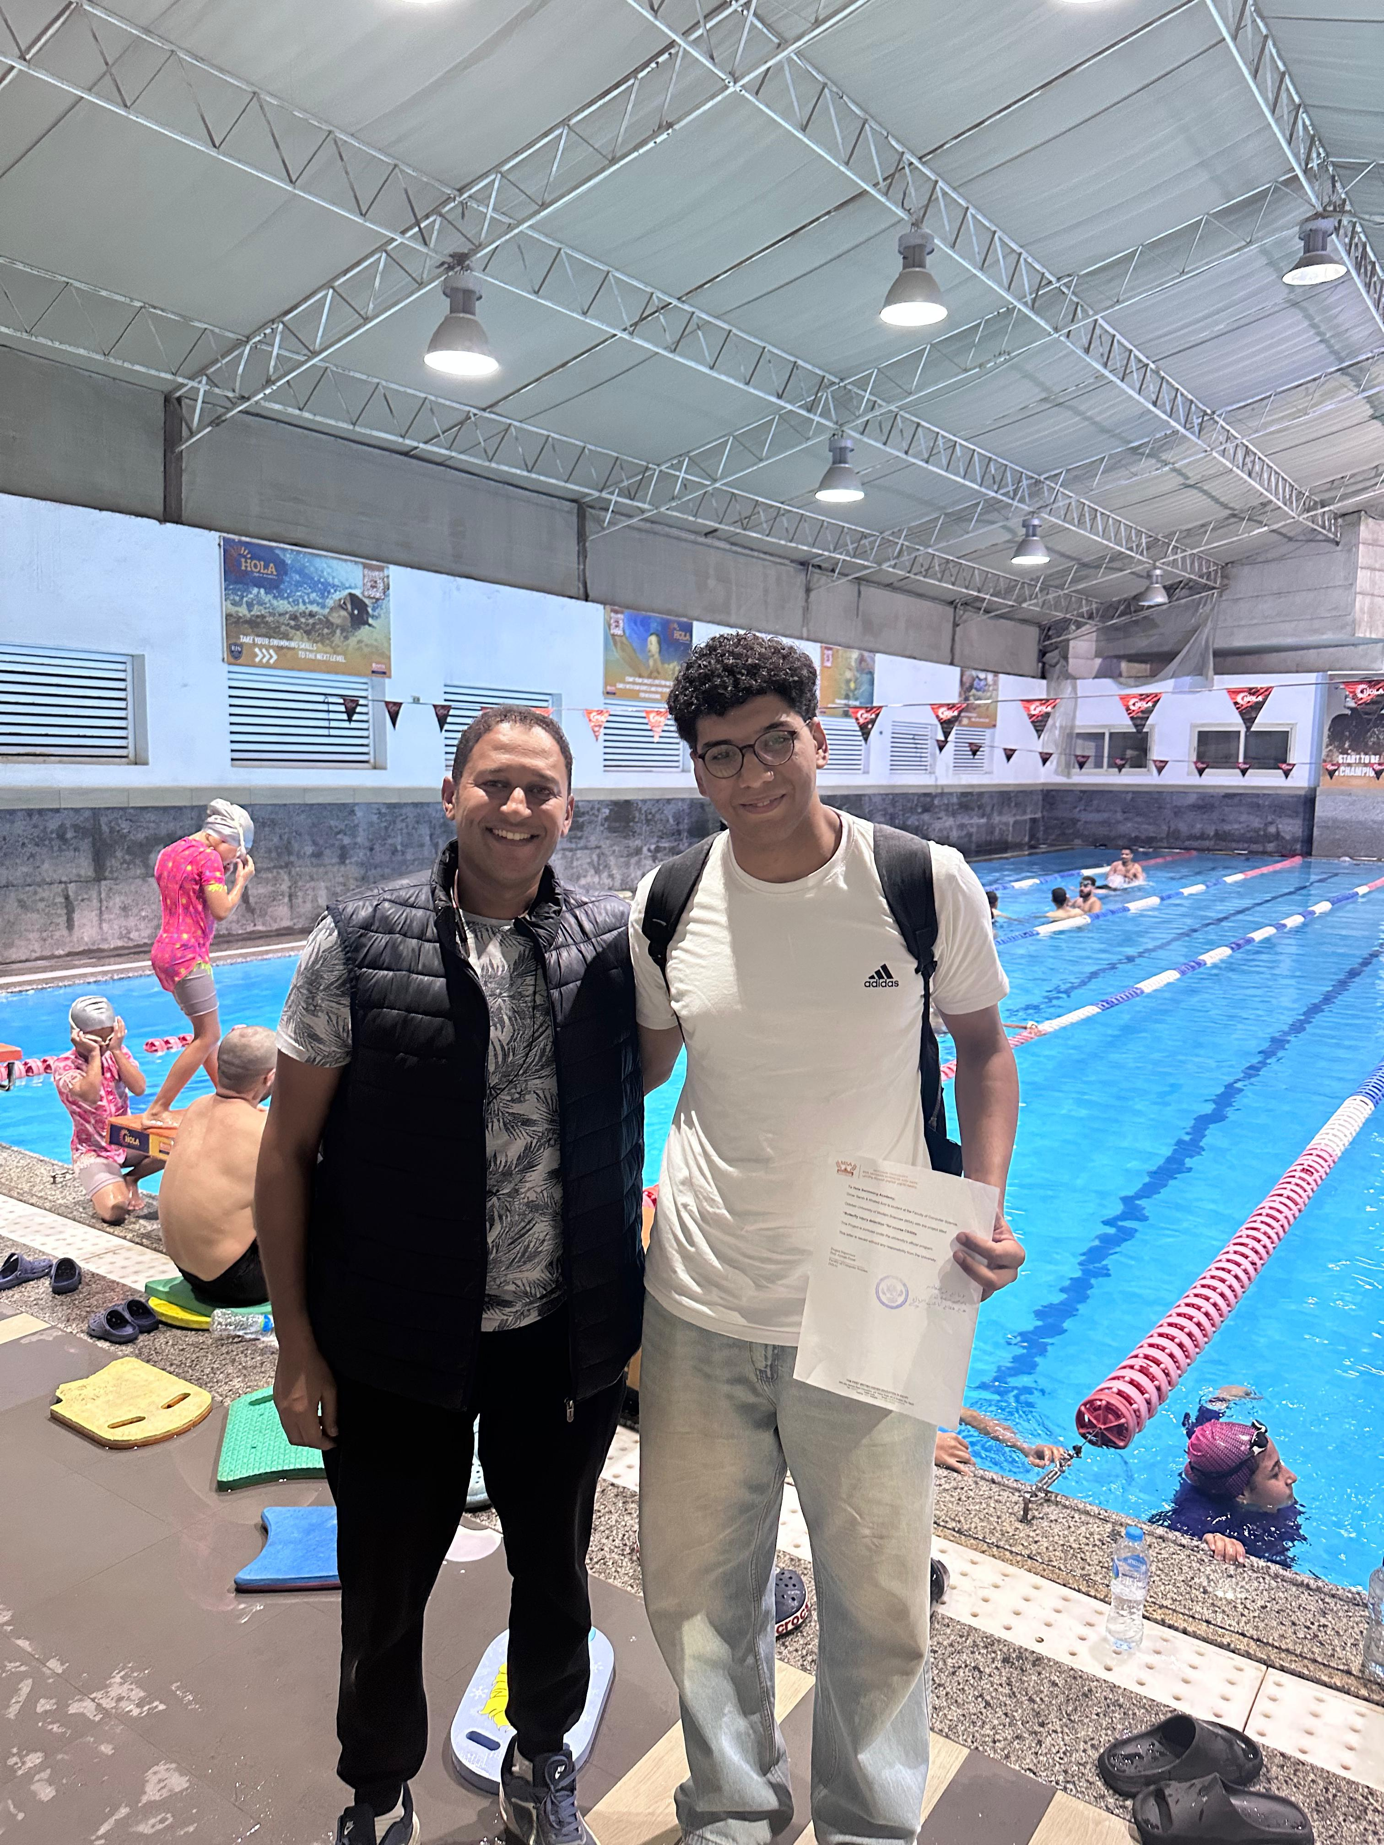
Motivation
Short discussion with Dr. Emam Talaat & Mohamed Soliman, owners of Hola Swimming Academy
Shared our idea for a swimming performance analysis system
Granted permission to collect and test data in the academy’s pool
Encouraged us to continue developing the system for real-world applications
Two IEEE 2026 papers accepted: Stroke-Type Recognition and Quality Classification — see IEEE 3SCEA 2026 — validating the full end-to-end pipeline from stroke recognition to quality assessment.
Notes:
Sowar

Slide 5
Objectives
Classify freestyle, butterfly, and breaststroke automatically using a single 6-axis wrist IMU at 100 Hz — freestyle, butterfly, and breast achieving 99.6% accuracy on custom data
Classify stroke quality (Good/Bad) using two pipelines: a model-based GRU quality classifier and a feature-extraction pipeline with calibration-based rules
Deliver objective per-stroke quality feedback automatically uploaded to athlete profiles on Supabase for longitudinal tracking
Evaluate both quality pipelines on a held-out test set of 23 sessions across professional swimmers skill levels (professional, medium, beginner) — achieving 82.61% accuracy with the feature-extraction pipeline

Slide 6
Problem Statement
High Injury Risk in Swimming: Poor stroke patterns frequently cause overuse injuries (shoulder, elbow, lower back) in competitive and intermediate swimmers.
Coaching Limitations: Traditional observation struggles with real-time detection especially underwater due to visibility issues and multi-swimmer monitoring challenges.
Delayed & Subjective Feedback: Swimmers lack immediate, objective alerts on movements likely to cause injury, increasing repeated harmful patterns.
6
Notes:
omar

Slide 7
Related Work (1/3)
J. Costa et al., "Framework for Intelligent Swimming Analytics with Wearable Sensors for Stroke Classification,"
Sensors, vol. 21, no. 15, p. 5162, 2021.DOI: 10.3390/s21155162
Overview: Uses IMU + heart rate sensors to classify swimming strokes in real time. Helps coaches prevent injuries with fast performance feedback.
Limitations: Needs many sensors → expensive. Tested mostly on young swimmers.
Methodologies: IMU data + filtering, Discrete Wavelet Transform features(DWT), Random Forest classifier (best one).
Results: 95.02% macro F1-score (Random Forest). Very good real-time help in pool training.
7
Notes:
omar

Slide 8
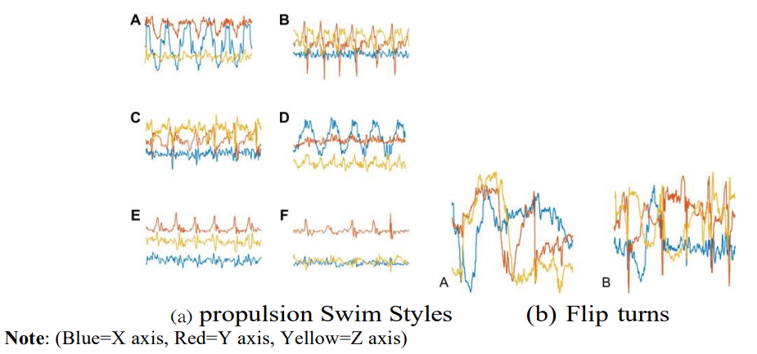
Related Work (2/3)
L. Powell et al., "The Real-Time Classification of Competency Swimming Activity...,"
Int. J. Aquatic Res. Educ., vol. 14, no. 1, Article 6, 2023. DOI: 10.25035/ijare.14.01.06
Overview: IMU data + ML to classify swimming as "competent" (good/safe) or "incompetent" (bad/risky) in real time helps prevent injuries.
Limitations: Basic good/bad only. Needs more real-pool tests on different swimmers.
Methodologies: IMU motion capture, Random Forest and other ML classifiers, real-time processing.
Results: 92–95% accuracy in detecting good vs bad technique. Strong for spotting risky movements early.
8
Notes:
omar

Slide 9
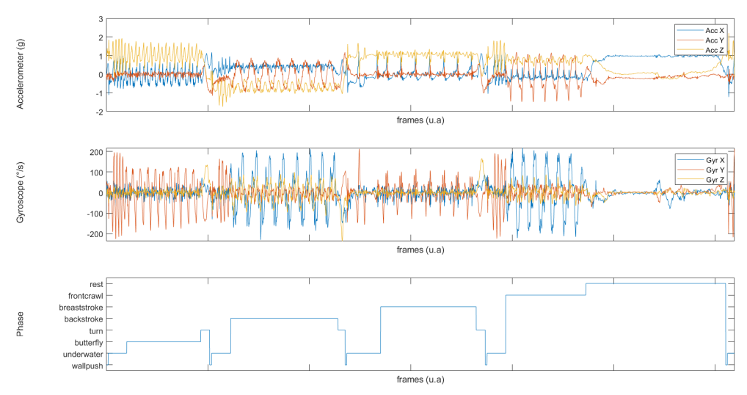
Related Work (3/3)
E. Delhaye et al., "Automatic Swimming Activity Recognition...," Sensors, vol. 22, no. 15, p. 5786, 2022. DOI: 10.3390/s22155786
Overview: Single IMU + deep learning recognizes 8 swimming activities and lap times → supports safe training.
Limitations: IMU on back (not wrist). Big differences between swimmers.
Methodologies: Gyro + accelerometer data; deep learning model; tested vs video.
Results: 96% F1-score (0.96). Lap time error: 1.15% (start), 1% (middle), 4.07% (end).
9
Notes:
khaled

Slide 10
Comparison
Paper | Best Result | Simple Meaning | Helps Injury Prevention ?
Paper 1 | 95.02% F1 | Very good stroke classification | A bit (better monitoring)
Paper 2 | 92-95% accuracy | Spots good vs bad technique fast | A lot (finds risky moves)
Paper 3 | 96% F1 + 1–4% lap error | Almost perfect activity + timing | A bit (accurate tracking)
Our Work ( GRU-LSTM) | 97% accuracy (on mixed real-world dataset with swimming + daily activities) | Very high accuracy in classifying butterfly, freestyle and breaststroke strokes using a single wrist-worn sensor | A lot (provides reliable stroke identification as foundation for future injury-risk analysis)

Slide 11
System Architecture
Notes:
khaled

Slide 12



Model Architecture
12
Notes:
omar

Slide 13
Dataset (our data)
Data Collection: 17 swimmers total (7 professional, 5 medium, 5 beginner) using a custom mobile app communicating with a single wrist-mounted 6-axis IMU. Sessions recorded above water for safety and supervision.
Sensor Data: 6-axis IMU (accelerometer + gyroscope) ax, ay, az, wx, wy, wz (measures motion for accurate stroke analysis).
Stroke Types: Breaststroke, Butterfly, Freestyle. 90 sessions (30 per type) for stroke-type recognition; quality labels (Low / Moderate / Moderate-High / High) assigned by experts for quality classification.
Dataset Size: 90 sessions for stroke-type training; 23 held-out labeled sessions for quality evaluation. Accelerometer at 100 Hz, gyroscope at 60 Hz (interpolated to 100 Hz). Each session auto-uploaded as raw CSV to Supabase.
Data Quality: Multi-level skill distribution (professional to beginner) ensures the system generalizes across skill levels. Session logs automatically posted to individual athlete profiles for longitudinal tracking.
13
Notes:
khaled

Slide 14
Methodology Summary
Common Model Elements (All Models)
Data Prep: 6D IMU input (accel + gyro) in 250-step windows, Butterworth filter and outlier removal for cleaning, StandardScaler normalization, augmentation (rotation, scaling, warping, noise).
Training Setup: 70/30 split, Adam optimizer + CrossEntropyLoss, 50 epochs, batch 64, early stopping, 5-fold CV for generalization.
Application Focus: Classify stroke types (freestyle, breaststroke, butterfly) then evaluate stroke quality (Good/Bad) using two pipelines: model-based GRU classifier and a feature-extraction pipeline with calibration rules.
14
Notes:
khaled

Slide 15
Methodology Summary
GRU Model Usage
Processing: Windows to 2 GRU layers (128 units) for features, FC layers (128→64→classes) with softmax.
Application: Identifies stroke types.
15
Notes:
omar

Slide 16
Methodology Summary
DCNN-BiLSTM Model Usage
Processing: 3-layer CNN extracts locals. BiLSTM (128 units) adds context. Multi-Head Attention and pooling (avg/max/var). FC with softmax and confidence.
Application: Detects types with unknown threshold.
16
Notes:
omar

Slide 17
Methodology Summary
GRU-LSTM Model Usage (Best Model)
Segmentation & Processing: Gyro magnitude peaks isolate strokes. GRU (2 layers, 128 units) + LSTM (2 layers, 128 units) for features/memory. 4-head Attention weights time steps. FC (64→32→classes) with softmax.
Application: Top performer chosen as main. Classifies stroke types with 99.6% accuracy on custom professional data and 91.0% on the 21-class real-world dataset (KU-HAR + swimming). Serves as the backbone of the stroke-type recognition pipeline feeding into quality classification.
17
Notes:
omar

Slide 18
Stroke Quality Classification
Style-Aware Stroke Segmentation
Gyro-magnitude peak detection: Butterfly 0.6s, Freestyle 0.4s, Breaststroke 0.8s min inter-peak intervals. Each peak defines a symmetric analysis window yielding per-stroke CSV segments.
Kinematic Feature Extraction per Stroke
Angular velocity stats, jerk, pull-phase gyro ranges, phase proportions. Expert labels (Low/Moderate/Moderate-High/High) collapsed to binary Good/Bad.
Pipeline 1 - Model-Based (GRU classifier): Accuracy 69.57% | F1 75.86%
Pipeline 2 - Feature-Extraction (Best): Accuracy 82.61% | F1 82.45% | Both: Recall 84.62%
+13% accuracy and +6.6% F1 over Pipeline 1 on 23 held-out sessions. No trained quality model required.

Slide 19
App Demo
18
Notes:
khaled

Slide 20
App Demo
19
Notes:
khaled

Slide 21
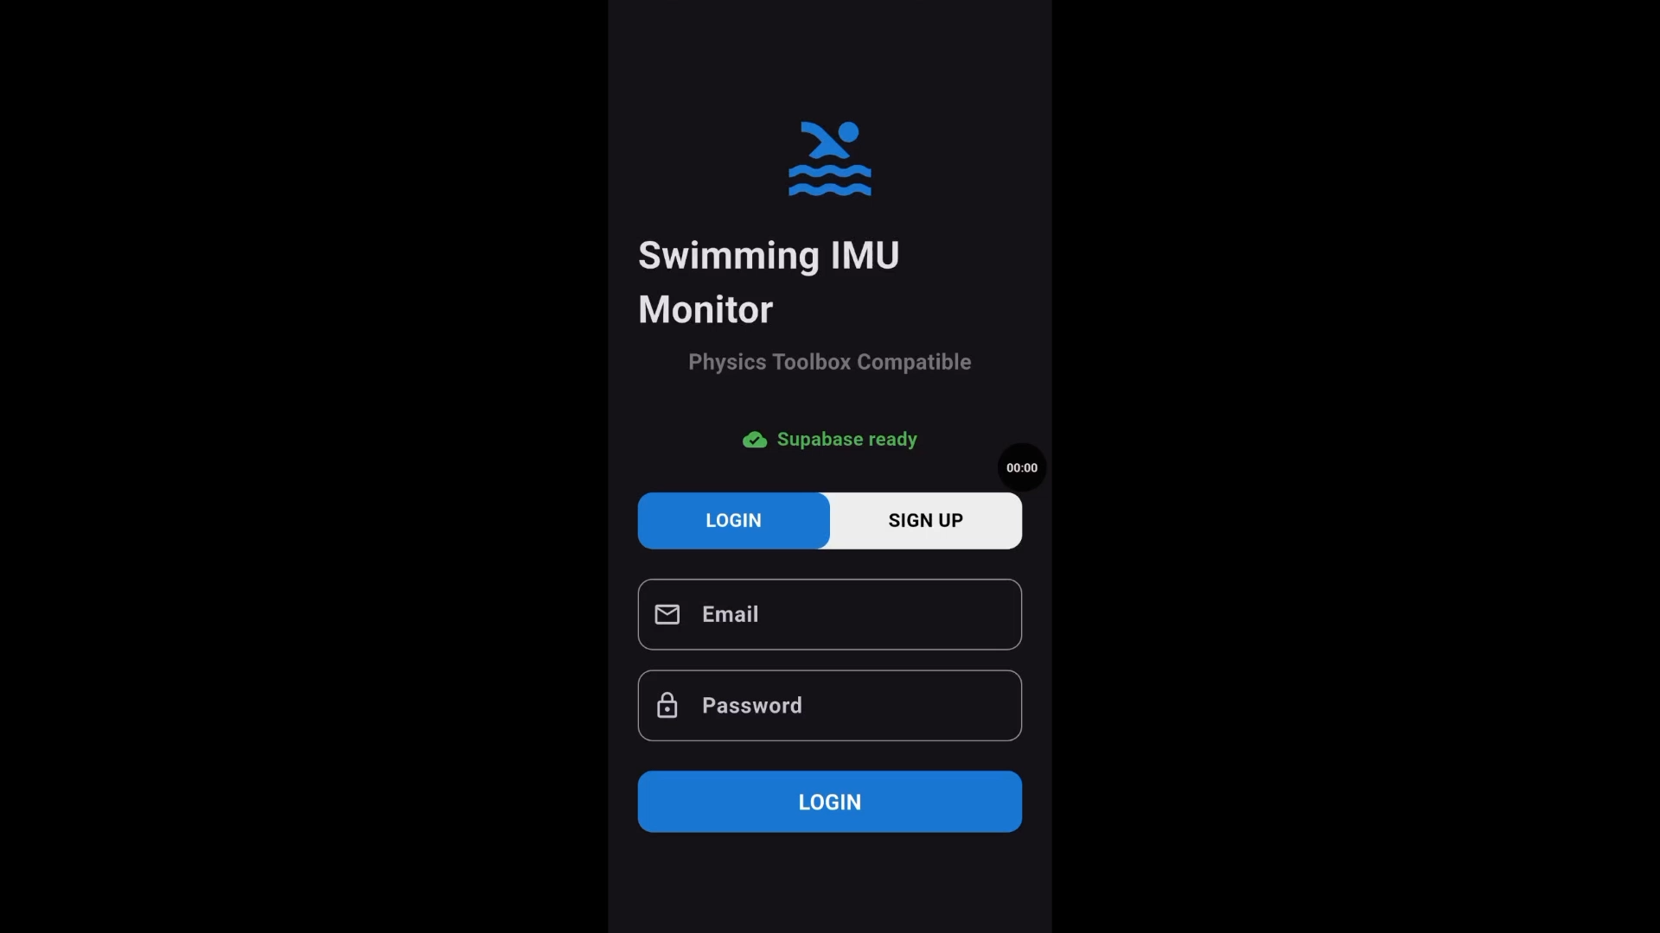
Video & Model Demo
20
Notes:
khaled

Slide 22
Challenges & Mitigation Plan
Challenge | Mitigation Strategy
Mobile phone used as IMU sensor (effective above water). Underwater deployment requires waterproofing and is impractical for live sessions. | Transitioned to dedicated wrist-mounted hardware IMU for cleaner signal acquisition. Future work: underwater deployment using waterproof wearables for in-pool real-time use.
Single wrist IMU achieves 99.6% stroke-type accuracy and 82.61% quality accuracy. May miss some full-body dynamics vs. multi-sensor setups. | Single-sensor setup confirmed as viable for practical daily training. Multi-sensor configurations remain as a future extension for richer biomechanical analysis.
Underwater signal noise and distortion (water resistance, bubbles, lighting effects) can degrade sensor readings and affect model reliability | Apply advanced filtering techniques (e.g., Kalman filtering, low-pass filtering) during data cleaning and explore robust training with noisy/augmented underwater-like data in upcoming iterations
Current pipeline processes sessions post-hoc; feedback available through Supabase dashboard after session upload. Some latency remains between session end and result visibility. | Coach and swimmer-facing Supabase dashboard being developed for real-time longitudinal tracking. Future work: near-real-time edge streaming for in-session stroke feedback.
21
Notes:
omar

Slide 23
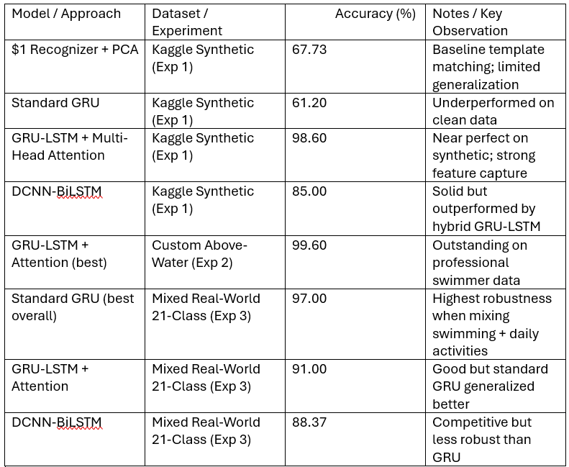
RESULTS & ANALYSIS

Slide 24
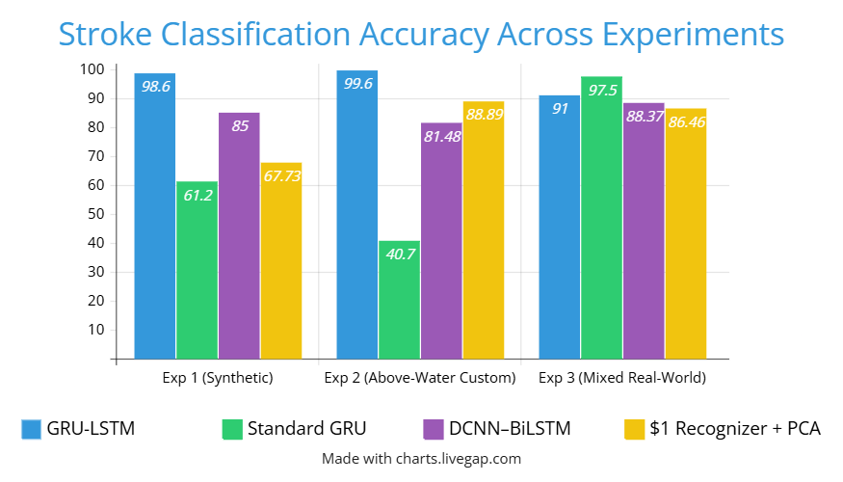

Slide 25
References
[1] I. M. Sumartana and Y. Setiaji, “The physical and mental health benefits of swimming: Enhancing fitness, relaxation, endurance, and overall well-being,” Journal of Interdisciplinary and Multidisciplinary Studies (JIMS), vol. 1, no. 2, pp. 88–100, 2025.
[2] C. Brunner, M. Schmid, S. Hoerzer, and S. Schroeer, “Swimming stroke classification using magnetic and inertial measurement units and deep learning,” Sensors, vol. 22, no. 19, p. 7501, 2022.
[3] J. E. Morais, J. P. Oliveira, T. Sampaio, and T. M. Barbosa, “Wearables in swimming for real-time feedback: A systematic review,” Sensors, vol. 22, no. 10, p. 3677, 2022.
[4] G. Lozano-Berges, E. Mainer-Pardos, and J. A. Casajus, “The future of wearable technology in competitive swimming: A review of real-time feedback systems,” Sports Medicine - Open, vol. 10, no. 1, pp. 12–28, 2024.
[5] A. Al-Majnoni, J. Al-Sahli, D. Al-Ahmady, A. Al-Mutairi, A. Alsini, and M. Alharbi, “Moar: A swimmer motion swimming style identification model using deep learning,” Engineering, Technology & Applied Science Research, vol. 15, no. 1, pp. 19295–19302, 2025.
[6] M. Shperkin, “Multi-task deep learning approach for segmenting and classifying competitive swimming activities using a single imu,” 2025.
[7] Y. Meng, “Swimming style recognition with convolutional neural network with single imu,” World Scientific Research Journal, vol. 10, no. 11, pp. 39–43, 2024.
[8] R. Bredun, “Swimming styles imu data.” https://www.kaggle.com/ datasets/ruslanbredun/swimming-styles-imu-data/discussion?sort= hotness, 2022. Accessed: 2025-10-02.

Slide 26

25

