Slide 1

EEG-Based Seizure Detection
Logistic Regression Comparative Study
Feature Selection • PCA • Regularisation • Imbalance Handling
Omar Khan
BS Computer Science Semester-VI-A
IMSciences, Peshawar

Slide 2
Study Roadmap
A complete pipeline from EEG datasets to comparative interpretation
Datasets
Preprocessing
Logistic Regression
Evaluation
Comparative Analysis
Bonn EEG, Seizure, BEED
ANOVA vs PCA pipelines
SAGA solver; 80:20 split
Accuracy, F1, PR-AUC
Regularisation & imbalance
Goal: classify EEG segments as seizure/event or non-event.
Main focus: how preprocessing, regularisation and imbalance correction change performance.
Why F1 and PR-AUC matter: datasets are class-imbalanced, so accuracy can be misleading.
EEG Seizure Detection | Logistic Regression Comparative Study
2

Slide 3
Problem Statement and Objectives
Biomedical problem
Machine-learning task
EEG seizure detection is difficult because EEG signals are high-dimensional, noisy and often imbalanced. Manual interpretation requires expertise and time.
Train Logistic Regression models that detect event/seizure class using transformed EEG features and compare the effect of design choices.
Objectives
Compare Pipeline-1 and Pipeline-2 across three EEG datasets.
Evaluate Logistic Regression using Accuracy, F1-score, Precision, Recall and PR-AUC.
Study bias–variance behavior by changing regularisation strength C.
Compare L1, L2 and Elastic-Net regularisation.
Assess class-imbalance handling using SMOTE, under-sampling and balanced weights.
EEG Seizure Detection | Logistic Regression Comparative Study
3

Slide 4
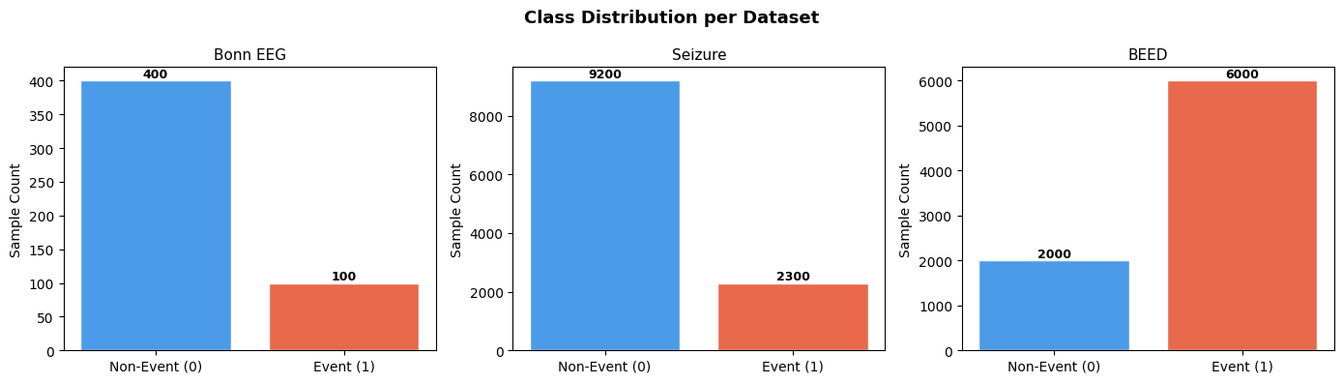
Datasets and Class Balance
Dataset
Rows
Features
Class Distribution
Bonn EEG
500
4097
0: 400, 1: 100
Seizure
11500
178
0: 9200, 1: 2300
BEED
8000
16
0: 2000, 1: 6000
Bonn EEG and Seizure datasets have fewer positive/event samples.
BEED has the event class as majority class.
Class distribution justifies use of F1, recall and PR-AUC along with accuracy.
EEG Seizure Detection | Logistic Regression Comparative Study
4

Slide 5
Methodology: Two Preprocessing Pipelines
Pipeline-1: Standardisation → ANOVA
Pipeline-2: Min-Max Scaling → PCA
StandardScaler converts features to zero mean and unit variance. SelectKBest with ANOVA F-score retains the most class-discriminative features.
Outputs: Bonn 50 features; Seizure 50 features; BEED 16 features.
MinMaxScaler transforms features into [0,1]. PCA reduces dimensionality without using labels.
Variance retained: Bonn 70.2%, Seizure 86.5%, BEED 100%.
Pipeline-1 is supervised at feature-selection stage because ANOVA uses labels.
Pipeline-2 is unsupervised; PCA preserves variance but not necessarily class separation.
EEG Seizure Detection | Logistic Regression Comparative Study
5

Slide 6
Classifier and Evaluation Metrics
Component
Setting
Metric logic
Model
Logistic Regression
Accuracy is reported but not trusted alone. F1-score balances precision and recall. PR-AUC is more informative than ROC-style thinking when positive class is rare.
Train/test split
80:20 stratified split
Solver
SAGA
Random state
7 / fixed for reproducibility
Regularisation
L1, L2, Elastic-Net
Metrics used
Interpretation principle
Accuracy
F1-score
Precision
Recall
PR-AUC
In seizure detection, missing true seizure cases is clinically important.
Recall and F1-score are therefore central in the final interpretation.
EEG Seizure Detection | Logistic Regression Comparative Study
6

Slide 7
Baseline Results: Pipeline-1 vs Pipeline-2
Dataset
Pipeline
Accuracy
F1
PR-AUC
Main reading
Bonn EEG
Pipeline-1
0.9100
0.7273
0.7922
Pipeline-1 performed better on Bonn EEG and Seizure. BEED was similar across both pipelines because the feature space was already small.
Bonn EEG
Pipeline-2
0.8800
0.5714
0.6276
Seizure
Pipeline-1
0.8113
0.1107
0.5048
Seizure
Pipeline-2
0.8039
0.0425
0.4673
BEED
Pipeline-1
0.8006
0.8825
0.7598
BEED
Pipeline-2
0.7969
0.8807
0.7395
Warning sign
The Seizure dataset had acceptable accuracy but very low F1-score, showing majority-class bias and weak minority-class detection.
Supervised ANOVA helped retain discriminative EEG features.
PCA may preserve variance that is not useful for seizure separation.
EEG Seizure Detection | Logistic Regression Comparative Study
7

Slide 8
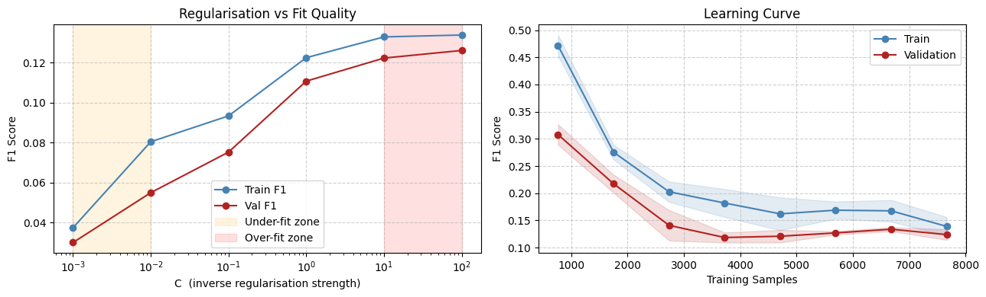
Bias–Variance Analysis
Regularisation strength C
Small C means stronger regularisation and may underfit. Large C weakens regularisation and may increase overfitting risk.
Key finding
For the Seizure dataset, poor performance was driven more by class imbalance and minority-class detection difficulty than by model complexity alone.
Learning curves support the need to look beyond accuracy.
Model tuning should be combined with class-imbalance strategy.
EEG Seizure Detection | Logistic Regression Comparative Study
8

Slide 9
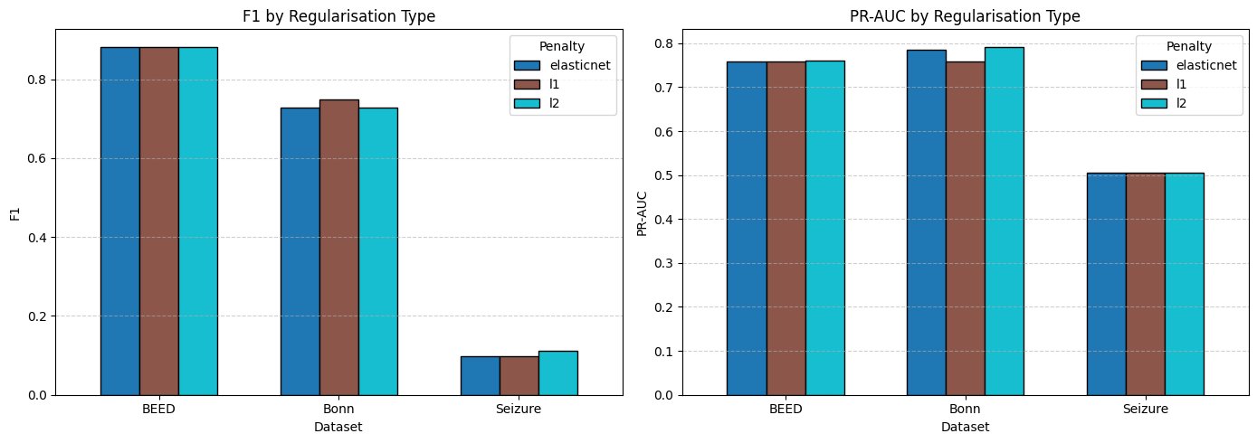
Regularisation Study: L1, L2 and Elastic-Net
Method
Best use
L1
Sparse model; embedded feature selection
L2
Stable generalisation; keeps all features
Elastic-Net
Compromise between L1 and L2
Bonn: L1 gave highest F1 and 48% zero coefficients.
Seizure: L2 was slightly better in F1, but performance remained low.
BEED: all regularisation methods produced almost identical F1-score.
Elastic-Net did not consistently outperform L1 or L2.
EEG Seizure Detection | Logistic Regression Comparative Study
9

Slide 10
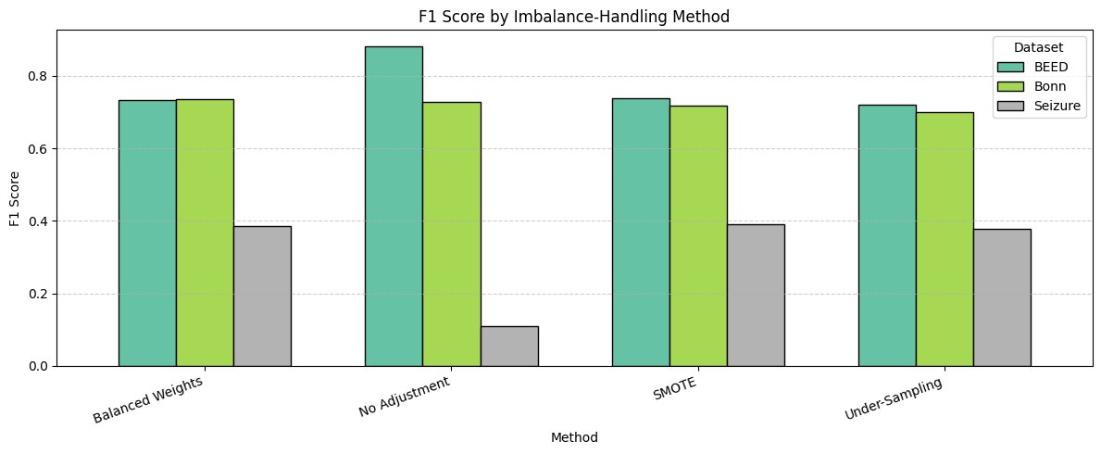
Class-Imbalance Handling
Methods tested
No adjustment, SMOTE, random under-sampling and balanced class weights were compared on Pipeline-1 features.
Trade-off
In Seizure data, imbalance handling improved recall and F1-score, but precision dropped because the classifier detected more positive cases.
Bonn: balanced weights gave the best F1-score.
Seizure: SMOTE, under-sampling and balanced weights all improved minority detection.
BEED: unadjusted model had best F1 because the event class was already dominant; imbalance methods improved PR-AUC.
EEG Seizure Detection | Logistic Regression Comparative Study
10

Slide 11
Comparative Analysis: What Actually Matters?
Preprocessing order matters
L2 generalises steadily
Elastic-Net is not magic
Standardisation + ANOVA performed better than Min-Max + PCA in high-dimensional EEG settings.
L2 regularisation was the most consistent across datasets, while L1 was valuable for sparsity.
Elastic-Net balanced sparsity and stability but did not consistently beat L1 or L2.
Imbalance changes decisions
Accuracy can mislead
Full pipeline wins
Correcting imbalance raises recall, especially in Seizure data, but can reduce precision.
Seizure data had reasonable accuracy but poor F1-score before imbalance handling.
Performance depends on preprocessing + model + regularisation + imbalance strategy, not classifier alone.
Central conclusion
A simple Logistic Regression model can be useful for EEG seizure detection only when the complete machine-learning pipeline is chosen carefully.
EEG Seizure Detection | Logistic Regression Comparative Study
11

Slide 12
Conclusion and Future Work
Conclusion
Practical recommendation
Pipeline-1 generally performed better than Pipeline-2. BEED achieved the strongest F1-score. Seizure remained the most challenging because of severe class imbalance and low minority-class recall.
Use ANOVA-based feature selection as a strong baseline, monitor F1/recall/PR-AUC, and apply imbalance handling according to class distribution and clinical aim.
Future work
Compare Logistic Regression with SVM, Random Forest and XGBoost.
Use CNN or LSTM models to learn temporal EEG patterns directly.
Validate on larger and more clinically representative EEG datasets.
Tune imbalance strategies to optimise seizure recall without excessive false alarms.
EEG Seizure Detection | Logistic Regression Comparative Study
12

Slide 13
Selected References
Tatum, Handbook of EEG Interpretation, 2014.
Pedregosa et al., Scikit-learn: Machine Learning in Python, JMLR, 2011.
Fisher, The use of multiple measurements in taxonomic problems, 1936.
Jolliffe, Principal Component Analysis, Springer, 2002.
Chawla et al., SMOTE: Synthetic Minority Over-sampling Technique, JAIR, 2002.
Zou and Hastie, Regularization and variable selection via the Elastic Net, 2005.
He and Garcia, Learning from imbalanced data, IEEE TKDE, 2009.
Prepared from the uploaded IEEE report and Jupyter notebook results.
EEG Seizure Detection | Logistic Regression Comparative Study
13

