Slide 1
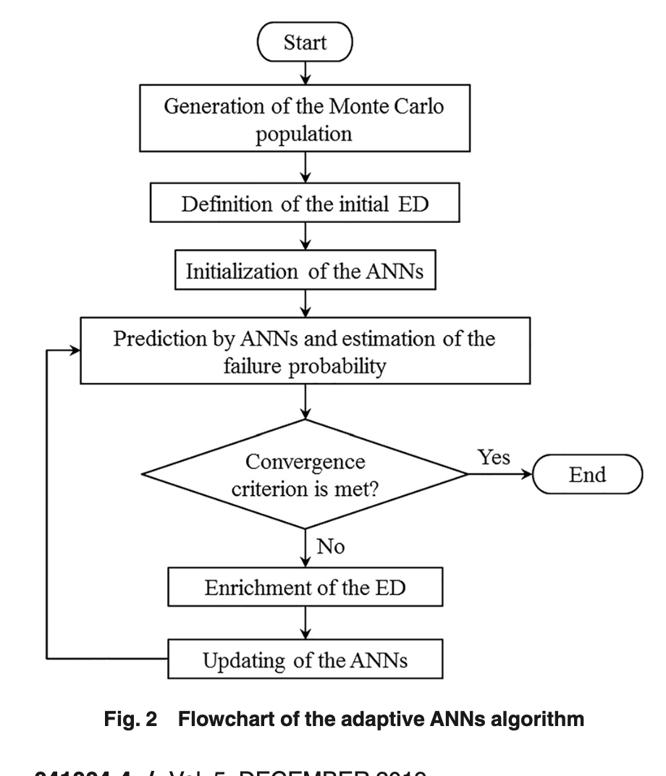

Slide 2
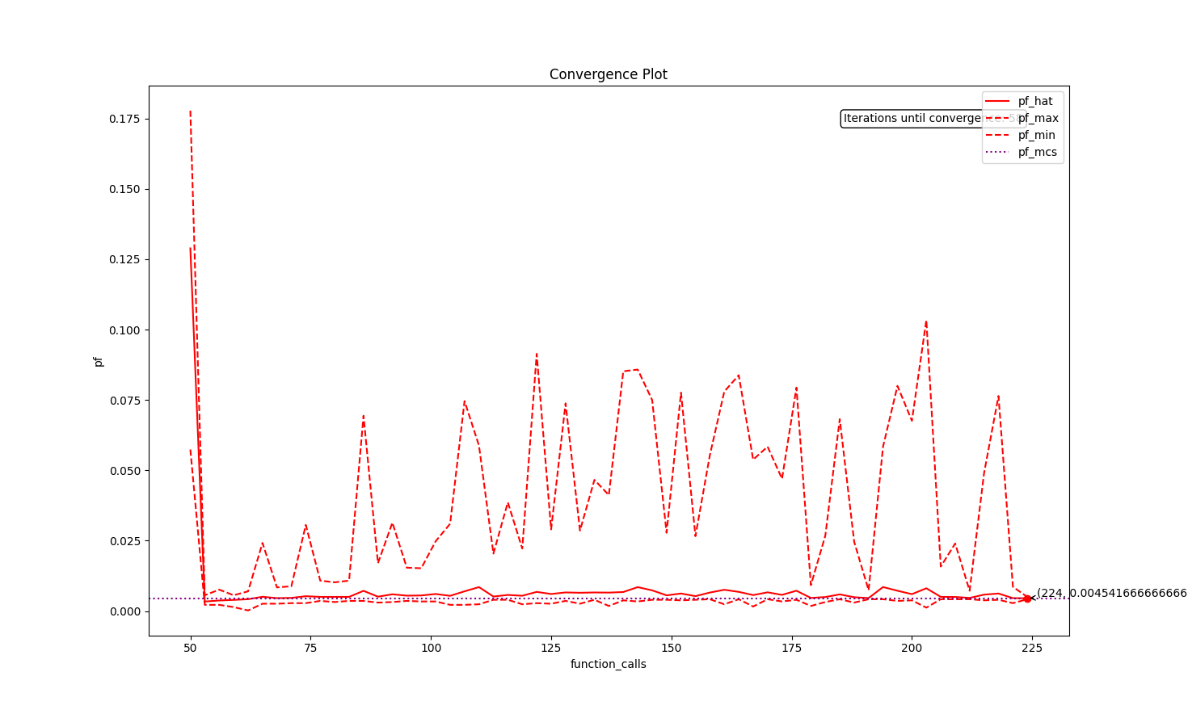
old
Notes:
Convergence seems to be random

Slide 3
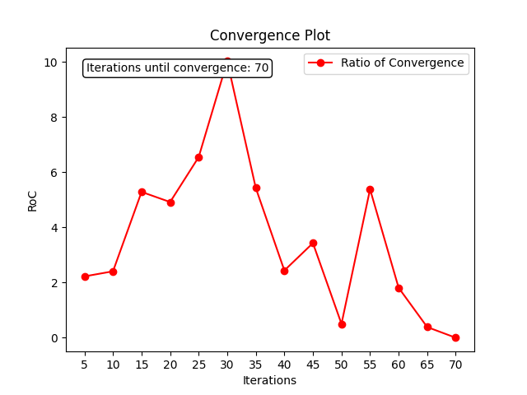
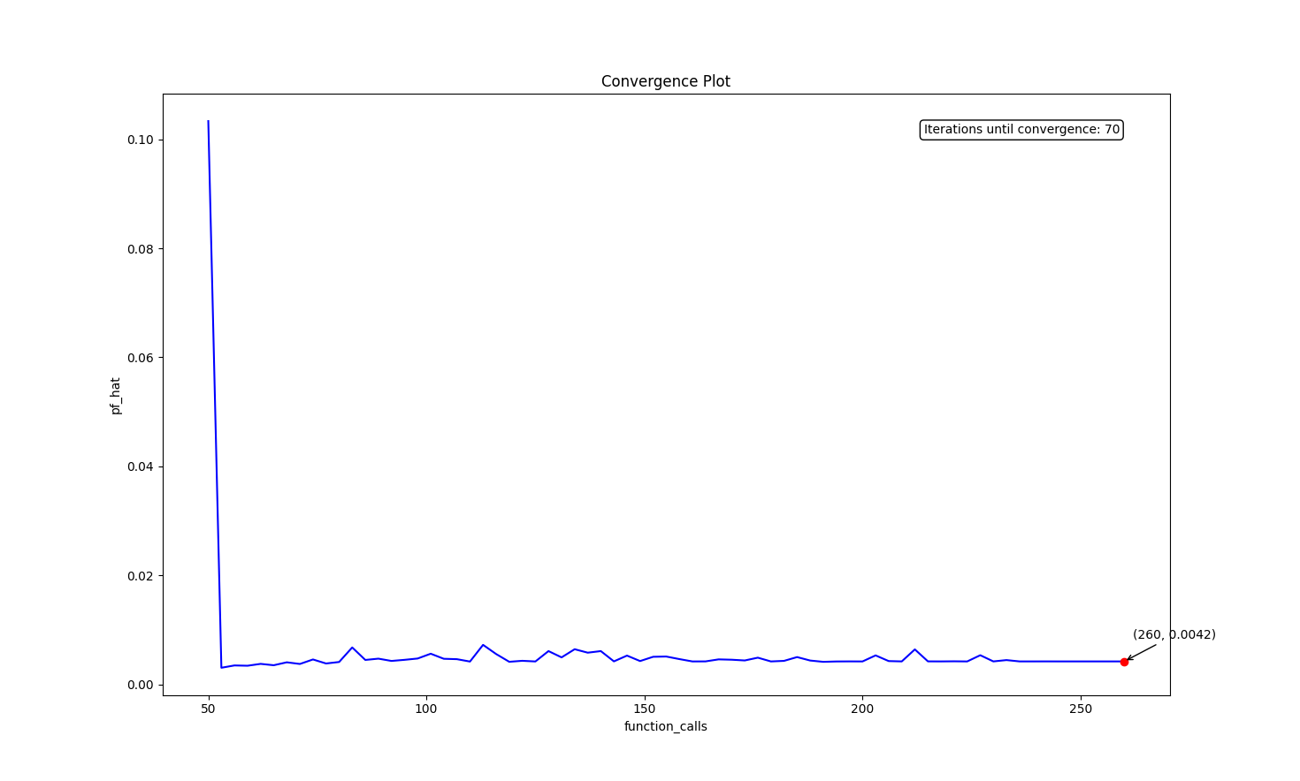
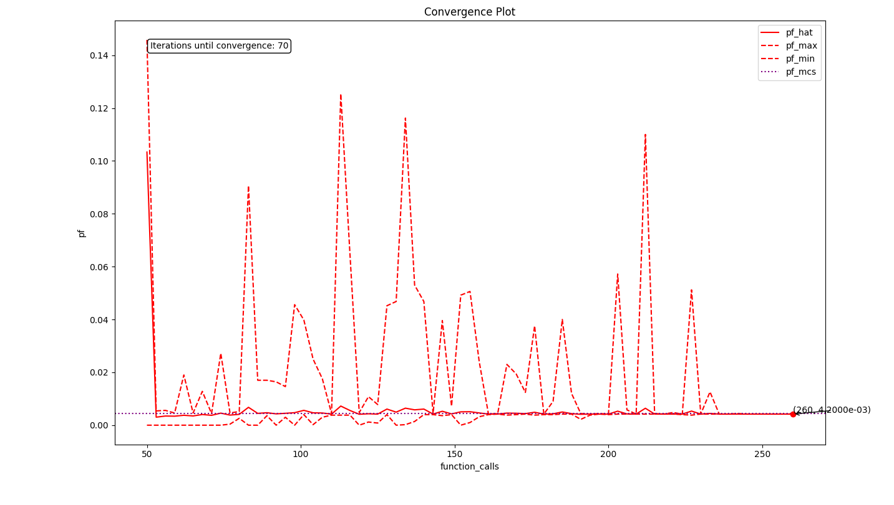
Notes:
Update 1 neural network at each iteration, uses the formula

Slide 4
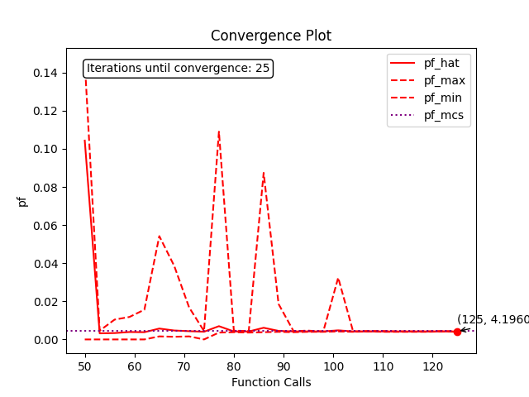
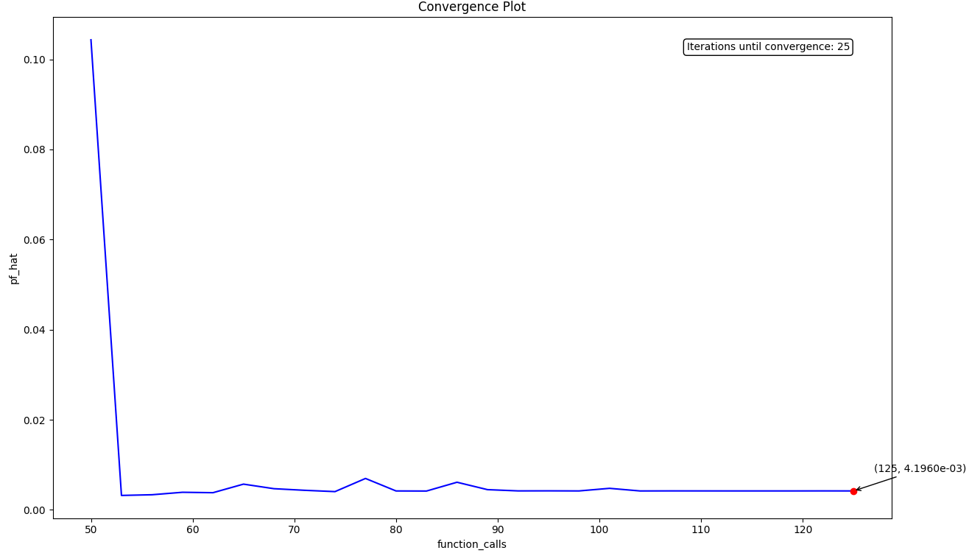
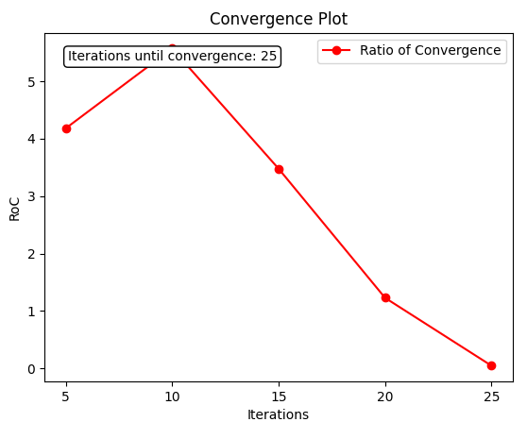
Notes:
Update 3 nn at each iteration

Slide 5
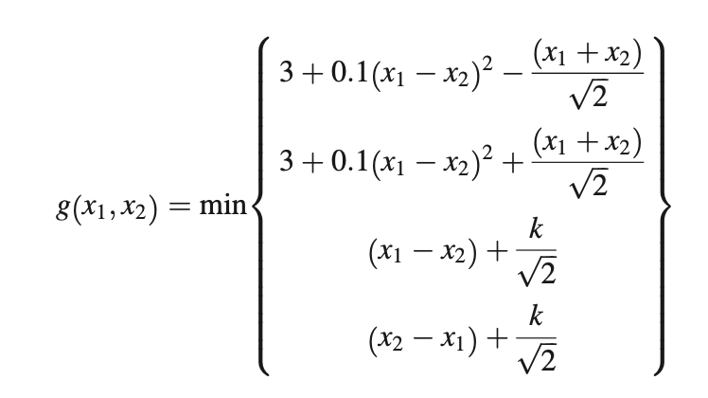
Method | Pf_hat | #function_calls
MCS | 4.4450 * 10^{-3 .} Std= 6.67 * 10⁻⁵ | 10⁶
Adaptive ANNs | 4.196*10⁻³ | 125
Non-adaptive ANN | 4.37.* 10⁻³ | 150
AK_MCS_U random sampling | 4.354*10⁻³ | 118
AK_MCS_U selected sampling | 4.418* 10⁻³ | 53
NN_classifier | 4.38 * 10⁻³ | 500
Reference (kriging) | 4.416 * 10⁻³ | 126

Slide 6
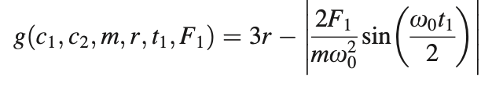
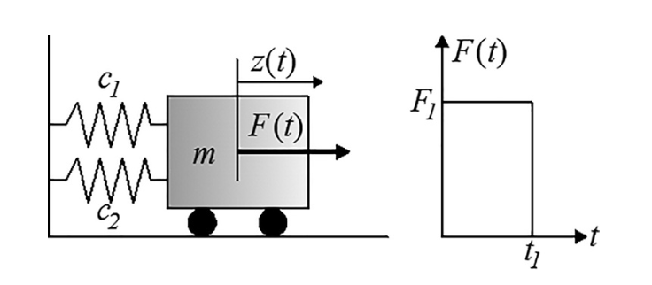
Method | Pf_hat | #function_calls
MCS | 2.254e-2 | 3*10⁵
Adaptive ANNs | 2.317e-2 | 155
Non-adaptive ANN | 2.855e-2 | 200
AK_MCS_U random initial sampling | * | *
AK_MCS_U selected initial sampling | 2.2e-2 | 340
NN_classifier | 2..377e-2 | 5000
Reference mcs | 2.8343e-2 | 3*10⁵

Slide 7
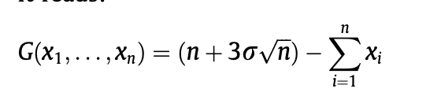
Method | Pf_hat | #function_calls
MCS 40 100 | 1.8400e-03 1.6667e-03 | 3*10⁵
Adaptive ANNs 40 100 |  | 125
Non-adaptive ANN 40 100 | 1.82e-3 * | 2000 *
AK_MCS_U random initial sampling | * | *
AK_MCS_U selected initial sampling 40 100 | 1.81 e-03 * | 620 *
NN_classifier | * | *
Reference mcs 40 100 | 1.813e-03 1.647 e-03 | 3*10⁵

