Slide 1
More balanced data: fast 1 to 1 ratio for training set
U1 = N(4,4)
U2 = N(2.5, 4)

Slide 2
Testing data
U1 = N(4,4)
U2 = N(-2,2)

Slide 4
Hypothesis testing:
H0: the means are the same
H1: there is significant difference in the means
T_test:
Reject the null hypothesis with 95% level of confidence

Slide 5
NN architecture
Random initial weights
Sigmoid activation function
BCE loss function
Learning rate = 0,01
Adam optimizer

Slide 7
Notes:
This is not reliable

Slide 8
number of training samples

Slide 9
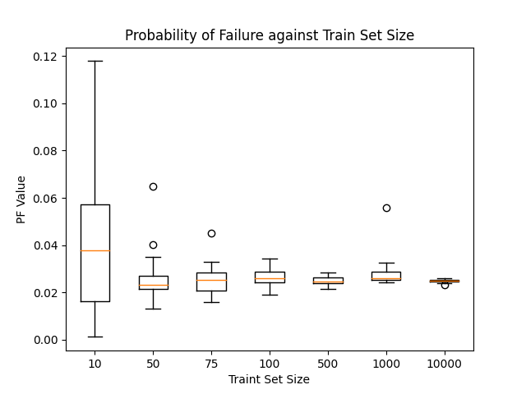

Slide 10
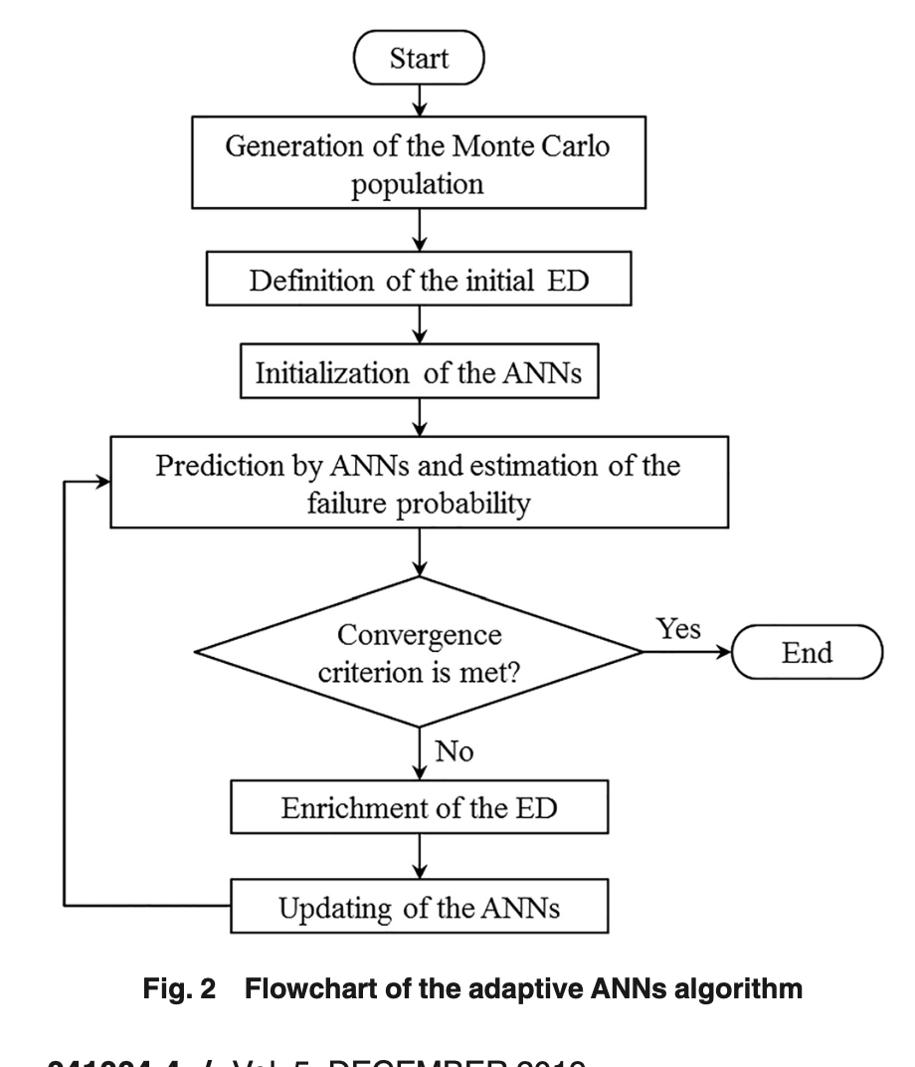

Slide 11
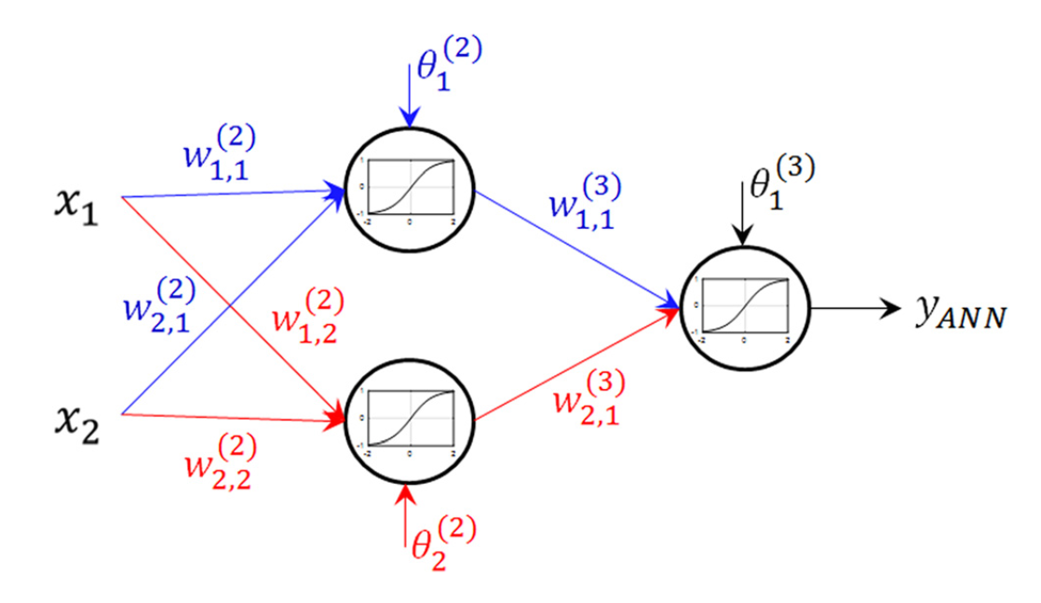

Slide 12
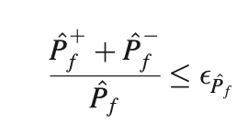
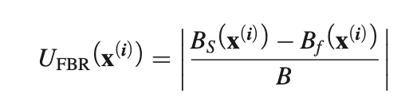
Stopping criterion:
Learning function :

Slide 13


