Slide 1
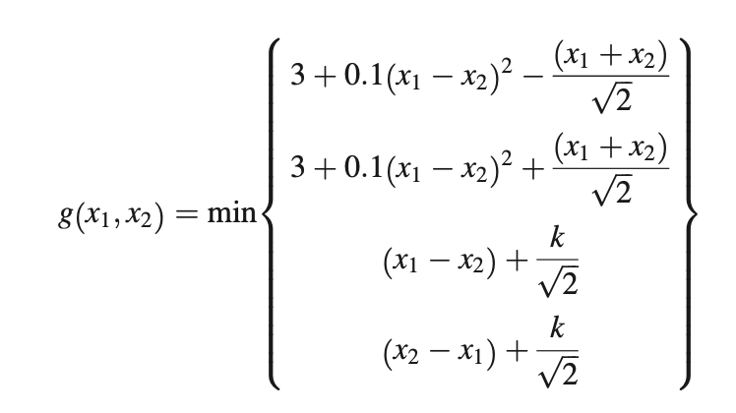
Method | Pf_hat | #function_calls
MCS | 4.432* 10⁻³ | 10⁶
Adaptive ANNs | 4.196*10⁻³ | 125
Non-adaptive ANN | 4.37.* 10⁻³ | 150
AK_MCS_U | 4.354*10⁻³ | 118
NN_classifier | 4.38 * 10⁻³ | 500

Slide 2
