Slide 1
Data Fetching
And what “rendering” actually means

Slide 2
What “rendering” actually means
Rendering is just how your page becomes HTML that the browser can display.
In Next.js, this can happen in two places. Either in the browser after the page loads, or on the server before the page is sent to the user.
The big idea is simple. The earlier you prepare the page, the faster it feels for the user.

Slide 3
The three main rendering strategies
Static Site Generation (SSG)
Incremental Static Regeneration (ISR)
Server-Side Rendering (SSR)
A newer idea: Partial Prerendering (PPR)

Slide 4
Static Site Generation (SSG)
With SSG, the page is created once at build time.That means when you deploy your app, Next.js already generates the HTML files. When a user visits, they just get a ready page instantly.Think of it like printing a book once and giving copies to everyone.It’s extremely fast and great for SEO, but the downside is that the content doesn’t change unless you rebuild the app.

Slide 5
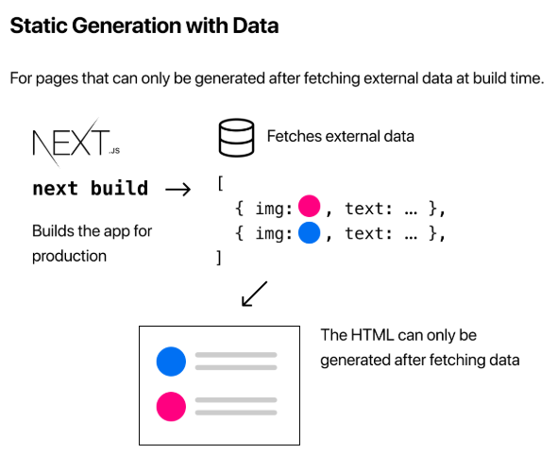
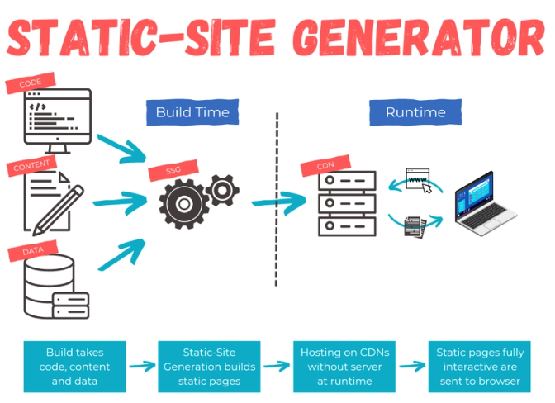
Static Site Generation (SSG)

Slide 6
Incremental Static Regeneration (ISR)
ISR is basically SSG but smarter. You still generate pages ahead of time, but you can update specific pages later without rebuilding the whole app.So instead of reprinting the whole book, you just replace one page when needed.This is perfect when your data changes sometimes but not constantly, like a blog or product listings.

Slide 7
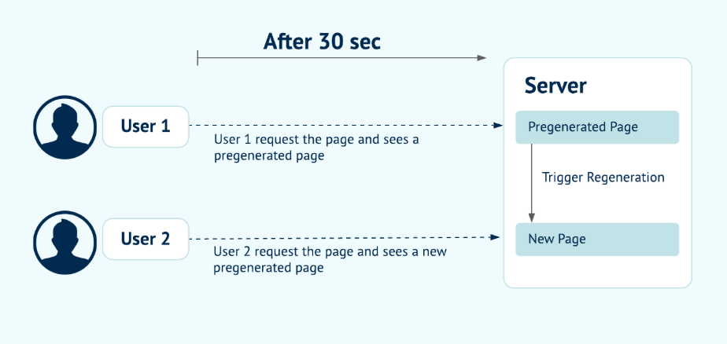
Incremental Static Regeneration (ISR)

Slide 8
Server-Side Rendering (SSR)
SSR generates the page on every request. Every time a user visits, the server builds the HTML with fresh data and sends it. This is like cooking a fresh meal for every customer.It’s perfect for real-time data like dashboards, user accounts, or anything personalized. But it’s heavier on the server and slightly slower than SSG.

Slide 9
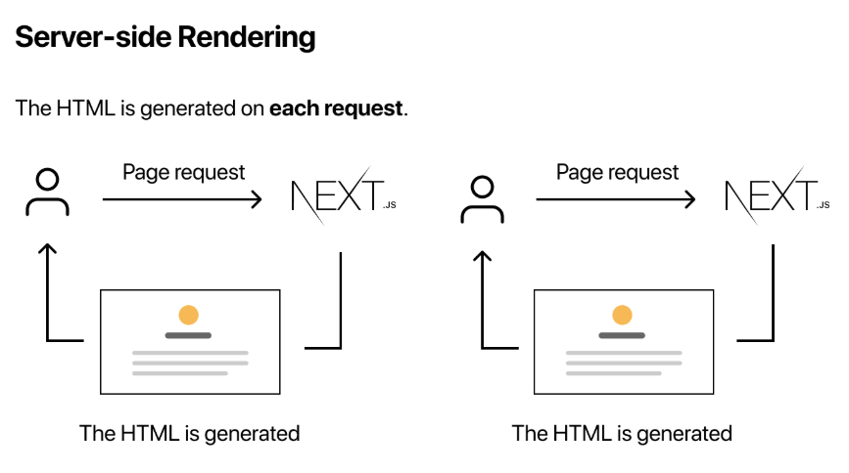
Server-Side Rendering (SSR)

Slide 10
Partial Prerendering (PPR)
This is a mix of static and dynamic. Part of the page is generated early (fast), and the dynamic parts load later. So you get both speed and live data at the same time. Think of it as loading the skeleton first, then filling in live content.

Slide 11
Client-side vs Server-side data fetching
Now let’s connect this to data fetching

Slide 12
Client-side fetching
This is the classic React way using useEffect
The page loads first, then it fetches data.
The problem is simple. The user sees a loading state first, and search engines don’t see the content immediately.

Slide 13
Server-side fetching (the Next.js way)
Here, the data is fetched before the page is sent to the browser.
So the user gets a fully ready page instantly.
This gives you faster perceived performance, better SEO, cleaner code, and better security since your API logic stays on the server.

Slide 14
How everything connects
Here’s the clean mental model you should keep:
Rendering strategy decides when the HTML is generated
Data fetching decides when the data is prepared
Next.js combines both to optimize performance.
If your content rarely changes, go with SSG
If it changes occasionally, use ISR
If it must always be fresh, use SSR

Slide 15
The End

