Slide 1
KNN and distance metrics project
Prepared by: Omar Sami Mousa

Slide 2
Outlines
Introduction to KNN
Datasets Details
KNN Distance Metrics implementation
KNN Classification
Graphs
Summary

Slide 3

Introduction
In the k-nearest neighbours (KNN) algorithm, the distance metric is used to determine which points in the training dataset are "nearest" to the new data point that we are trying to classify. The distance metric is used to compute the distance between the new data point and the existing points in the training dataset. The KNN algorithm then selects the K points in the training dataset that are closest to the new data point and classifies the new data point based on the most common class among these K points.

Slide 4
Datasets Details
Let's talk a little bit about the datasets.
what it consists of.!
what modifications have been made to it.!
Analytics of the datasets we chosen:
exams dataset
diabetes dataset
covid-19 dataset

Slide 5
Exam Dataset
What is this dataset about
This dataset consists of the marks of the students in various subjects, it evaluates students’ performance in exams.
The original dataset contains 8 columns (attributes)-- [gender, race/ethnicity, parental level of education, lunch, test preparation course, math score, reading score, writing score] and 1001 rows (observations).

Slide 6
Diabetes Dataset
What is this dataset about
This dataset is originally from the National Institute of Diabetes and Digestive and Kidney Diseases. The objective of the dataset is to diagnostically predict whether a patient has diabetes, based on certain diagnostic measurements included in the dataset.
It contains 8 attributes and the class -- [Pregnancies, Glucose, BloodPressure, SkinThickness, Insulin, BMI, DiabetesPedigreeFunction, Age, Outcome(class)] and 769 observations

Slide 7
Covid-19 Dataset
What is this dataset about
Contains a vast amount of anonymized patient-related information including pre-conditions. The raw dataset consists of 21 different features and 1,048,576 unique patients. In the Boolean features, 1 means "yes" and 2 means "no". values as 97 and 99 are missing data.

Slide 8
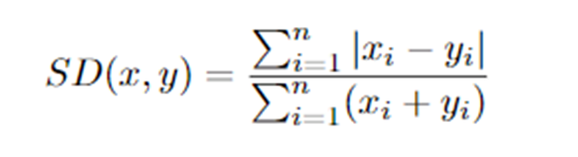
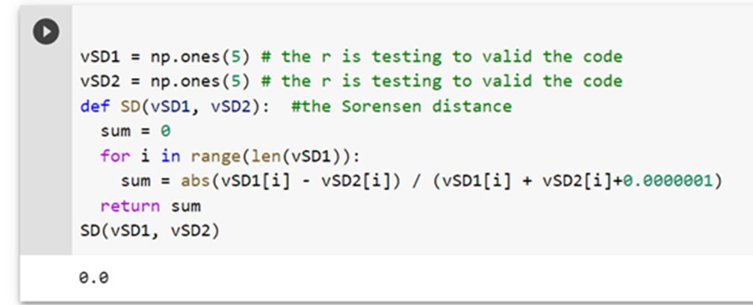
Sorensen distance (SD)
The Sorensen distance is a measure of dissimilarity between two sets. It is defined as the sum of the absolute differences between the elements of the two sets, divided by the sum of their elements.

Slide 9
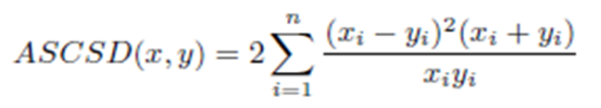
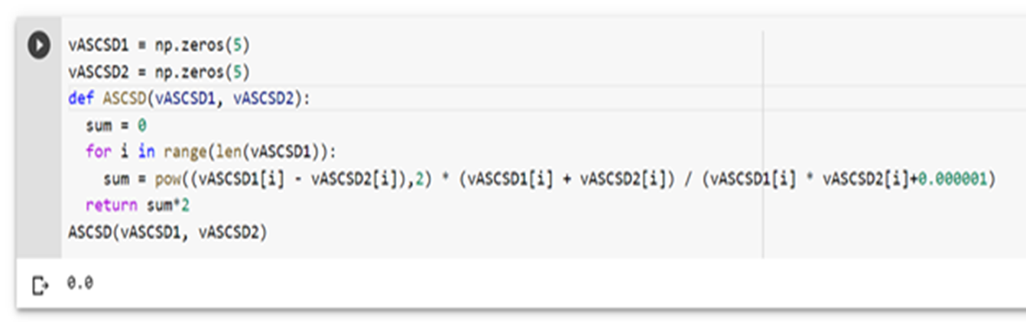
Additive distance (ASCSD)
The Additive distance is a measure of dissimilarity between two sets. It is defined as the sum of the squared differences between the elements of the two sets, multiplied by the sum of their elements, divided by the product of their elements

Slide 10
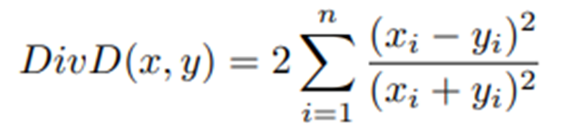
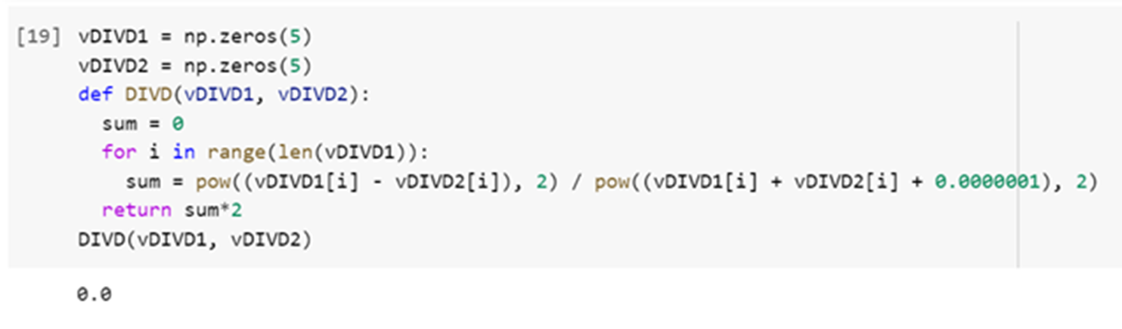
Divergence distance (DivD)
Is a measure of the dissimilarity between two probability distributions

Slide 11
Jaccard distance (JacD)
Defined as the sum of the squared differences between the elements of the two sets.

Slide 12
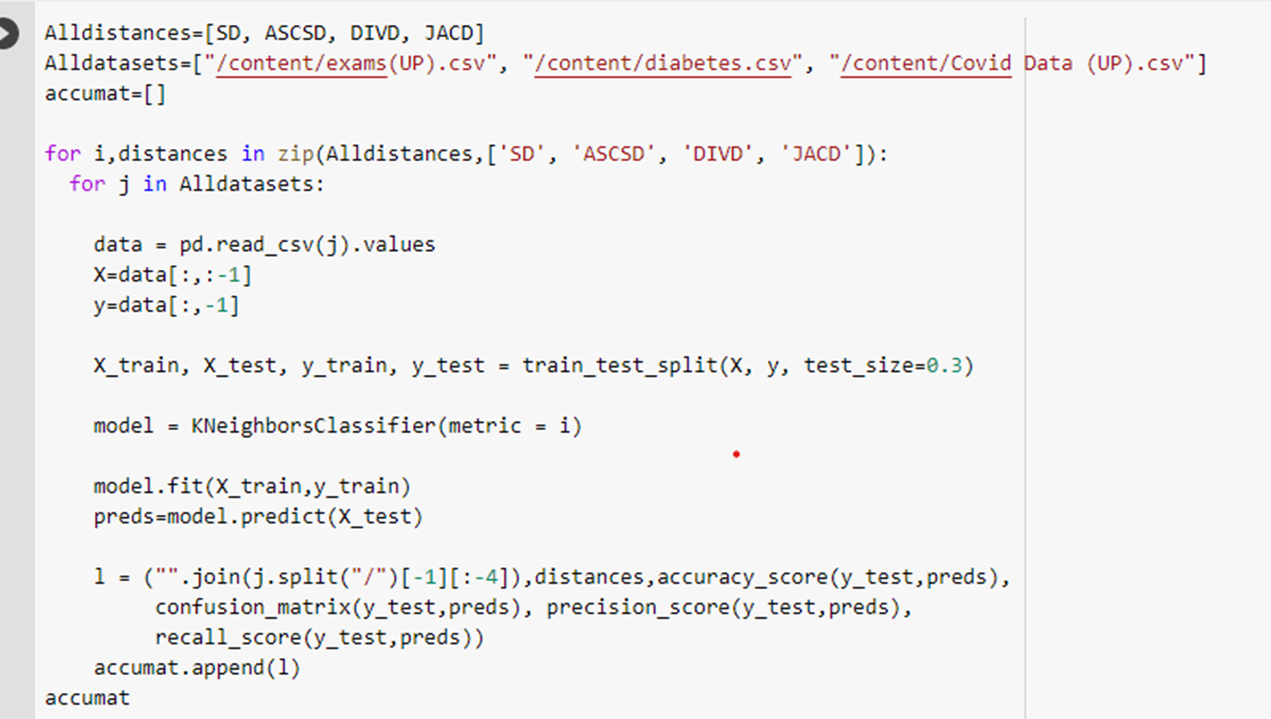
KNN Classifcation

Slide 13
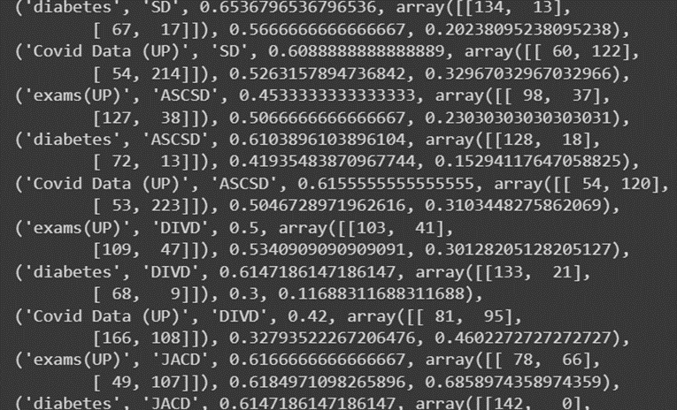
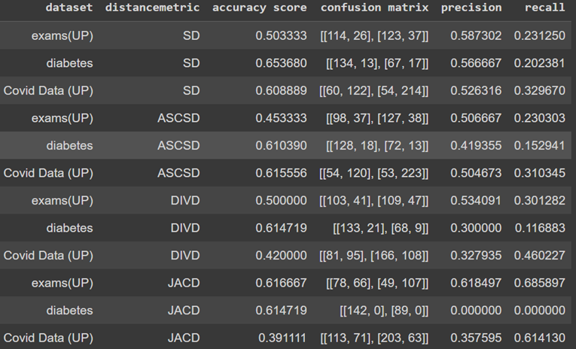
From unclear to clear
By using (join) and (split)
By using data frame

Slide 14
Graphs

Slide 15
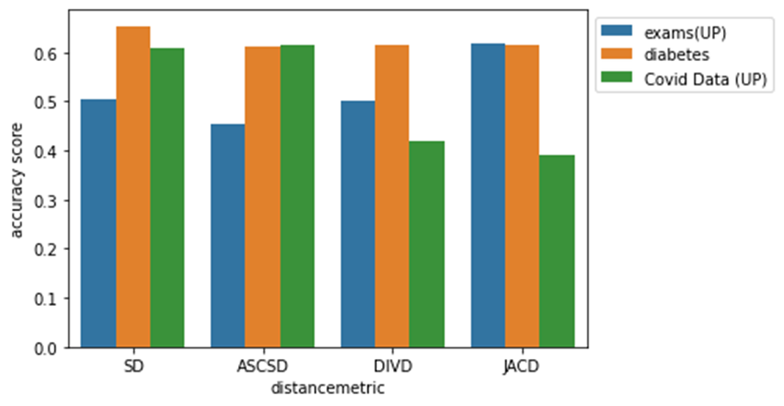
Accuracy Score

Slide 16
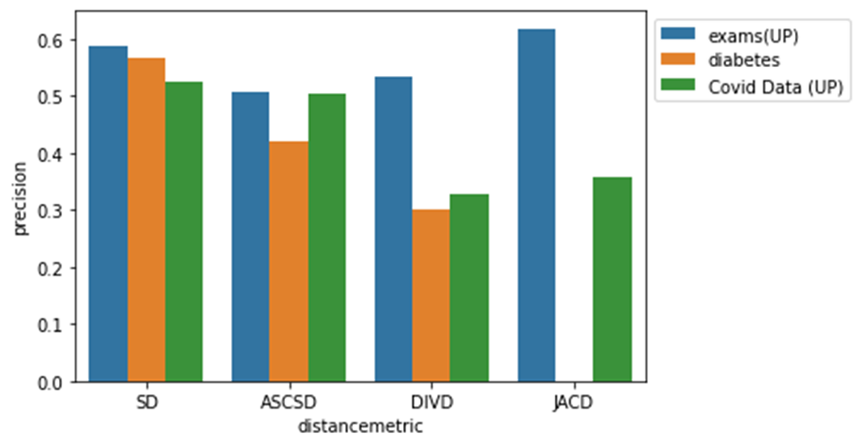
Precision

Slide 17
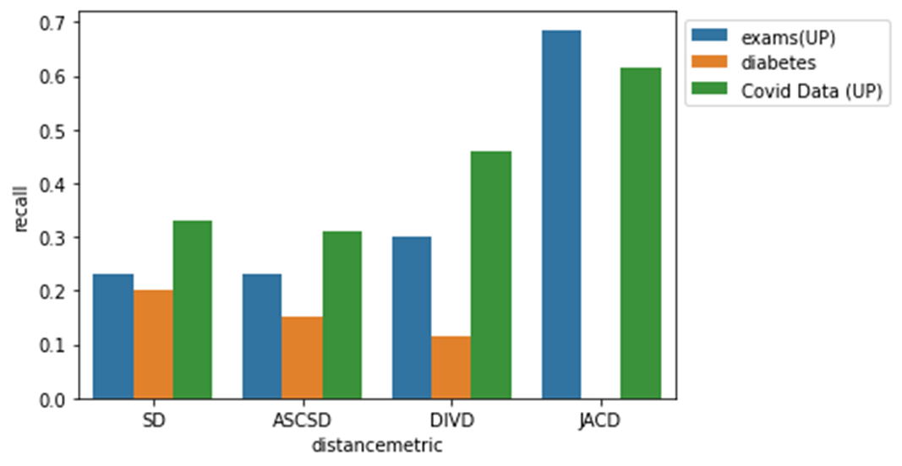
Recall

Slide 18
Summary
According to the statistics that appeared with us in the accuracy score, we conclude that the values are close, but the distance ASCSD is better than SD because all datasets in it are of high accuracy. As for the distance DIVD and JACD, they are similar.
While the Jaccard distance yielded a good accuracy it did so because it misclassified most of the data and the data was mostly negative class, however it performed the worst because it was intended for Boolean vector space rather than real number victor space.

