Slide 1
Super Market Sales
Presenters :
Omar Sami Mousa

Slide 2
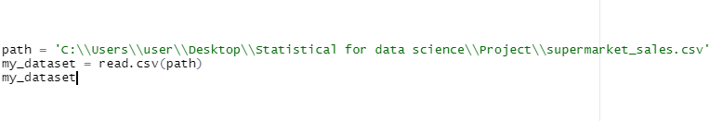
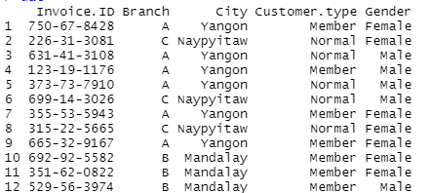
Read.csv
We can read any data by using method read.csv() this method will show your dataset organized :
Here our code for read :
The part of output here :

Slide 3
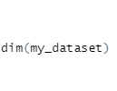

How we know number col & row
To know how many columns and rows in our dataset we use method calling dim() .
The code :
Output :

Slide 4


Statistical mean
So , we have a method mean() that mean “sum of the values, divided by their number”.
We use method mean() on column “cogs” to find the average :
The output for average cogs :

Slide 5


Apply some statistical
The sd() method that mean “Standard Deviation”,
computes the standard deviation of the column “gross.income”
Here is doing :
Result :

Slide 6


Statistical for Gender
We need to find the mean for all each male and female from column “Gender” by using method group_by() and summarise()
Doing :
Will get :

Slide 7

Statistical for Time
To find the mean of column “cogs” for each time from column “Time” by using ggplot() ,
Take your time :
Cont…

Slide 8

Statistical for Time
Let’s talk about last code a little bit,
We use method mutate() to change the time for example the time is “12:44” if use the method time will be “12” without a minute.
By using method summarise() we find the mean for column “cogs” and stored in variable calling “mean_cogs” :
cont…

Slide 9

Statistical for Time
Time to use method ggplot() to create Visualization and show more details here the code to show Visualization :
The code will view the “Time” in horizontal(x) axis and “mean_cogs” in vertical(y) axis next slide.
cont…

Slide 10
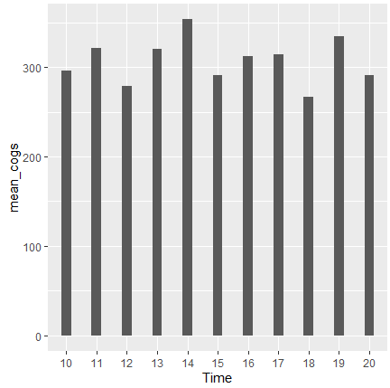
Visualization for Time and mean_cogs

Slide 11
t.Test mean for Gender
We filtered column “Gender” for Simplified display of statistics.
Sorting the groups for males and females and showing the column “gross.income” for test the mean from each groups by using method t.test() .
For males :
cont…

Slide 12
t.Test mean for Gender
For Females :
Now to test the mean for each groups :
cont…

Slide 13
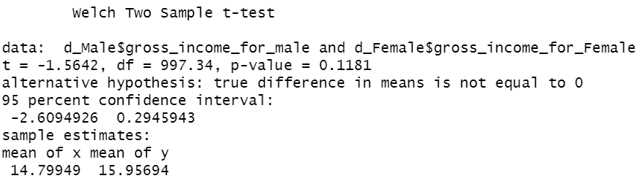
t.Test mean for Gender
After showing the results, we notice the p-value 0.1181 is greater than 0.05 and this means that we can’t refuse the H0 which states that the averages are the same.

Slide 14
Statistical for Product
In column “Product.line” There are several products, and each customer wants quantities from column “Quantity” of these products, we use mean() statistics to find out which products have mean quantities.
cont…

Slide 15
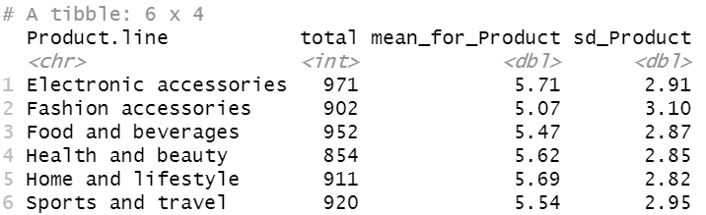
Statistical for Product
The mean and standard deviation for each products is same average
cont…

Slide 16

Anova testing
After we made the anova test on the type of “product” and the “Quantity” sold we have found that the p value is 0.328 which means that we can’t refuse the H0

Slide 17
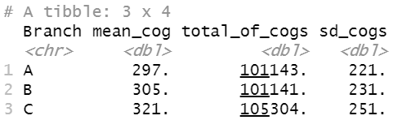
Statistical for branch
Every “Branch” column have cost of goods sold but we have a many of branches A, B, C, to Simplified this problem, use group_by() :
In result we sorting branches to 3 rows and get some Statistic ,
The mean and standard deviation
is same.
cont…

Slide 18

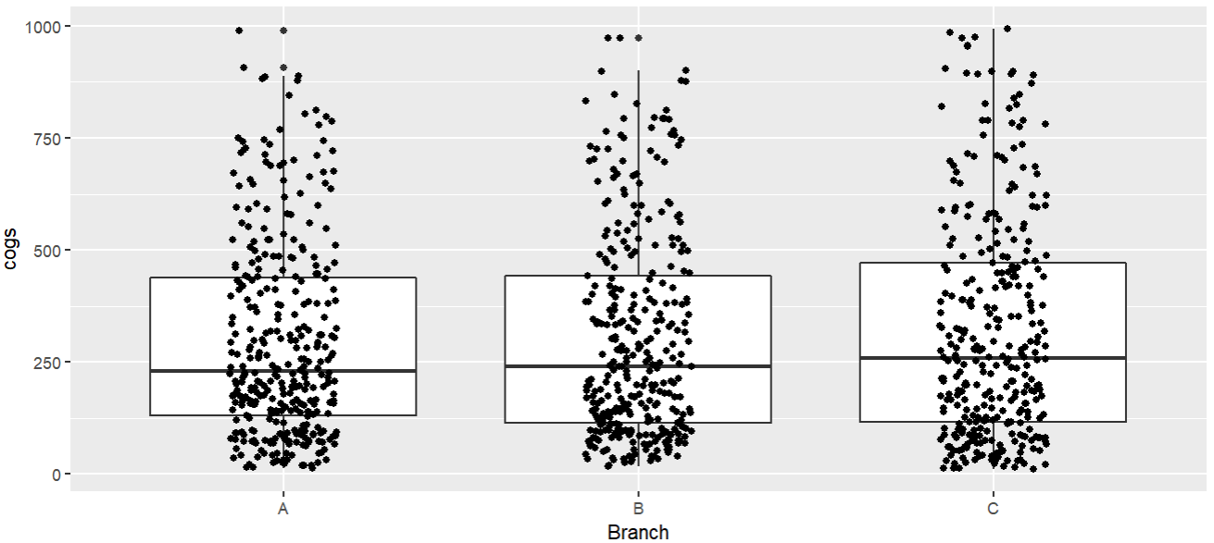
Visualization for branch
In the plot notice there are not different between branches, they have same cost of goods sold.
cont…

Slide 19

Anova testing
After we made the anova test on the type of “Branch” and the “cogs” sold we have found that the p value is 0.413 which means that we can’t refuse the H0

Slide 20
Statistical for Payment
From column “Payment” customers have several ways to pay, Some pay cash, some pay with a credit card, and some pay with an electronic wallet, for each payment have rate from column “Rating” let’s find the average and standard deviation for each of the gross-income and rate :
cont…

Slide 21
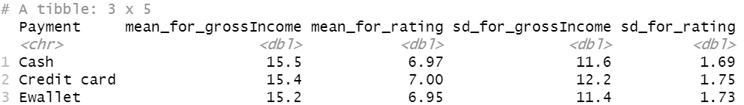
Statistical for Payment
The mean for gross-Income is same.
cont…

Slide 22

Anova testing
After we made the anova test on the type of “Payment” and the “gross.income” sold we have found that the p value is 0.922 which means that we can’t refuse the H0.
cont…

Slide 23
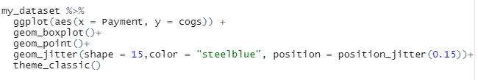
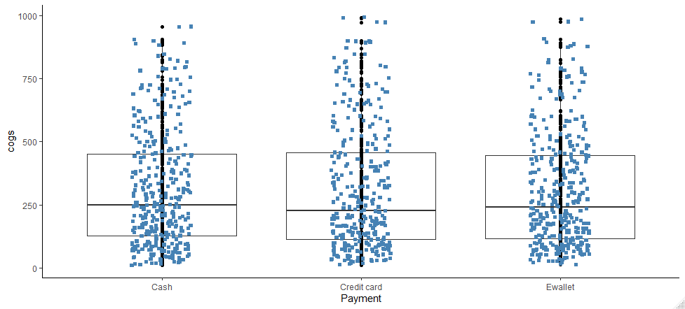
Visualization for payment

Slide 24
Thank You

