Slide 1
MKT
EXECUTIVE DATA ANALYTICS PORTFOLIO CASE STUDY
Marketing Campaign
Performance Analysis
Turning Customer Data Into Marketing Insights & Business Decisions
Customer Personality Analysis · Python · SQL · K-Means Segmentation · Power BI
A fictional company scenario, built on real analytical evidence.

Slide 2
02
BUSINESS PROBLEM
Marketing data is valuable only when
it leads to better decisions.
“How can a company understand its customers and marketing campaign performance
to make better marketing decisions?”
Business
Problem
→
Customer
Understanding
→
Campaign
Performance
→
Better
Targeting
→
Data-Driven
Decisions
PROJECT OBJECTIVES
Identify behavioral and demographic patterns associated with campaign response.
Segment customers into actionable behavioral groups.
Translate analytical evidence into marketing strategies.
MARKETING CAMPAIGN PERFORMANCE ANALYSIS
2

Slide 3
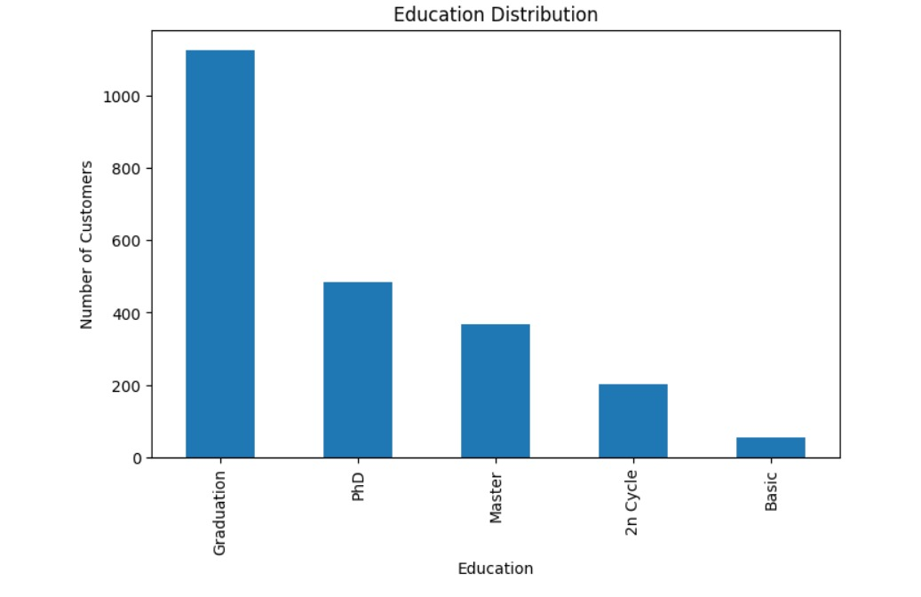
03
THE DATA
Starting with 2,240 customers
and 29 variables.
Customer Personality Analysis dataset — household demographics, purchasing behavior, and marketing campaign history.
After cleaning, the analytical base narrowed to 2,233 customers across four behavioral data domains.
2,240
29
2,233
Original customers
Original columns
Final analytical dataset
CORE DATA DOMAINS
Customer Profile
Purchasing Behavior
Channel Engagement
Campaign Response
Source: Python EDA — customer education distribution, one facet of the customer-profile domain
MARKETING CAMPAIGN PERFORMANCE ANALYSIS
3

Slide 4
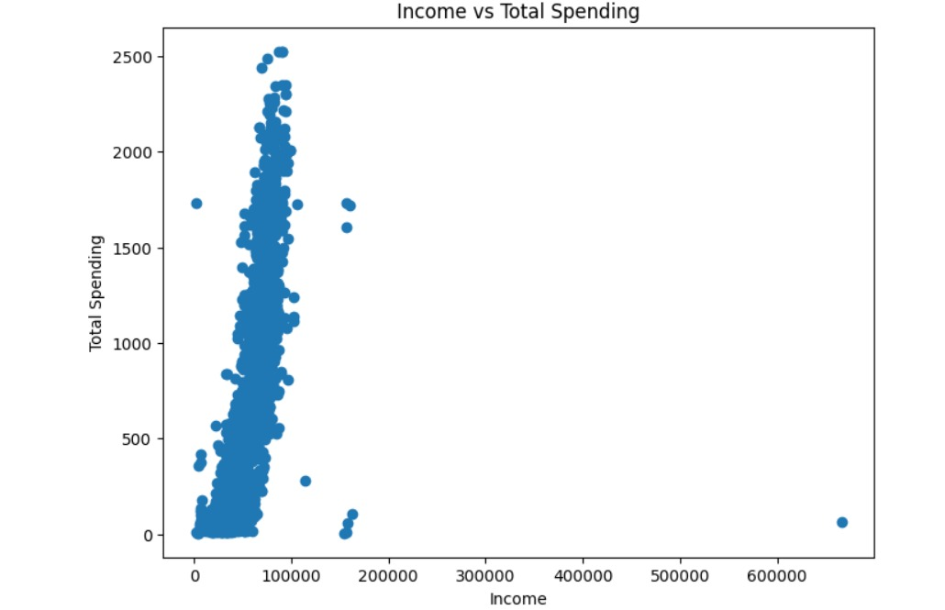
04
DATA QUALITY
Before analysis, the data had
to earn our trust.
24 missing Income values — the only field with gaps.
0 duplicate records found.
3 implausible birth years (1893, 1899, 1900) identified and removed.
Final customer age range: 18–74 (average 45.1).
One income outlier of 666,666 was preserved in the dataset — it was excluded only from distance-based clustering, where it would have distorted segmentation.
Source: Python EDA — Income vs. Total Spending, showing the 666,666 income outlier
MARKETING CAMPAIGN PERFORMANCE ANALYSIS
4

Slide 5
05
FEATURE ENGINEERING
Raw columns became
business-ready metrics.
Raw
Data
→
Cleaning
→
Feature
Engineering
→
Business
Metrics
DERIVED BUSINESS METRICS
Children
Total Spending
Total Purchases
Family Size
Customer Tenure
Kidhome + Teenhome
Sum of 6 product categories · avg 605.38
Web + Catalog + Store · avg 12.54
Children + household adult mapping
Reference date − enrollment date · avg 353.54 days
MARKETING CAMPAIGN PERFORMANCE ANALYSIS
5

Slide 6
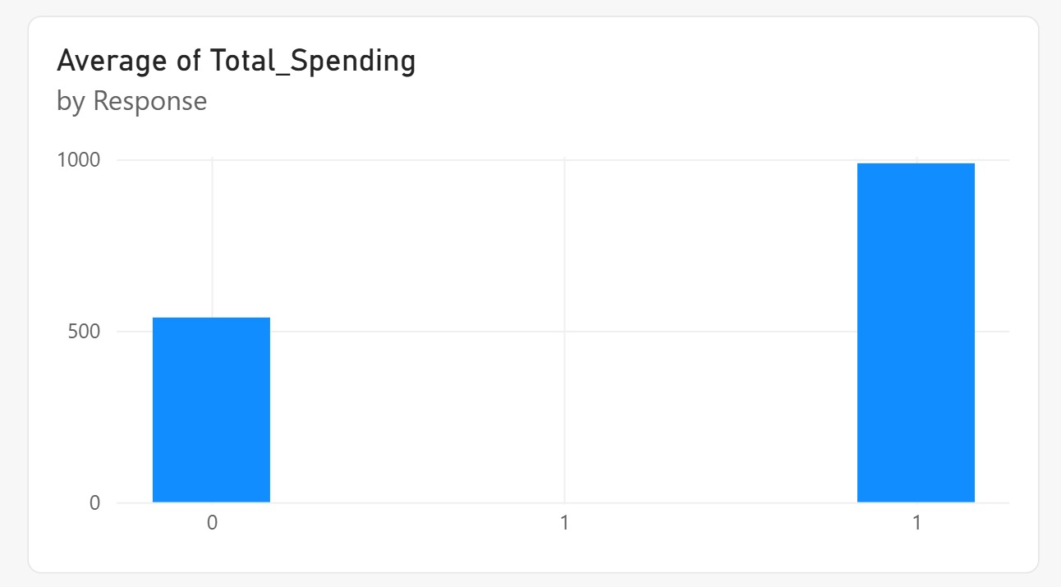
06
RESPONDER BEHAVIOR
Responders behaved differently
from non-responders.
METRIC
NON-RESPONDERS
RESPONDERS
Total Spending
$538.49
$988.40
Total Purchases
12.05
15.36
Average Income
$50,824.61
$60,161.23
Recency (days, lower = more recent)
51.54
35.41
Higher spending, more purchases, higher income, and more recent activity were all associated with campaign response.
Source: Power BI — Average Total Spending by Response
MARKETING CAMPAIGN PERFORMANCE ANALYSIS
6

Slide 7
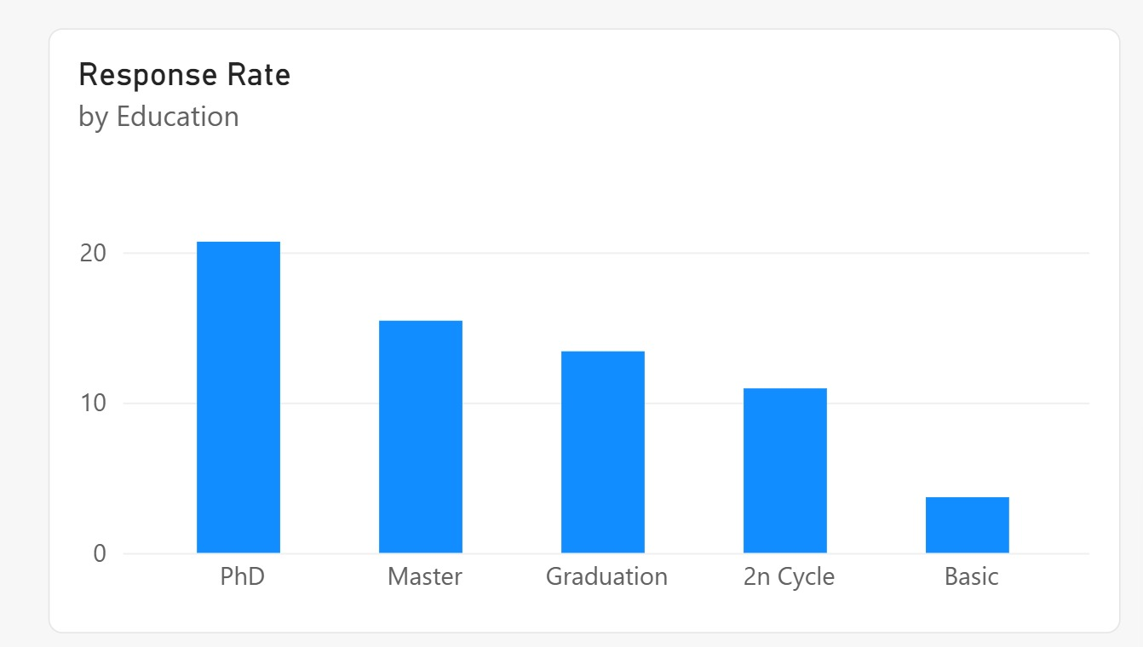
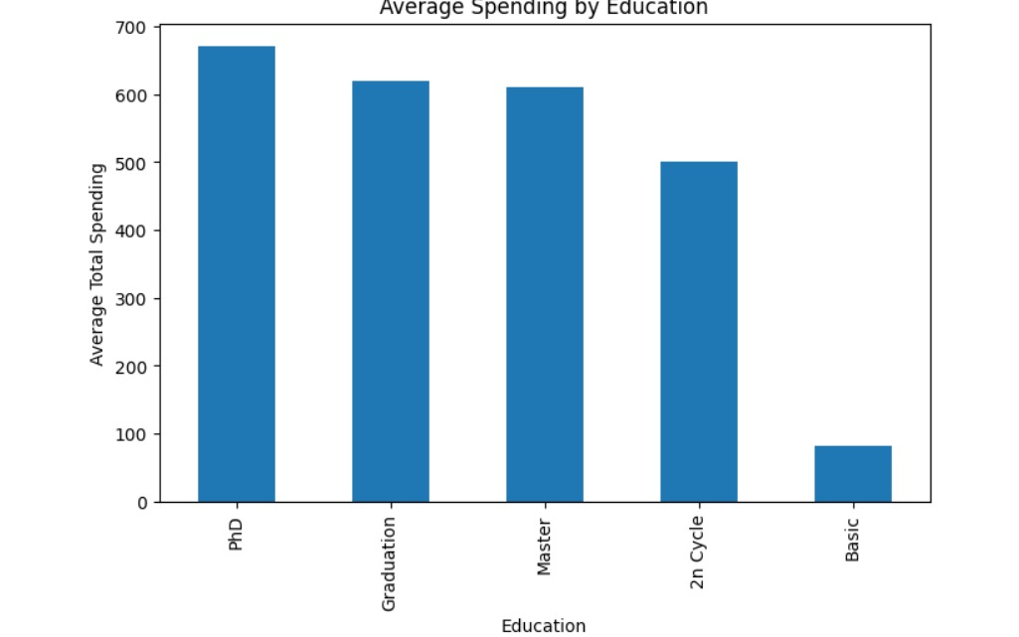
07
WHO RESPONDS?
Response was not evenly distributed across customer groups.
READING THE PATTERN
Higher education levels and having fewer children at home were both associated with higher response — households with no children showed the highest response rate observed in the dataset.
Power BI — Response Rate by Education
Python — Average Spending by Education
EDUCATION — RESPONSE RATE
CHILDREN AT HOME — RESPONSE RATE
PhD — 20.70%
Master — 15.45%
Graduation — 13.41%
2n Cycle — 10.95%
Basic — 3.70%
0 children — 26.46%
1 child — 10.23%
2 children — 11.16%
3 children — 3.77%
These are observed associations, not causal drivers of response.
MARKETING CAMPAIGN PERFORMANCE ANALYSIS
7

Slide 8
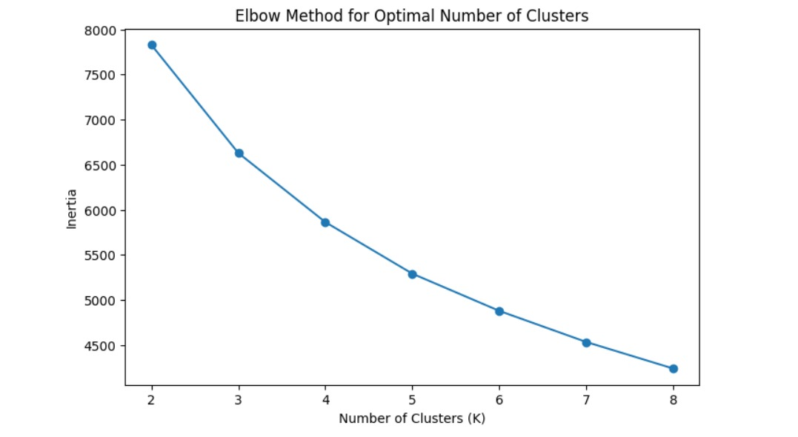
08
CUSTOMER SEGMENTATION
Two behavioral customer
segments emerged from the data.
Method: K-Means clustering on StandardScaler-normalized features.
Features: Income, Recency, Total Spending, Total Purchases, and Web / Catalog / Store purchases (7 total).
Response and AcceptedCmp1–5 were deliberately excluded from clustering to avoid target leakage and circular analysis.
K = 2
0.436
Selected cluster solution
Silhouette score at K = 2
Source: Python — Elbow Method used to evaluate cluster count (K = 2–8)
MARKETING CAMPAIGN PERFORMANCE ANALYSIS
8

Slide 9
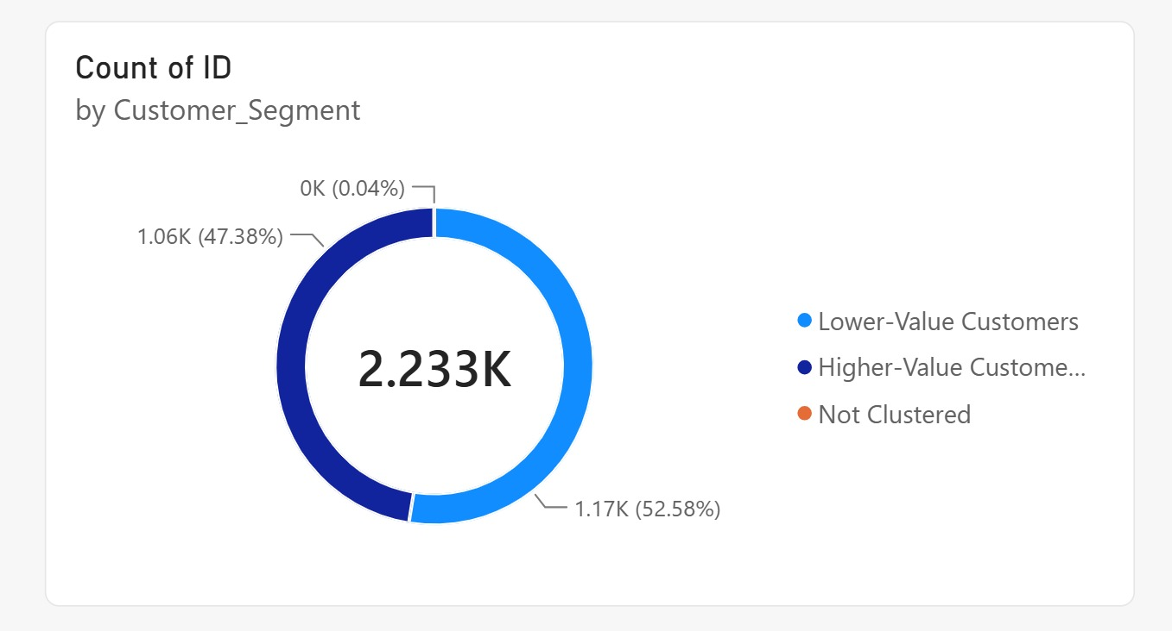
09
THE SEGMENTATION INSIGHT
47% of customers generated
nearly 67% of responders.
Lower-Value Customers
Higher-Value Customers
52.6% of customers
47.4% of customers
9.37% response rate
20.98% response rate
33.13% of all responders
66.87% of all responders
2.24×
response-rate lift for Higher-Value customers compared to Lower-Value customers.
Source: Power BI — Customer count by Customer_Segment
MARKETING CAMPAIGN PERFORMANCE ANALYSIS
9

Slide 10
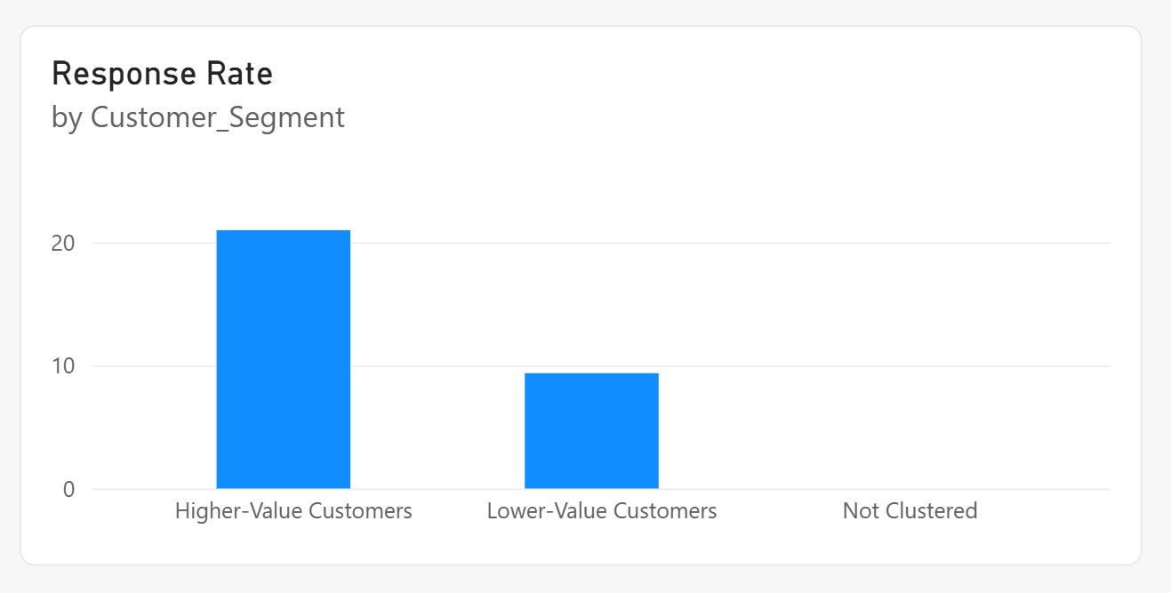
10
VALUE GAP
The Higher-Value segment behaves fundamentally differently.
METRIC
LOWER-VALUE
HIGHER-VALUE
Customers
1,174 (52.6%)
1,058 (47.4%)
Average Income
$36,530.38
$69,033.82
Total Spending
$130.71
$1,132.60
Total Purchases
6.58
19.15
Web Purchases
2.43
5.92
Catalog Purchases
0.68
4.85
Power BI — Response Rate by Customer_Segment
Store Purchases
3.47
8.38
Response Rate
9.37%
20.98%
8.66×
higher spending
2.91×
more purchases
+11.61 pp
response rate
MARKETING CAMPAIGN PERFORMANCE ANALYSIS
10

Slide 11
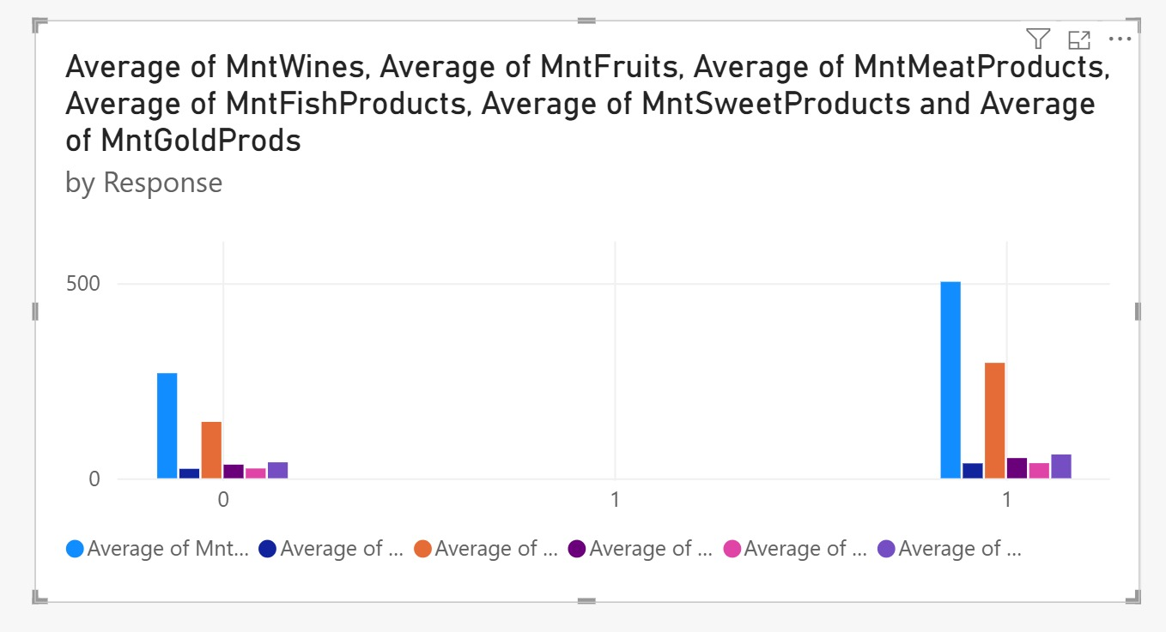
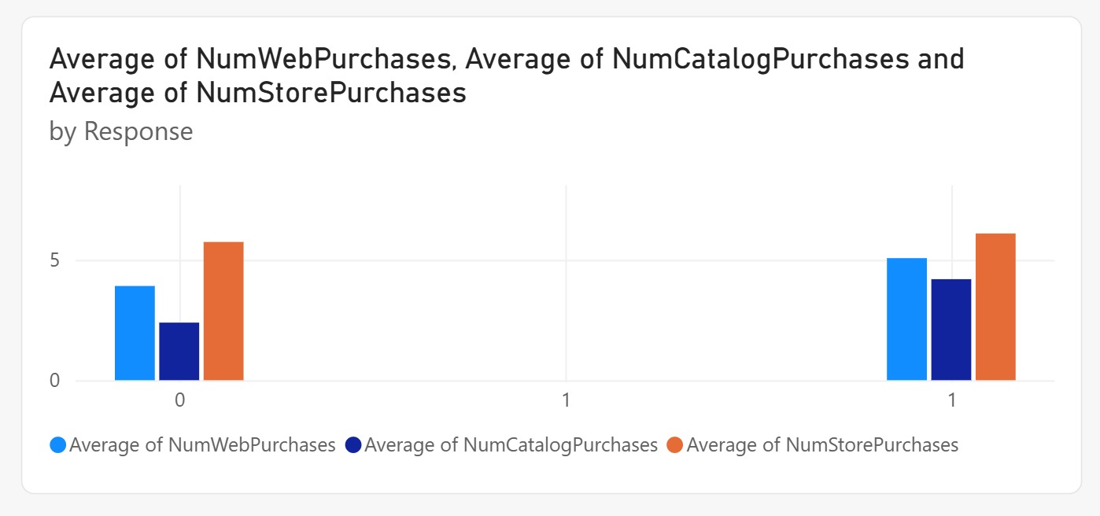
11
PRODUCT & CHANNEL BEHAVIOR
Responders were more active across products and channels.
Power BI — Average product spending by Response
Power BI — Average purchases by channel, by Response
PRODUCT SPENDING — NON-RESPONDER → RESPONDER
CHANNEL — NON-RESPONDER → RESPONDER
Wines: $269.11 → $503.34 (largest absolute gap)
Meat: $144.41 → $295.60 (2nd largest gap)
Fish / Sweets / Gold / Fruits: smaller, consistent gaps
Catalog: 2.39 → 4.20 purchases (strongest relative gap)
Web: 3.91 → 5.07 purchases
Store: 5.74 → 6.09 purchases (smallest relative gap)
MARKETING CAMPAIGN PERFORMANCE ANALYSIS
11

Slide 12
12
TENURE & RECENCY
Customer relationship depth and
recent activity matter.
RECENCY (DAYS SINCE LAST PURCHASE)
51.54
35.41
Avg. days — Non-Responders
Avg. days — Responders
Responders were associated with more recent engagement — 16.13 fewer days, on average, since their last purchase — and with longer overall tenure as a customer.
Average tenure: 337.29 days (non-responders) vs. 446.62 days (responders) — a 109.33-day difference.
MARKETING CAMPAIGN PERFORMANCE ANALYSIS
12

Slide 13
13
FROM INSIGHT TO ACTION
Insights become valuable when
they change what we do.
PROPOSED STRATEGIES TO TEST
Higher-Value audience
→
Prioritize targeted campaigns toward this segment
Recent engagement
→
Re-engage customers based on inactivity windows
Wine / Meat spending patterns
→
Test relevant bundles and cross-sell offers
Longer customer tenure
→
Build loyalty and retention strategies
Newer customers
→
Strengthen onboarding and early engagement
Insight — labelled as observed association — mapped to a proposed business action, not a guaranteed outcome.
MARKETING CAMPAIGN PERFORMANCE ANALYSIS
13

Slide 14
14
POWER BI EXECUTIVE DASHBOARD
From analysis to an interactive business view.
2,233
332
14.87%
$52.21K
$605.38
12.54
Customers
Responders
Response Rate
Avg. Income
Avg. Spending
Avg. Purchases
Power BI — Customer_Segment distribution and response rate, live-connected to the analytical dataset.
MARKETING CAMPAIGN PERFORMANCE ANALYSIS
14

Slide 15
15
EXECUTIVE TAKEAWAYS
Data analysis is not about finding numbers.
It's about finding decisions.
01
02
03
04
Targeted Value
Behavioral Footprint
Customer Behavior
Data-Driven Roadmap
47.4% of customers represented 66.87% of all campaign responders.
Responders showed higher spending, more purchases, and more recent engagement.
Wine and Meat drove the largest spending gaps; Catalog showed the strongest relative channel gap.
Python, SQL, K-Means segmentation, and Power BI turned raw data into actionable marketing insight.
DATA
→
EVIDENCE
→
INSIGHTS
→
DECISIONS
MARKETING CAMPAIGN PERFORMANCE ANALYSIS
15

