Slide 1

Student Performance Prediction using Machine Learning Model
A machine learning project that predicts students
final grades based on academic and personal factors such as study time, absences, and previous performance.

Slide 2


Table of Contents
1
2
3
Introduction
Team Members
Data Description
4
5
6
Dataset & Features
Data Preprocessing
Exploratory Data Analysis (EDA)
7
Model Training
8
ML Models Used
Results & Evaluation
9
11
Conclusion & Future Work
12
Thank You!
10
Diagram

Slide 3
Introduction
1
Predicting student performance is an important task in education because students’ final grades are influenced by many academic and personal factors such as study time, attendance, and previous exam scores.
In this project, we apply Machine Learning techniques to build a model that predicts students’ final grades based on real student data.
The goal of this project is to better understand the factors that affect student success and to estimate final performance in a simple and data-driven way

Slide 4
2
Team Members
Omar Saleh Abdel-Zaher Mohamed (2401601)
2) yousef zaker allah elsaid abd eltwaib (2400398 )
3) osama mohamed ahmed abd elhafize (2402271)
4) ahmed essam hamdy mohamed (2401636)
5) abdullah nasser ramadan abdulhai (2401605)
6) abdalrahman ahmed el sayed (2401811)

Slide 5
Data Description
3
Overview :
Our dataset contains 395 student records with 33 features related to academic and personal information.
Each record represents a student and includes variables such as study time, number of absences, previous grades, and other school-related factors.
The dataset provides a clear view of the factors that may influence student performance, making it suitable for building a machine learning model to predict final grades (G3).

Slide 6
4
Dataset & Features
Dataset :
The dataset contains 395 student records with 33 features related to academic performance and personal information. Each record represents a student and their school-related attributes.This dataset helps analyze the factors that influence student success and final exam performance.
Selected Features :
G1 : First period grade
G2 : Second period grade
study time : Weekly study time
absences : Number of school absences
failures : Number of past class failures
school support : Educational support from school
family support : Parental involvement and support
internet access : Availability of internet at home

Slide 7
Data Preprocessing
5
steps to prepare the data :
Missing Values : The dataset was examined and found to have no significant missing values.
Removing Duplicates : The data was checked for duplicates to ensure consistency.
Feature Scaling : Important features such as G1, G2, study time, and absences were selected for model training.
Data Preparation : Numerical values were prepared directly for machine learning models without complex transformations.
Train-Test Split : The dataset was split into training and testing sets to evaluate model performance fairly.

Slide 8
6
Exploratory Data Analysis (EDA)
The main characteristics and patterns :
We performed exploratory data analysis to understand the relationships between different features and student performance.
Calculated basic statistics for key features such as G1, G2, study time, and absences.
Used visualizations (histograms and scatter plots) to observe data distribution and patterns.
Analyzed correlations between features and the final grade (G3).
Found that previous grades (G1 and G2) have the strongest influence on final performance
Observed that higher study time and lower absences are generally associated with better grades..

Slide 9
7
Modeling Approach
These Main Steps :
Model Selection We selected Linear Regression as the main machine learning algorithm to predict students’ final grades (G3), since the target variable is continuous.
Feature Selection : We used the most relevant academic features such as G1, G2, study time, and absences to train the model.
Training Process : The dataset was split into training and testing sets. The model was trained on the training data and tested on unseen data to evaluate performance.
Model Evaluation : We evaluated the model using metrics such as Mean Squared Error (MSE) and R² Score to measure prediction accuracy.
Final Model Selection : Linear Regression was chosen as a baseline model for predicting student performance.

Slide 10
ML Model Used
In this project , we focused on predicting student final grades (G3) using machine learning.
Linear Regression : We used Linear Regression as the main model because it is suitable for predicting continuous values such as student grades.
Model Evaluation : The model was evaluated using Mean Squared Error (MSE) and R² Score to measure how well it predicts the final grade.
Final Approach : Linear Regression was selected as a baseline model for student performance prediction due to its simplicity and interpretability.
8

Slide 11
Results & Evaluation
We evaluated our models using standard regression metrics :
Mean Squared Error (MSE) : Measures the average squared difference between predicted and actual gradesR² Score: Indicates how well the model explains the variation in student performance
Model Performance : The model achieved good performance in predicting students’ final gradesIt was able to capture the general trend between input features and G3
Key Insights : Previous grades (G1 and G2) were the most influential factorsStudents with consistent past performance were easier to predictSome variation remains due to factors not captured in the dataset
Conclusion:
Machine learning can provide useful predictions for student performance, but results can be improved by adding more features or using more advanced models.
9

Slide 12
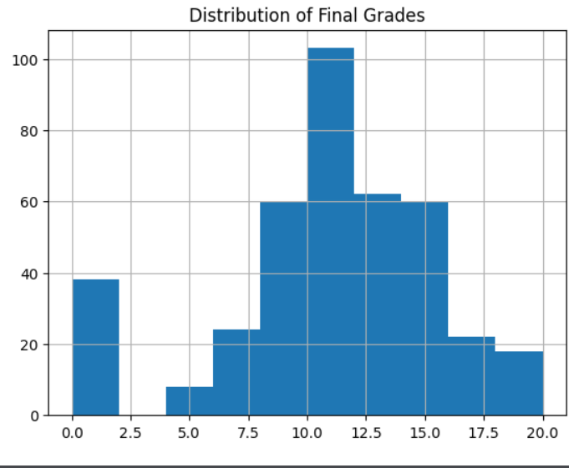
Diagram (1)
10

Slide 13
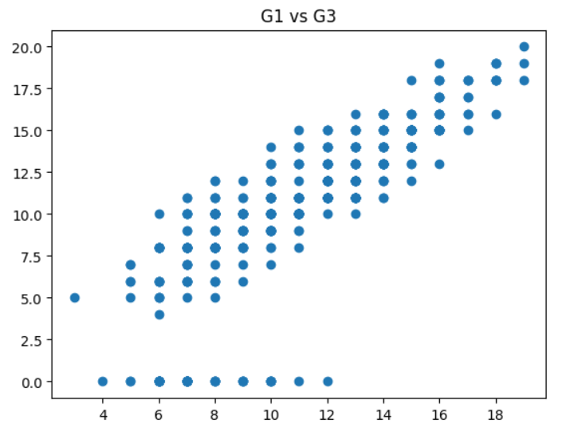
Diagram (2)
10

Slide 14
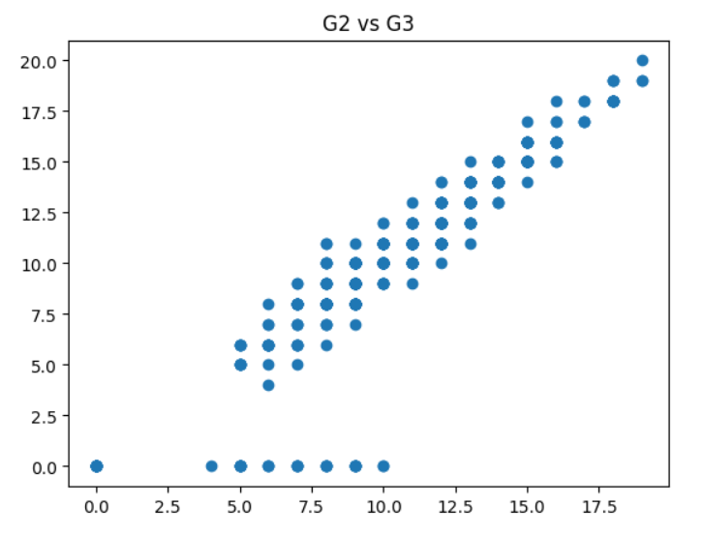
Diagram (3)
10

Slide 15
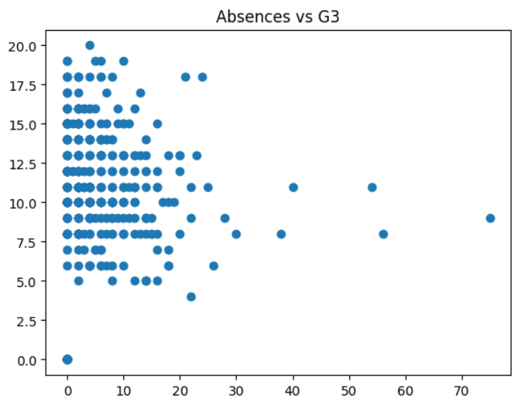
Diagram (4)
10

Slide 16
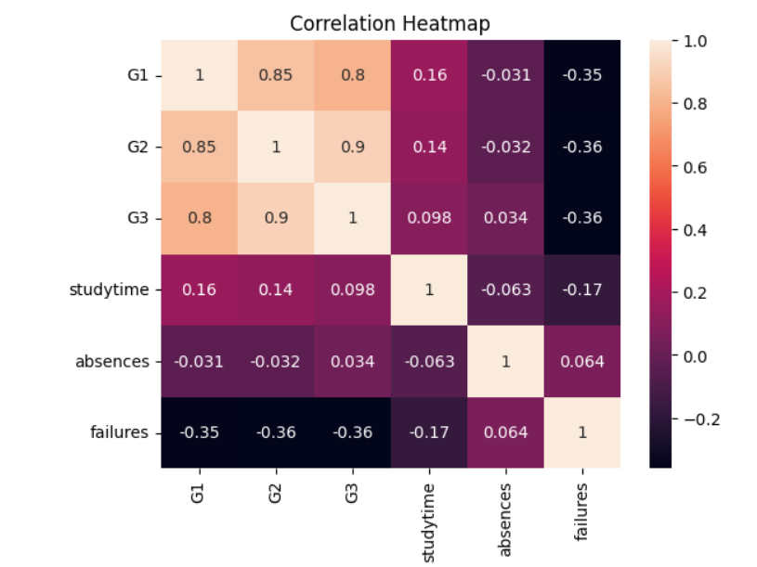
Diagram (5)
10

Slide 17

Thank You!
Dr. mohamed zedaan
&
Eng.khalil

