Slide 1
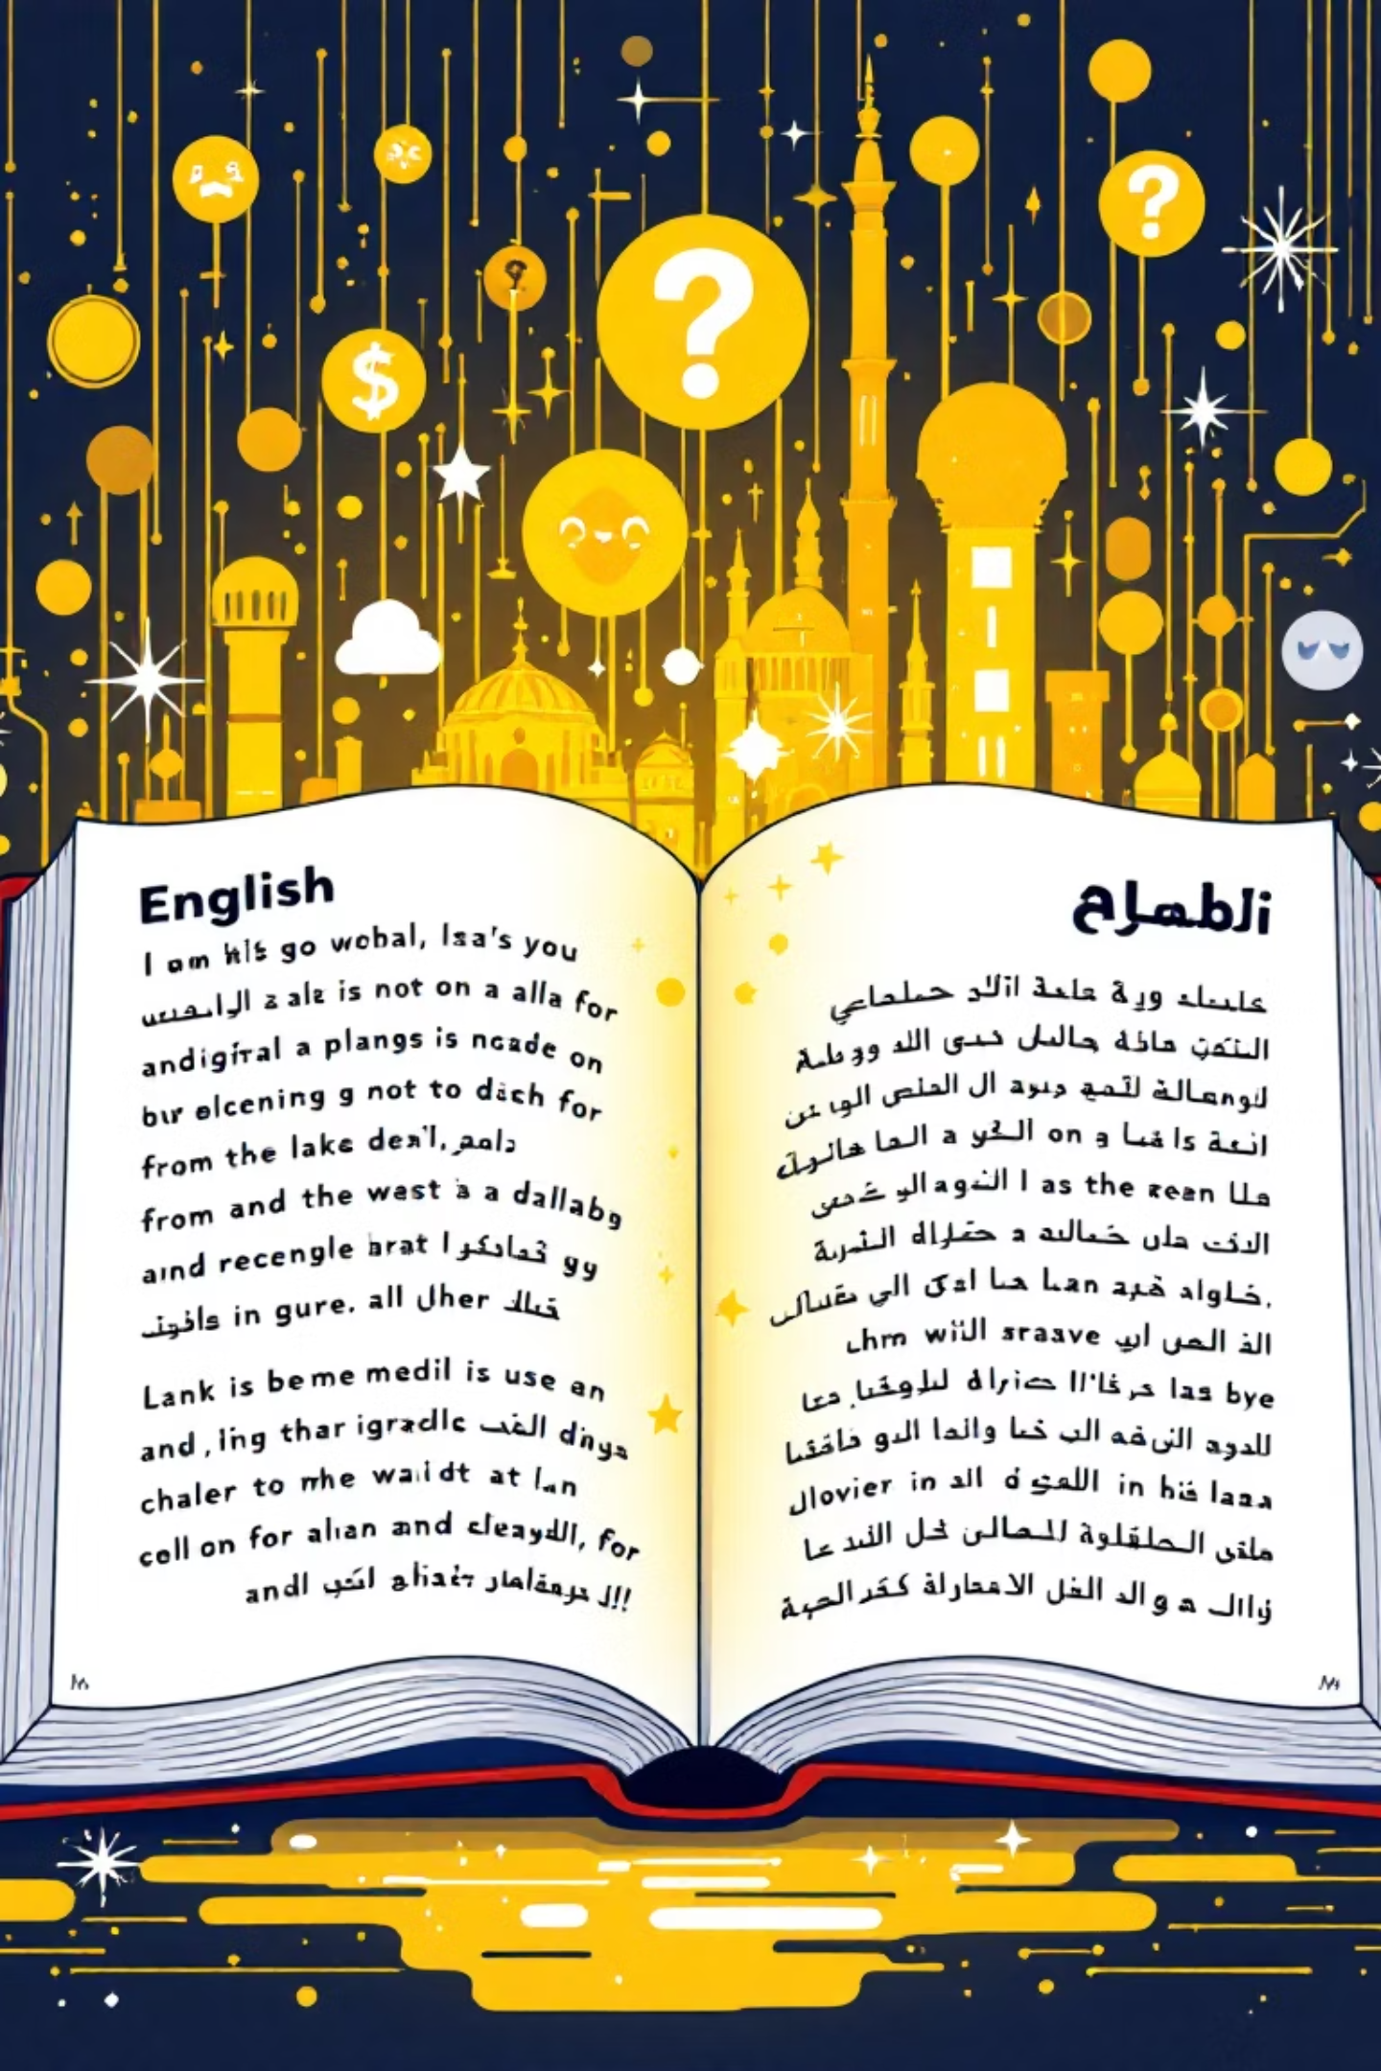
Automated Book Summarisation: English & Arabic
Unlocking knowledge: a powerful tool for instantly summarising books in both English and Arabic.

Slide 2
Team Members :
Abdelrahman Mostafa Mohamed
Abdelrahman Ahmed Sobhy
Omar Abdalla Gaber
Khaled Gamal Ali
Ahmed Mohamed Ahmed

Slide 3


Problem Statement:
Reading and analyzing long research papers or books is time-consuming. Users struggle to extract summaries, translate them, or interact with content efficiently.

Slide 4

Motivation:
As students and researchers, we faced challenges handling large amounts of academic content. We wanted to simplify the process of understanding, summarizing, and asking questions about texts.

Slide 5





Target Users:
Students
Researchers
Academics
Anyone working with books, papers, or lengthy documents

Slide 6




Expected Impact:
- Faster comprehension of long texts
- Easy multilingual access to research through translation
- Interactive chat with documents to enhance learning and productivity

Slide 7



Project Overview
Core Functionality
Technical Architecture
User Experience
Frontend (Streamlit)→ handles user interactions Backend (FastAPI) → APIs for login,
file handling,summarization, QA Database (SQLite + ChromaDB)
Automated summarisation of books, supporting both English and Arabic outputs.
Intuitive Streamlit user interface for seamless interaction and summary downloads.
This project integrates cutting-edge NLP with practical machine translation to deliver an accessible and efficient summarisation solution.

Slide 8
The Engine Room: Jupyter Notebooks
Core Processing Notebook
Enhancement Notebook
Data Ingestion: Loads books in common formats (PDF, EPUB, TXT). Split chunks
Advanced Features: Incorporates improvements and additional functionalities.
Text Preprocessing: Cleans and prepares raw text for analysis.
Translation Integration: Key module for translating English summaries to Arabic.
English Summary Generation: Applies NLP models to create concise English summaries.
Testing & Validation: Ensures accuracy and performance across the pipeline.

Slide 9
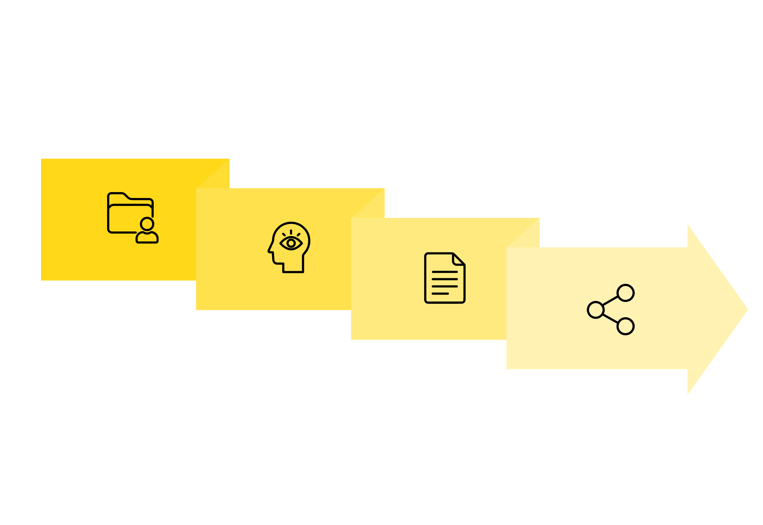




Seamless Workflow: From Input to Output
Preprocessing Splitting to chunks
Export Results
Data Input
English Summary
Our streamlined workflow ensures efficient processing, transforming raw book data into actionable summaries ready for export.

Slide 10
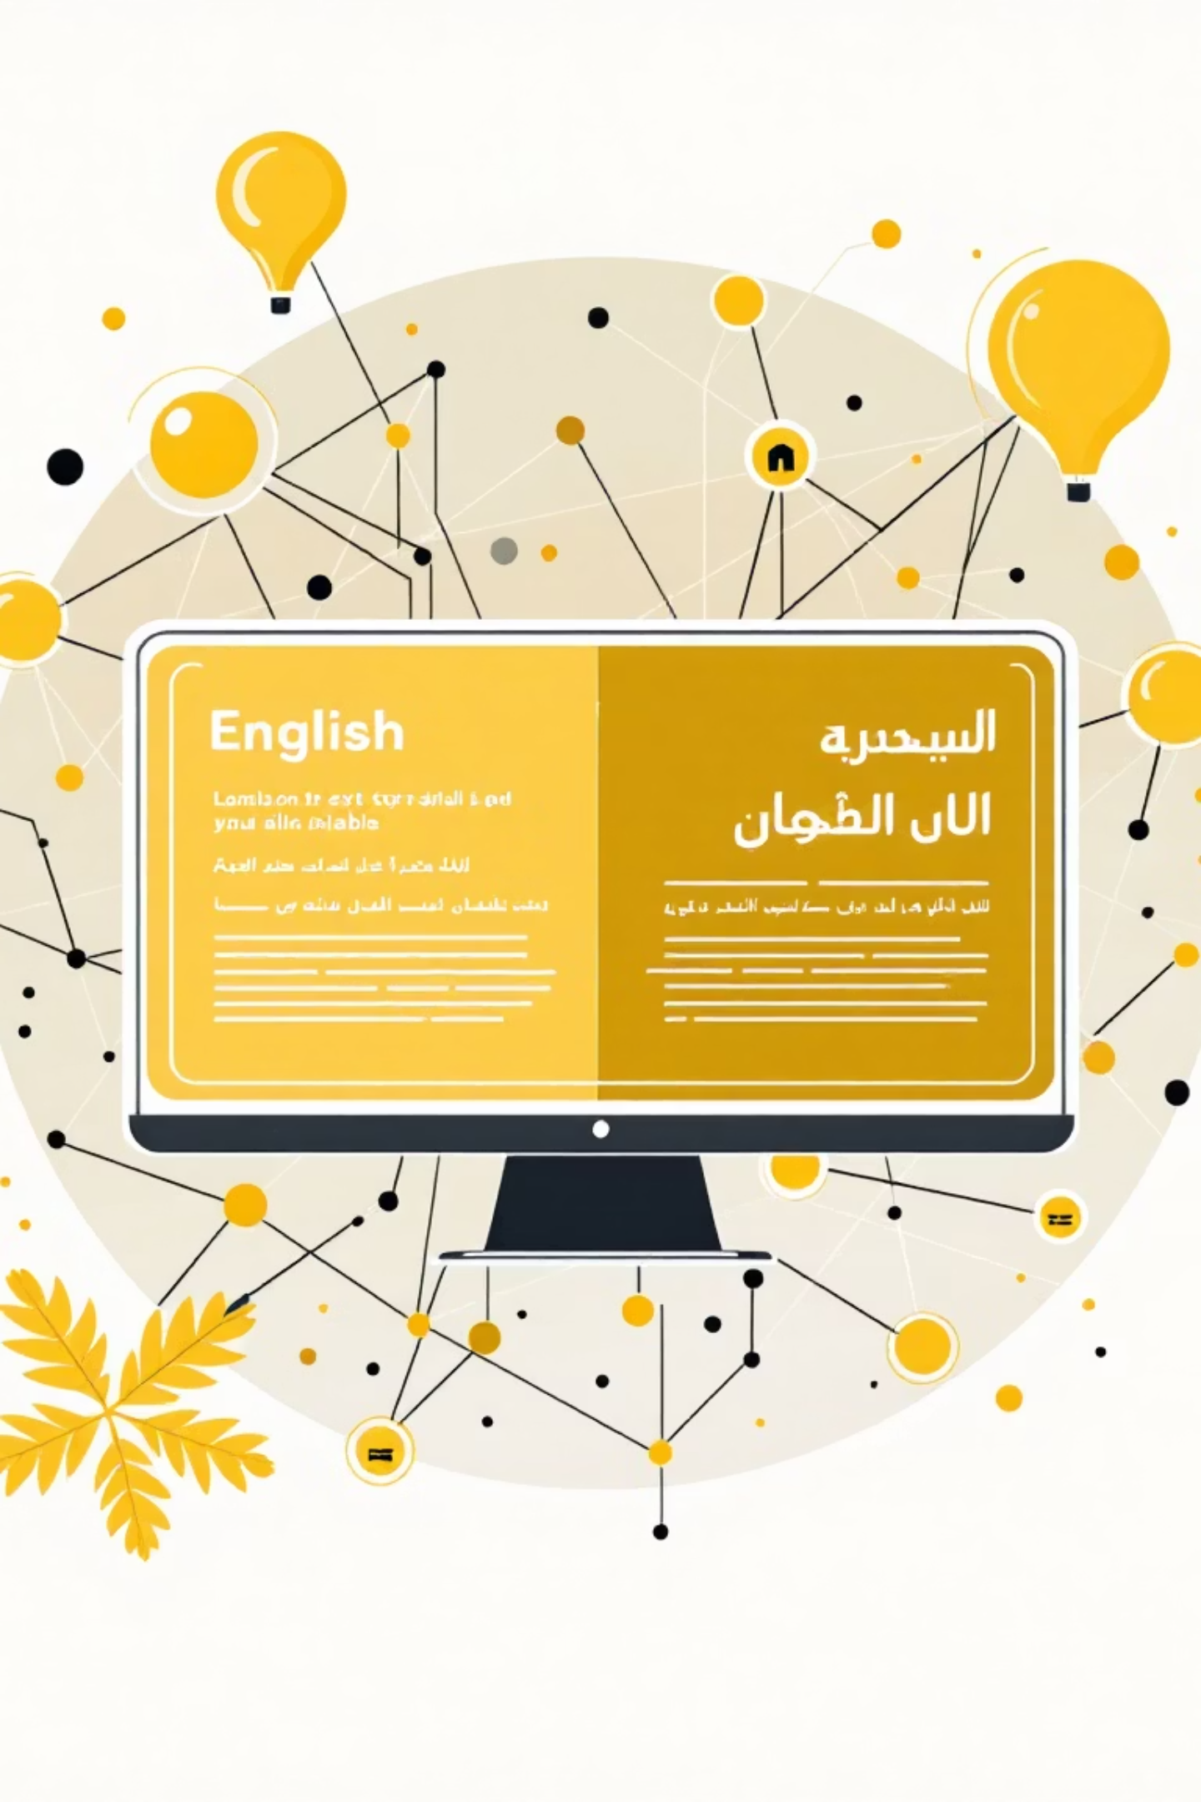

Bridging Languages: The Translation Module
Expanding Horizons: Summaries in Arabic
Following English summary generation, a dedicated translation module converts the content into Arabic. This crucial step enables bilingual support, significantly broadening the project's reach.
Key Value Proposition
Enhanced Accessibility: Opens up the project to a vast Arabic-speaking user base, fostering greater knowledge sharing and inclusivity in diverse linguistic contexts.

Slide 11
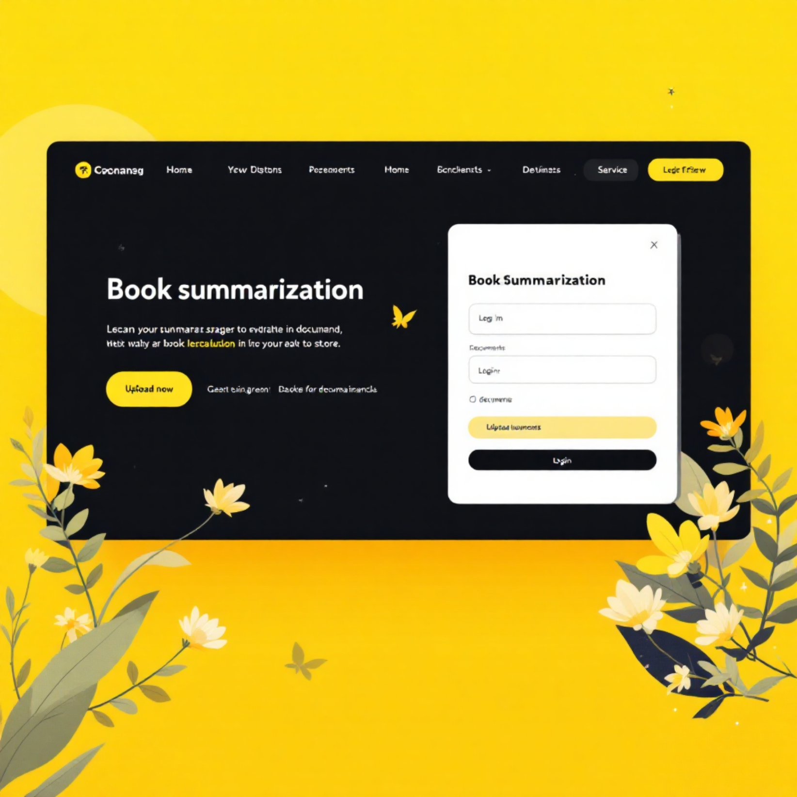
User Interface: Streamlit in Action
Key Features:
Secure Authentication: Users can register and log in via email, username, and password, ensuring data privacy.
Effortless Book Upload: Supports diverse input formats (PDF, EPUB, TXT) for maximum flexibility.
Instant Summarisation: A single click initiates backend processing, delivering summaries swiftly.
Dual Language Download: Provides both summary_en.txt and summary_ar.txt files for immediate download.

Slide 12
The User Journey
1
1. Access & Auth
2
2. Book Upload
User logs in or registers seamlessly.
Uploads a book in PDF, EPUB, or TXT format.
3
3. Summary Generation
4
4. Download & Utilise
System generates English, then Arabic summaries.
User downloads both summaries for immediate use.
5
5. Interactive Chatbot
A dedicated chatbot for dynamic interaction
This intuitive flow ensures a smooth and efficient experience from initial access to final summary retrieval.

Slide 13
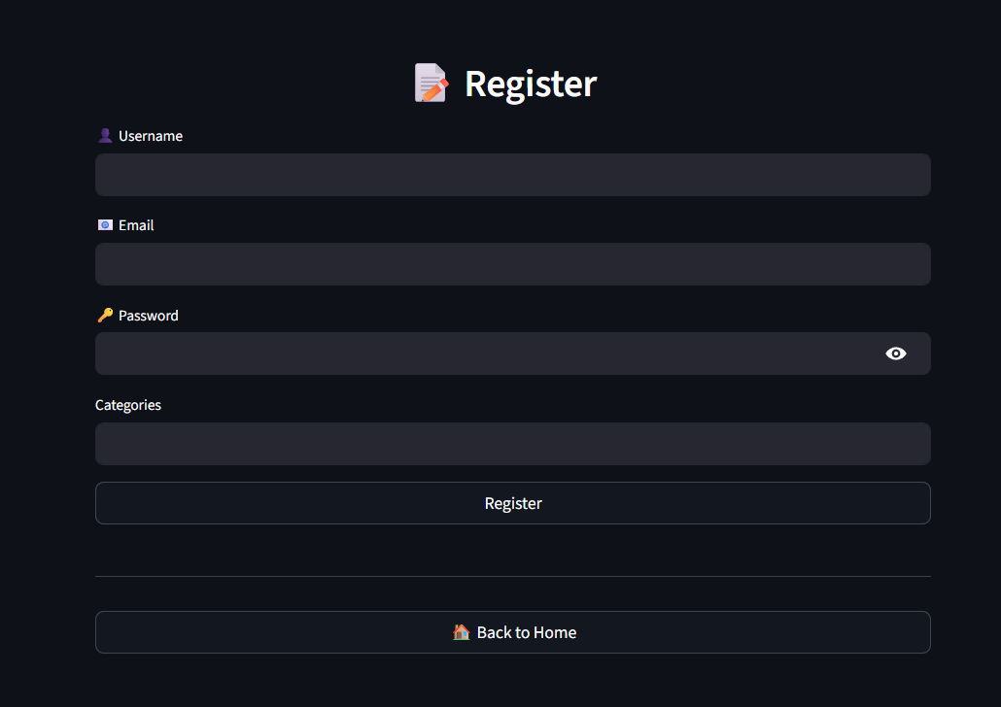
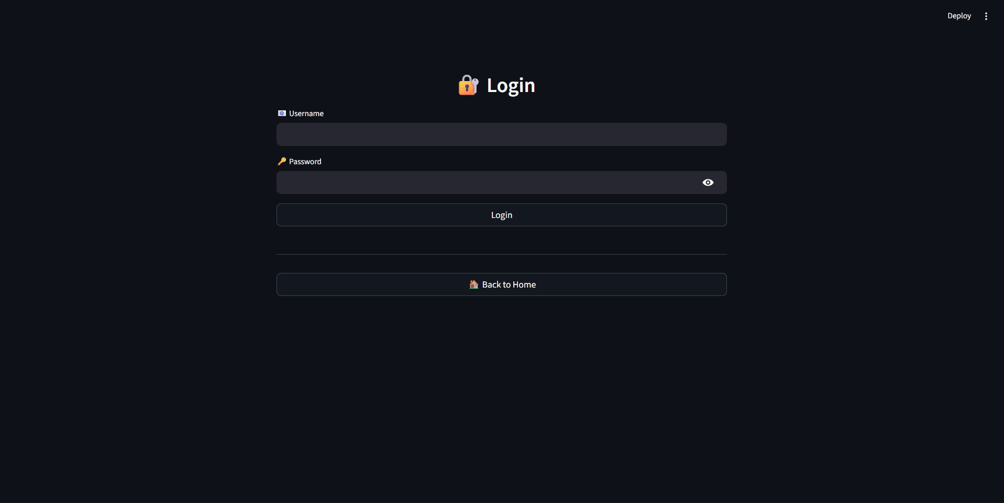
The User Journey
1
1. Access & Auth
User logs in or registers seamlessly.

Slide 14
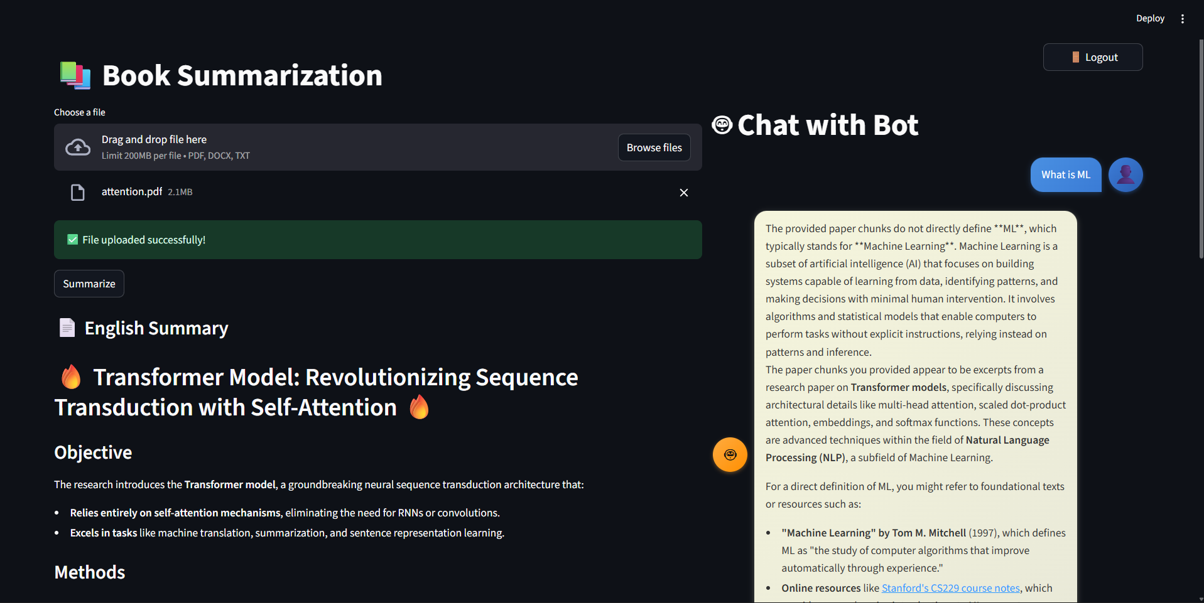
The User Journey
2
2. Book Upload
Uploads a book in PDF, EPUB, or TXT format.

Slide 15
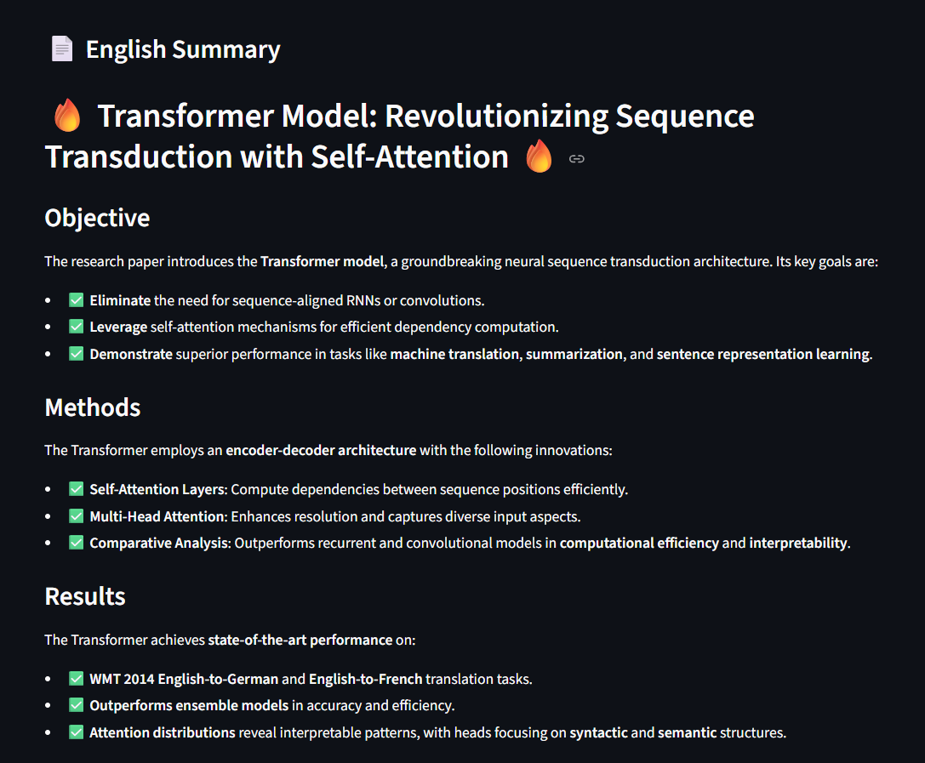
The User Journey
3
3. Summary Generation
System generates English, then Arabic summaries.

Slide 16

The User Journey
4
4. Download & Utilise
User downloads both summaries for immediate use.

Slide 17
The User Journey
5
5. Interactive Chatbot
A dedicated chatbot for dynamic interaction

Slide 18

Future Innovations: Beyond Summarisation
Planned Features:
Multi-document support (summarize or query across multiple books at once)
Voice input & speech-to-text for asking questions.
Cloud deployment for scalability (Docker, AWS/GCP).
Visualization of summaries (knowledge graphs, key concept maps)

Slide 19



Next Steps: Enhancing the Platform
Chatbot Finalisation
Personalised Favourites
Richer Analytics
Complete integration and fine-tuning of the interactive chatbot module.
Develop user-specific personalisation for the favourite books library.
Implement advanced analytics to provide deeper insights into book summaries.

Slide 20

Project Conclusion
Synergistic Technologies
Global Reach
Future-Proofed
Bilingual support for English and Arabic significantly broadens audience accessibility.
Ongoing development aims to introduce more interactive and personalised features.
The project successfully merges natural language processing, machine translation, and a user-centric UI.
Transforming how we interact with information, one summary at a time.

