Slide 1



DSC: Predicting Donations for Future Campaigns
Omar Abdelgelil | Omar Masrouji | Shabenoor Kamal
Kurt Maxwell Kusterer | Alejandro Lopez Zeron
PANDAS ANALYTICA

Slide 2
CONTENTS
1. Introduction to Pandas Analytica
2. Direct Social Communication – Business Case
3. DSC – 2013 Reactivation Campaign
4. Data and Variables (Original and Created)
5. Feature Selection
6. Models and Algorithm Evaluation
7. Final Model
8. Business Implications and Recommendations

Slide 3
Pandas ANALYTICA
One of the top young, consultancy firms in Europe based on Forbes
Founded in 2005 in Belgium
Additional offices:
Cairo, Egypt
Karachi, Pakistan
Cape Town, South Africa
San Pedro Sula, Honduras
Jerusalem, Palestine
Top areas of expertise:
Political consultancy
Financial markets
Marketing analytics

Slide 4
Direct Social Communications: Business Case
Background:
Specializing in fundraising since 1985
Help charities raise money to develop their activities
400 fundraising campaigns using DM per year
More than 600k donations per year
€24 million in donations per year
Business Problem:
Efficiently contact donors for a reactivation campaign in a profitable way
Goal:
Identify donors who, if contacted, will donate more than €35. Focus on donors who have been inactive in the past few years

Slide 5
2013 Campaign: €27 average donation
Contacted: 34,888
Total Donors: 1,220
Total Donation: €32,884
Average Donation: €26.95
Penetration Rate: 3.5%
Donors > €35: 518
Males: 43% | Females: 34% | Couples: 20%
Languages: 93% Dutch | 7% French
Antwerp: 23% | E. Flanders: 22% | W. Flanders: 21%
Baseline
Total Cost | €17,444
Total Donors > €35 | 518
Average Donation | €45
Total Revenue (using average donation) | €23,310
Conversion Rate | %1.48 (518/34,888)

Slide 6

Data & Variables: Originals
Training Data: Campaign 2013-04-11
Test Data: Campaign 2014-01-15
Data Received from DSC:
Donors: donorID, gender, language, zipcode, region
Gifts: donorID, campID, amount, date
Campaign 2013-04-11: donorID, amount
Dummy Variables from Original Data:
Gender & language
Region & province (created from zipcode)

Slide 7
Data & Variables: Created
latest_gift_above_35 | min_amount_gifted | first_gift_years
times_gift_above_35 | avg_gift_amount | last_gift_years
earliest_gift_date | avg_weighted_gift_amount | ever_received_camp
total_freq_gifted | total_weighted_amount_gifted | mostly_gift_35
total_amount_gifted | max_weighted_amount_gifted | latest_gift_date
max_amount_gifted | min_weighted_amount_gifted | avg_gift_per_year
 | ever_gifted

Slide 8
Data & Variables: Created
max_window | latest_growth | amount_gift_5y
min_window | freq_gift_10y | weighted_amount_gift_5y
avg_window | amount_gift_10y | freq_gift_3y
max_growth | weighted_amount_gift_10y | amount_gift_3y
min_growth | freq_gift_5y | weighted_amount_gift_3y
avg_growth | weighted_amount_gift_1y | freq_gift_1y
latest_window | latest_amount | amount_gift_1y

Slide 9
Feature Selection Method: Fisher’s Score
Measures information gain from each variable towards the target variable
Top 20 predictor variables selected using this feature selection method
Advantage: Fast, efficient and widely accepted
Disadvantage: Selects each feature independently which may lead to a suboptimal subset of features
Checked the correlation between these variables and removed the highly correlated ones (correlation above 95%)
Target variable: Donate over 35 (binary)

Slide 10
Feature Selection Method: Fisher’s Score
Variables Included:
latest_gift_above_35 | latest_amount | region_is_Wal | gender_is_U | weighted_amount_gift_10y
latest_window | language_is_N | amount_gift_1y | latest_growth | province_is_Hai
freq_gift_3y | first_gift_years | avg_gift_per_year | province_is_W_B | last_gift_years
freq_gift_1y | region_is_Fla | weighted_amount_gift_3y | region_was_missing | amount_gift_3y

Slide 11
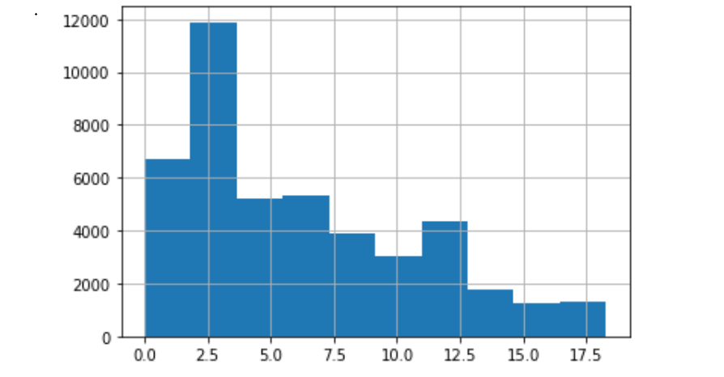
Model assumptions
Up-sampling was done for the training data (2013 reactivation campaign data) using SMOTE
The models only include people who have been inactive for more than 3 years
To calculate the return per donor we used the average donation amount (€45) from donors who donate more than €35 (instead of using €35)

Slide 12
Models
Decision Tree
Logistic Regression
Random Forest - BEST PERFORMANCE
Boosted Tree - BEST PROFITABILITY
Support Vector
Neural Net
k Nearest Neighbors

Slide 13
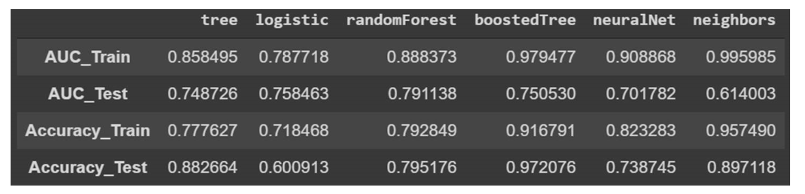
Algorithm Evaluation

Slide 14
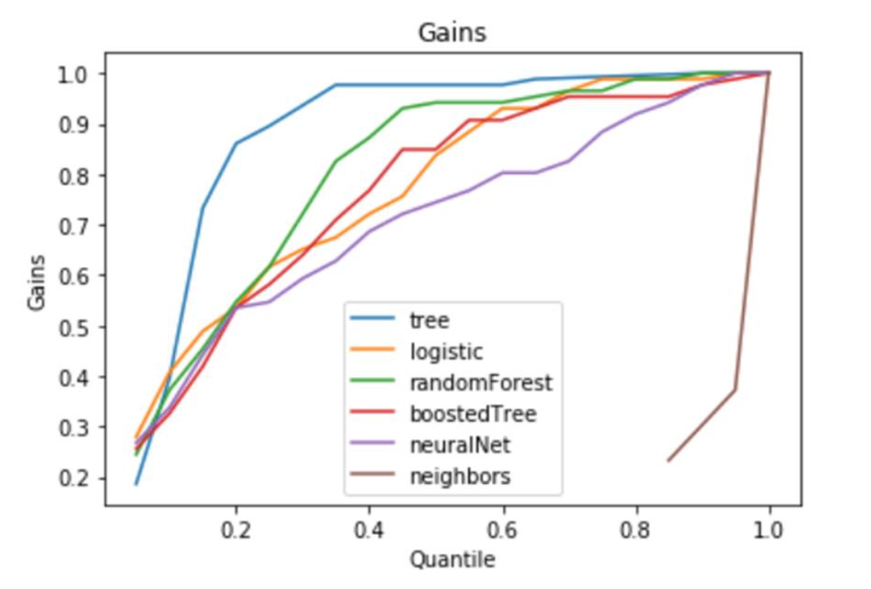
Algorithm Evaluation
Cumulative Gains

Slide 15
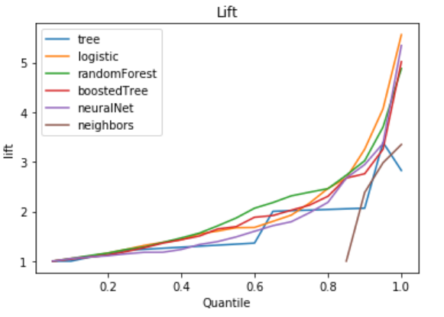
Algorithm Evaluation
Lift Curve
Logistic Regression and Random Forest perform the best
Neighbors and Tree perform the worst

Slide 16
Algorithm Selection
 | # Donors contacted | # Donors who will donate > €35 | Total donations (average €45) | Total Cost (€) | Overall profitability (€) | Conversion rate | Margin
BASELINE | 34888 | 518 | 23310 | 17444 | 5866 | % 1.5 | % 33.6
Logistic Regression | 8956 | 62 | 2790 | 4478 | -1688 | % 0.7 | % -37
Random Forest | 4585 | 47 | 2115 | 2292.5 | -177.5 | % 1 | % -7
Boosted Tree | 572 | 17 | 765 | 286 | 479 | % 3 | % 167
Logistic Regression overfits the least but Boosted Tree makes the most business sense
Note: Assumes cost per person is 0.5

Slide 17
Final Model – Boosted Tree
Actual - Above 35 | Predicted
 |  | False | True
 | False | 21705 | 555
 | True | 69 | 17
Confusion matrix
Y axis (actual)
A donor actually donated in the 2014 campaign (1)
Donor did not donate in the 2014 campaign (0)
X axis (predicted)
Our model predicted this donor would donate in the 2014 campaign (1)
Model predicted this donor would not donate (0)

Slide 18
Business Implications – Impact of Cost
 | Cost per person contacted (€) | Total Cost (€) | Overall profitability (€) | Margin
Boosted Tree | 0.25 | 143 | 622 | % 434
Boosted Tree | 0.5 | 286 | 479 | % 167
Boosted Tree | 1 | 572 | 193 | % 34
Boosted Tree | 1.25 | 715 | 50 | % 7

Slide 19
Recommendations – Business
Collect more data from donors
Some useful variables would include age, level of education, employment status, number of people in household etc
Use the model at scale
Will allow you to reactivate donors who have been inactive for the past 3 years
Will result in higher profits and margin (even if the cost of contacting a donor increases)

Slide 20
Notes
Employ a different feature selection method
Fisher’s score was used for variable selection because it is fast and efficient
However other techniques are available that may provide better results but are more time consuming
Apply a variety of techniques to select variables, when an algorithm picks a variable it gets an upvote. The total votes can be calculated for each variable
Use PCA for dimension reduction
Cross validation
Grid search to optimize hyperparameters
RFM on gift data to identify the most profitable segments of donors

Slide 21

Q&A

