Slide 1




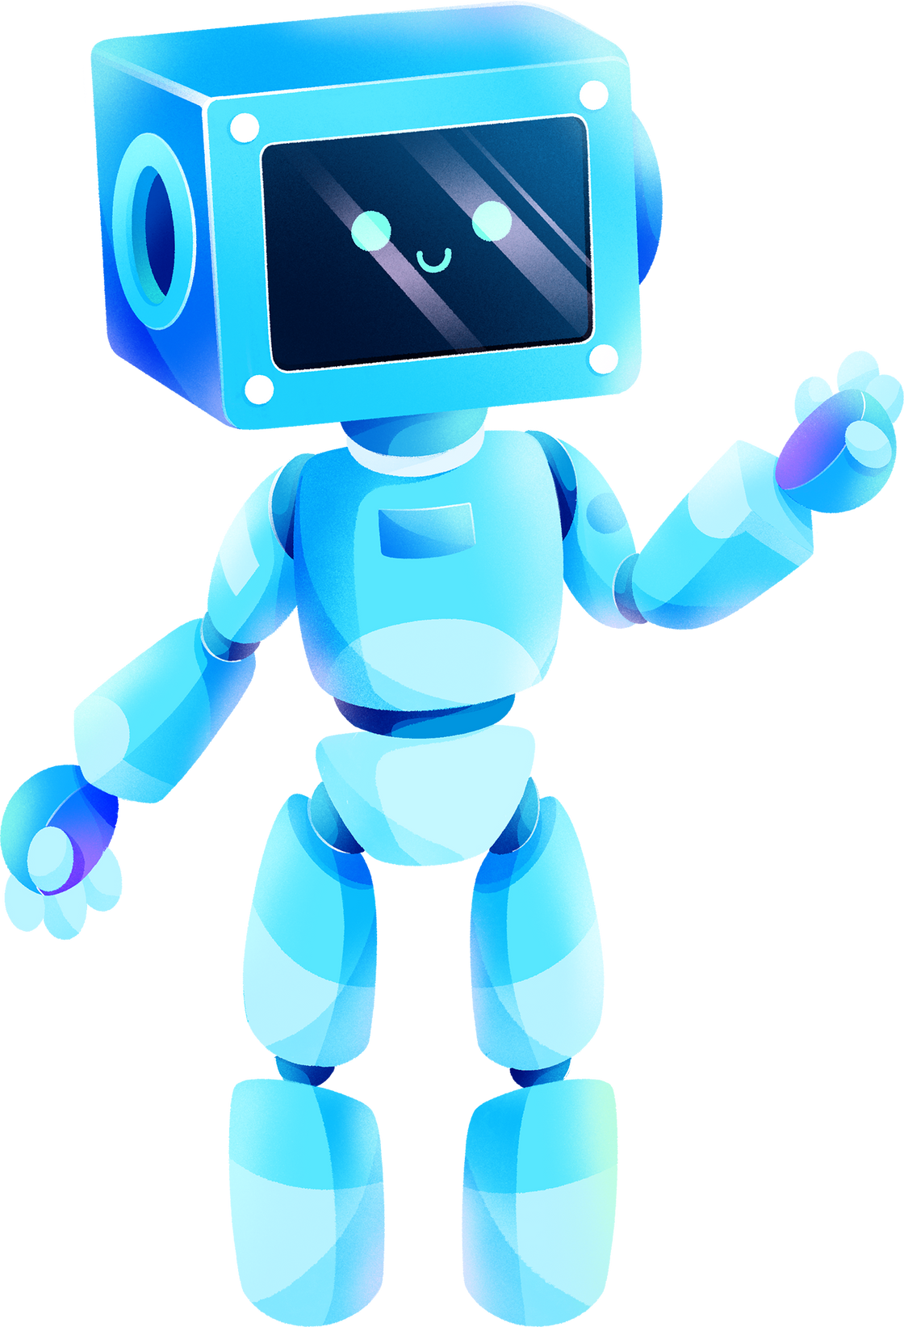

ARTIFICIAL INTELLIGENCE
FUNDAMENTALS, APPLICATIONS, AND CHALLENGES
By omar Abuhassan

Slide 2
TABLE OF CONTENTS
What is Artificial Intelligence
Types and Applications
Pros and Cons of AI
Security and Ethical Issues
Technical Challenges
Legal and Security Implications
Challenges and Opportunities

Slide 3
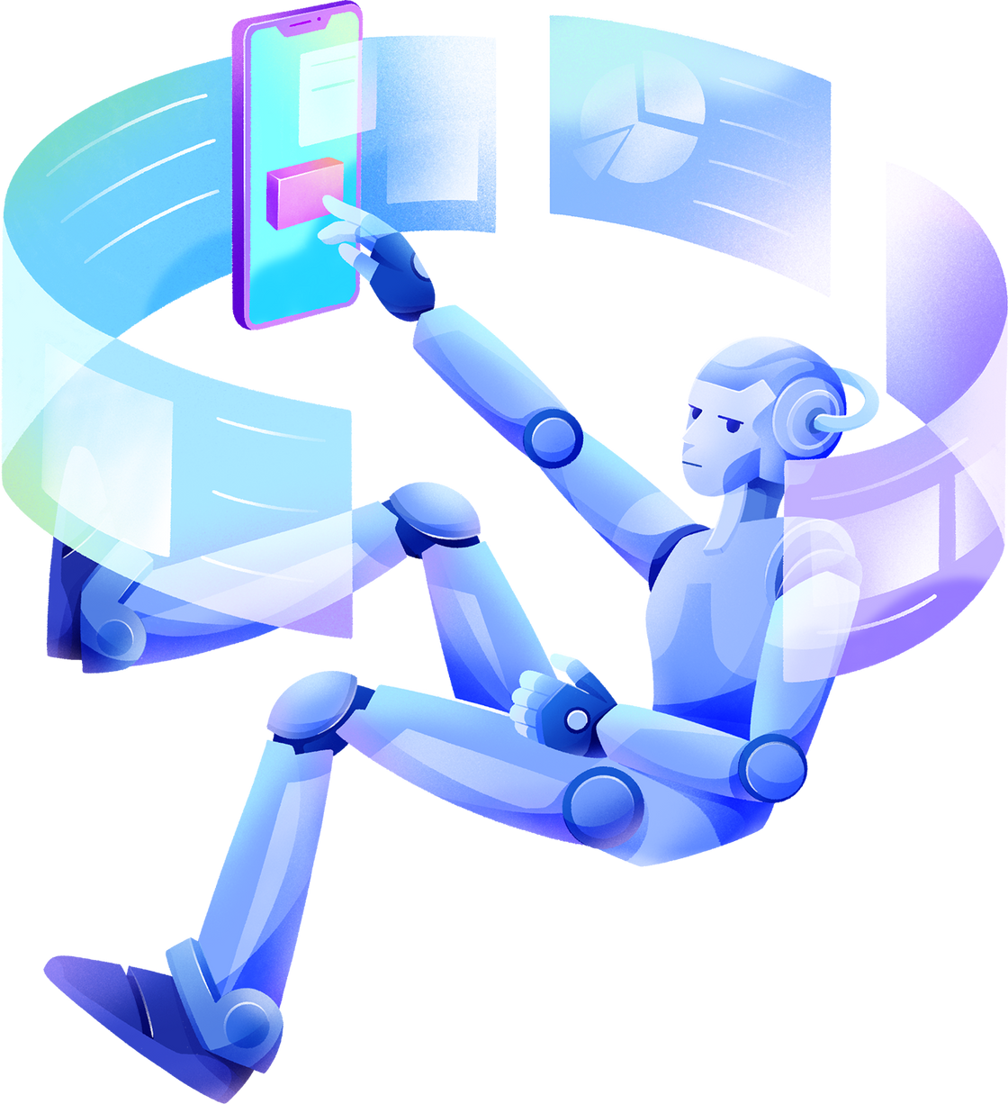
WHAT IS ARTIFICIAL INTELLIGENCE?
Definition:
Machines simulating human intelligence for tasks like learning, reasoning, and problem-solving.
Core Functions:
Learning (e.g., machine learning).
Reasoning (e.g., decision-making).
Interaction (e.g., chatbots, NLP).

Slide 4

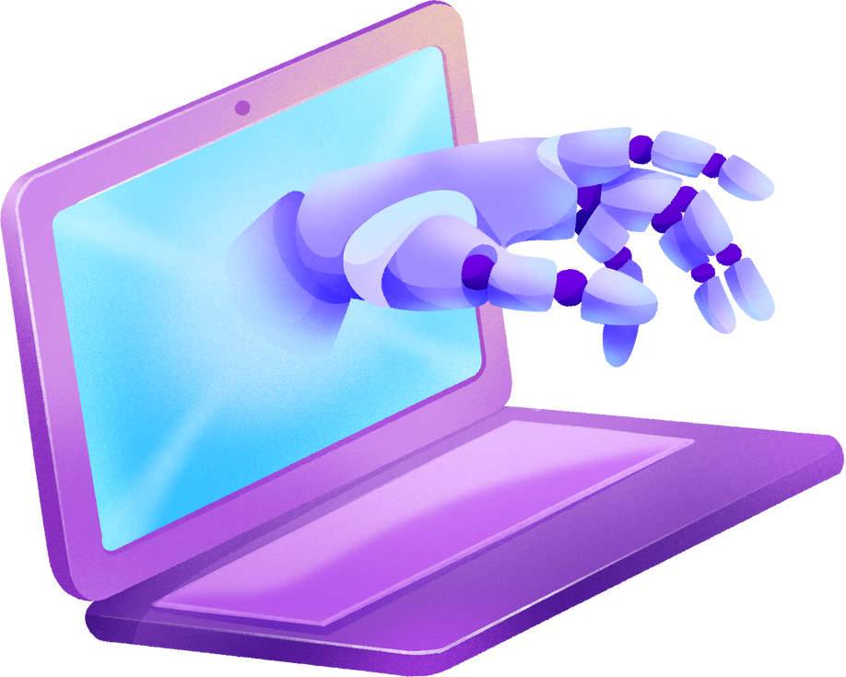
TYPES AND APPLICATIONS
Types
Narrow AI (e.g., Alexa, recommendation systems).
General AI (future concept).
Applications
Healthcare: Diagnosis and drug discovery.
Transportation: Autonomous vehicles.
Finance: Fraud detection.
Education: Personalized learning.

Slide 5

PROS AND CONS OF AI
ADVANTAGES
DISADVANTAGES
Early disease detection (e.g., cancer screening).
Personalized treatments based on patient data.
Faster drug discovery and research.
Real-time monitoring with wearables.
Bias in decision-making due to data limitations.
High costs of implementation.
Privacy risks with patient data breaches.

Slide 6






SECURITY AND ETHICAL ISSUES
SECURITY RISKS
ETHICAL CONCERNS
Data breaches, hacking, misuse of AI (e.g., deepfakes).
Bias in AI models, transparency, and privacy.

Slide 7

TECHNICAL CHALLENGES
HIGH COMPUTATIONAL COST.
INTEGRATION WITH LEGACY SYSTEMS.
KEEPING MODELS ACCURATE OVER TIME.

Slide 8
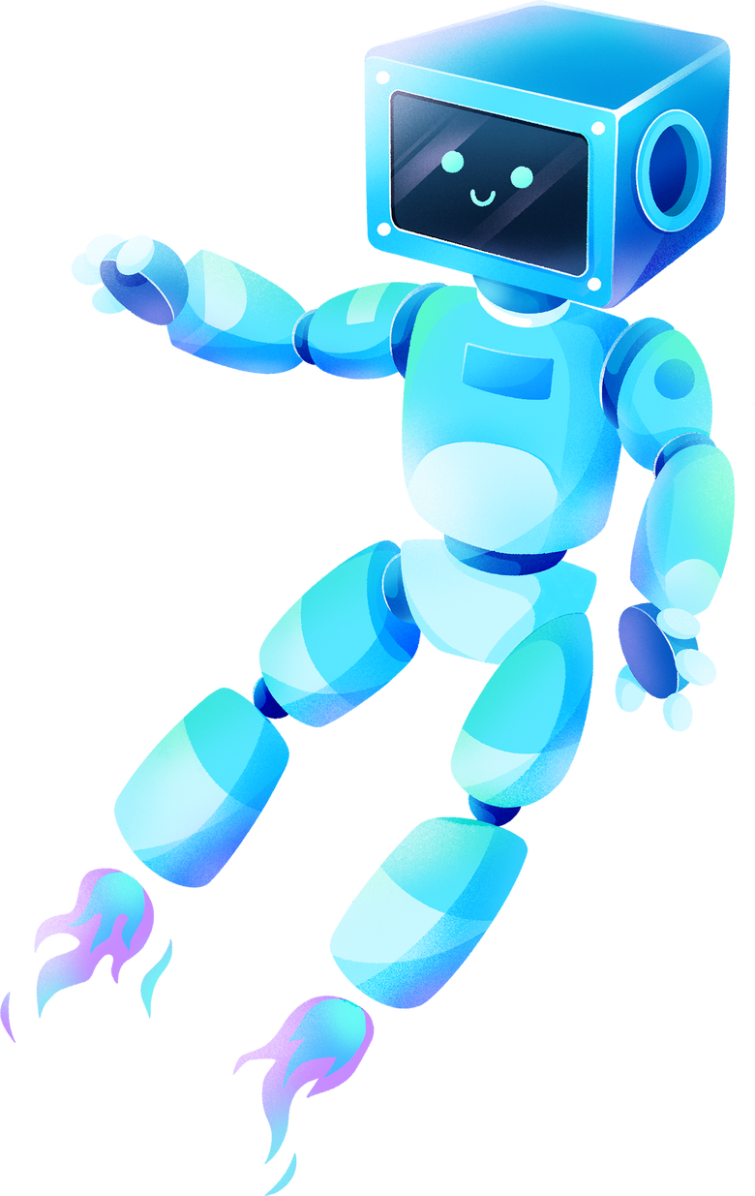
LEGAL Issues
Accountability for AI decisions, compliance with data laws.
LEGAL AND SECURITY IMPLICATIONS
SECURITY RISKS
Cyberattacks on AI systems, economic disruptions.

Slide 9




CHALLENGES AND OPPORTUNITIES
Challenges:
Explainability, data quality, interoperability.
Opportunities:
Efficiency, innovation, global accessibility.

Slide 10
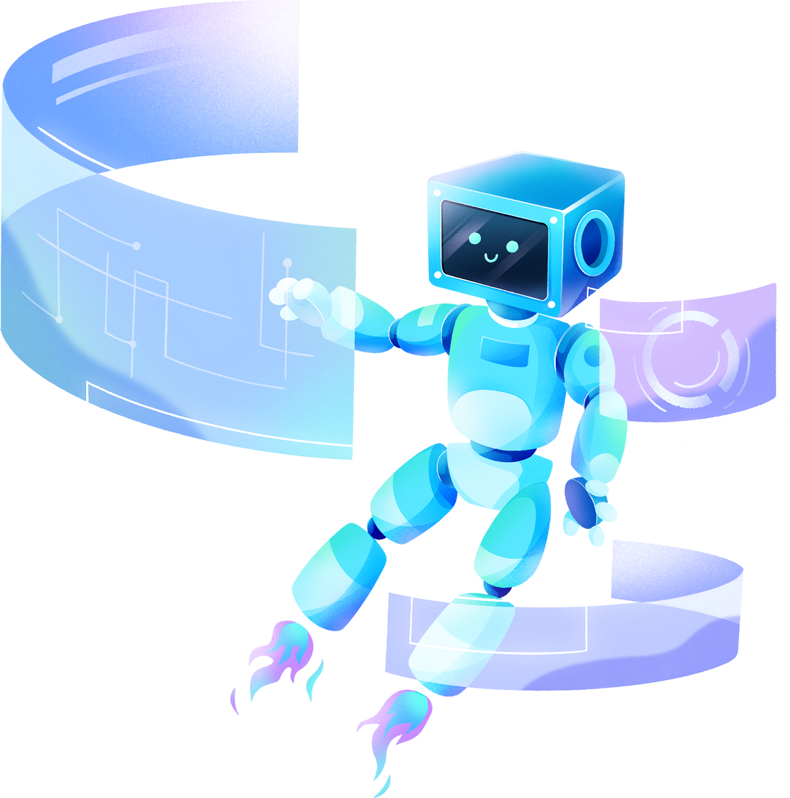
THANK YOU!

