Slide 1

Amazon Predection amount
Final_project Omar Ahmed

Slide 2

Agenda
Dataset Overview
Data cleaning
EDA
Feature engineering
Model trials
Final Model

Slide 3

Dataset
The dataset used in this project contains Amazon product order and sales information. It includes transactional, categorical, and numerical features related to products, shipping, quantities, order status, and pricing.
Main Features
Category
Size
Courier Status
Qty
Amount
Ship State
Fulfillment
B2B
Promotion IDs
Order Status

Slide 4
Data cleaning
In this dataset we deal with missing data a lot and unlogical data like amount checked out and =0

Slide 5
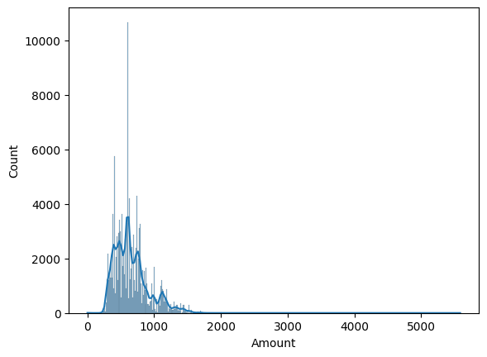
Amount

