Slide 1



ZAGAZIG UNIVERSITY • FACULTY OF COMPUTERS AND INFORMATICS
Artificial Intelligence and Data Science Program
Health Mate
An AI-Assisted Remote Monitoring System for Chronic Cardiovascular Care
GRADUATION PROJECT TEAM
Omar Ashraf Mohamed Kamal (Team Leader) • Seif EL-Deen Amr Mohamed
Rofida Mohamed Ahmed Ibrahim • Farida Abdelazim Gharib Mohamed
Supervised by Ass. Prof. Dr. Amr Abdellatif & Eng. Mohamed Ameen 2025 – 2026

Slide 2
ROADMAP
What We'll Cover in the Next Few Minutes
01
02
03
04
The Problem
The Market Today
Our Solution
Architecture & Data
The silent killer, and an invisible caregiver gap
What's out there — and why it isn't enough
One coherent system: app + backend + AI + hardware
How it's actually built, end to end
05
06
07
08
Custom IoT Hardware
Two AI Models
The Experience
Impact & What's Next
A cuffless BP sensor and a smart medicine box
Cuffless blood pressure & symptom triage — results and limitations
A walkthrough of the real, running app
Who benefits today, and the road ahead
Health Mate • Zagazig University — 2025/2026
1

Slide 3
THE PROBLEM — “THE SILENT KILLER”
Hypertension has no symptoms —
until it becomes an emergency.
The World Health Organization calls hypertension “the silent killer” for exactly this reason: most people with high blood pressure feel completely normal, right up until a stroke, heart attack, or kidney failure.
Snapshot vs. Trend
Patients Skip Readings
Caregivers Are Blind
A clinic visit captures one moment. Disease progression is a trend across weeks, not a single number.
Cuff placement, sitting still, remembering to log — any one step failing means a missed reading.
Family caregivers have no channel to the data unless told directly. They can only react, never notice.
Health Mate • Zagazig University — 2025/2026
2

Slide 4
WHY CURRENT CARE FALLS SHORT
Two Failure Modes, Recurring Constantly
Patient side
Caregiver side
● Correct cuff placement is easy to get wrong
● Sitting still for an accurate reading takes discipline
● Remembering a daily schedule, unassisted, is unreliable
● Medication doses are just as easy to forget or misplace
● No channel to the patient's data short of phoning and asking
● Can only react to what they are told — often after the fact
● No automatic warning when a reading crosses a dangerous line
● No way to reach the patient quickly during a real emergency
THE SILENT KILLER, BY THE NUMBERS
1.28 B
46%
10 M+
adults worldwide live with hypertension (WHO)
don't know they have it — no symptoms until it's serious
deaths every year from uncontrolled blood pressure
Source: WHO Global Report on Hypertension, 2023 / 2025
Health Mate • Zagazig University — 2025/2026
3

Slide 5
THE MARKET TODAY
How This Is Solved Right Now
Traditional Cuff + Paper Log
Consumer Wearables
(e.g. Omron HeartGuide)
Connected Home Monitors
(e.g. Withings BPM Connect)
Clinical RPM Platforms
Manual measurement, manual logging. Cheap and accurate, but entirely dependent on patient discipline and memory.
A cuff built into a wristwatch. FDA-cleared and convenient, but still a cuff, and still no caregiver-facing safety net.
Automated Wi-Fi upload of cuff readings to an app. Great trend logging, but no cuffless sensing and no clinical triage layer.
Care-team dashboards for chronic conditions. Powerful for providers, but built around clinical staff — not a family caregiver.
All four share the same gap: none combine cuffless sensing, AI-driven safety alerts, and a built-in family-caregiver channel in one system.
Health Mate • Zagazig University — 2025/2026
4

Slide 6
COMPARISON
Health Mate vs. the Market
Capability | Traditional Cuff + Log | Consumer Wearables | Connected Home Monitors | Clinical RPM Platforms | Health Mate
Cuffless AI-based sensing | ✗ | ✗ | ✗ | ✗ | ✓
Live caregiver linking + alerts | ✗ | △ | △ | △ | ✓
Symptom / red-flag triage engine | ✗ | ✗ | ✗ | △ | ✓
Smart medication reminder hardware | ✗ | ✗ | ✗ | ✗ | ✓
Built-in emergency calling | ✗ | ✗ | ✗ | ✗ | ✓
Full Arabic + English parity | ✗ | ✗ | ✗ | △ | ✓
Clinically validated / cleared | ✓ | ✓ | ✓ | ✓ | Research prototype
△ = partial / not designed for this use case • Based on each product's public specifications; Health Mate is an unvalidated graduation-project prototype.
Health Mate • Zagazig University — 2025/2026
5

Slide 7
OUR ANSWER
Solve Both Halves Together —
Not Separately.
A cuffless sensor and a family health-sharing app already exist separately elsewhere. The distinctive bet here: fuse sensing, AI safety, and caregiver visibility into one system.
1
2
3
4
BP Sensing Unit
FastAPI Backend
Smart Medicine Box
Flutter Mobile App
ESP8266 + MAX30102 PPG + AD8232 ECG — no cuff
Every clinical decision + 2 trained AI models
ESP32 + LEDs + buzzer — adherence indicator
One shared codebase: patient & caregiver views
Note: the BP sensing unit and the smart medicine box are two independent devices — they never talk to each other, only to the backend.
Health Mate • Zagazig University — 2025/2026
6

Slide 8
PRODUCT AT A GLANCE
What a Patient and a Caregiver Can Actually Do
Patient
Caregiver
● Guided, 8-second cuffless BP measurement
● Manual entry + calibration against a cuff reading
● Medication catalog with smart-box drawer assignment
● Structured symptom assessment with urgency triage
● One-tap audio/video call to a linked caregiver
● Full experience in Arabic or English, RTL included
● Live view of a linked patient's BP, risk tier & history
● Automatic alert on a high or critical reading
● Medication adherence visibility, not just reminders
● Notification if a patient's calibration drifts or goes stale
● Direct call-back to the patient in a concerning moment
● Can monitor more than one linked patient at once
Both sides connect through one shared, AI-monitored backend — the same reading that reassures a patient is the one that can alert their caregiver.
Health Mate • Zagazig University — 2025/2026
7

Slide 9
SYSTEM CONTEXT
Two Actors, One Shared App, One Backend of Record
BP Sensing Unit
ESP8266
Patient
REST
+ WS
HTTP
POST
Flutter Mobile App
patient & caregiver UI
FastAPI Backend
every clinical decision
+ 2 AI models
→
Caregiver
activate
Smart Medicine Box
ESP32
The hardware never makes a clinical decision — signal validation, model inference, calibration and alerting all run in the backend, not on the devices themselves.
Note: the BP unit and the smart medicine box never talk to each other directly — both are independent, reporting only to the backend.
Health Mate • Zagazig University — 2025/2026
8

Slide 10
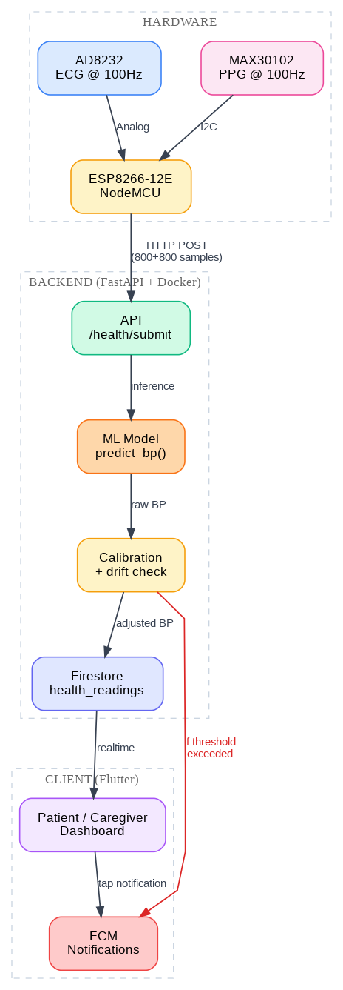
SOFTWARE ARCHITECTURE
Four Layers, Two Architectural Styles
Service-layer style (most of the system)
● Auth, medications, vitals, notifications, contacts, calls, IoT
● Routers → flat services → SQLAlchemy models, wired via Depends()
● Simple, direct, easy to trace end to end
Clean / hexagonal architecture (symptom checker v2 only)
● Domain rule engine, application use-cases, infrastructure adapters
● Use-cases depend on interfaces, not concrete implementations
● Two chat-storage backends (Redis / in-memory) already prove the boundary works
Health Mate • Zagazig University — 2025/2026
9

Slide 11
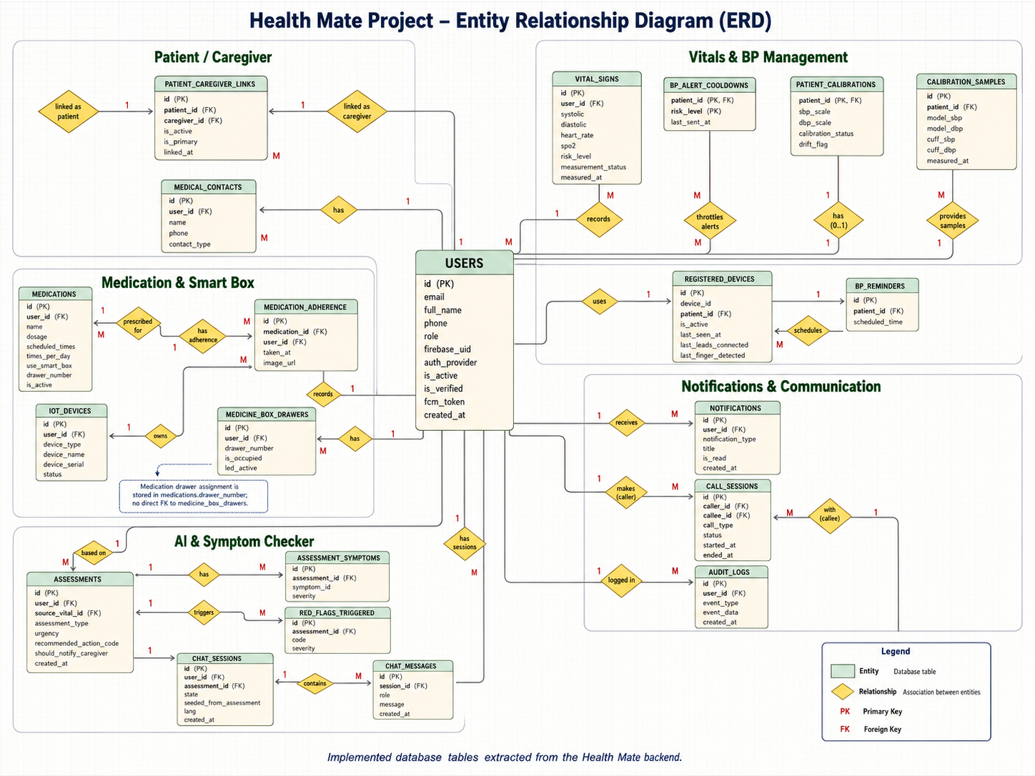
DATABASE DESIGN
21 Tables, One PostgreSQL System of Record
21
SQLAlchemy models
16+
Alembic migrations
1
many-to-many table
(patient ↔ caregiver)
A partial unique index enforces one active primary caregiver per patient — a real database-level rule, not just app logic.
Health Mate • Zagazig University — 2025/2026
10

Slide 12
TECHNOLOGY STACK
What It's Actually Built With
Layer | Technologies
Mobile App | Flutter, Riverpod, Dio + Retrofit, Hive, flutter_secure_storage, easy_localization
Backend API | FastAPI (Python), Socket.IO (WebRTC signaling), APScheduler (reminders/alarms)
Data & Infra | PostgreSQL 15 + asyncpg, Redis, Cloudinary, Firebase Cloud Messaging
AI / ML | TensorFlow / Keras (BP model), LightGBM (symptom triage), scikit-learn baselines
IoT Firmware | ESP8266-12E (BP unit), ESP32 (smart medicine box), Arduino C++
Engineering | Docker Compose, Alembic migrations, 15 automated backend test suites
100%
Async
Type-safe
Open-source
containerized via Docker Compose
I/O throughout the FastAPI backend
Dart mobile codebase end to end
entire stack, no proprietary lock-in
Health Mate • Zagazig University — 2025/2026
11

Slide 13
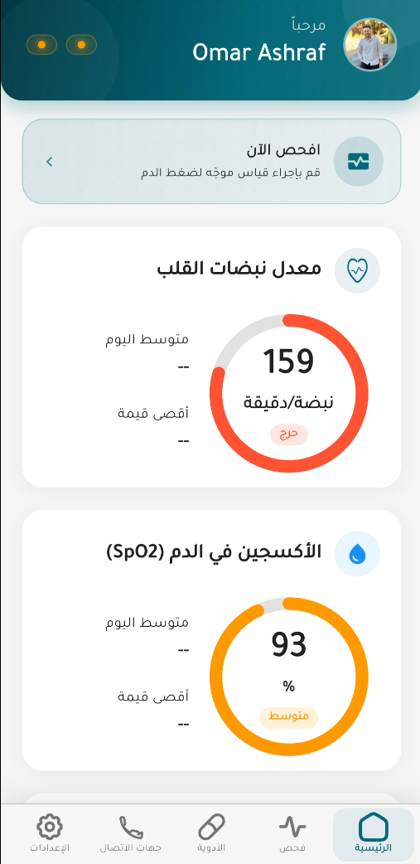
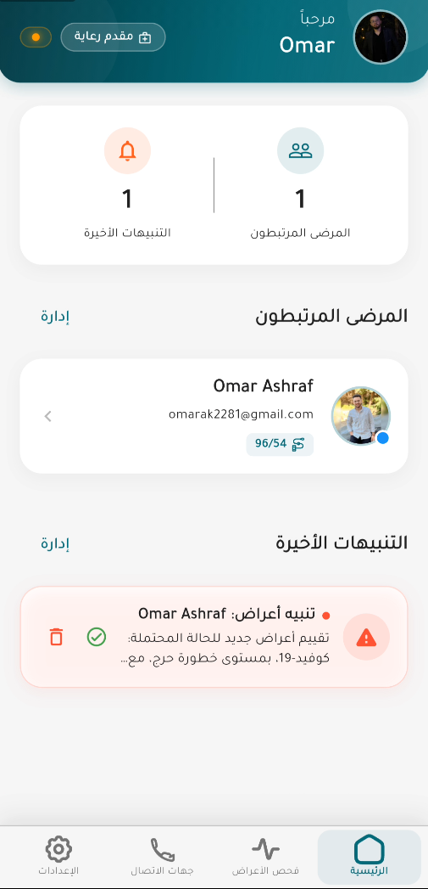
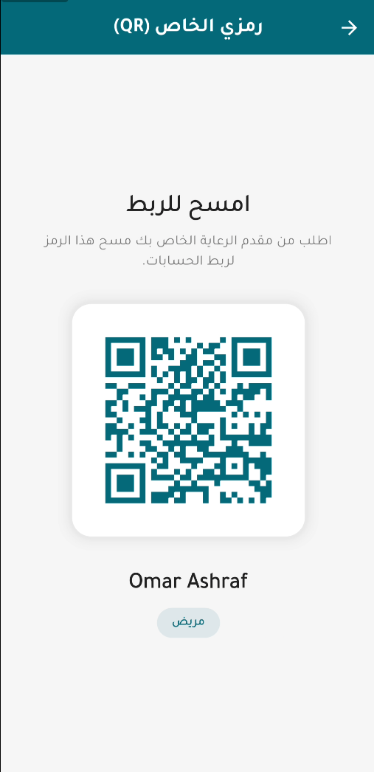
THE SHARED MOBILE APP
Same Data, Two Tailored Experiences
Patient Home
Caregiver Home
QR Patient ↔ Caregiver Linking
Health Mate • Zagazig University — 2025/2026
12

Slide 14
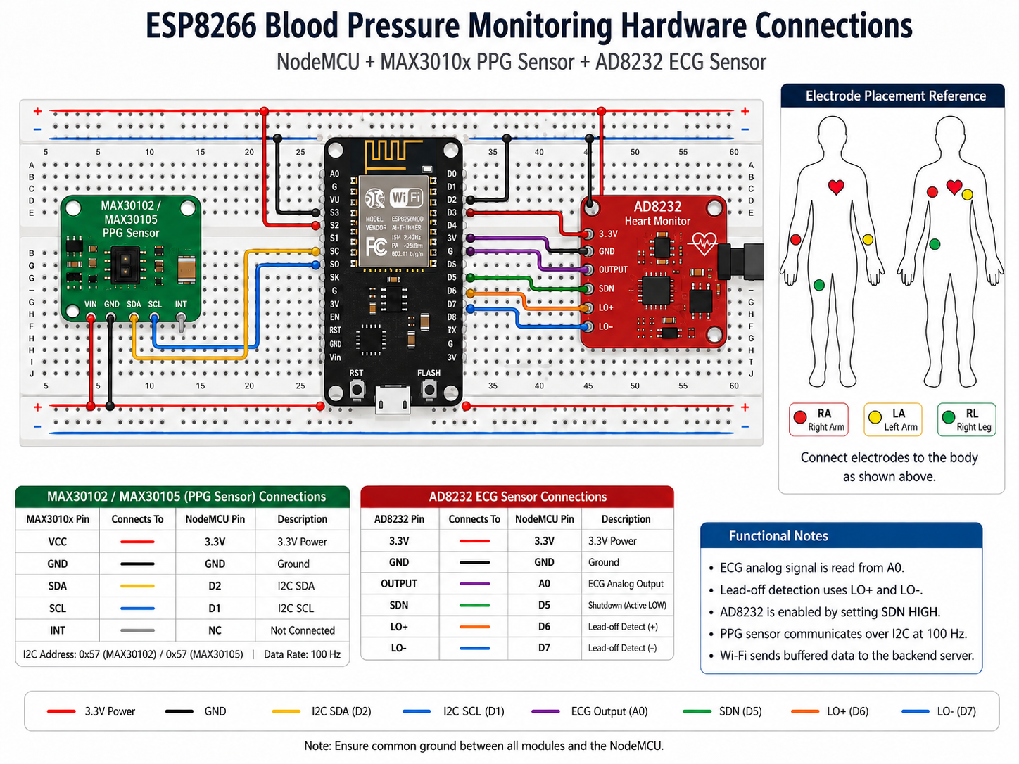
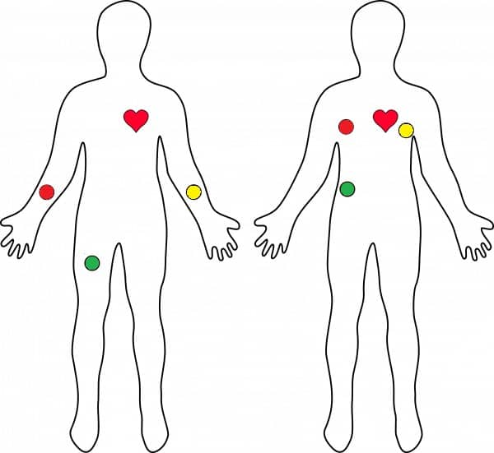
CUSTOM IOT HARDWARE
Blood-Pressure Sensing Unit
Health Mate • Zagazig University — 2025/2026
13

Slide 15
CUSTOM IOT HARDWARE
Firmware Built for Real Conditions, Not a Demo
What the firmware guarantees
Known Limitations
● ESP8266-12E + MAX30102 (PPG) + AD8232 (ECG) — no on-device model
● Samples both channels at a precise 100 Hz, unaveraged, matching the trained model exactly
● Gates on finger + lead contact before accepting any sample — discards a bad window rather than sending it
● Retries uploads with exponential backoff; a 10-second heartbeat keeps device status current
● The device authentication token shipped in this firmware is a hardcoded placeholder rather than a per-device provisioned secret — production deployment requires per-device credential issuance
● The hardware never runs the model, calibration, or risk logic — every clinical decision happens in the backend
● No accuracy numbers yet exist from real MAX30102/AD8232 recordings — every reported metric comes from the held-out test dataset
100 Hz
800
8 s
≤500 ms
sampling rate, unaveraged
samples per channel per window
capture window per reading
to discard a bad window
Health Mate • Zagazig University — 2025/2026
14

Slide 16
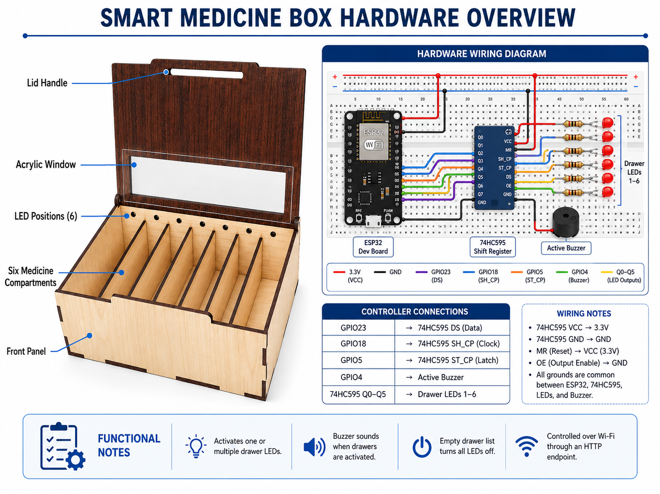
CUSTOM IOT HARDWARE
Smart Medicine Box: Indicator, Not Dispenser
No motor, servo, or locking mechanism exists in the firmware — the box indicates the correct drawer via LED, and the patient opens it by hand.
● ESP32 + 74HC595 shift register driving up to 6 drawer LEDs, plus a buzzer
● The LED lights the correct drawer; the patient still opens it by hand
● Fail-soft: an unreachable box never blocks the phone notification for the same reminder
● Adherence is logged from the patient tapping “taken” in the app — not from any drawer-open sensor
● Still genuinely useful: it turns “time for a dose” into one unambiguous physical pointer
0
6
Fail-soft
motors or locks
max drawers supported
always
Health Mate • Zagazig University — 2025/2026
15

Slide 17
THE AI CORE
Two Purpose-Built Models,
Compared Fairly.
Not a single black box — two independent problems, each benchmarked against multiple baseline alternatives.
Cuffless Blood-Pressure Model
Symptom-Triage Model
650,000+ signal windows from a MIMIC-derived dataset • 10 models compared: 6 classical + 4 deep learning • Estimates SBP/DBP from 8s of PPG+ECG
232-dimensional structured feature vector • Severity, duration, age, vitals & risk factors — not bag-of-words • Backed by an escalate-only safety rule engine
The two models are otherwise independent — they connect at exactly one point: a high or critical BP reading can offer an optional symptom follow-up, feeding the same triage engine (shown ahead).
Health Mate • Zagazig University — 2025/2026
16

Slide 18
BLOOD-PRESSURE MODEL
Why Estimating BP Without a Cuff Is Hard
The Physiology
The Signal
The Catch
Pulse transit time — the delay between an ECG R-peak and the matching PPG pulse — shortens as arterial pressure rises. It's the classical basis for cuffless estimation.
An 8-second, 800-sample window of PPG + ECG at 100 Hz has to be turned into two numbers: systolic and diastolic pressure.
The PTT-to-pressure relationship is nonlinear and patient-dependent — a well-known hard problem in biomedical signal processing, easy to overfit to one dataset.
Health Mate • Zagazig University — 2025/2026
17

Slide 19
BLOOD-PRESSURE MODEL — METHODOLOGY
A Rigorous, Record-Level Fair Comparison
653,015
1,631
10
21
total signal windows
held-out patient records
models trained & compared
hand-crafted waveform features
● Record-level split (train/val/test) — not window-level — so overlapping windows from the same patient never leak across splits
● Bandpass filter → z-score normalize → feature extraction: the exact same code runs in training and in the production backend
Health Mate • Zagazig University — 2025/2026
18

Slide 20
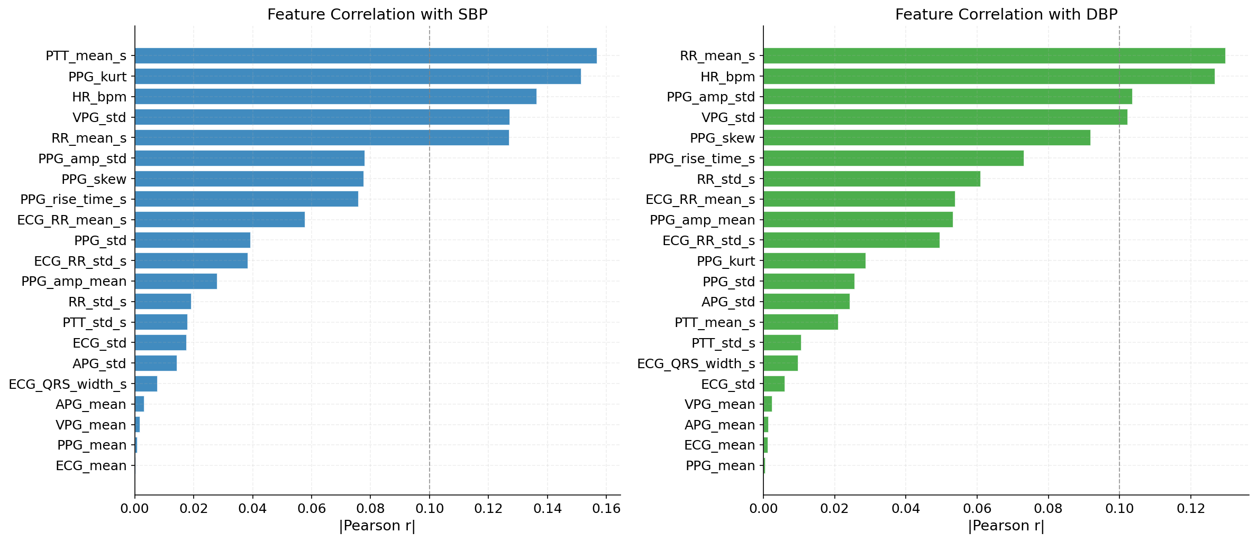
BLOOD-PRESSURE MODEL
21 Hand-Crafted Signal Features
Category | # | Examples
Heart rate & rhythm | 3 | HR (bpm), RR interval mean / std
Pulse transit time | 2 | PPG-peak minus preceding ECG R-peak
PPG waveform shape | 7 | Rise time, amplitude, mean/std/skew/kurtosis
PPG derivatives | 4 | 1st (velocity) & 2nd (acceleration) plethysmogram
ECG waveform | 5 | RR interval, QRS width, mean / std
Pulse transit time and heart rate carry the strongest linear correlation with SBP/DBP among the 21 features — but no single hand-crafted feature is strong enough alone, which is exactly why the raw waveform matters too.
Health Mate • Zagazig University — 2025/2026
19

Slide 21
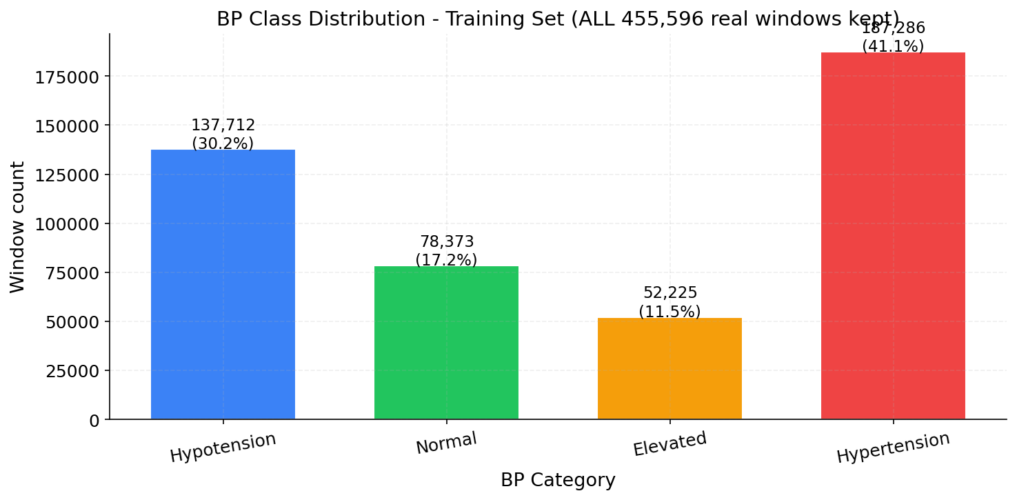
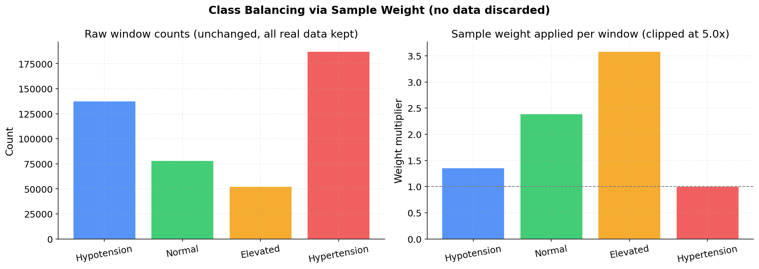
BLOOD-PRESSURE MODEL
Handling Imbalance Without Throwing Data Away
● Hypertension & Hypotension windows dominate the dataset; Normal & Elevated are comparatively rare
● A prior attempt downsampled to force balance — it discarded most of the data and made results worse (SBP MAE 11.47 vs. 9.13)
● Current approach: inverse-frequency sample weights (capped at 5×) — every real window is kept
● A modest 15% synthetic augmentation (noise, baseline wander, amplitude scaling) tops up the real data, not replaces it
Health Mate • Zagazig University — 2025/2026
20

Slide 22
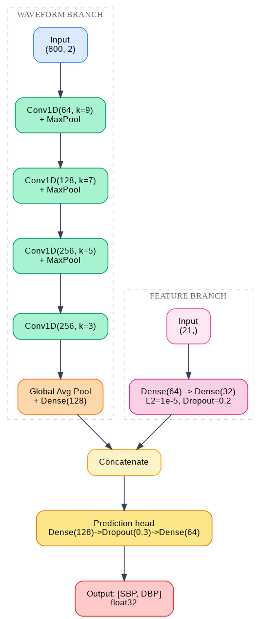
BLOOD-PRESSURE MODEL
Ten Models, One Clear Winner
Model | SBP MAE | DBP MAE | DBP BHS
1D-CNN (best) | 9.08 | 4.91 | B
TCN | 9.79 | 5.31 | B
TCN+BiLSTM+Attn (ours) | 10.17 | 5.63 | B
BiLSTM | 14.34 | 7.28 | C
XGBoost (best classical) | 14.71 | 7.45 | C
Ridge (weakest) | 18.03 | 8.59 | D
The team's own purpose-built architecture (TCN+BiLSTM+Attention) did not win — a plain 1D-CNN did. More complexity did not translate into better accuracy on this dataset.
Health Mate • Zagazig University — 2025/2026
21

Slide 23
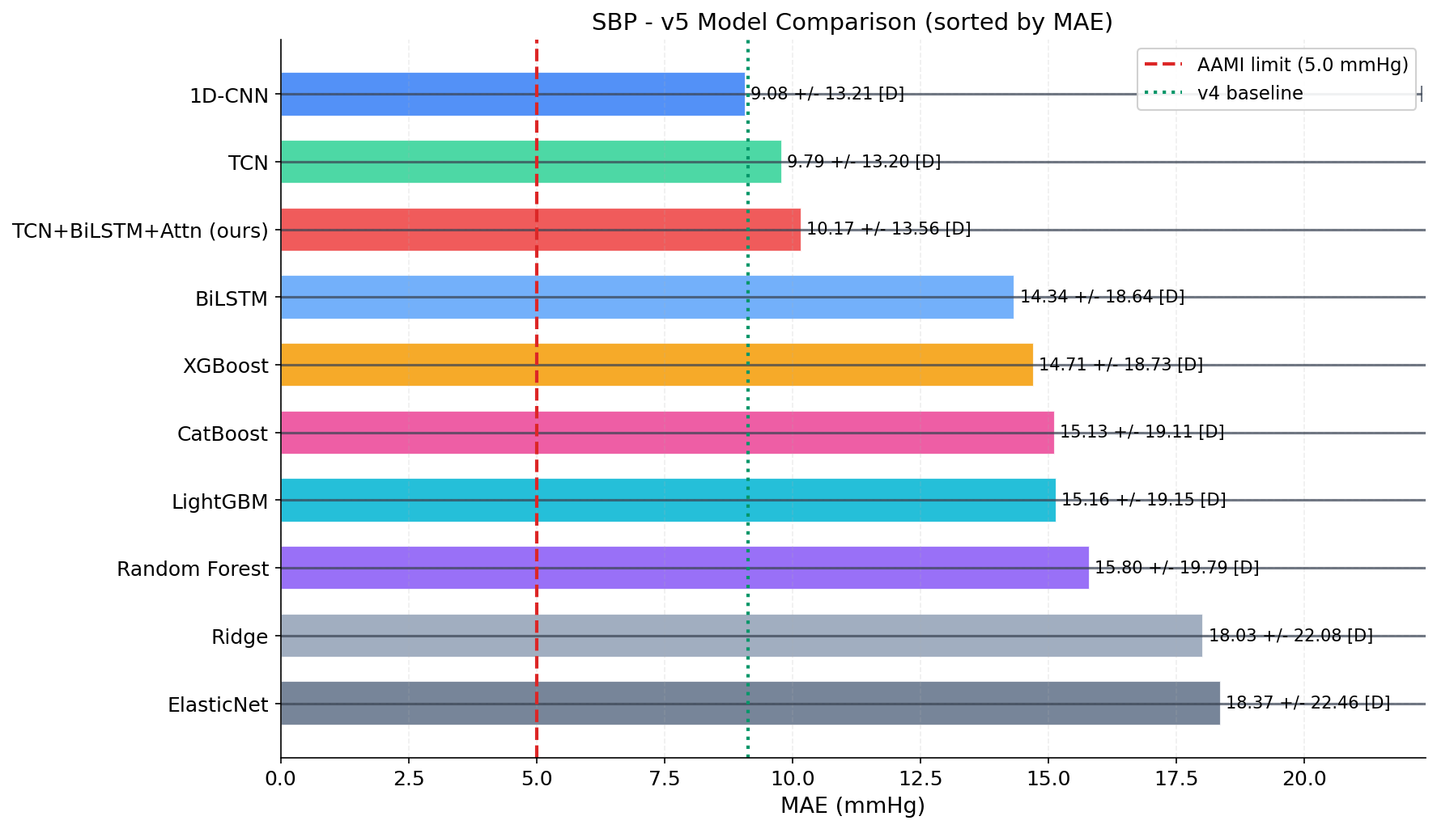
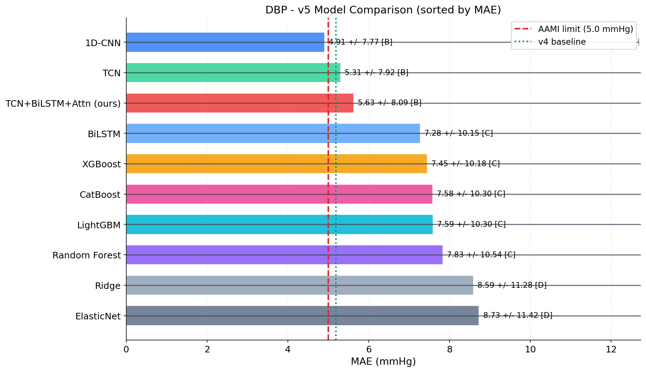
BLOOD-PRESSURE MODEL — RESULTS
Best ≠ Clinically Acceptable — Both Are True
9.08 mmHg
4.91 mmHg
80 ms
SBP MAE — Grade D, fails AAMI
DBP MAE — Grade B, PASSES AAMI
model inference time (of an 8s window)
Health Mate • Zagazig University — 2025/2026
22

Slide 24
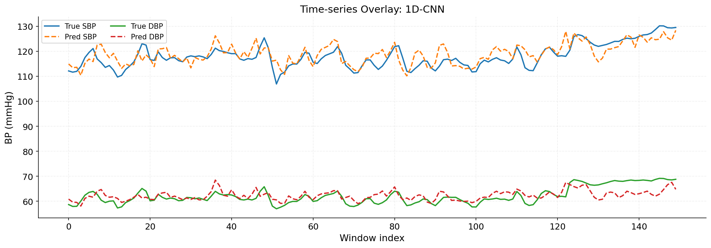
BLOOD-PRESSURE MODEL — CLINICAL EVALUATION
Predicted vs. Actual, Over Time
R² = 0.671
R² = 0.546
SBP — predicted tracks the true value over time
DBP — predicted tracks the true value over time
Health Mate • Zagazig University — 2025/2026
23

Slide 25
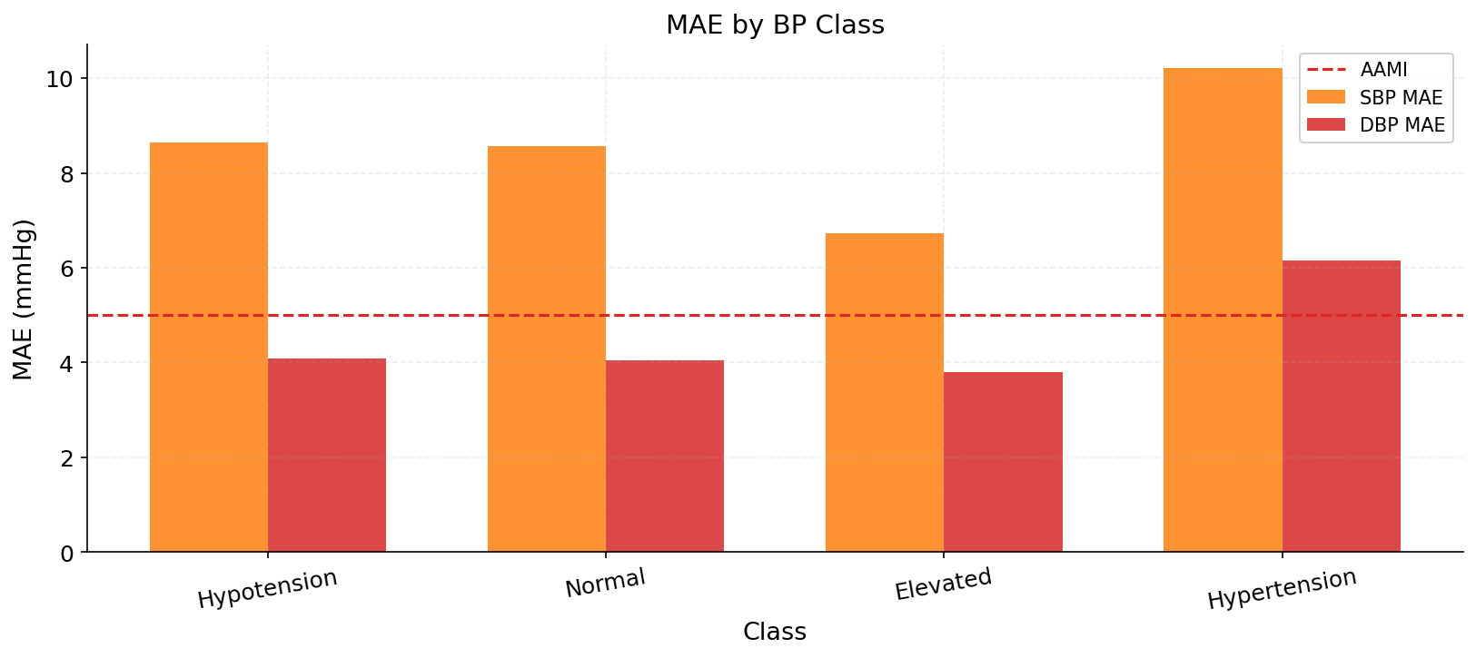
BLOOD-PRESSURE MODEL
What's Still Open
● Every model in the study fails AAMI for SBP — treated as an indicative trend, not a diagnostic-grade number
● Trained and evaluated on ICU arterial-line data (MIMIC) — not yet on an ambulatory, home-use population
● No accuracy numbers yet from real MAX30102/AD8232 hardware recordings
This is a validation gap, not an integration gap: the firmware, backend inference, and calibration pipeline are all wired together end to end — what's missing is a measured accuracy number from real sensor hardware on a live subject.
Health Mate • Zagazig University — 2025/2026
24

Slide 26
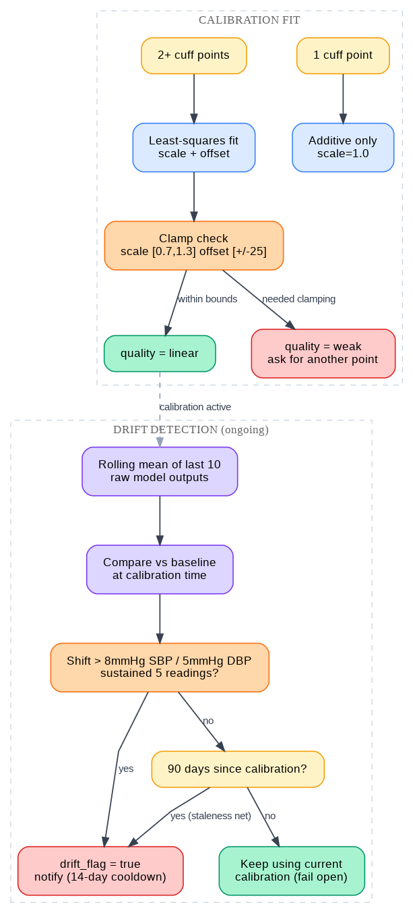
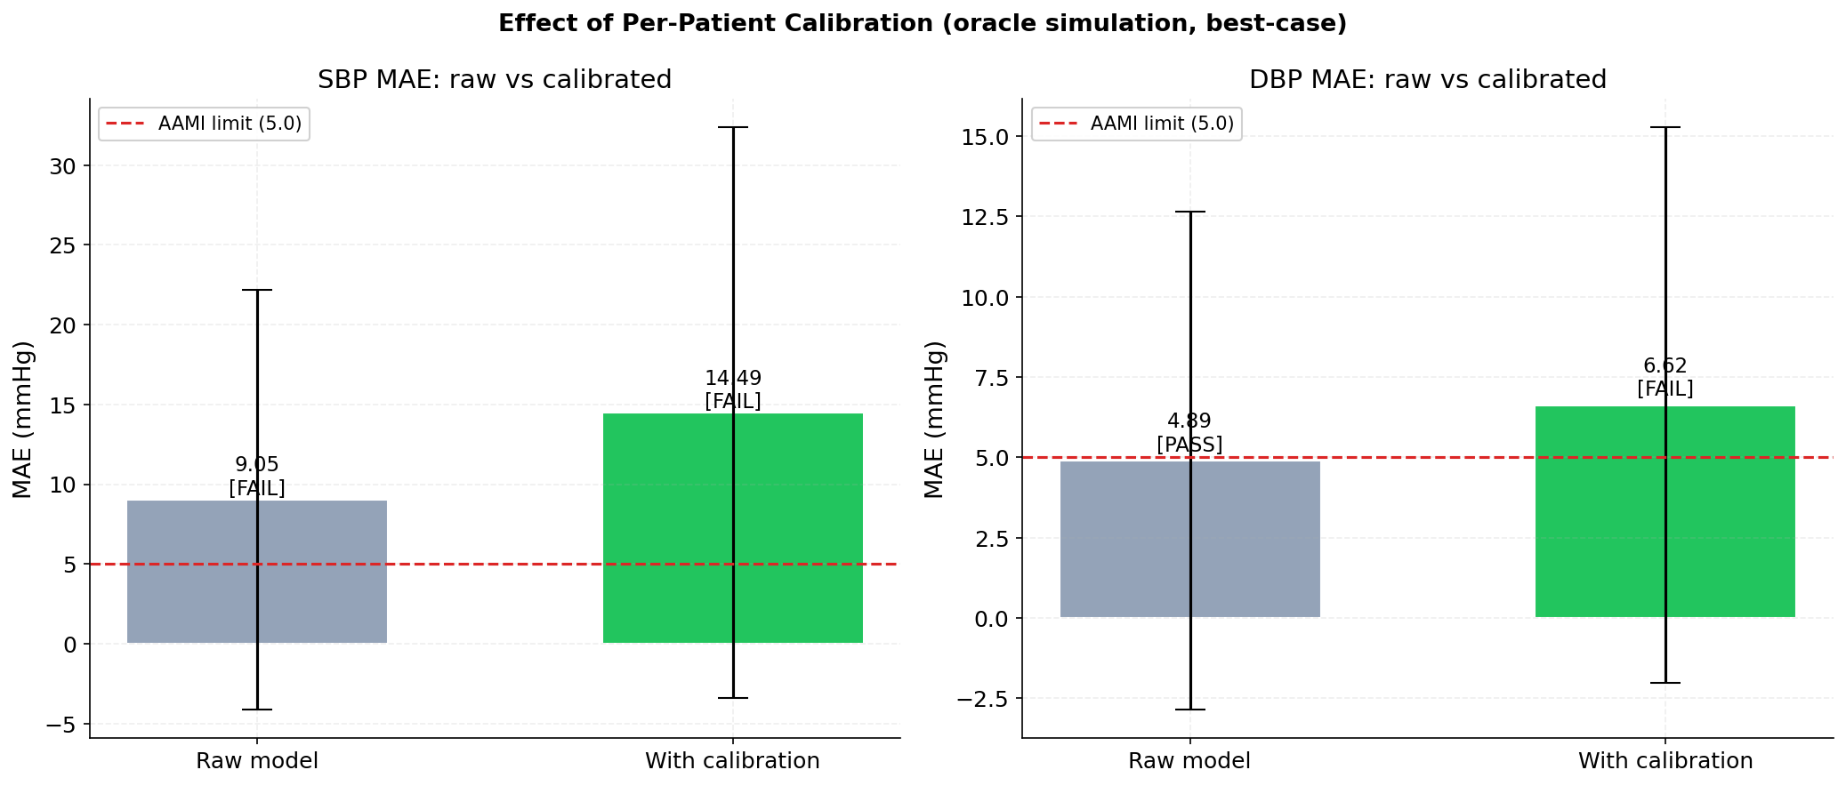
PER-PATIENT CALIBRATION
Adapting the Model to One Specific Person
● Fewer than 8 cuff-vs-model samples → robust median offset only
● 8 or more samples → upgrades to a full least-squares linear fit
● Scale clamped to [0.70, 1.30], offset to [−25, +25] mmHg — a bad fit can't run away
● A separate scheduled job detects drift (>8 mmHg SBP / >5 mmHg DBP shift) or staleness (>90 days), prompting recalibration
Health Mate • Zagazig University — 2025/2026
25

Slide 27
SYMPTOM-TRIAGE MODEL
Two Generations, Both Still Live Today
Aspect | v1 — Legacy | v2 — Structured (production)
Input | Free text or a flat symptom list | Severity, duration, age, vitals, conditions
Representation | TF-IDF vectorizer | 232-dimensional engineered feature vector
Model | Best of 5 classical candidates | LightGBM, 40 disease classes
Safety logic | None beyond the model's own output | Dedicated rule engine, escalate-only
A free-text / TF-IDF model has no slot to weigh “a mild headache for 2 days” differently from “a severe headache for 2 weeks.” v2 exists precisely to fix that — a genuinely different representation, not a tuning pass on v1. Both remain reachable in the app today.
v1
v2
+
Free text
TF-IDF vectorizer
→
Structured wizard
232-dim feature vector
→
Safety-first
rule engine (escalate-only)
Health Mate • Zagazig University — 2025/2026
26

Slide 28
SYMPTOM-TRIAGE MODEL
232 Dimensions Built for Nuance
Segment | Size | Content
Symptom presence | N | Multi-hot: 1 if the symptom was selected
Symptom severity | N | 0 if absent, else reported severity
Duration bucket | 4 | <1, 1–3, 4–7, >7 days (one-hot)
Age group | 3 | Child / adult / elderly (one-hot)
Risk factors | 5 | Hypertension, diabetes, asthma, hypothyroidism, CKD
Vitals | 4 | Normalized SBP/DBP/HR + a vitals-present flag
Synthetic, on purpose
● 9,840 train / 2,460 test cases generated from a symptom-taxonomy profile per disease
● Every case's urgency label comes from the real rule engine — the dataset can never disagree with production logic
● Confusable pairs (Cold/Flu/COVID-19, Hypertension/Migraine/Stroke) were specifically targeted
9,840
2,460
40
training cases
held-out test cases
disease classes covered end to end
Health Mate • Zagazig University — 2025/2026
27

Slide 29
SYMPTOM-TRIAGE MODEL — RESULTS
Strong Overall, With Room to Improve
85.8%
95.5%
0
40
top-1 accuracy
top-3 accuracy
cross-confusion in targeted disease pairs
disease classes
Weakest classes (top-1 accuracy) | Score
Myocarditis | 0.350
Hypertrophic cardiomyopathy | 0.400
Coronary artery disease | 0.517
Congestive heart failure | 0.600
Ventricular tachycardia | 0.650
● Almost every weak class is a cardiac subtype — exactly the specialty this project is built around
● Logistic Regression (0.870) and Random Forest (0.866) both score higher than the deployed LightGBM (0.858) on the identical dataset
Health Mate • Zagazig University — 2025/2026
28

Slide 30
THE SAFETY NET
A Rule Engine That Can Only Escalate — Never Suppress
1. Red Flags
2. Vitals Floor
3. Urgency Level
4. Caregiver Alert
Certain symptoms (e.g. syncope) trigger regardless of the ML model's own confidence
SBP/DBP/SpO2 thresholds set an urgency floor, shared with the BP-alerting feature
Critical / High / Moderate / Low — combining red flags, vitals, and the model
High or Critical urgency can trigger an immediate caregiver notification
→
→
→
The ML model's prediction is never allowed to override a rule-engine red flag downward — a hard, explicit design rule enforced in code, not a soft guideline.
WHERE THE TWO AI MODELS ACTUALLY CONNECT
High / Critical
BP reading
→
Patient offered a
quick symptom check
→
Feeds the same
urgency engine
Health Mate • Zagazig University — 2025/2026
29

Slide 31
THE PROJECT'S BIGGEST LESSON
Architectural complexity
must earn its place.
It does not, by default, beat a simple baseline that is actually run — the same pattern appeared independently in both AI systems built for this project.
Blood Pressure
Symptom Triage
A plain 1D-CNN beat the team's own TCN + BiLSTM + Attention model, purpose-built for this exact task.
SBP MAE: 9.08 (1D-CNN) vs. 10.17 (ours)
Logistic Regression outscored the LightGBM model actually chosen for production, on the identical dataset.
Accuracy: 0.870 (LogReg) vs. 0.858 (LightGBM)
Health Mate • Zagazig University — 2025/2026
30

Slide 32
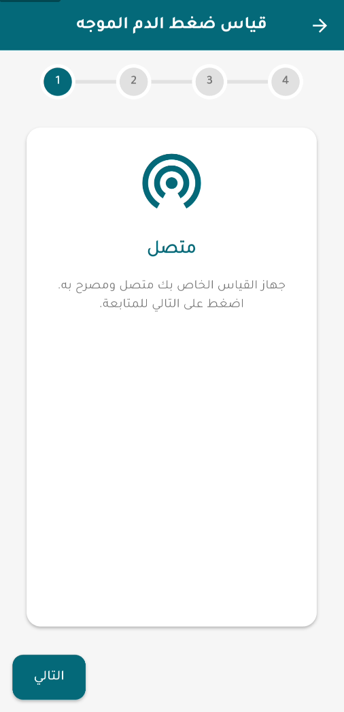
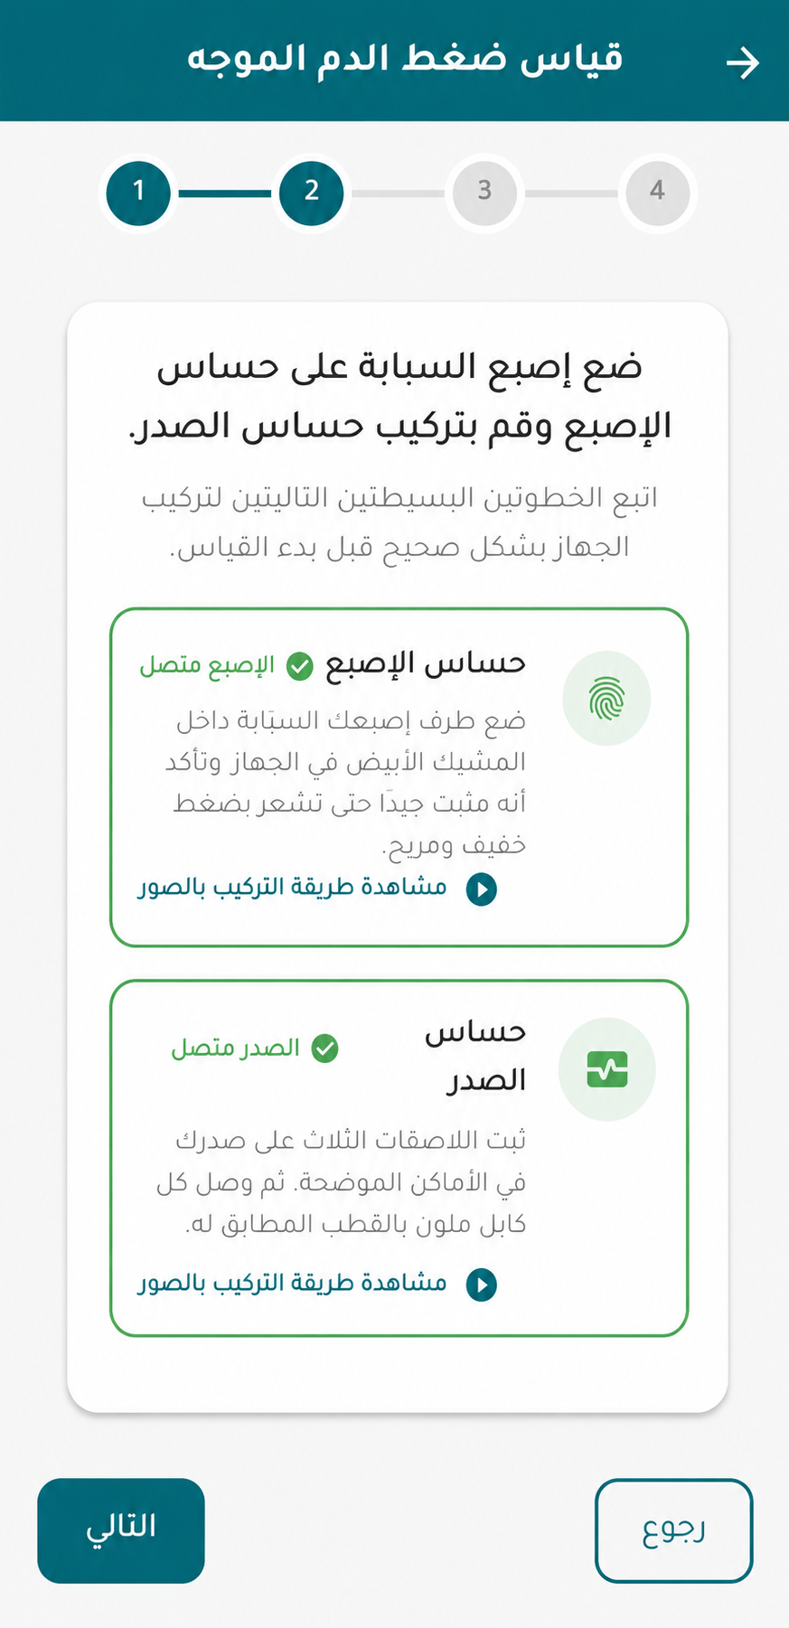
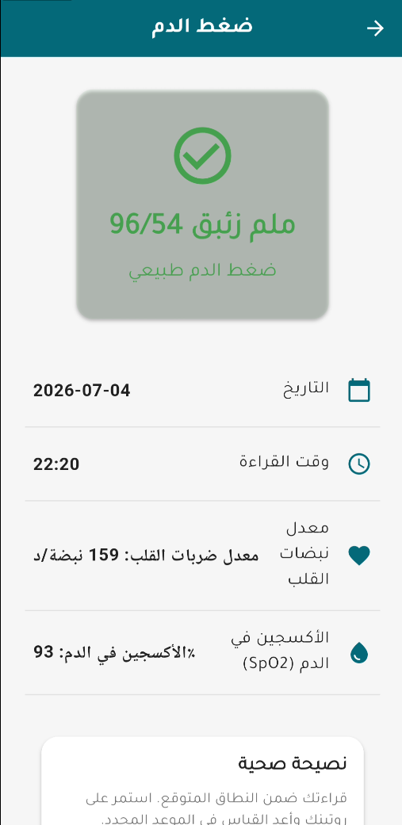
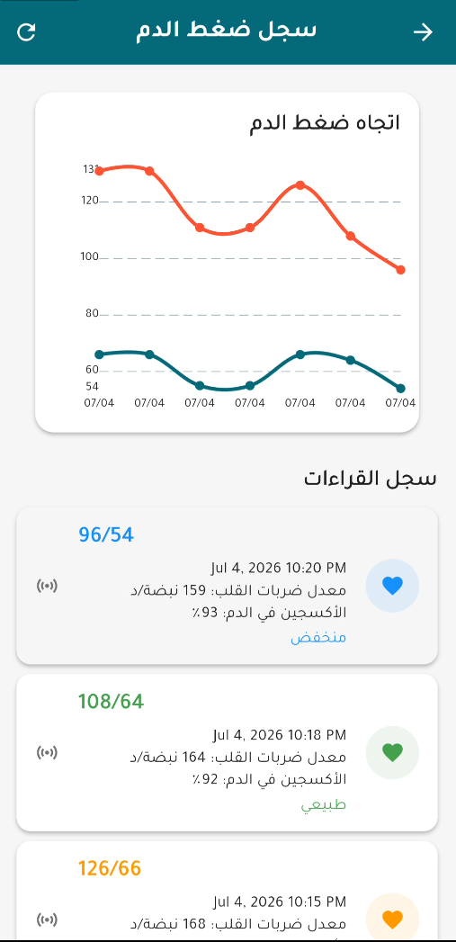
THE EXPERIENCE
Guided Blood-Pressure Measurement, Step by Step
1. Setup — live sensor status
2. Measuring — 8s capture
3. Result — risk tier shown
4. History — trend, not a snapshot
Health Mate • Zagazig University — 2025/2026
31

Slide 33
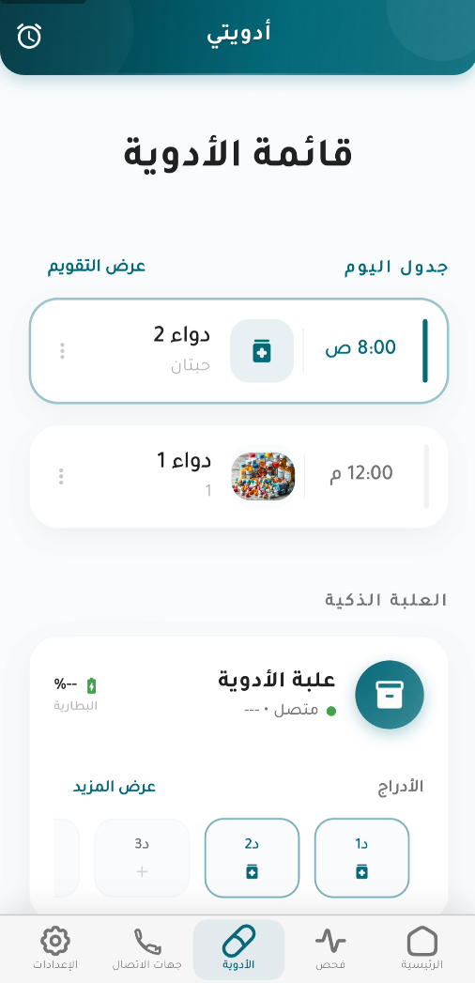
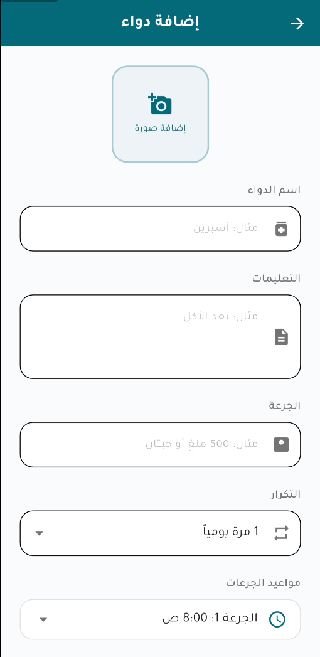
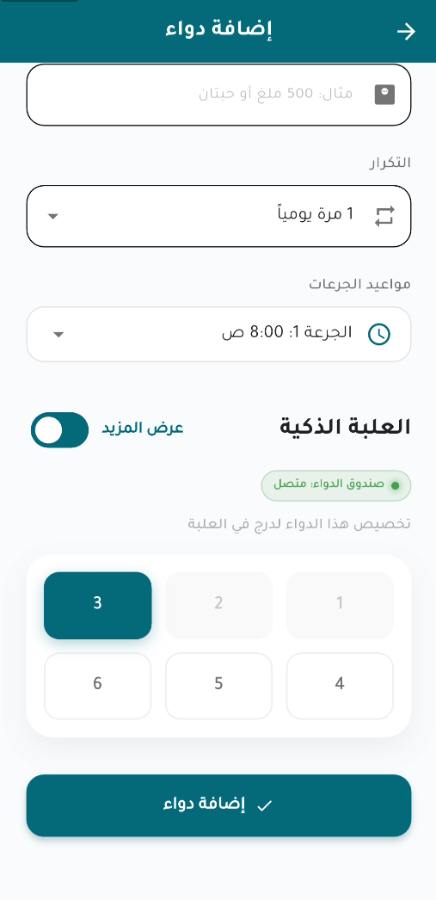
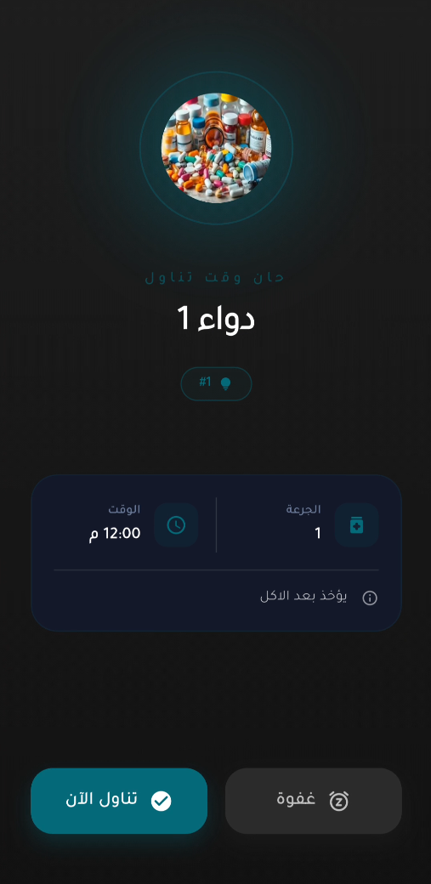
THE EXPERIENCE
Medication Management & the Smart Box
1. Medication list
2. Add / edit a medicine
3. Assign a smart-box drawer
4. Full-screen dose alarm
Health Mate • Zagazig University — 2025/2026
32

Slide 34
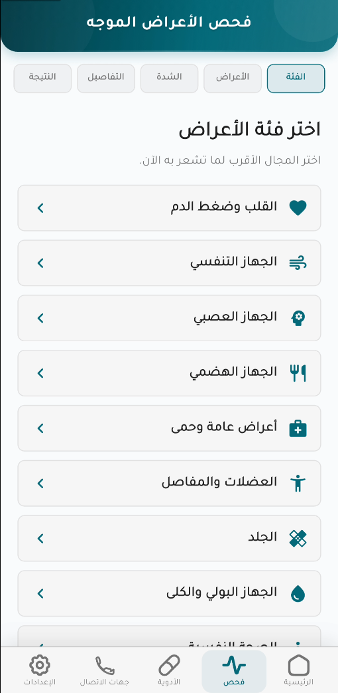
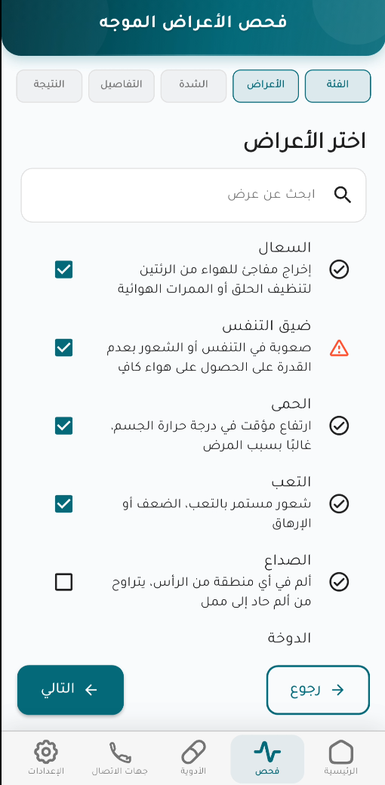
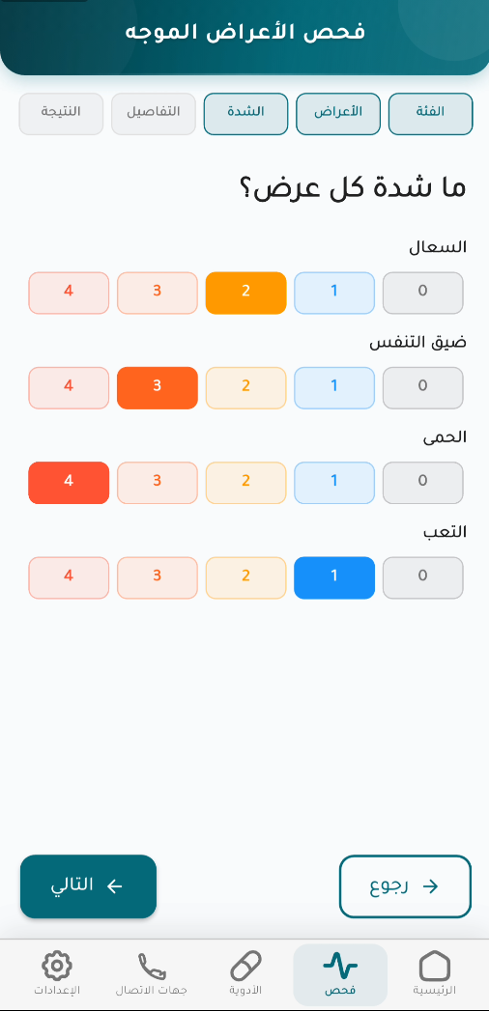
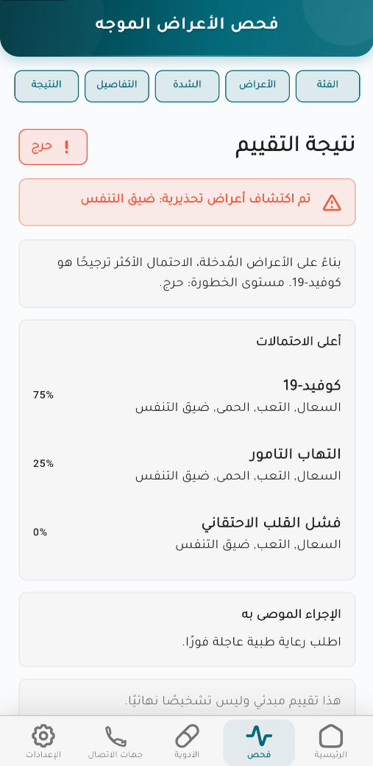
THE EXPERIENCE
The Structured Symptom-Checker Wizard
1. Category
2. Symptoms
3. Severity
4. Result & urgency
Health Mate • Zagazig University — 2025/2026
33

Slide 35
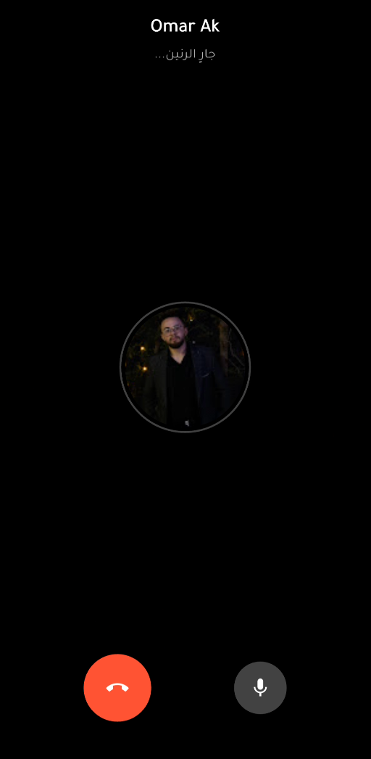
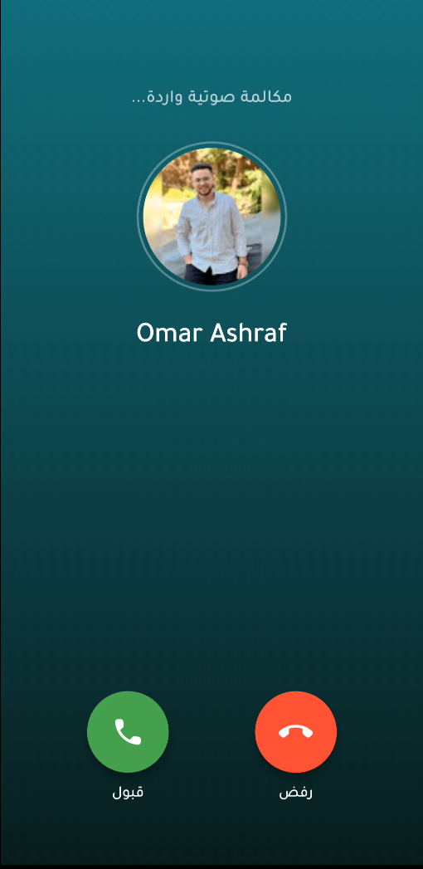
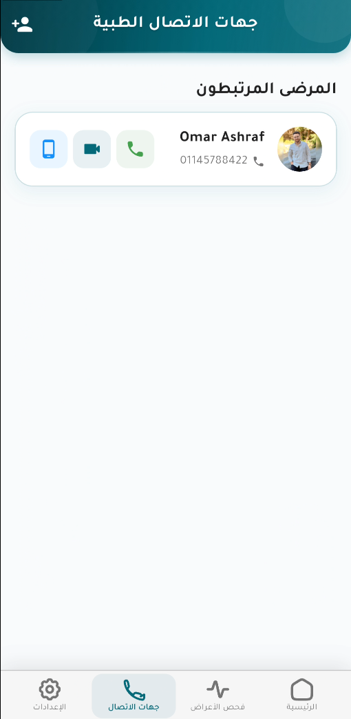
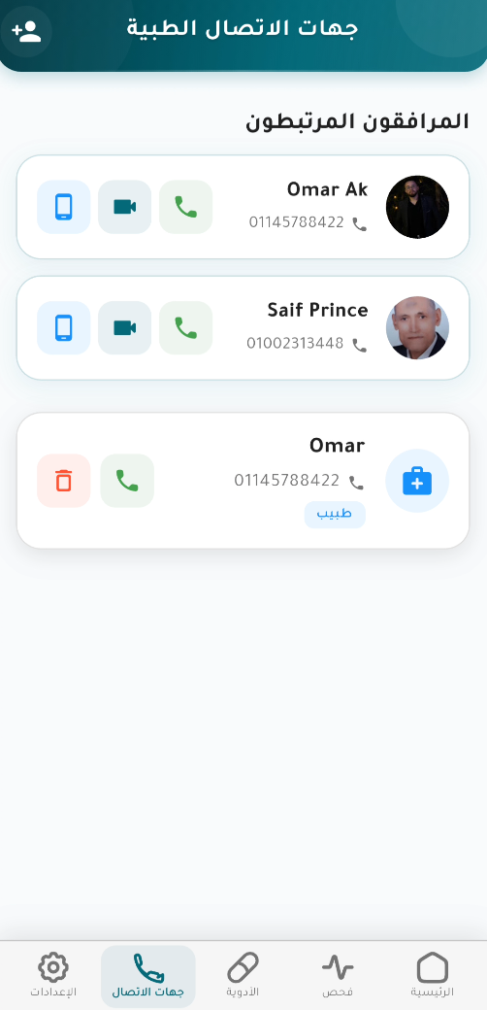
THE EXPERIENCE
Emergency Calling, Built In
Outgoing call
Incoming call
Active call
Emergency call action
Health Mate • Zagazig University — 2025/2026
34

Slide 36
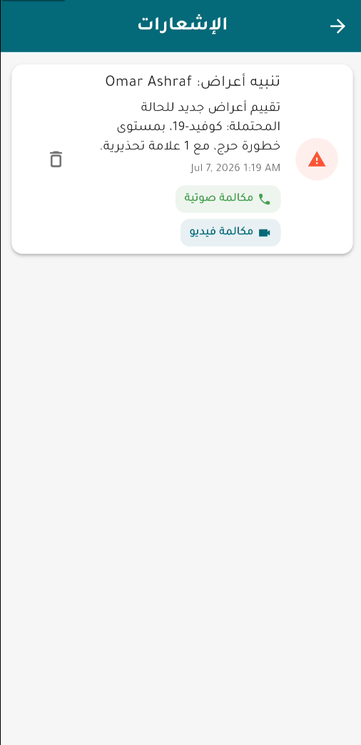
THE EXPERIENCE
The Notifications Inbox
Every alert, in one place
How Alerts Are Delivered
● Medication reminders and confirmations
● BP risk-tier alerts sent to a linked caregiver
● Calibration drift / staleness prompts
● Symptom-checker urgency notifications
● Read / unread state, oldest to newest
● Firebase Cloud Messaging push, plus a persistent in-app inbox
● Caregiver BP alerts respect a cooldown — 15 min for critical, 30 min for high — so one event never floods them
● Read / unread state persists per user across devices
Health Mate • Zagazig University — 2025/2026
35

Slide 37
BUILT FOR EVERYONE
Bilingual and Offline-First, Not as an Afterthought
613 / 614
100%
Hive
English / Arabic translation keys — near 1:1 parity
of reminders & alerts localized, not just static text
offline cache for last-known BP reading & history
● Full right-to-left layout for Arabic — a first-class concern in the codebase, implemented at the translation-key level
● Risk levels (Normal/Low/Moderate/High/Critical) are computed once in the backend as plain strings — the UI decides how to translate and display them, never the reverse
● Reminders keep firing locally without connectivity; the last known BP reading and history stay visible offline
English → left to right
العربية ← right to left
Home > Vitals > BP History
سجل ضغط الدم < المؤشرات < الرئيسية
Health Mate • Zagazig University — 2025/2026
36

Slide 38
IMPACT
Who We Built This For
Elderly Hypertension Patients
Any Long-Term Hypertension Patient
Memory-Impaired Patients
Large, simple UI and a guided sensor flow that removes every step they could get wrong, in their own language.
Continuous history instead of clinic snapshots, with automatic caregiver escalation on a critical reading.
The smart box turns “time for a dose” into one unambiguous physical pointer at a single drawer.
Health Mate • Zagazig University — 2025/2026
37

Slide 39
RELIABILITY
What Works, What's Left
What we hardened
What's Still Open
● Hardware fails soft — a missing model or unreachable device degrades, never crashes
● Dedicated unit tests on the newest, safety-relevant code: the rule engine, BP endpoints, calibration/drift
● Every clinical output is clamped to a physiologically plausible range before it reaches a screen
● Automated test scans for Arabic text-encoding corruption — a real, previously-seen bug class
● Session/token revocation isn't implemented — a standard stateless-JWT tradeoff
● The caregiver-linking QR code carries a plain, unencrypted user ID
● /iot/sensors/* always returns simulated data, regardless of mode — it should not be read as live telemetry
● Test coverage is concentrated on the newest BP/symptom-checker work, not spread evenly across the codebase
15
0
2
automated backend test suites
crashes from a missing model/device
known open gaps, disclosed above
Health Mate • Zagazig University — 2025/2026
38

Slide 40
RESULTS THAT MATTER
The Project at a Glance
4.91 mmHg
85.8% / 95.5%
21
2
DBP MAE — clears AAMI
symptom-triage top-1 / top-3
database tables, 1 backend of record
custom IoT devices, built from scratch
653K+
15
613/614
0
signal windows across 1,631 patients
automated backend test suites
EN/AR translation-key parity
cross-confusion in targeted disease pairs
Health Mate • Zagazig University — 2025/2026
39

Slide 41
KNOWN RISKS & LIMITATIONS
The Risk Register
Risk | Severity
SBP estimation fails the clinical AAMI standard | High
Symptom checker weakest on cardiac subtypes — the project's own focus | High
No server-side session / refresh-token revocation | Medium
Caregiver-linking QR code is an unencrypted user ID | Medium
BP model not yet validated against real sensor hardware | Medium
Severity reflects how directly each risk affects the core clinical claim or production-readiness — each maps to a mitigation on the roadmap that follows.
2
3
5
high-severity risks
medium-severity risks
tracked risks, each with a mitigation path
Health Mate • Zagazig University — 2025/2026
40

Slide 42
ROADMAP AHEAD
What Comes Next
Validate against reality
Harden for production
● Collect real MAX30102/AD8232 recordings against reference cuff readings
● Re-run the calibration study using samples genuinely separated in time, matching how the deployed service actually collects them
● Investigate why the attention-based model underperformed the simpler 1D-CNN
● Server-side session/refresh-token revocation
● Sign, encrypt or expire the caregiver-linking QR payload
● Clinical sign-off on the one still-unsigned BP threshold in the triage rules
● Unify the two symptom-checker generations behind one entry point
HOW WE GET THERE
Now
Next
Then
Goal
Working prototype
→
Real-hardware validation
→
Security hardening
→
Clinical sign-off
Health Mate • Zagazig University — 2025/2026
41

Slide 43
CONCLUSION
Health Mate, in One Slide
A working, end-to-end remote-monitoring system spanning custom sensor hardware, two independently trained AI models, and a backend that centralizes every clinical decision — built and evaluated end-to-end, from firmware to trained models.
4.91 mmHg
85.8% / 95.5%
21 tables / 4 layers
DBP MAE — clears AAMI
symptom-triage accuracy
one coherent, working system
Every number in this deck is measured directly from the code and data, and every limitation is disclosed deliberately.
Health Mate • Zagazig University — 2025/2026
42

Slide 44
Thank You
Questions & Discussion
HEALTH MATE TEAM
Omar Ashraf Mohamed Kamal • Seif EL-Deen Amr Mohamed
Rofida Mohamed Ahmed Ibrahim • Farida Abdelazim Gharib Mohamed
Supervised by Ass. Prof. Dr. Amr Abdellatif & Eng. Mohamed Ameen

