Slide 1



Health Mate
An AI-assisted remote monitoring system for chronic cardiovascular care
Graduation Project Defense - AI and Data Science Program
Omar Ashraf Mohamed Kamal (Team Leader) - Seif EL-Deen Amr Mohamed
Rofida Mohamed Ahmed Ibrahim - Farida Abdelazim Gharib Mohamed
Supervised by ASS. Prof. Dr. Amr Abdellatif and Eng. Mohamed Ameen

Slide 2
OPENING
The project closes the gap between a reading and a response.
Health Mate is not a single-feature app; it is an end-to-end loop for patients and caregivers.
Measure
Understand
Act
8-second PPG + ECG capture, or manual cuff reading
AI estimation, rule-based urgency, calibration and drift checks
Caregiver alerts, medication alarms, and emergency calling
By the end, the committee should believe this is a working remote-monitoring system with measurable AI results, real hardware integration, and honest boundaries.
Health Mate - Zagazig University - 2025/2026
2

Slide 3
PROBLEM
The danger is not only high blood pressure; it is delayed awareness.
A patient can miss the reading, misread the risk, or fail to reach help in time.
Patient side
Caregiver side
Design target
- cuff placement and logging are easy to skip
- daily routines fail under fatigue or memory loss
- a critical moment still depends on the patient noticing
- no live view unless the patient reports back
- no automatic escalation when risk crosses a line
- the family reacts after the fact
- reduce measurement friction
- make the risk visible immediately
- give the caregiver a direct action path
The story of the system is a safety loop, not a feature checklist.
Health Mate - Zagazig University - 2025/2026
3

Slide 4
MARKET
Existing solutions solve pieces of the loop, not the whole loop.
Capability
Cuff + log
Wearables
Connected monitors
Clinical RPM
Health Mate
Cuffless AI sensing
No
No
No
No
Yes
Family caregiver alerts
No
Partial
Partial
Partial
Yes
Symptom + red-flag triage
No
No
No
Partial
Yes
Smart medication hardware
No
No
No
No
Yes
Emergency call path
No
No
No
No
Yes
Arabic + English parity
No
Partial
Partial
Partial
Yes
Positioning: Health Mate is a research prototype, not a cleared medical device. Its strength is integration depth and transparent evaluation.
Health Mate - Zagazig University - 2025/2026
4

Slide 5
SOLUTION
Health Mate is built as one closed safety loop.
The hardware collects; the backend decides; the app turns decisions into action.
FastAPI backend
validation, inference, calibration
BP sensing unit
AI + rule engine
ESP8266 + MAX30102 + AD8232
BP model + symptom triage
Core architectural rule: devices never make clinical decisions.
Smart box + calls
Flutter app
medication cues and escalation
patient and caregiver views
Health Mate - Zagazig University - 2025/2026
5

Slide 6
ARCHITECTURE
Backend decisions make safety traceable.
That choice makes safety logic traceable and testable.
IoT hardware
BP unit captures 800 samples; smart box indicates drawers
Backend API
FastAPI, Socket.IO, APScheduler, model services
Data and infra
PostgreSQL, Redis, Cloudinary, Firebase Messaging
Mobile app
Flutter, Riverpod, Dio, Hive, secure storage, localization
Two architectural styles coexist: service layer for most features; clean/hexagonal architecture for symptom checker v2.
Health Mate - Zagazig University - 2025/2026
6

Slide 7
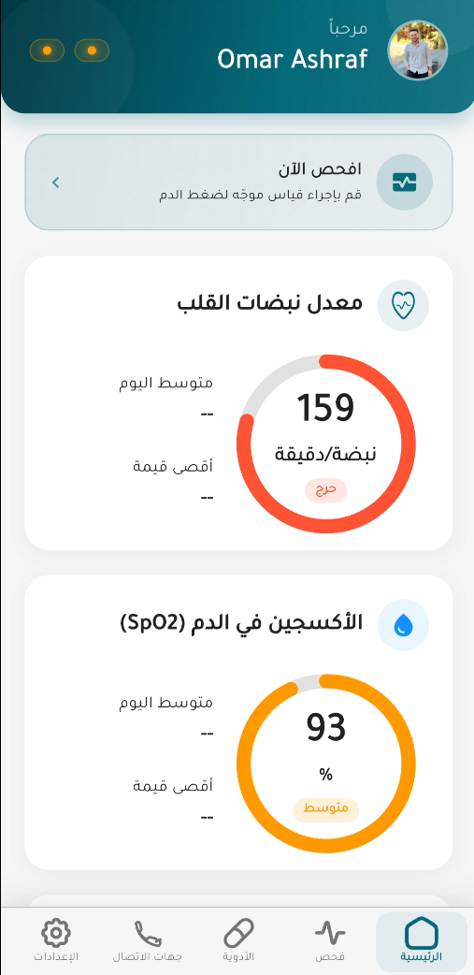
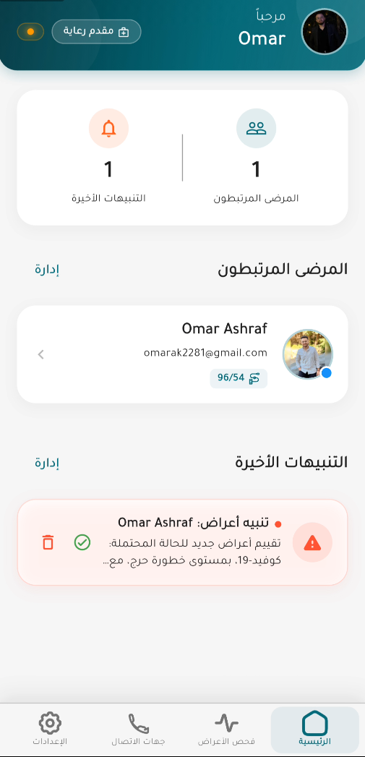
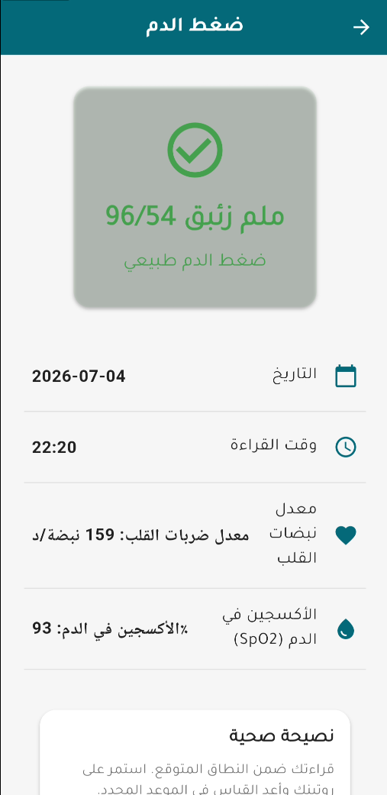
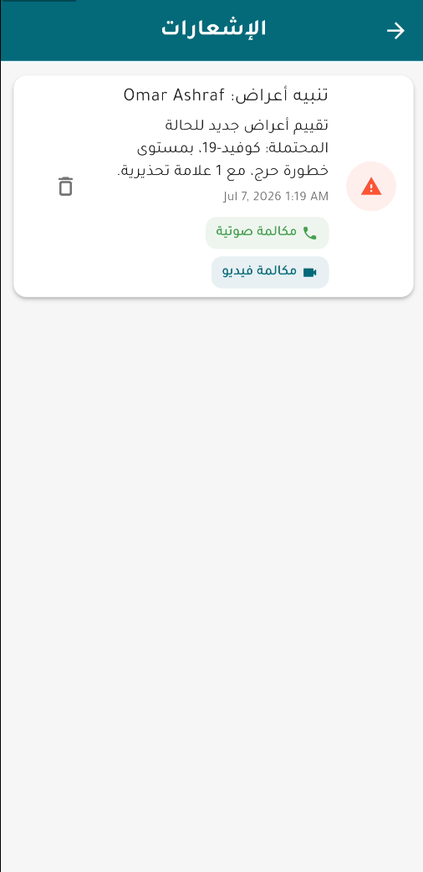
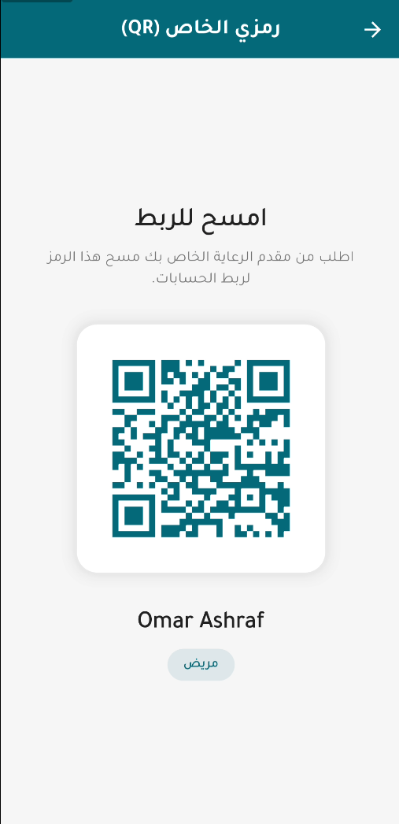
EXPERIENCE
The same app serves two people without duplicating the system.
Screens are Arabic/RTL-capable and backed by shared providers and repositories.
Patient
Caregiver
BP result
Alerts
Linking
One codebase, role-aware routing, localized reminders, and offline access to the last known vital history.
Health Mate - Zagazig University - 2025/2026
7

Slide 8
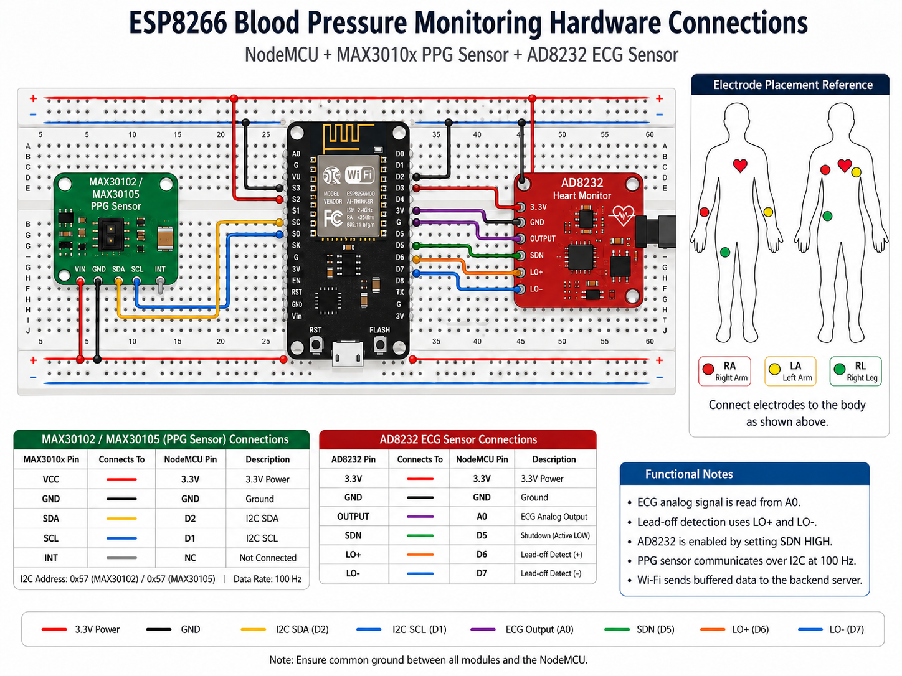
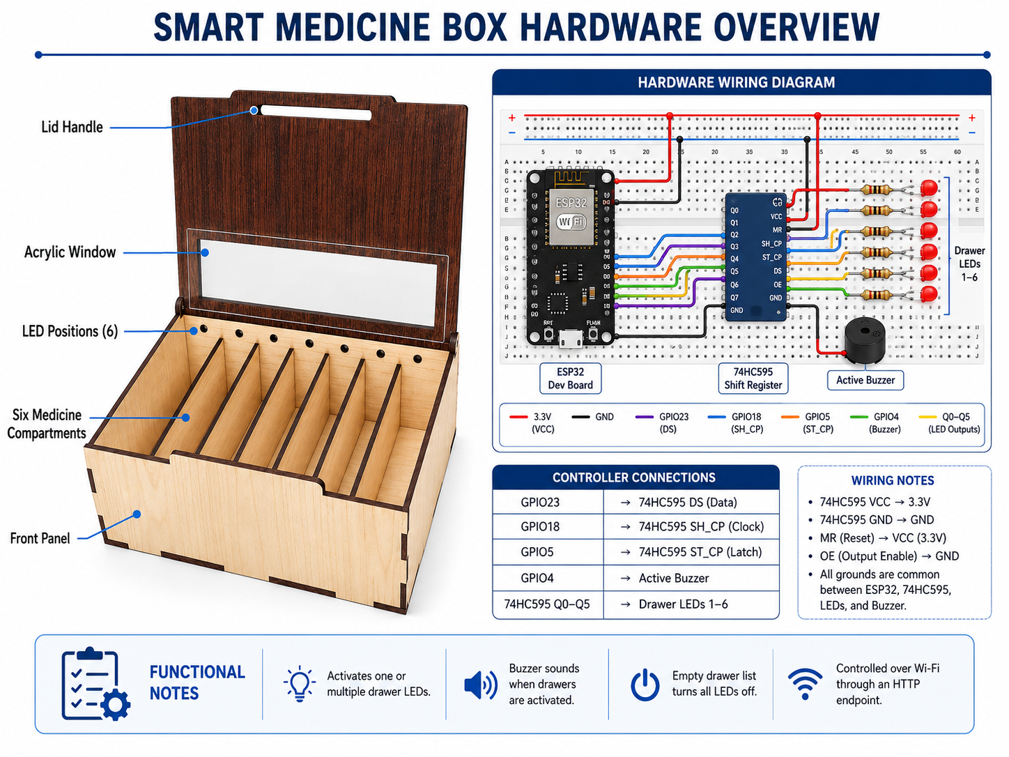
HARDWARE
The hardware is custom, but each device has a narrow responsibility.
That makes the prototype easier to reason about and safer to fail.
Blood-pressure sensing unit
Smart medicine box
- ESP8266-12E, MAX30102 PPG, AD8232 ECG
- 100 Hz sampling, exactly 800 samples per channel
- finger and lead-off gates reject bad windows
- ESP32 plus 74HC595, LEDs and buzzer
- indicator, not dispenser: patient opens drawer
- fail-soft: phone alarm still fires if box is offline
Honesty point: neither device contains the AI model; all clinical interpretation stays in the backend.
Health Mate - Zagazig University - 2025/2026
8

Slide 9
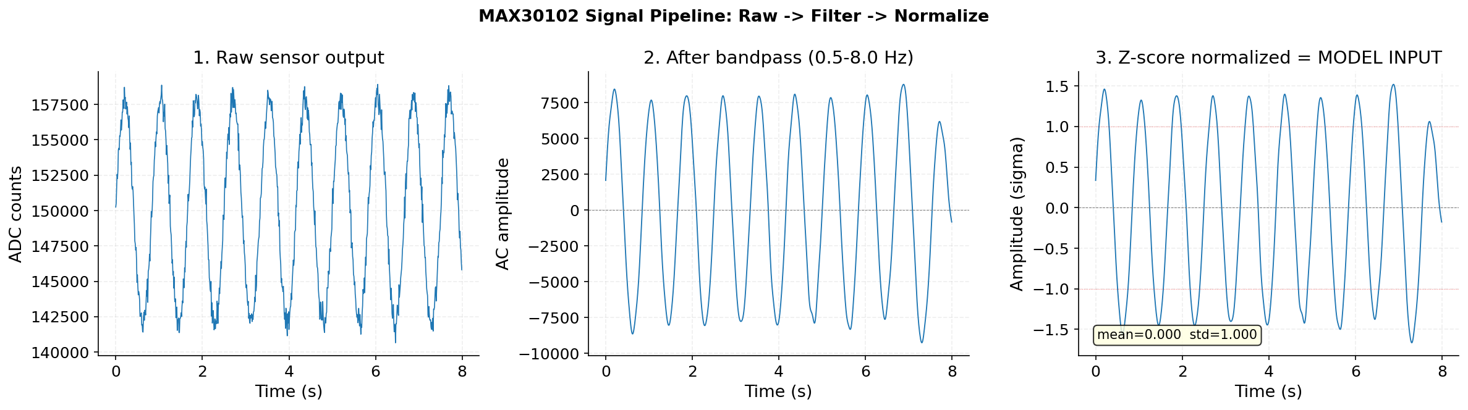
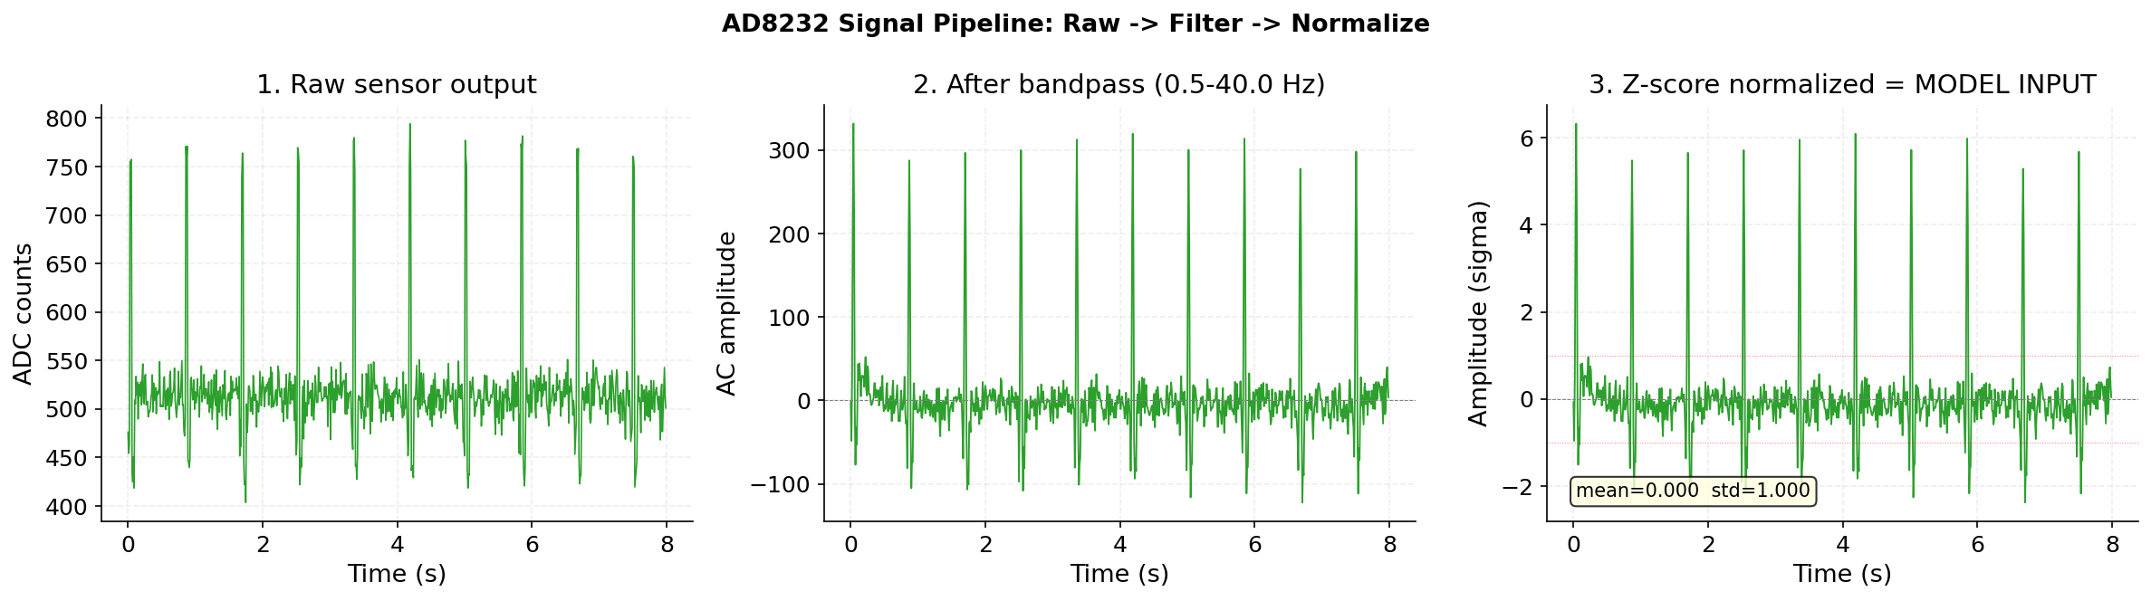
BP MODEL
The BP model was evaluated as a fair model-selection problem.
The dataset split and preprocessing choices are the credibility story.
653K+
1,631
10
21
PPG + ECG signal windows
held-out patient records
models compared
hand-crafted waveform features
Record-level split prevents leakage from overlapping windows of the same patient. Training and production share the same filtering, normalization, and feature extraction path.
Health Mate - Zagazig University - 2025/2026
9

Slide 10
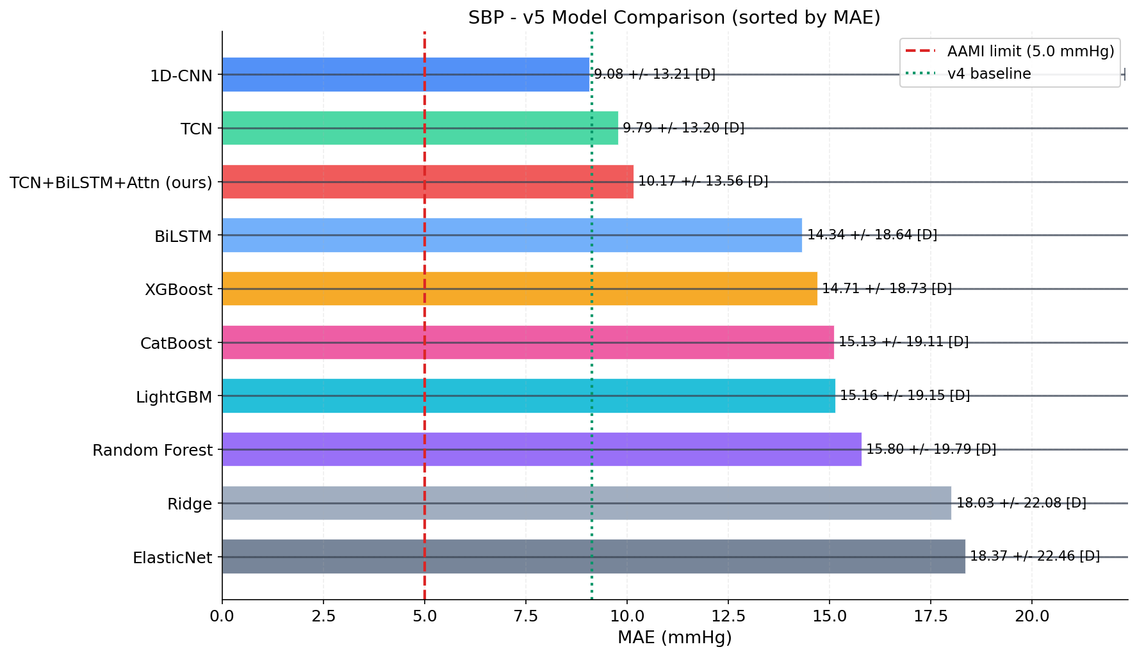
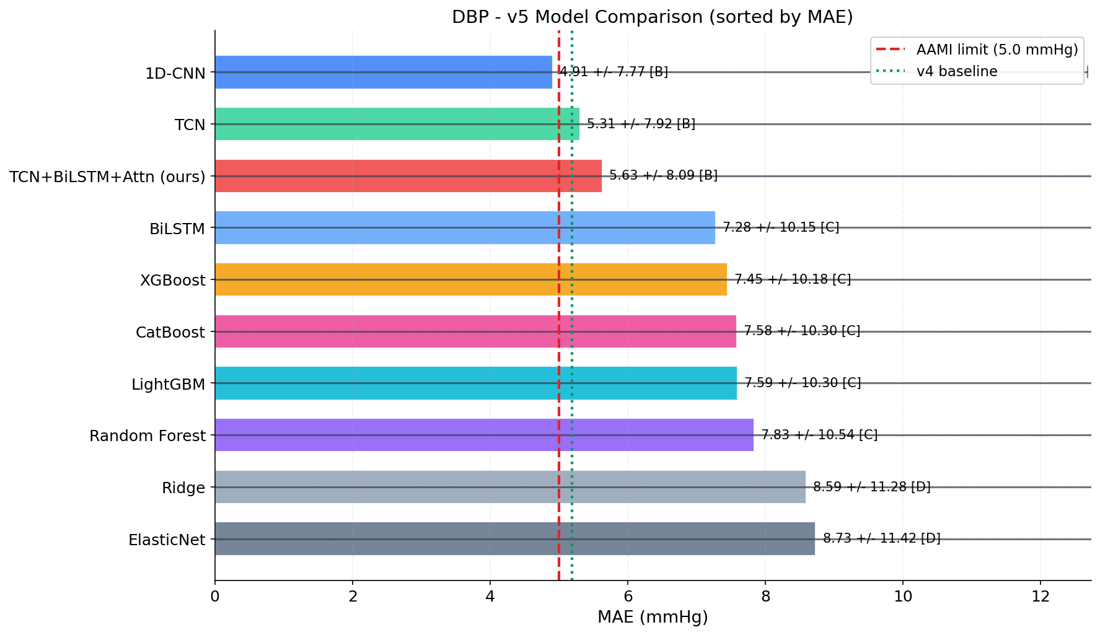
BP RESULTS
The strongest result is also the most honest one: the simplest deep model won.
More architecture did not automatically mean better accuracy.
Model
SBP MAE
DBP MAE
DBP BHS
Interpretation
1D-CNN
9.08
4.91
B
best overall
TCN
9.79
5.31
B
close but weaker
TCN+BiLSTM+Attn
10.17
5.63
B
our proposed model did not win
BiLSTM
14.34
7.28
C
weaker sequence baseline
XGBoost
14.71
7.45
C
best classical baseline
Committee-ready takeaway: the team ran the baseline, accepted the result, and deployed the model that actually performed best.
Health Mate - Zagazig University - 2025/2026
10

Slide 11
CLINICAL TRUTH
Best model and clinically acceptable model are different claims.
The deck says both out loud before the committee has to ask.
9.08
4.91
80 ms
SBP MAE - fails AAMI, BHS D
DBP MAE - passes AAMI, BHS B
model inference after an 8s window
How we present it safely
- SBP is a trend indicator until real-hardware validation closes the gap
- DBP clears the clinical accuracy bar in the current test set
- calibration, physiological clamping, and withheld states protect the app experience
Health Mate - Zagazig University - 2025/2026
11

Slide 12
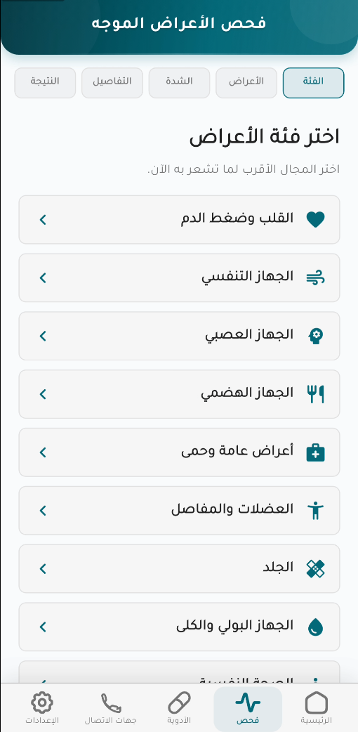
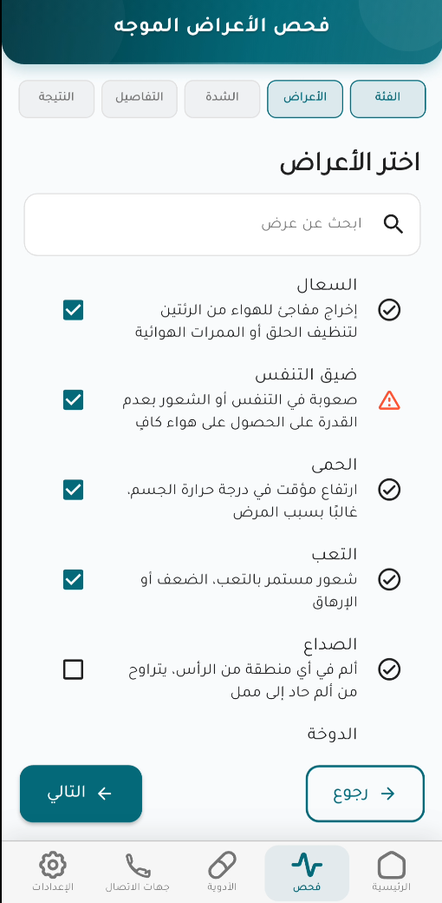
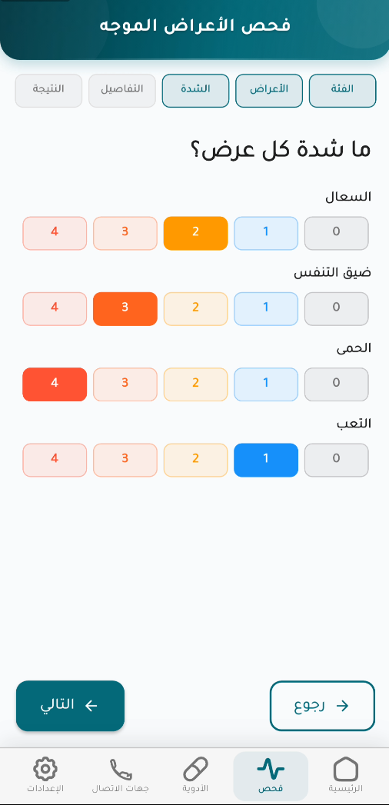
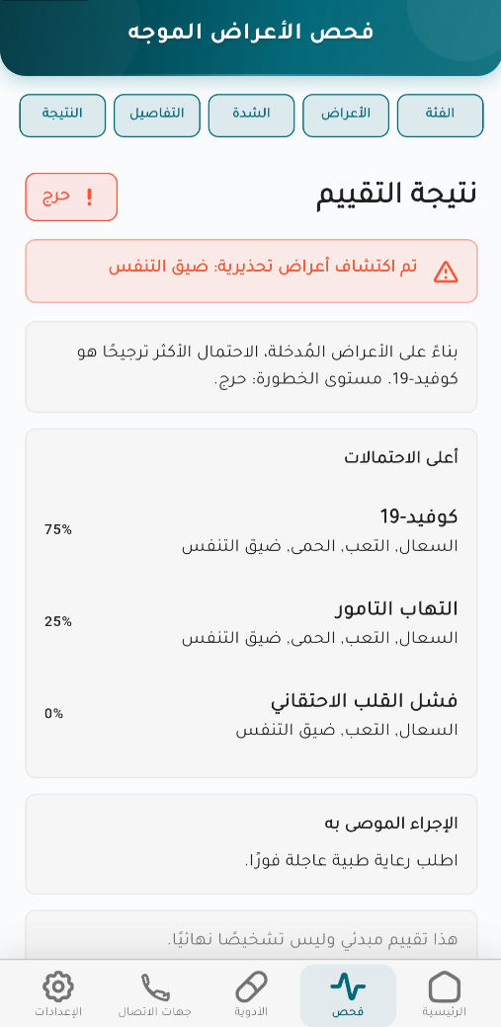
SYMPTOM TRIAGE
The symptom checker moves from text matching to structured triage.
Severity, duration, vitals, and risk factors become model input.
232
structured features
85.8%
top-1 accuracy
Category
Symptoms
Severity
Result
95.5%
top-3 accuracy
Training uses synthetic structured cases generated from disease profiles, so the next validation step is real patient assessment data.
Health Mate - Zagazig University - 2025/2026
12

Slide 13
SAFETY
The safety layer can escalate the model, but it cannot be talked down by it.
This is the core defense against overtrusting ML confidence.
1
2
3
4
Red flags
Vitals floor
ML prediction
Caregiver alert
symptoms like syncope trigger independently
BP, HR, SpO2 create a minimum urgency
top disease candidates and confidence
high or critical cases trigger escalation
Hard rule: ML may support triage, but rule-engine red flags set the floor.
Health Mate - Zagazig University - 2025/2026
13

Slide 14
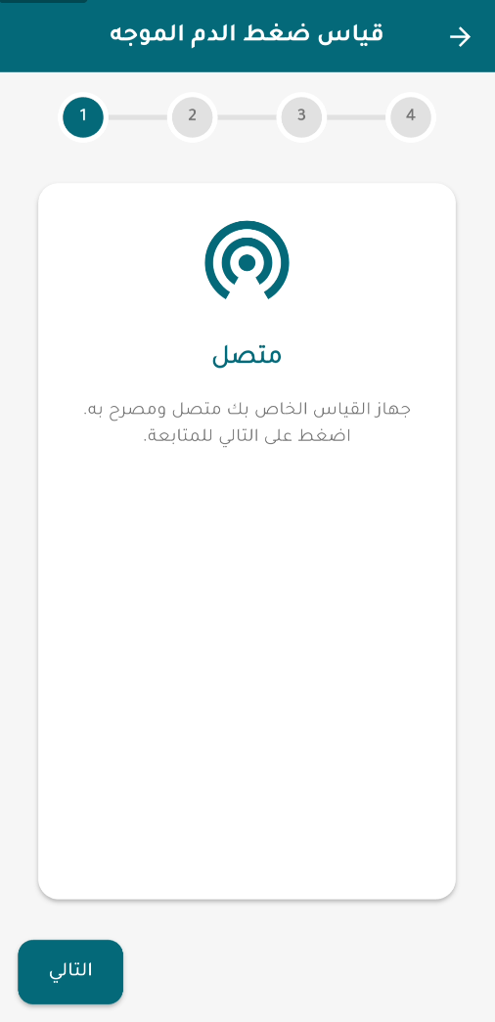
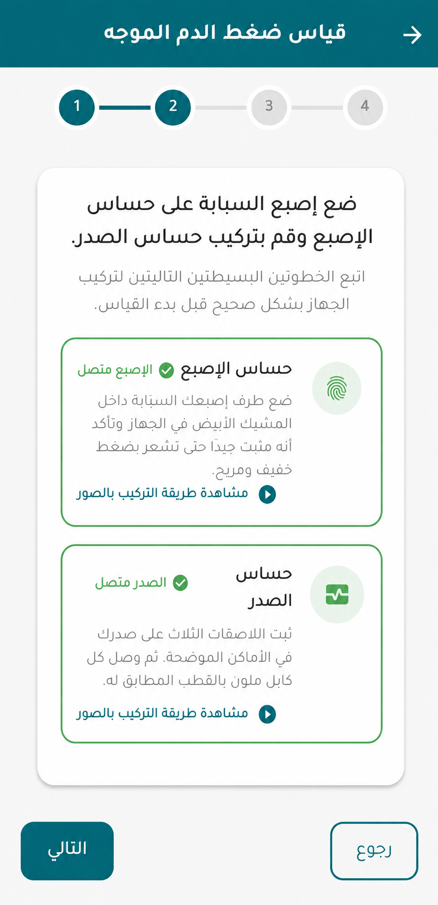
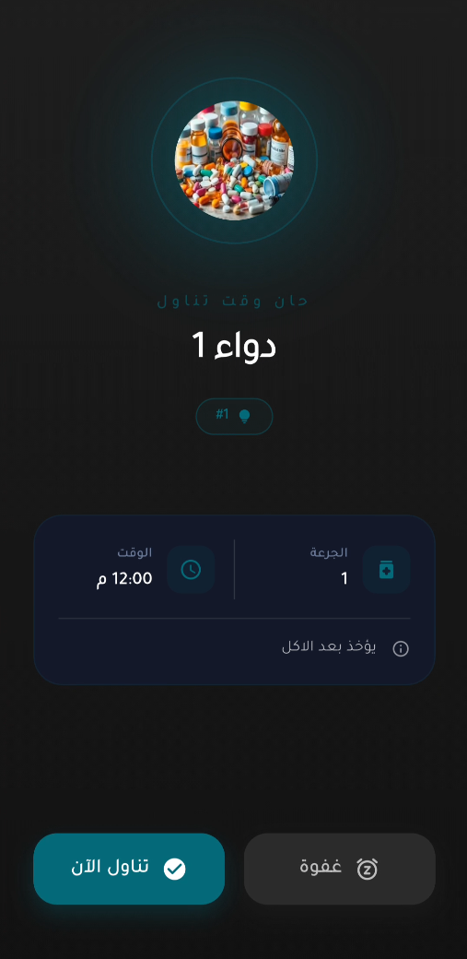
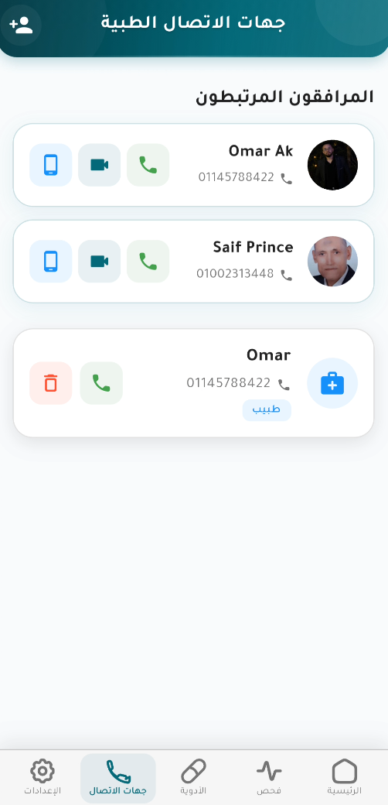
DEMO STORY
The demo should be narrated as one patient journey.
A story-driven demo beats a tour of screens.
setup
measure
result
dose
call
caregiver
Recommended narration: a patient measures, risk is interpreted, the caregiver sees the state, medication support keeps the routine alive, and emergency calling closes the action path.
Health Mate - Zagazig University - 2025/2026
14

Slide 15
ENGINEERING
The engineering work is visible in the failure paths, not only the happy path.
These details are the committee's evidence that the project is more than UI.
Backend safeguards
Data rules
Mobile resilience
- model_not_ready fallback instead of silent failure
- risk-tier cooldowns for alert spam control
- physiological clamps before storing values
- 21-table PostgreSQL schema
- one active primary caregiver enforced in DB
- nullable BP values represent withheld readings intentionally
- Hive cache for last known readings
- localized push and local alarms
- role-aware screens reuse shared logic
Health Mate - Zagazig University - 2025/2026
15

Slide 16
RESULTS
Every headline number is grounded in code or documentation.
This slide is the answer to 'what did you actually achieve?'
4.91
85.8 / 95.5
653K+
21
DBP MAE, AAMI pass
symptom top-1 / top-3
signal windows
database tables
2
613/614
0
custom IoT devices
EN/AR key parity
targeted cross-confusion pairs
The strongest proof is not one number. It is the breadth of a working chain: sensor -> model -> rules -> database -> notification -> caregiver action.
Health Mate - Zagazig University - 2025/2026
16

Slide 17
LIMITS
Limitations are part of the defense.
Naming them early reduces surprise questions and shows engineering judgment.
Known gap
Why it matters
Planned answer
SBP fails AAMI
primary BP number is not clinical-grade yet
validate on real hardware and target SBP error
BP model not tested on live sensor recordings
dataset does not equal home-use conditions
collect cuff-paired MAX30102/AD8232 data
Cardiac subtype weakness in triage
the domain focus is cardiovascular
add real assessment data and retrain baselines
QR linking is unsigned/unexpired
security hardening needed before production
sign, encrypt or expire the payload
No refresh-token revocation
standard stateless JWT tradeoff
add server-side token/session revocation
Health Mate - Zagazig University - 2025/2026
17

Slide 18
ROADMAP
The next work is validation and hardening, not inventing a new product.
The roadmap follows directly from measured gaps.
Validate
Improve
Harden
- real sensor recordings vs reference cuff
- time-separated calibration samples
- clinical review of remaining thresholds
- target SBP-specific error sources
- investigate why complex models underperformed
- strengthen cardiac subtype discrimination
- signed/expiring caregiver linking
- refresh-token revocation
- unify symptom checker generations
Health Mate - Zagazig University - 2025/2026
18

Slide 19
CLOSE
Health Mate proves the full loop.
Custom sensing hardware, two evaluated AI subsystems, a backend that owns safety decisions, and a bilingual app that connects patients with caregivers.
The project is strongest when presented honestly: what works, what passes, what does not pass yet, and exactly what comes next.
Questions and discussion

Slide 20
APPENDIX
Appendix: likely committee questions, already prepared

Slide 21
APPENDIX
Why not just use a connected cuff?
Because the project target is the whole family-response loop.
Question
Short answer
Is a cuff more clinically reliable?
Yes. That is why Health Mate keeps cuff calibration and does not claim SBP clinical readiness.
Then why cuffless?
To reduce measurement friction and study whether PPG+ECG can support trend monitoring.
What is the unique contribution?
The integration: cuffless sensing, triage, caregiver alerts, medication hardware, and emergency calling.
Is it production-ready?
No. It is a graduation research prototype with a clear validation roadmap.
Health Mate - Zagazig University - 2025/2026
21

Slide 22
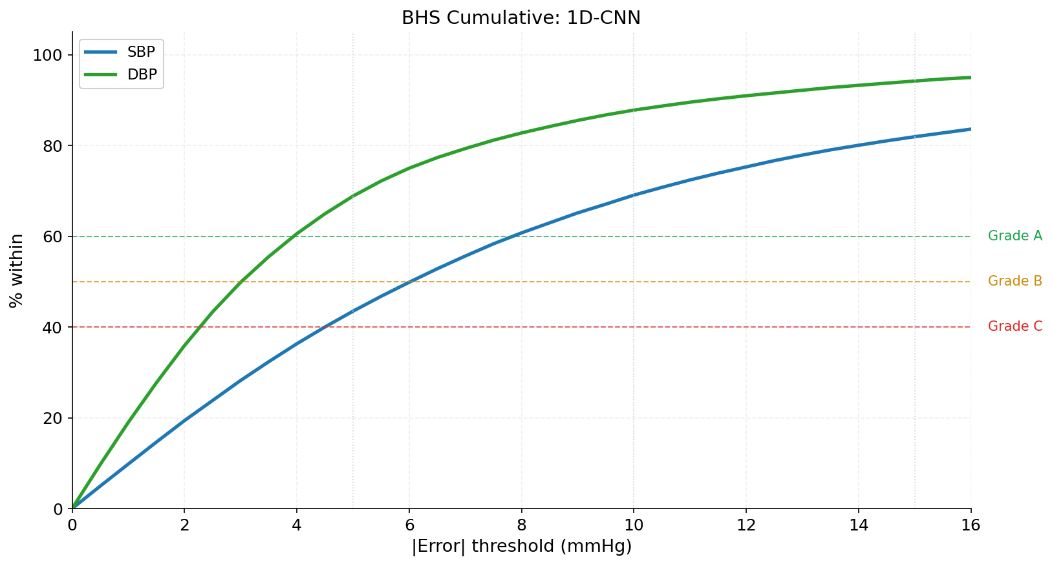
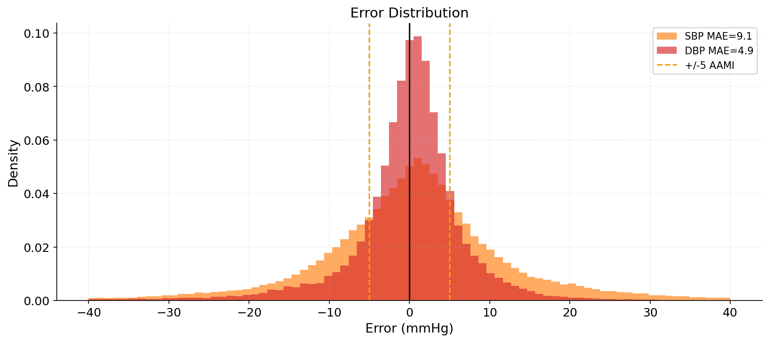
APPENDIX
The BP model table is deliberately not cherry-picked.
The best deployed BP model was selected by measured performance.
Use this slide if asked about clinical evaluation curves, error bands, or why DBP and SBP are treated differently.
Health Mate - Zagazig University - 2025/2026
22

Slide 23
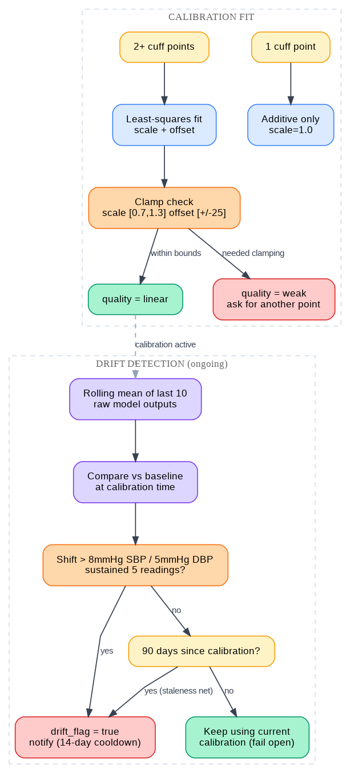
APPENDIX
Calibration exists in the backend, but the simulation result is not overclaimed.
This is a strong answer to a predictable technical question.
- fewer than 8 paired samples use a robust median offset
- 8 or more samples upgrade to a constrained linear fit
- drift is flagged after sustained shifts or stale calibration
- the oracle simulation was inconclusive because its samples were not time-separated like real use
Health Mate - Zagazig University - 2025/2026
23

Slide 24
APPENDIX
The symptom checker is safer because prediction and urgency are separated.
Use this when asked whether the model can miss a red flag.
Layer
Owns
Can it lower urgency?
Rule engine
red flags and vitals floor
No
LightGBM model
top disease predictions
No
LLM phrasing layer
wording only, optional
No
Caregiver notification
high/critical escalation
No
The model can help explain likely disease classes; it cannot suppress a rule-engine red flag.
Health Mate - Zagazig University - 2025/2026
24

Slide 25
APPENDIX
Sources used inside the deck
Local project documentation is the primary evidence.
- Docs/PRD.md, ARCHITECTURE.md, FRONTEND.md, BACKEND.md, DATABASE.md, IOT.md
- Docs/BP_PREDICTION.md and Docs/SYMPTOM_CHECKER.md for metrics and limitations
- assets/branding screenshots, diagrams, model figures, university and faculty logos
- Reference deck TAFANEEN .pptx.pdf for academic coverage pattern and comparison/table expectations
- Presentation research: Duarte/TED storytelling structure and Kawasaki 10/20/30 pacing guideline
Health Mate - Zagazig University - 2025/2026
25

