Slide 1


Excell-on consulting services
Report Project
Group 3 – C0812L
SEM III
Supervisor : Vinh Duong Le
Project :

Slide 2
Eproject - Content
Introduce about our team
Introduce about our project
Architecture of our project
Entity Relationship diagram

Slide 3
Eproject – Our team
Application analyse
Database design
GUI
Hoang Do Phu
(Leader)
Login to system
Manage Account
Manage Employee
Manage Department
Manage Order
Manage Service
Statistic
Document

Slide 4
Eproject – Our team
Application analyse
Database design
Anh Le Tien
Manage Company
Manage Product
Manage Dealer
Manage Problem
Manage Customer
User guide

Slide 5
Eproject – Our team
Application analyse
Cuong Pham Huy
Database design
Insert data to database
Test application

Slide 6
Eproject – Our team
Application analyse
Tung Trinh Minh
Database design
Test application

Slide 7
Eproject – Our project
Excell-on Consulting Services (ECS) helps organizations develop innovative business and commerce strategies and solutions. These solutions allow their (organizations, say clients of Excell-on Consulting Services) customers to capitalize on new technologies to create innovative products and services for the economy. Their consulting team stays focused on defining, optimizing, and aligning their client’s business and IT strategies.
Our project is a web application that use .NET technology and SQL Server.

Slide 8
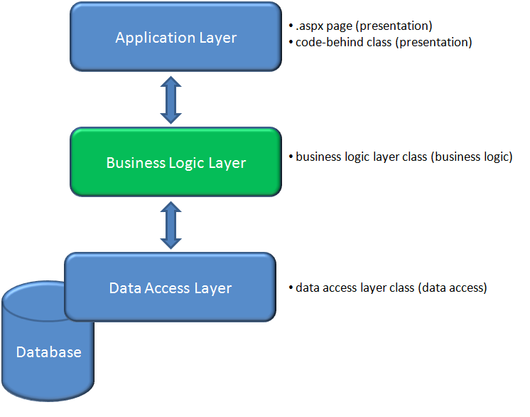
Eproject – Architecture of our project

Slide 9
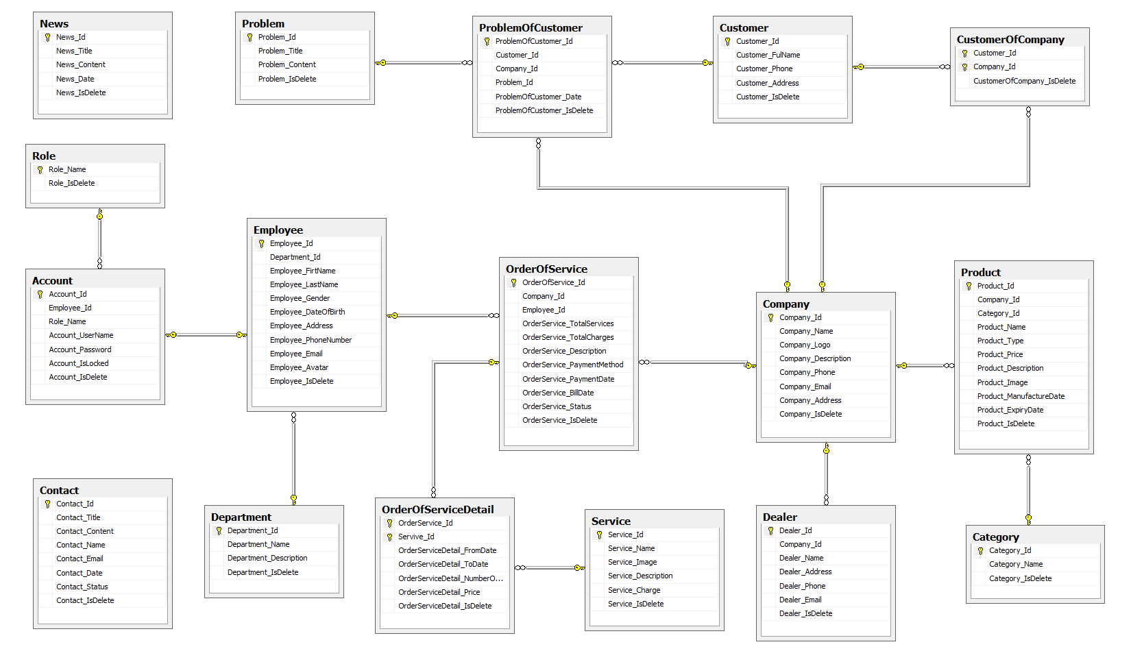
Eproject – Entity Relationship Diagram

Slide 10
THAnk you for YOur listening !
Developer Team
© Group 3 – C0812L
Ha Noi – 07/2011

