Slide 1
NFL Draft Pick Success
DSC 530
Omar Rodriguez Arellano

Slide 2
The Question
The NFL Draft is a critical process where teams select college football players, aiming to acquire future stars. A common assumption is that first-round picks outperform later-round selections. This study examines whether first-round picks significantly outperform later-round picks using fantasy football points as a key performance metric.
Do first-round draft picks perform significantly better than later-round picks?

Slide 3
The Variables
By analyzing fantasy points (PPR), total yards, touchdowns, games played, and draft round we assess whether draft position correlates with NFL success.
Fantasy points (PPR): a statistical measure of overall performance.
Total Yards: overall production from rushing, receiving, and passing.
Touchdowns: scoring ability.
Games Played: player availability and durability.
Draft Round: determines the round in which a player was drafted.

Slide 4
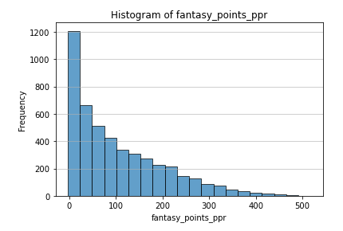
Histogram – Fantasy Points (PPR)
The distribution is right-skewed.
Most players accumulate under 100 fantasy points, meaning they are role players or backups.
Some elite fantasy performers exceed 300+ points.
The majority of players do not produce high fantasy points, and top-tier players account for most of the scoring.

Slide 5
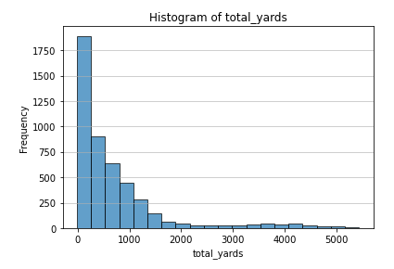
Histogram – Total Yards
The distribution is right-skewed.
Most players accumulate under 1,000 yards, with only a few reaching 3,000+ yards.
A small group of outliers surpasses 5,000 yards, likely elite players.
Most players have moderate yardage, but elite performers stand out.

Slide 6
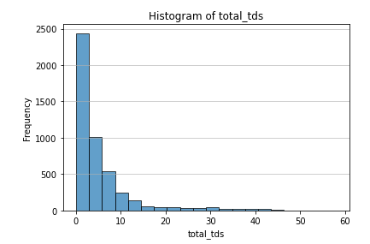
Histogram - Touchdowns
The distribution is right-skewed.
Most players score fewer than 10 touchdowns per season.
A few outliers exceed 30+ touchdowns, which likely includes MVP-caliber QBs and elite RBs/WRs.
Scoring touchdowns is heavily concentrated among a few elite players.

Slide 7
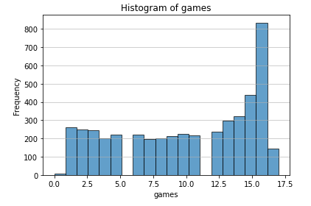
Histogram – Games Played
The distribution is right-skewed.
he most frequent value is 16-17 games, meaning many players played a full season.
A significant number of players played fewer than 10 games, likely due to injuries, being backups, or short careers.
The majority of NFL players in the dataset are available for most of the season.

Slide 8
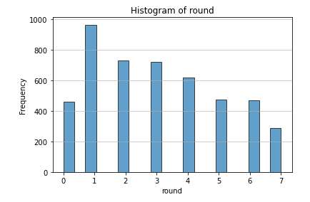
Histogram – Draft Round
The distribution is right-skewed.
The draft round appears evenly distributed across rounds 1-7, with no extreme imbalance.
Rounds 1-3 have slightly higher frequencies, meaning more players in the dataset were drafted in earlier rounds.
There is a good mix of early and late-round picks, allowing for fair comparisons in the analysis.

Slide 9
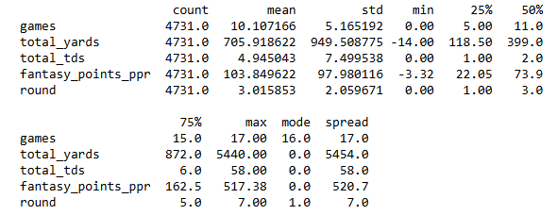
Descriptive Statistics

Slide 10
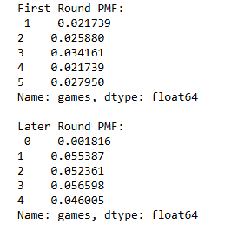
Probability Mass Function (PMF)
First Round PMF Analysis:
The probabilities for playing 1–5 games are relatively low (around 2-3%).
Players picked in the first round have a lower probability of playing very few games.
Higher stability: First-round picks are more likely to stay active and play more games.
Later-Round PMF Analysis:
The probabilities for playing 0-4 games are much higher than in the first round.
Later-round players are more likely to have short seasons, possibly due to injuries, lack of playing time, or not making the team roster.

Slide 11
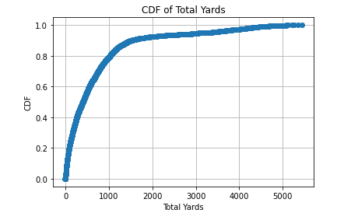
Cumulative Distribution Function (CDF)
The steep curve on the left shows that most players accumulate fewer than 1,000 total yards.
Around 80% of players have less than 2,000 total yards.
The curve flattens after 3,000 yards, meaning very few players exceed this threshold.
The upper tail (beyond 4,000 yards) represents only a small fraction of elite players.

Slide 12
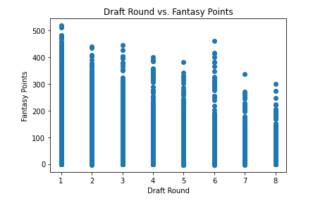
Scatter Plot #1
Games Played: Players from all rounds appear to have similar distributions, suggesting draft round doesn’t strongly affect the number of games played.
Total Yards & Total Touchdowns: First-round picks tend to have higher upper limits, while later-round picks show greater variability.
Fantasy Points (PPR): First-round picks generally score higher fantasy points, while later-round picks have greater spread with many scoring lower.
While there are productive later-round players, first-round picks tend to perform more consistently at a high level.

Slide 13
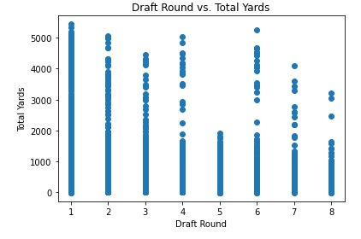
Scatter Plot #2
First-round picks (Draft Round = 1) tend to have higher total yards, with many players surpassing 4,000+ yards.
Later-round picks (Rounds 6-8) show more variability, with fewer high-yardage players and a greater concentration of low-yardage players.
As draft round increases, total yards tend to decrease, though some later-round players still achieve high production.
There are outliers in all rounds, meaning some late-round players still perform at an elite level, but they are much less frequent

Slide 14
Pearson Correlation
Negative correlation: As draft round increases (later picks), fantasy points decrease.
Strength of correlation (-0.4086):
Moderate negative correlation (values between -0.3 and -0.7 indicate a moderate relationship).
While not a perfect relationship, draft round still has a significant impact on fantasy points.
There is a clear negative relationship between draft round and fantasy performance.
First-round picks tend to score significantly more fantasy points than later-round picks.
Later-round players can still succeed, but their average performance is lower.
The correlation isn't extremely strong, meaning other factors (team, position, injuries, playing time) also influence performance.

Slide 15
Analytical Distribution of Fantasy Points (Normal Fit)
T-Statistic = 18.39: This is a very large positive value, meaning there is a strong difference between the two groups.
P-Value = 1.71e-67 (essentially 0): This is far below the common significance threshold (0.05 or 0.01), meaning the difference is highly statistically significant.

Slide 16
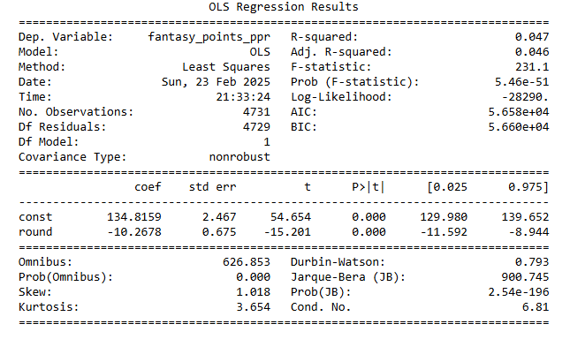
Regression Analysis
Negative Coefficient (-10.27):
Later-round picks score fewer fantasy points.
For every increase in draft round, expected fantasy points decrease by ~10.27.
Example: A 7th-round pick is expected to score ~72 fantasy points less than a 1st-round pick (7 × -10.27).
Statistical Significance (p < 0.001):
The impact of draft round on fantasy points is not due to random chance.
Draft position matters in predicting player success.
Low R-Squared (0.047):
The model only explains ~4.7% of the variance in fantasy points.
Other factors (position, team role, injuries, playtime) also influence performance.
Interpretation: Draft round is an important factor but not the only one.

Slide 17
Final Thoughts
This study provides strong evidence that first-round picks perform significantly better than later-round picks. The t-test confirmed first-round picks score significantly higher fantasy points, while regression analysis demonstrated a negative relationship between draft round and performance. However, draft round alone is not the sole determinant of success. Future research should include positional analysis, team strength, and injury history to develop a more comprehensive predictive model. While draft capital is essential, great players can emerge from any round under the right circumstances.

