Slide 1

PREDICTING THE SCOREBOARD
A Data-Driven Approach to NFL Game Scoring
Omar Rodriguez Arellano
Notes:
Welcome. This presentation covers my data science project: Predicting the Scoreboard. The goal was to use publicly available NFL data to build a regression model that predicts total points scored in a game before it starts — using only pre-game information. Let me walk you through the problem, the data, the methods, and what I found.

Slide 2
BUSINESS PROBLEM
The Challenge NFL analysts, coaches, and broadcasters need tools to anticipate game scoring but current approaches rely on expert opinion or betting market lines.
The Goal Build a transparent, reproducible regression model that predicts total points scored using only pre-game team statistics and situational factors.
The Audience NFL analysts, coaching staffs, and sports broadcasters who want data-backed game previews without needing a data science background.
The Benchmark Compare model accuracy against Vegas over/under lines which is the best publicly available real-world standard for scoring prediction.
Notes:
The business problem is straightforward: NFL analysts and broadcasters need better tools. Betting lines exist, but they're proprietary and opaque. This project asked whether publicly available data alone could get us close. The intended audience is domain professionals — not data scientists — so explainability was as important as accuracy.

Slide 3
DATA & METHODS
Data Sources
Four Models Compared
nflfastR (Primary)
45,000+ games, 1999–2023 Play-by-play EPA, game-level aggregation
Pro Football Reference (Supplemental)
Temperature, wind speed, stadium type Precipitation & travel excluded
Key Engineered Features
Rolling 4-week EPA averages
Season-to-date EPA averages
Dome indicator, temp, wind
Linear Regression Baseline: linear feature relationships
Ridge Regression Regularized: handles correlated features
Random Forest Ensemble: non-linear interactions
Gradient Boosting XGBoost: complex pattern detection
Notes:
For data, I used nflfastR — a well-established open-source NFL dataset — combined with weather and stadium data from Pro Football Reference. The key insight in feature engineering was using rolling 4-week EPA averages and season-to-date averages, computed strictly from prior games to avoid data leakage. I compared four models, all trained on 2000–2021 data with a held-out test set from the 2022 and 2023 seasons.

Slide 4
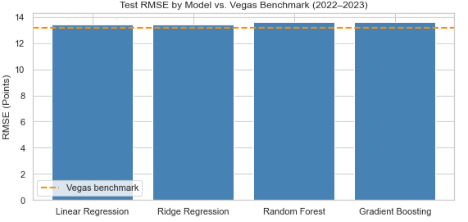
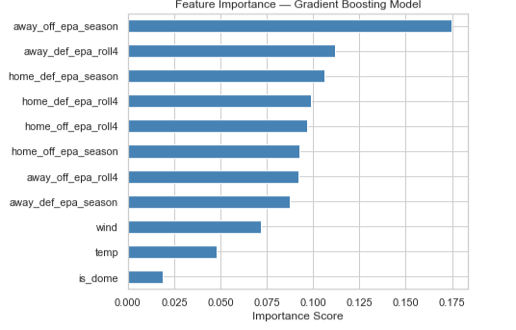
RESULTS
Test RMSE by Model vs. Vegas Benchmark
Feature Importance — Gradient Boosting Model
13.41
13.18
0.23 pts
Best Model RMSE
(Linear & Ridge)
Vegas Benchmark
RMSE
Gap vs. Vegas
Public Data Only
Notes:
The results were striking. All four models clustered tightly between 13.41 and 13.63 RMSE. Linear and Ridge Regression performed best — the non-linear models added no value, suggesting the relationship between EPA features and scoring is largely linear. The Vegas benchmark came in at 13.18, meaning our best model trails professional oddsmakers by only 0.23 points using only public data. On the right, you can see that offensive EPA season averages dominate feature importance at 17.5%, with defensive EPA collectively accounting for over 40% — confirming defense matters as much as offense.

Slide 5
KEY FINDINGS & RECOMMENDATIONS
EPA Dominates Offensive EPA season averages were the strongest predictor at 17.5% feature importance. Defensive EPA collectively accounted for over 40%.
Wind Beats Dome Wind (7.2% importance, negative) outperformed dome indicator (1.9%) despite dome games averaging 4.2 more points. EPA features absorb most venue signal.
Season > Recent Form Full-season EPA averages outperformed rolling 4-week averages, especially mid-to-late season when team identity has stabilized.
Public Data is Powerful A model built on free, public data trailed Vegas oddsmakers by only 0.23 RMSE points demonstrating how much signal EPA captures.
Notes:
Four key findings stand out. First, EPA-based metrics dominate — season averages more than rolling windows, which was somewhat surprising. Second, wind is a stronger environmental predictor than dome status, even though dome games average 4.2 more points. Third, season averages beat recent form, especially later in the year. And fourth, the gap to Vegas is only 0.23 RMSE points, which is the headline result — public data gets you surprisingly close.

Slide 6

LIMITATIONS & FUTURE USES
Limitations
Future Applications
No injury or practice data
Weather missing for ~10-15% of games
Predicts combined total only, not individual team scores
Era differences (1999 vs. 2023 NFL) not fully adjusted
Predictions carry meaningful uncertainty
Separate models per team score
Live in-season weekly updating
Quarterback EPA as individual feature
Adaptation to NBA, NHL, college football
Real-time broadcast scoring range tool
Notes:
No model is without limitations. The biggest gap is the absence of injury and practice data — quarterback changes in particular are a known blind spot. That said, the future applications are exciting. A live in-season version that updates weekly, or a version that incorporates individual player EPA ratings, could close much of the remaining gap to Vegas. Thank you — I am happy to take questions.

