Slide 1
A
Presentation
on NoteShares
Teach || Learn || Share

Slide 2
Table of Content
01
Introduction
A brief discussion about the idea
02
Idea Generation
Why this is our idea?
03
Chapter Wise Discussion
Market Analysis, Organization and Management, Financial Analysis, Funding Request
04
Summary
Final discussion about the idea
2

Slide 3
Existing Market Problems
Service starts from $15/month
Complex payment method
Competitive market place
There is no platform where engineering student can access standard content for exam in Bangladesh
3

Slide 4

Our Solution
Meet NoteShares
A local platform that connects teachers and students.
We are changing the way of learning.
4

Slide 5
What is NoteShares?
1
4
Pay subscription fee (500Tk/ month) and access 20 questions
An online portal for students and teachers
Allows instructors to share important content/information with student in form documents
2
5
Each answers will review by the expert team
Any user can create an account using Name, Contact and Email ID
3
6
Answer a relevant and get a free access for asking a question
5

Slide 6

How NoteShares Works
Give Reviews & Ratings
Give reviews or suggestions for better service
Get Answers
Get relevant answers verified by experts
Ask Questions
Ask any type of engineering related questions
Buy package
Mothly: 500Tk
Yearly: 4000 Tk
Payment through mobile financial services
SignUp
Using email or phone no. Category for both student and instructor’s account
6

Slide 7
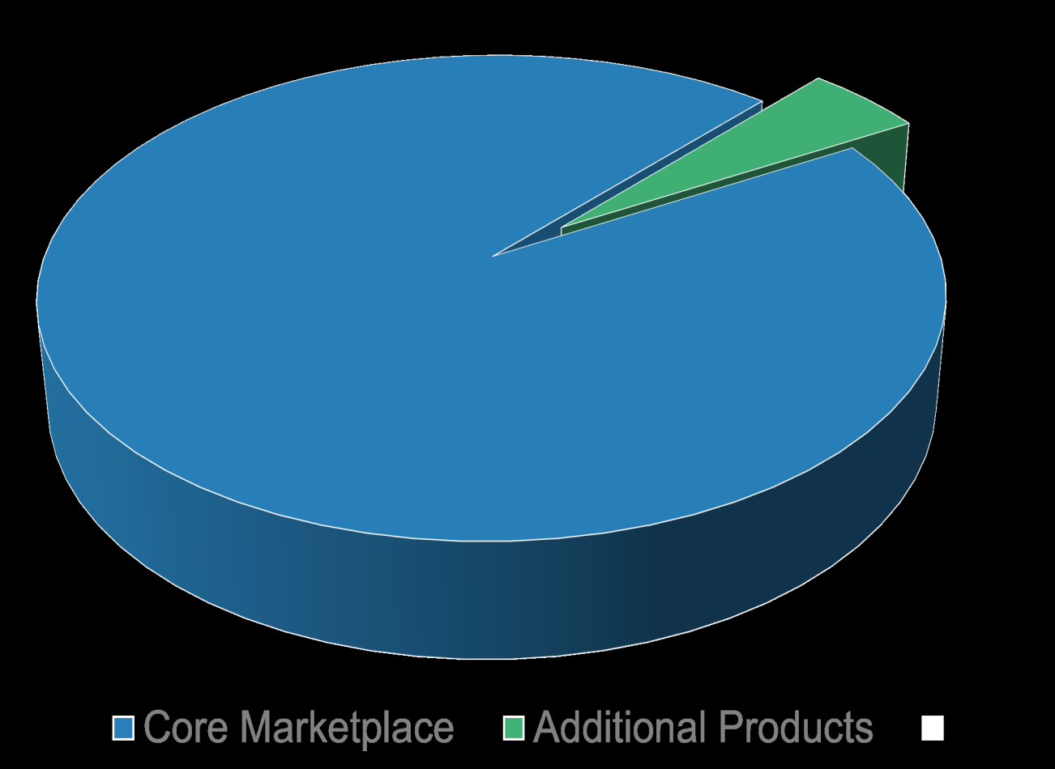
How we generate revenues
Core Marketplace
Additional Products
NoteShares monthly/yearly subscriptions on NoteShares’s core marketplace.
Show Ads (CPC based advertising)
You can simply impress your audience and add a unique zing and appeal to your Presentations.
7

Slide 8
Market Analysis
Identifying target market & customer survey
8

Slide 9
Objectives
60% market share in Bangladesh by the year 2025
Expected to be on top of customers’ mind
To be no. 1 e-learning site in Bangladesh
9

Slide 10
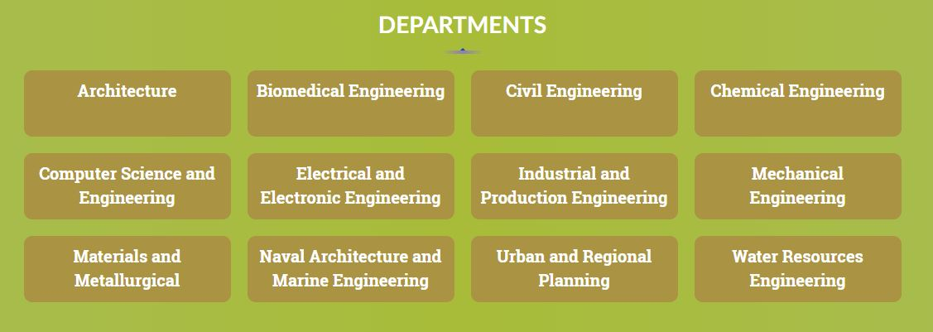
Target Market
Undergraduate engineering student from public and private universities in Bangladesh
Division of Departments in the Platform
10

Slide 11
Customer Survey
Students
Instructors/Experts
Which semester are you in?
2. What is your main source of learning?
3. How often do you make your handwritten notes?
4. Do you wish to share your knowledge with your peers?
5. How often do you interact with your faculties outside classroom?
6. Do you feel the need of obtaining knowledge apart from your decided syllabus?
7. Does your university have a centralized formal channel to exchange documents/knowledge with your faculties, seniors, juniors, and alumni?
8. Will you be interested to join a platform that brings together your college's faculties, students, and alumni together?
1. What is your familiarity with the following concepts related to OER (open educational resources)?
2. Approximately how many years in total have you been actively creating, using, distributing or otherwise working with online education?
3. What is your degree of managerial responsibility in your primary occupation?
4. In which country (whether where you live presently or where you have lived in the past) have you gained the most experience related to business models for online education?
5. What is the highest degree or level of school you have completed?
6. What is your gender?
7. How old are you?
Content Here
You can simply impress your audience and add a unique zing and appeal to your Presentations.
11

Slide 12
SWOT Analysis
Students
Students
Excitement about the technology-based online learning environment.
Online flexibility learning and technology navigational independence.
Insufficient capability to link technological design.
Unstable Internet connectivity.
Lack of Online Equipments (laptops, pc’s, android mobile phones)
Strengths
Instructors
Instructors
Weaknesses
Opportunities
Threats
Customized and structural e-learning teaching sessions.
May experience better and faster communication with Students.
May receive better classroom evaluations in the face-to-face classroom than online teaching.
May encounter difficulty in mastering online teaching because of several technology-based advancement..
SWOT
Students
Students
Increase of digital market share expansion available.
Lower costs and reuse content for any E-Learning online courses.
Lack of motivation of the students because of multiple study options.
High drop-outs of students.
Lack of E-Content Policies in different institutions referring its’ online E-Contexts.
Instructors
Instructors
May gain a competitive edge over traditional face-to-face colleagues.
May offer departments scheduling flexibility when trained.
Customized Have doubt about the integrity and effectiveness of online teaching and e-learning towards learners or students.
Reduced teacher and students’ physical engagement.
12

Slide 13
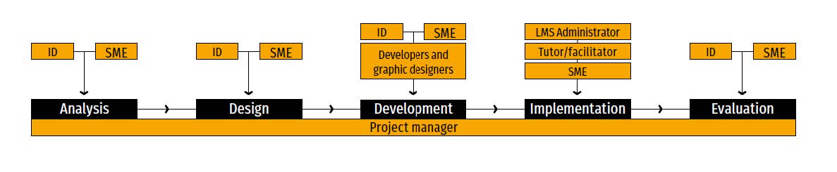
Organizational Structure
13

Slide 14
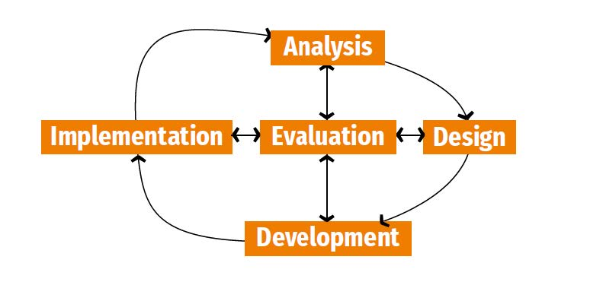
Service Line
Evaluate learners’ reactions, the achievement of learning objectives, the transfer of job-related knowledge and skills.
Actual delivery of the content to a group of participants.
Take new products and services to market and add to the company's bottom line.
Identifies the job tasks that learners should complete and the knowledge and skills that need to be developed or reinforced.
Formulating a set of learning objectives required to achieve the general, high-level course objective.
05 EVALUTION
04 IMPLEMENTATION
03 DEVELOPMENT
02 DESIGN
01 ANALYSIS
14

Slide 15
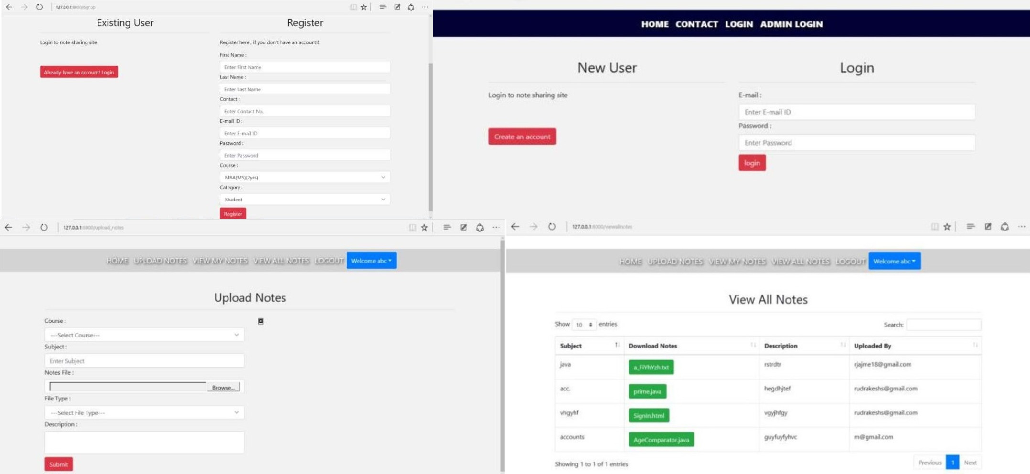
Developing the Product
15

Slide 16
Limitations of the System
Not a large-scale system
Customers need an internet connection
Limited information is provided by system
Success rely on agile participation of users
Larger database is required for wider use
Assigning admin is a tedious task
16

Slide 17
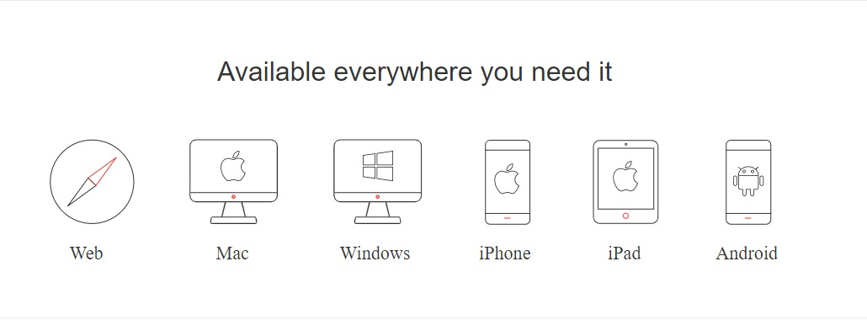
Future Prospective
The possible updates which can be in this project are the following:
Better search feature and GUI
Integration of a larger database
This service will eventually be available on all devices as an app.
17

Slide 18
Financial Analysis
Cost estimation & Funding
18

Slide 19
Cost Analysis
FIXED COST (Yearly)
VARIABLE COST (Monthly)
TOTAL COST (Yearly)
REVENUE (Monthly)
 | Build up website: 50k
 | Office equipment: 50k
 | 100,000 BDT
 | Web developer: 25k
 | Advertisement: 10k
 | Experts: 60% monthly revenue share (60k)
 | (let, 100,000/month revenue)
 | 95,000 BDT
 | Total Investment =
 | Fixed Cost
 | +
 | Variable Cost*12
 | 1,240,000 BDT
 | Subscription: 500Tk/Package
 | Estimated buyer: 200
 | 100,000 BDT
100k
95k
1240k
100k
19

Slide 20




Funding Process For Start Up Business
Bootstrapping
Angel investment
Building a business without the help of outside capital.
Don’t need to share income with investors
Don’t need to spend time searching for an investor
Angel investors are more likely to take a risk on young, up and coming companies
Don’t need to pay anything back
Becomes a minority shareholder in success of a business
Crowdfunding
Its an alternative finance option if someone struggled to get bank loans or traditional funding
Ability to provide access to a larger and diverse group of investors.
It can be a first way to raise finance with no upfront fees
Venture Capital
Invest money in a business that have huge potential to grow
In addition to capital, it provides valuable information, resources to make a business successful
20

Slide 21
Business Owners
Funding Process
Bootstrapping
 | Mehedi: 40,000 Tk
 | Shahriar: 40,000 Tk
 | Javed: 40,000 Tk
 | Mehedy: 40,000 Tk
 | Zaki: 40,000 Tk
Total Investment: 200,000 Tk
21

Slide 22
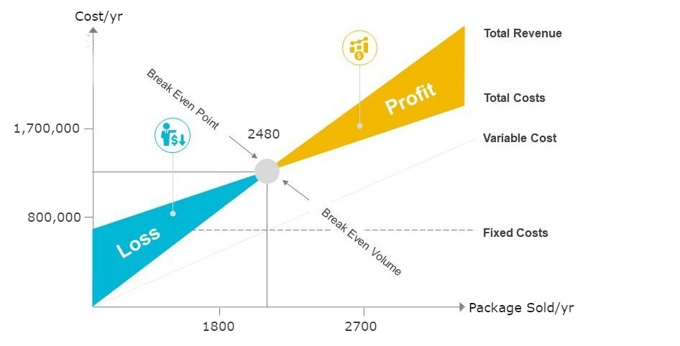
Breakeven Analysis
22

Slide 23
Summary
23

Slide 24
THANK YOU
Happy Learning

