Slide 1

php from scratch
Welcome to php course
Omar masoud

Slide 2
What is PHP
Server side scripting language
Not programming language

Slide 3
Script
Run in response to event
Not run until webpage is requested
perform sequence of instructions

Slide 4
Where it works
Server Side scripting language
Run in the server send result to client
Cannot running alone need running web server
Where Javascript Client side
Run in client browser

Slide 5
PHP
Does Not need to be complied.
execute by web server exactly as it written
Java, C# need to complied to another format to be read

Slide 6
Benefits
Open source
Cross platform, works on windows , linux,etc without framework install
Powerfull
used by Facebook, Yahoo, WikiPedia
OOP
Visit
http://php.net

Slide 7
You need to know
HTML,CSS

Slide 8


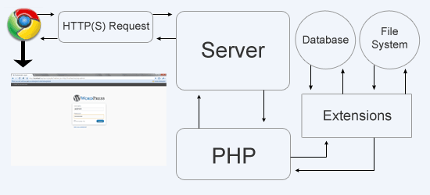
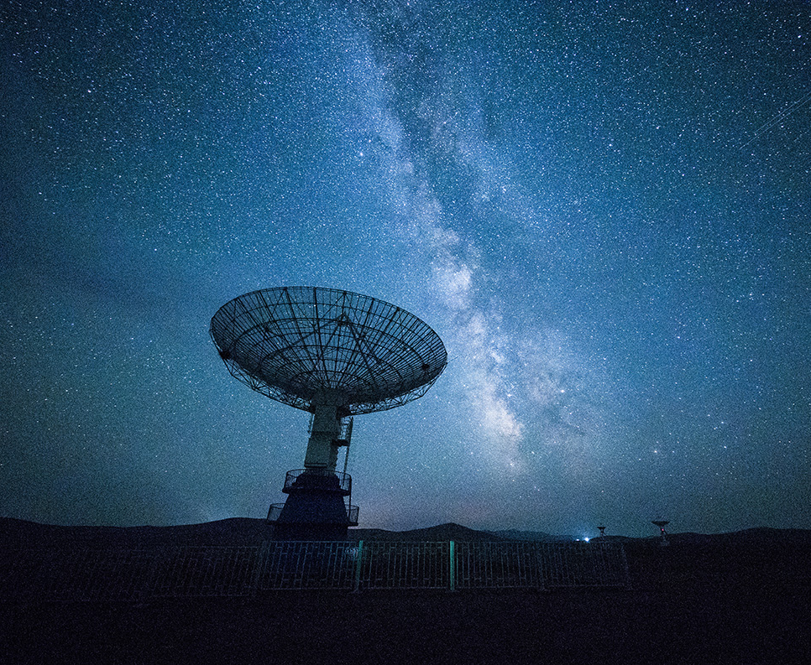
How it's work ?
This lesson will take 40-30 min
First of all we need to know and understand a litile bit about php
- let's talk about how php works

Slide 9
So let's setup our server
Xamp is a great to start with let's setup it and make sure the server is ready to go.
The editor
Microsoft make a great editor for and it's completly free to use just go a head on google and type Visual Studio Code
Now let add some php extensions to our editor to make it easier to work

Slide 10

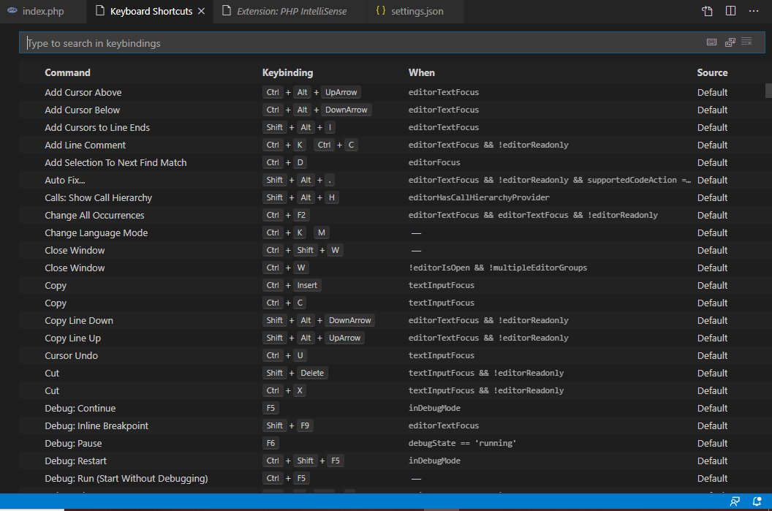
Editor shortcuts
It's make a work so much easier and save alot of time if you don't know the shortcuts you should learn it now

Slide 11
Index
index
Variables
Operations
null
Array
If
POST
Login
Homework

Slide 12

Thank You!
omarmasoud@hotmail.com

