Slide 1

Fraud Detection Identifying Credit Card Fraudulent Transactions

Slide 2
Problem Statement​
explore a fraud detection problem using a dataset containing information about credit card transactions. The goal is to build a model that can accurately classify transactions as fraudulent or benign based on various features associated with each transaction.
“Fraud” is the target variable to predict.

Slide 3
Data Description
The dataset consists of the following columns:
Step: Maps a unit of time in the real world. 1 step = 1 hour of time.
Customer: Unique customer ID associated with each transaction.
zipCodeOrigin: The zip code of the transaction's origin/source.
Merchant: The unique ID of the merchant involved in the transaction.
zipMerchant: The zip code of the merchant.
Age: Categorized age (0: <= 18, 1: 19-25, 2: 26-35, 3: 36-45, 4: 46:55, 5: 56:65, 6: > 65 , U: Unknown)
Gender: Gender of the customer (E : Enterprise, F: Female, M: Male, U: Unknown)
Category: Category of the purchase.
Amount: Amount of the purchase
Fraud: Target variable which shows if the transaction fraudulent(1) or benign(0) and it is highly imbalanced

Slide 4
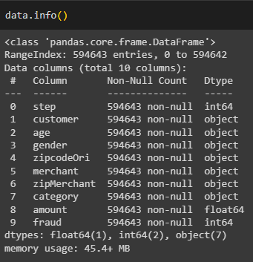
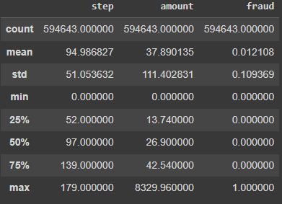
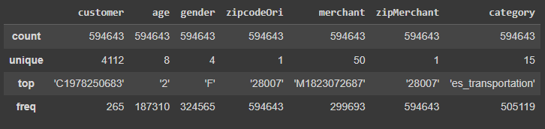
Exploring the data
Having a look first at data types, null values existence , the shape of the dataset , and statistical summaries

Slide 5
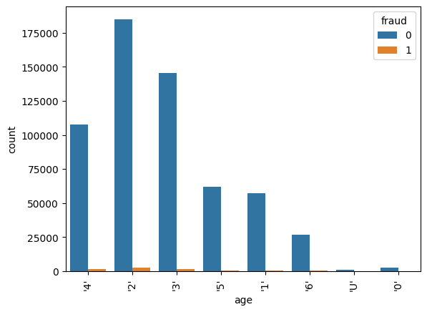
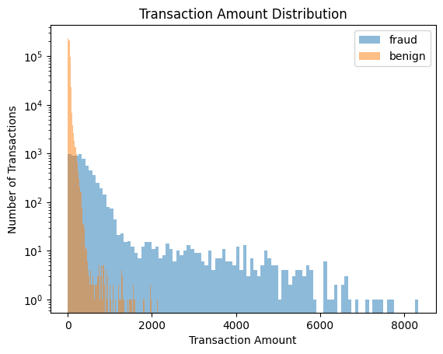
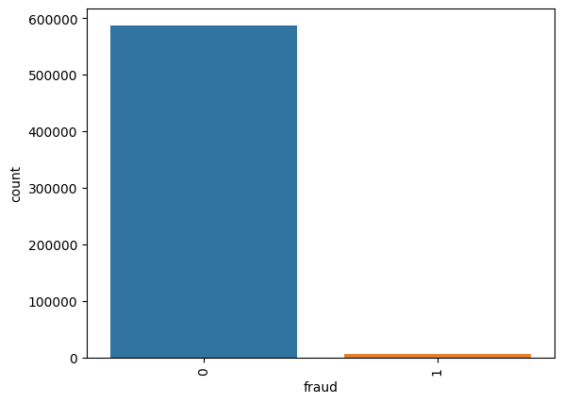
Exploratory Data Analysis
Determining the categorical and numerical features.
Visualizing the distribution of features.
Analyzing the relations between features and with the target variable using visuals and calculations.

Slide 6
Data Preprocessing & Feature engineering:
This step consists of:
Categorical variables encoding
Selecting relevant features
Splitting data into train and test data sets
Data scaling for the numerical variables

Slide 7
Categorical Variables encoding
It is important to deal with the categorical variables to be a suitable input to the machine learning model.
To avoid curse of dimensionality, because of the very high number of categories in some features, I Used one-hot encoding for some features , and used label encoding for others like “step” and “customer”.

Slide 8
Splitting the dataset
We split the data into X: Features , and y: Target variable.
The data set should also be split into train and test data sets to be able to train the ML model on the data set then evaluate the built model on an unseen data set to test its performance when dealing with new data.
The splitting method used is “ Train_test_split “ from Sklearn library.
Other common methods of splitting data is cross validation, but it is not used now in this project.

Slide 9
Data scaling
Scaling is very important when building machine learning models to make all features on the same scale to avoid bias and that some features of values with large magnitude outweigh other features
Common methods of scaling are Standardization and Normalization
Standard Scaler was used to scale numerical values in our dataset ( Standardization )

Slide 10
Modelling
Testing multiple models as a preliminary test.
Chose the Random Forest classifier due to its robustness and ability to handle imbalanced data.
Class weights were adjusted to give more importance to the minority class (fraudulent transactions).
The model performance should be measured using more than one metric, and accuracy score alone will not be enough since our target variable is imbalanced.
Model evaluation will be done using Accuracy score, F1-score , precision and recall values from the classification report to ensure that the model is performing well in predicting both classes labels.

Slide 11
Oversampling using SMOTE method
As a result of the imbalance in our dataset the preliminary results were not as desired
As a solution SMOTE method was used to do the oversampling
The results improved significantly after using this method in predicting the actual fraudulent transactions

Slide 12
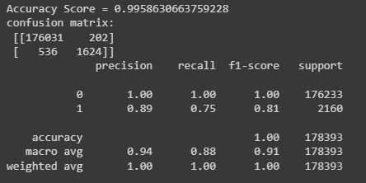
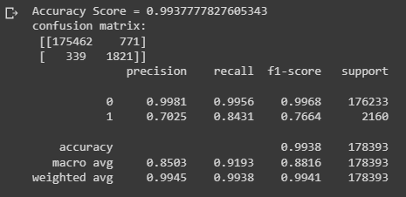
Results and recommendation
Before SMOTE:
Based on my analysis the random forest model showed reliable results and performance
Results improved significantly after doing the oversampling step to mitigate the imbalance problem considering the recall but not precision
There is no overfitting since both training and testing sets showed high results
After SMOTE:
Precision, Recall, F1-Score:
For Non-Fraudulent Transactions (Class 0):
Precision: 0.9981 Out of all the transactions predicted as non-fraudulent, 99.81% were actually non-fraudulent.
Recall: 0.9956 Out of all the actual non-fraudulent transactions, 99.56% were correctly identified.
F1-Score: 0.9968 This is the harmonic mean of precision and recall, providing a balanced view of the two metrics.
For Fraudulent Transactions (Class 1):
Precision: 0.7025 Out of all the transactions predicted as fraudulent, 70.25%70.25% were actually fraudulent.
Recall: 0.8431 Out of all the actual fraudulent transactions, 84.31%84.31% were correctly identified.
F1-Score: 0.7664 Again, this metric provides a balance between precision and recall for fraudulent transactions.

Slide 13
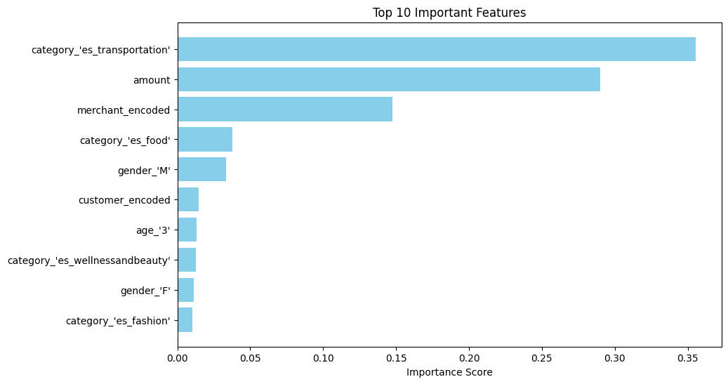
Results and recommendation
Hyperparameter tuning can be done using Grid search and Cross validation to improve results even more.
Top features having the most significant impact on the predictions are evaluated in the chart below, which agrees to a considerable level with some findings noticed during the EDA stage
“category” , “amount”, are contributing the most and as found in EDA, some categories have the significantly higher percentages of frauds compared to others and usually frauds tend to have higher amounts that non fraudulent transactions
Sometimes, a small increase in recall (detecting more actual fraud cases) might be more valuable, even if it comes at the cost of a lower precision (more false positives). The business cost of missing a fraud might be much higher than the cost of a false alarm.

Slide 14
Results and recommendation
“category” , “amount”, are contributing the most and as found in EDA, some categories have the significantly higher percentages of frauds compared to others and usually frauds tend to have higher amounts that non fraudulent transactions
Sometimes, a small increase in recall (detecting more actual fraud cases) might be more valuable, even if it comes at the cost of a lower precision (more false positives). The business cost of missing a fraud might be much higher than the cost of a false alarm.
In conclusion, while SMOTE can be beneficial in many scenarios, it's not a one-size-fits-all solution. The best approach often requires experimentation, and it's entirely valid to achieve better results without oversampling in certain cases.

