Slide 2

IKEA CUSTOMER PROFILING
Presented By: Omar Althunaiyan

Slide 3
Table of Contents
01
02
03
Project Overview & DQ Importance
COMPLIANCE & GOVERNANCE
Data Quality Dimensions
04
05
06
Technical Profiling & Finding Insights
Strategic Recommendations & Roadmap
Conclusion & Q&A

Slide 4
01
Project Overview & DQ Importance

Slide 5





Project Overview & DQ Importance
Project Mission
Goal: Profile 1,000 IKEA customer records
Vision: Reliable assets for customer journeys
Why DQ Matters?
Customer Loyalty: Accurate targeting & personalized offers
Cost Efficiency: Zero waste on invalid contact details
Market Growth: Fact-based insights for KSA expansion
DQ
The Golden Rule
"Trust the Data, Trust the Decision."
Reliable analytics start with clean data
auto_awesome

Slide 6
02
COMPLIANCE & GOVERNANCE

Slide 7



COMPLIANCE & GOVERNANCE
SDAIA & NDMO:
The primary regulators setting data standards for the Kingdom.
2030
PDPL:
Personal Data Protection Law that protects customer privacy and ensures data safety.
The Vision Target
Data Residency:
Ensuring data residence and quality standards are met within Saudi borders.

Slide 8
03
Data Quality Dimensions

Slide 9




Data Quality Dimensions
Uniqueness
Completeness
Validity
Accuracy
No duplicate Customer IDs (We found 50 duplicates)
No missing fields in Email or Phone columns
Data must follow standard formats (e.g., +966 for phones)
Information matches the real-world customer identity

Slide 10
04
Technical Profiling & Finding Insights

Slide 11




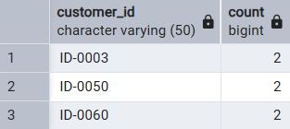
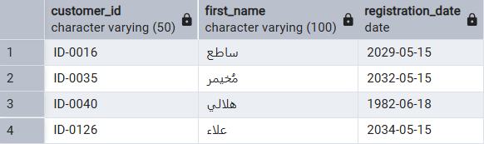
Technical Profiling & Finding Insights
Duplicate Clusters
Timeline Integrity Issues
Customer_ID uniqueness is compromised; 50 primary keys are reused across distinct geographic profiles, distorting reporting accuracy.
Temporal profiling reveals registration dates that defy logic, indicating system clock errors or entry glitches.
50
63
DUPLICATED
IDENTIFIERS
TIMELINE
ANOMALIES

Slide 12
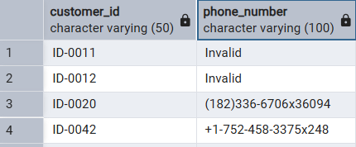
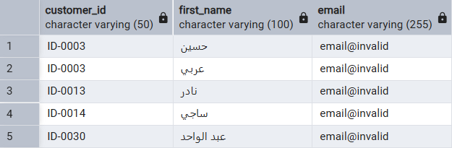
Technical Profiling & Finding Insights
Invalid Email Strings
Unreachable Phone Data
Dummy placeholders (email@invalid) were used to manually circumvent mandatory field constraints, compromising data integrity.
132 records found with 'Invalid' text, internal extensions (x), and lengths that are universally impossible.
62
132
HARDCODED
PLACEHOLDERS
CONTACT
UNREACHABILITY

Slide 13

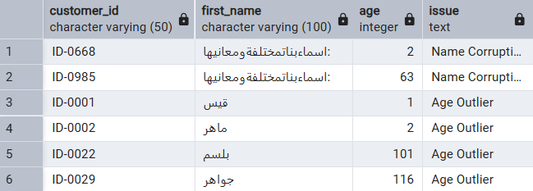
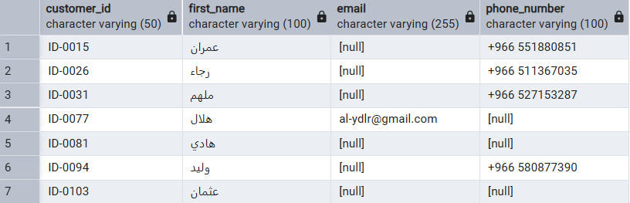
Technical Profiling & Finding Insights
Age & Name Profiling
fmd_bad
Null Values & Empty Fields
Age distribution analysis indicates extreme values from manual entry bypass or default errors, alongside invalid entries in the name field.
The analysis identifies significant gaps in mandatory data fields, where null values and empty strings compromise record completeness.
200
2
58
Inaccurate Ages
Inaccurate
Names
Missing Data
Points

Slide 14
05
Strategic Recommendations & Roadmap

Slide 15




Strategic Recommendations & Roadmap
gavel
GOVERNANCE
Align IKEA data standards with NDMO & SDAIA frameworks for full PDPL compliance.
VALIDATION
Deploy real-time automated validation for mobile numbers and email formats.
IDENTITY FIX
Resolve 50+ identity collisions by re-assigning unique IDs to ensure a single "Golden Customer Identity”.
PROJECT ROADMAP
PHASE 1
Correction
Fix the past: Clean 1,000 records and remove placeholders.
PHASE 2
Standards
Secure the present: Unified validation across all platforms.
PHASE 3
Monitoring
Protect the future: Live dashboards for real-time audits.

Slide 16
06
Conclusion & Q&A

Slide 17
Conclusion & Q&A
Profiled 1,000 IKEA customer records for technical accuracy.
Delivered a strategic roadmap to ensure a "Single Source of Truth.
01
03
DQ Framework
02
Key Findings
04
Explored global Data Quality dimensions and their business impact.
Audit Scope
Detected critical anomalies in identity, contactability, and logic.
Final Outcome
Clean data isn't just a technical goal; it's a foundation for trust, efficiency, and growth.

