Slide 1
EVENTDRIVE
Fleet & Event Vehicle
Rental Platform
Multi-tenant booking, fleet management, maintenance tracking, and AI-assisted analytics — built and running end to end.
Product Walkthrough — August 2026

Slide 2
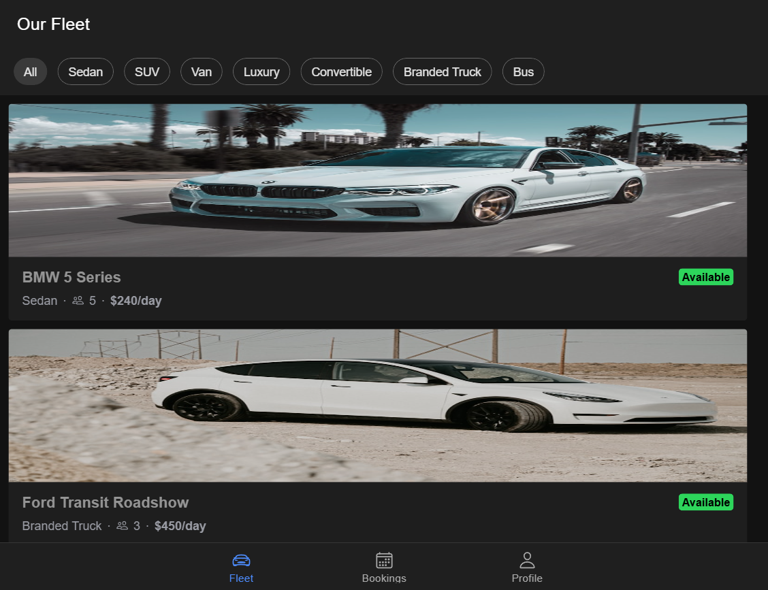
THE IDEA
Two apps, one platform
EventDrive is built around a simple split: a booking experience for clients, and a management cockpit for fleet owners — sharing one multi-tenant backend, so every company gets its own isolated, branded instance.
Client app
Browse the fleet, check live availability, request bookings
Owner / admin app
Approve requests, manage vehicles, track maintenance, see profit
Multi-tenant core
Each company's data is fully isolated behind its own login
Bilingual + themed
Full Arabic (RTL) and English, light and dark modes
EventDrive
2

Slide 3
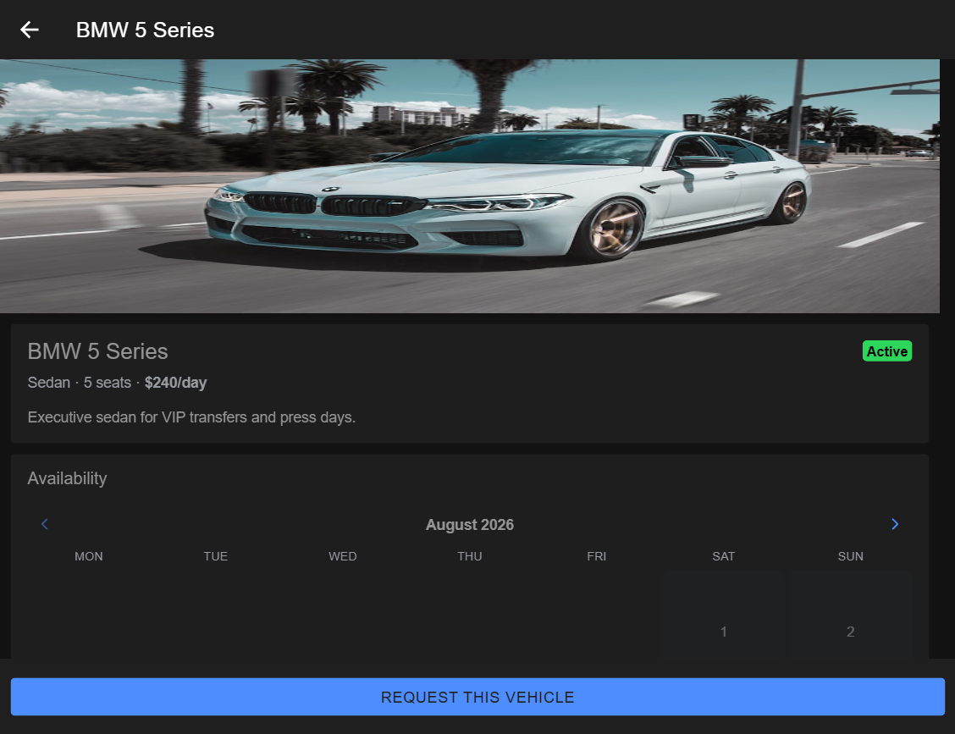
CLIENT EXPERIENCE
Live availability, real bookings
Clients pick a vehicle, see a real per-day availability calendar (not a guess), and submit a request in a couple of taps. Every car carries its category, seats, and pricing — per day or per event.
6
vehicle categories
2
pricing models — per day / per event
EventDrive
3

Slide 4
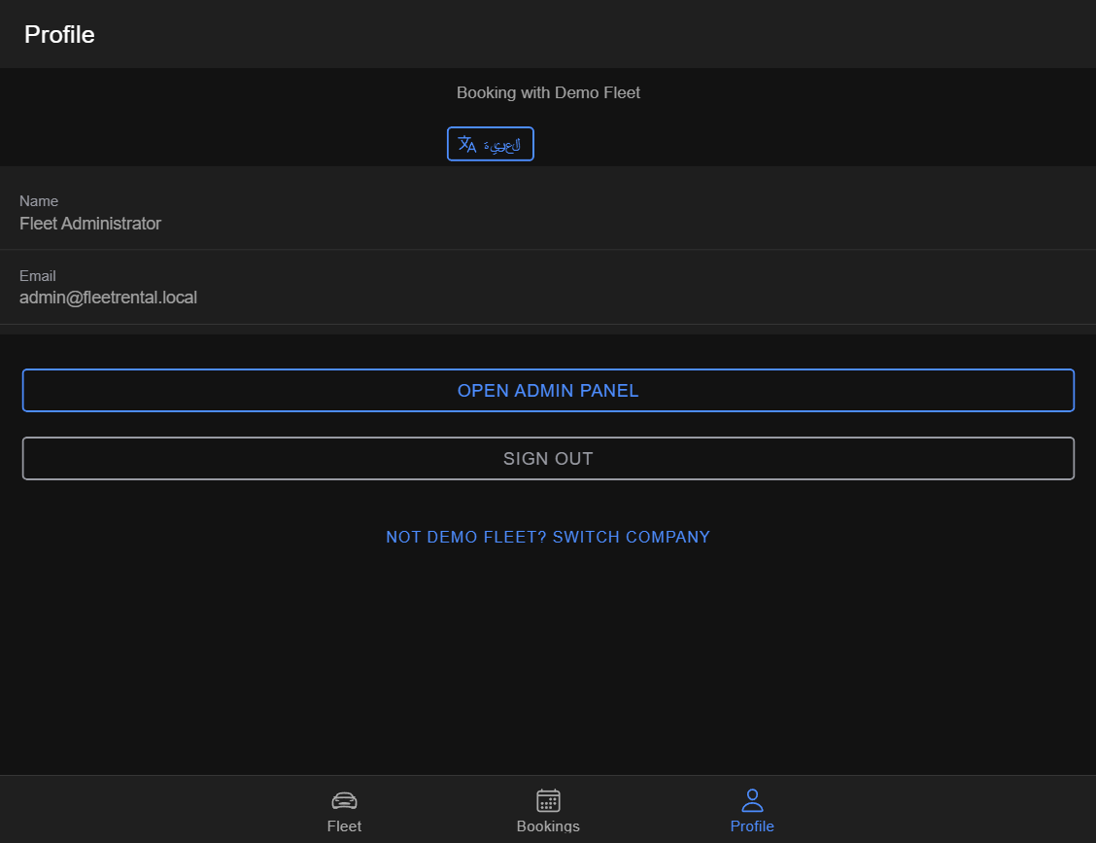
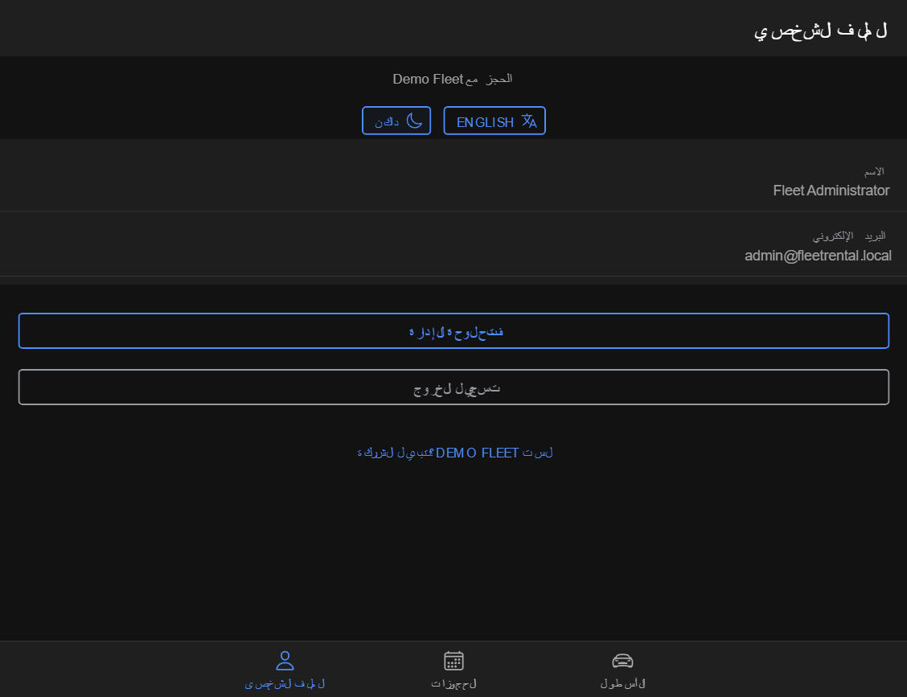
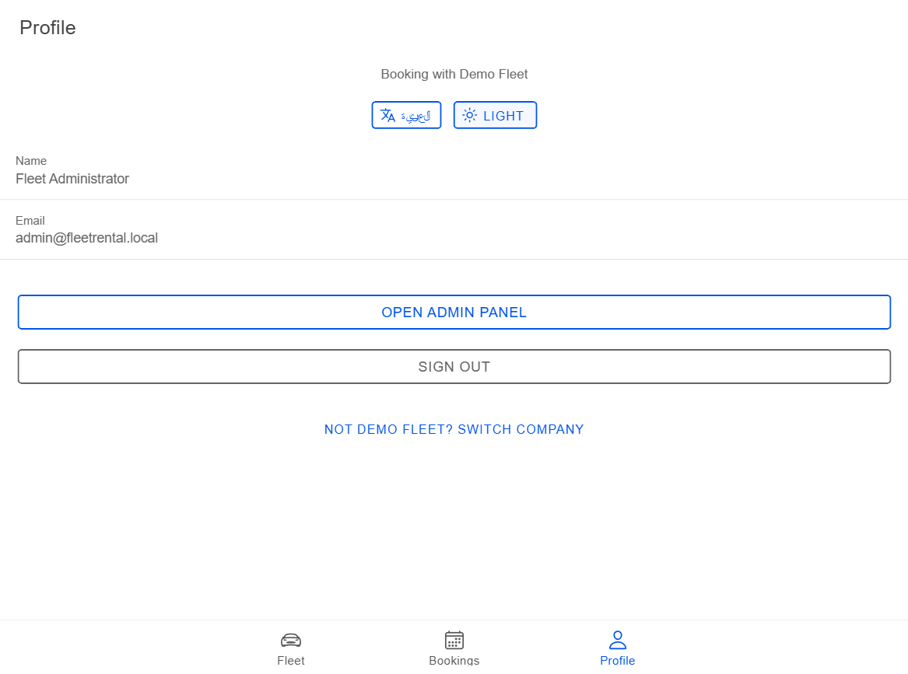
BUILT FOR
Real markets, real preferences
Full English/Arabic localization with proper right-to-left mirroring, plus a light and dark theme — not just a color swap, the whole layout flips.
English
العربية (RTL)
Light theme
EventDrive
4

Slide 5
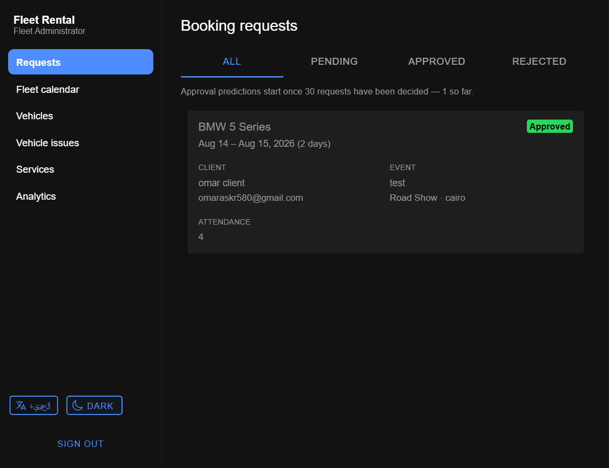
OWNER COCKPIT
Booking requests, with a memory
Every request lands in one queue with the client, event, and attendance details. As decisions pile up, the system starts predicting approval likelihood from the fleet's own history — flagging requests worth a second look.
Learns from your own approval history
No cold-start guesswork — predictions activate once enough decisions exist.
EventDrive
5

Slide 6
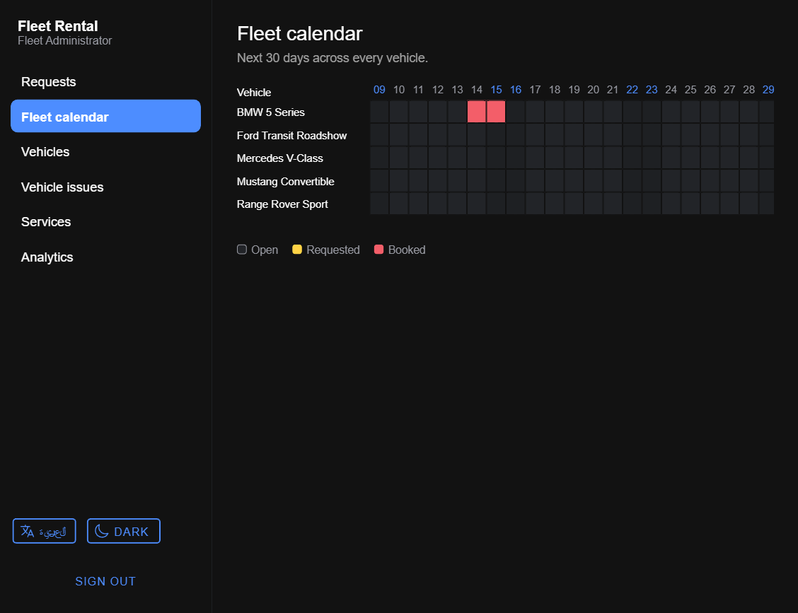
OWNER COCKPIT
Every vehicle, one calendar
A single 30-day grid across the whole fleet — open, requested, and booked days at a glance. No more checking each car's page one at a time to plan the week.
EventDrive
6

Slide 7
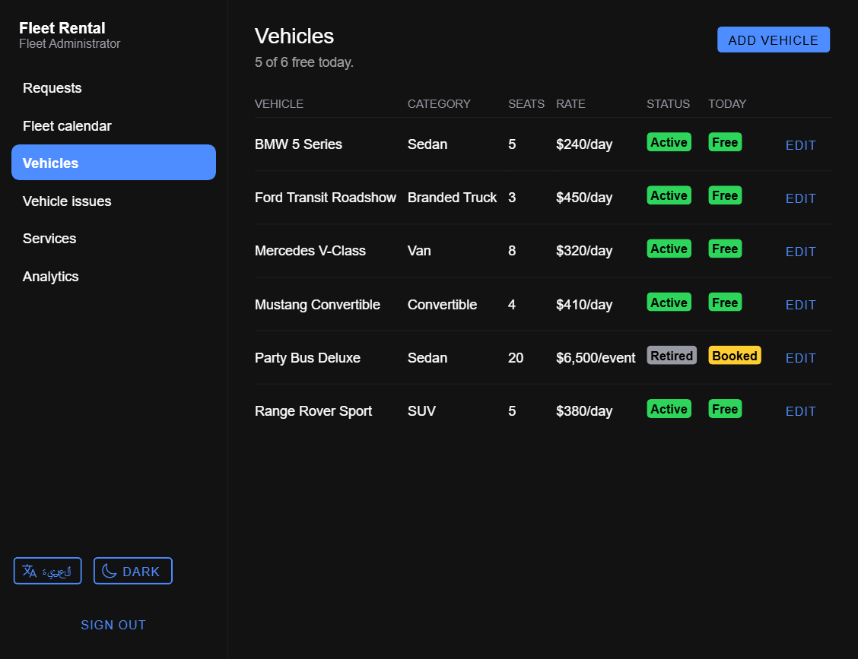
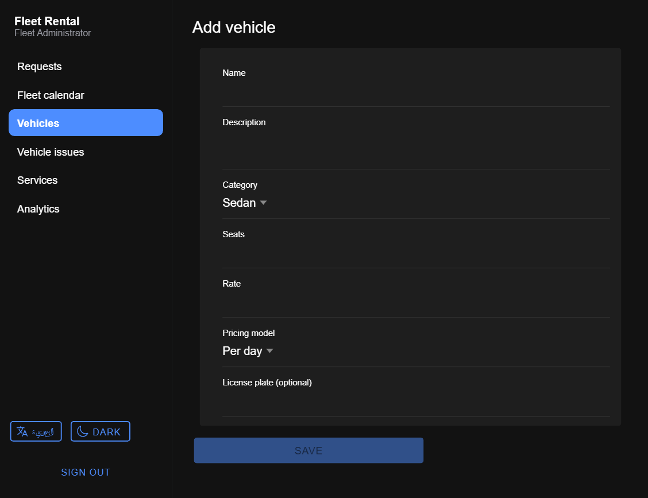
OWNER COCKPIT
Full control over the fleet
Add, edit, retire, or remove vehicles at any time. Set the rate as per-day or per-event pricing — a branded roadshow truck and a wedding sedan don't sell the same way, so they don't have to be priced the same way.
EventDrive
7

Slide 8
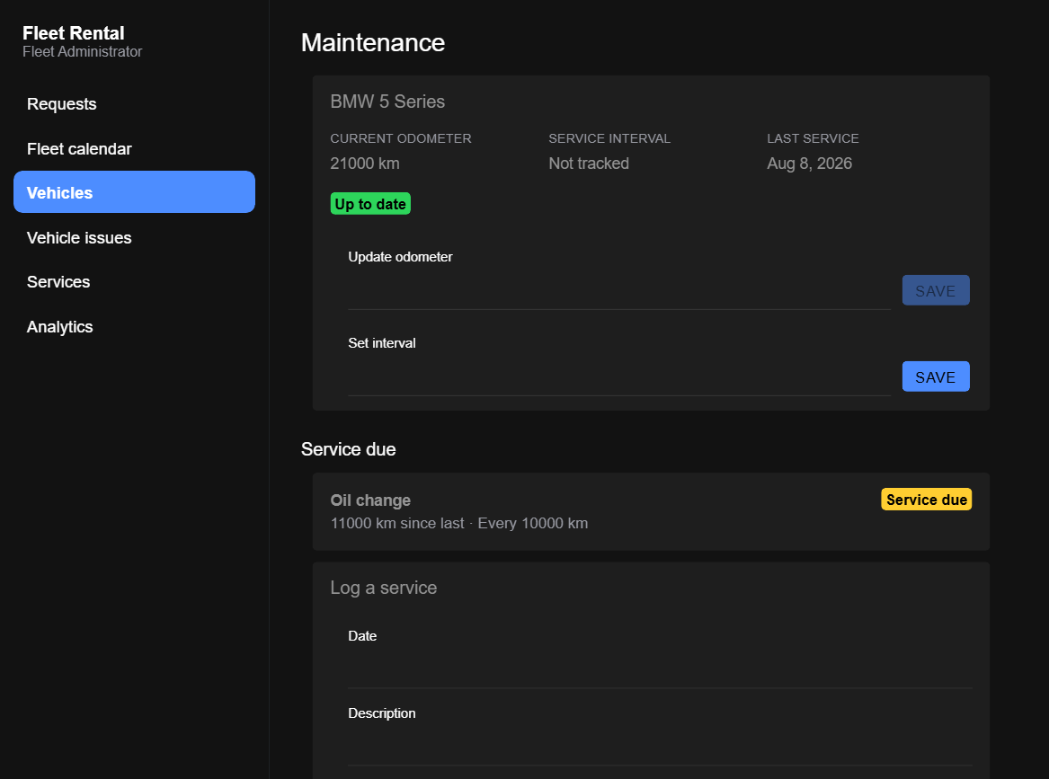
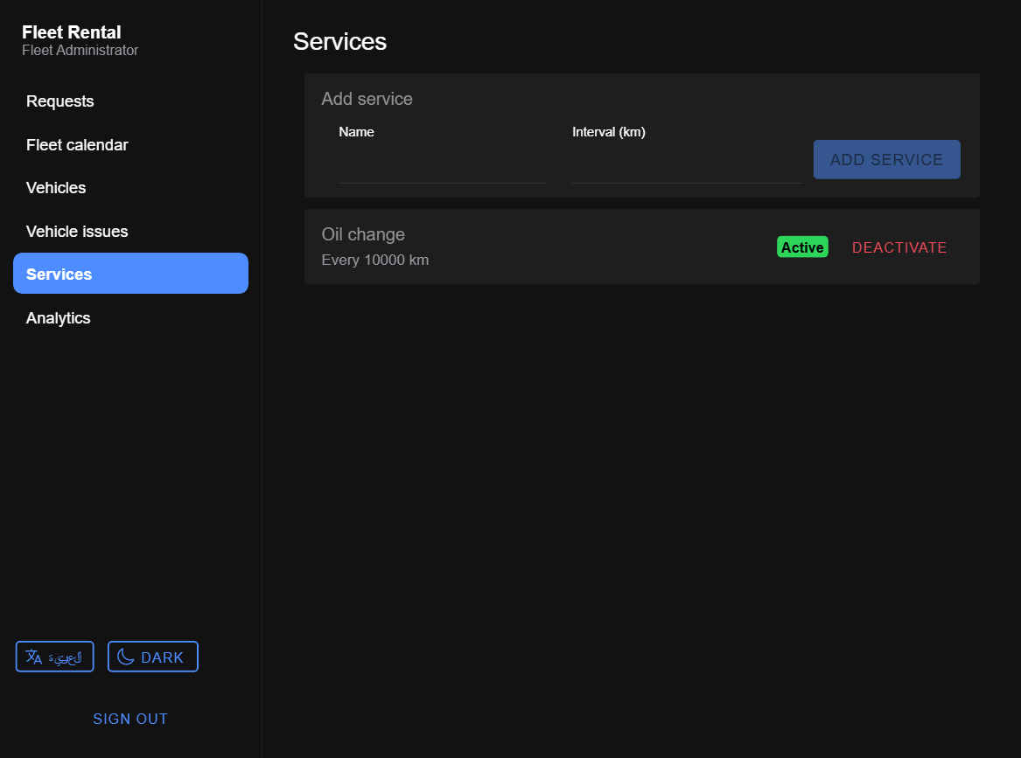
OWNER COCKPIT
Maintenance that tracks itself
Define service types once — e.g. an oil change every 10,000 km — and every car checks itself against it automatically. Log an odometer reading and the fleet tells you exactly which vehicle needs service, and when.
EventDrive
8

Slide 9
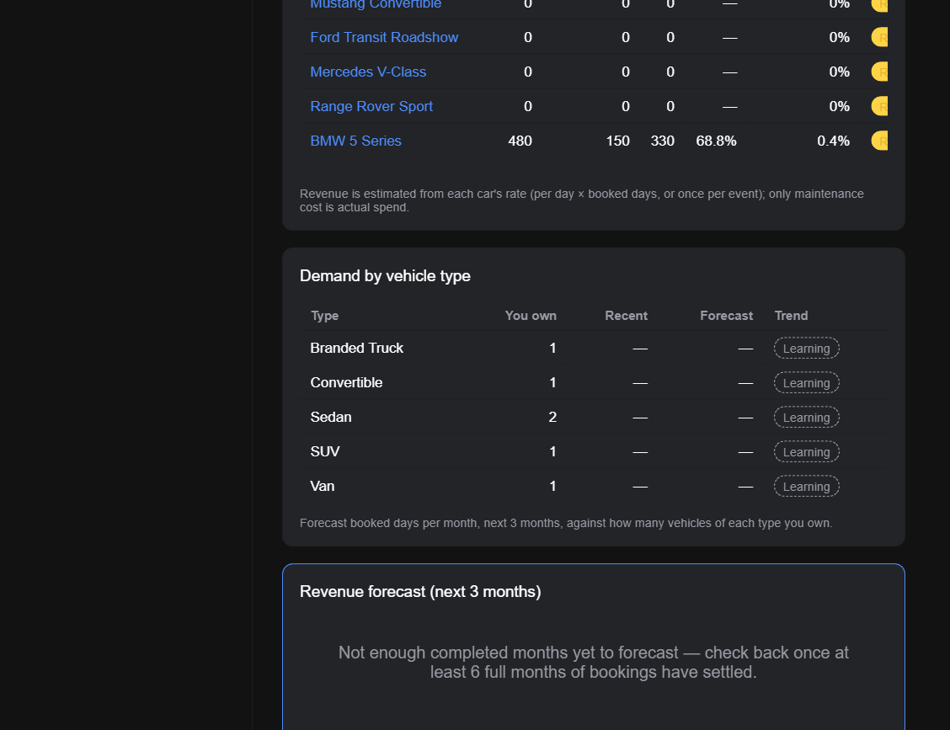
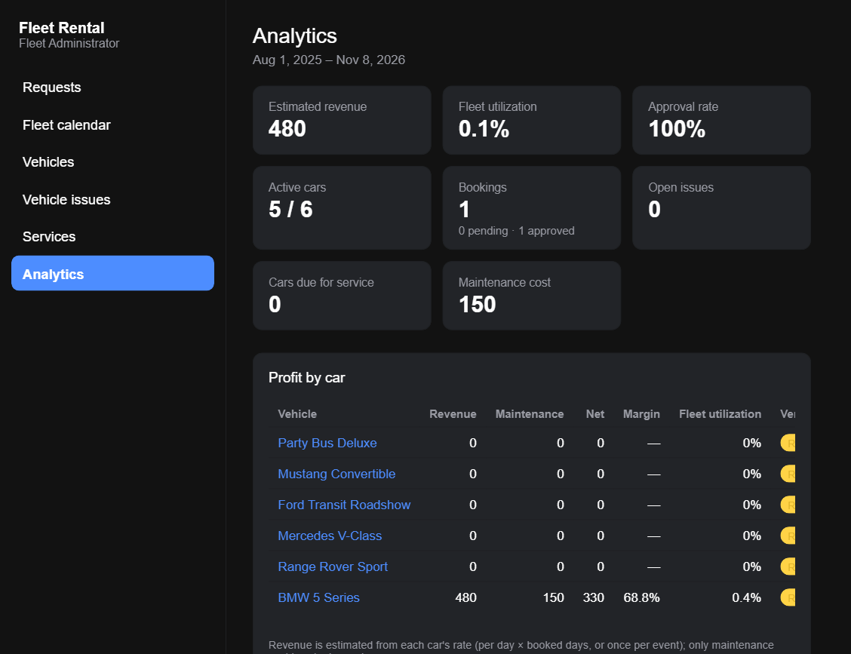
BUSINESS INTELLIGENCE
Data behind every booking
Revenue, utilization, approval rate, and per-car profitability in one dashboard — plus demand forecasting by vehicle category, so fleet purchase decisions are backed by data instead of gut feel.
EventDrive
9

Slide 10
READY TO RUN
Built. Tested. Running today.
Multi-tenant architecture, automated test coverage across the full booking and maintenance flow, and a Docker-based environment ready to point at a real deployment.
Fleet booking & approvals
Vehicle & pricing management
Maintenance tracking
Analytics & forecasting
Arabic / English, light / dark

