Slide 1
ME FOR IT INDUSTRY (18CS51)
Syllabus Module-2
Directing - Meaning and nature of directing, leadership styles, motivation Theories, Communication- Meaning and importance, Coordination- meaning and importance, Controlling- meaning, steps in controlling, methods of establishing control.
Directing (Meaning and Nature of directing)
- Direction is a vital management function.
- Direction means issuance of orders, leading and motivating subordinates to execute the orders. Without the issuance of orders, without leading and motivating subordinates nothing can be accomplished.
- According to Haimann - Directing consists of the processes and techniques utilised in issuing instructions and making sure that operations are carried out as originally planned.”
- Directing is also called management in action.

Slide 2
- The function of direction thus breaks down into two major activities:
1. Giving orders to employees, and
2. Leading and motivating them
Requirements of effective direction
- Some important principles or requirements of effective direction are-
1. Harmony of Objectives
2. Unity of Command
3. Direct Supervision
4. Efficient Communication
5. Follow-through

Slide 3
Leadership
- According to Peter Drucker - “Leadership is the lifting of man’s visions to higher sights, raising of man’s performance to a higher standard, the building of man’s personality beyond its normal limitations.
Difference between a leader and a manager
Leader | Manager
A person emerges as a leader. | A manager, on the other hand, is always put into his position by appointment.
A leader always has some personal power (i.e., ability to influence) that enables him to lead. He may or may not have positional power (i.e., the right to command). | A manager, on the other hand, always has some positional power. He may or may not have personal power.
A leader focuses on people and generally seeks those objectives which are the objectives of his followers. | Manager on the other hand, focuses on systems and structures and seeks those objectives which his subordinates do not regard as their own.
A leader generally looks at the horizon and not just the bottom line. | A manager, on the other hand, is generally bureaucratic
He believes in doing right things. | He believes in doing things right

Slide 4
Leadership styles or approaches to leadership
- Following are three important approaches to studying leadership:
(1) Traits approach
(2) Behavioural approach and
(3) Contingency approach.
Traits Approach: - traits are nothing but characteristics or qualities of a leader.
- Numerous trait studies have been made of the physical, intellectual, and social characteristics of leaders.
- According to Fayol the leader should have
- Good health and physical fitness
- Intelligence and mental strength
- Moral qualities
- Knowledge and managerial ability.

Slide 5
- Qualities of a Leader
- One can group these qualities into three broad categories:
1. Physical qualities
2. Moral qualities and
3. Mental qualities
1. Physical qualities:-
- That a leader must possess a high degree of physical and nervous energy. He must have strong sense in his mission and healthy body and mind to stand up to the stress and strain of his high office and responsibility.
2. Moral qualities:-
i). Moral courage – (taking action or careful thoughts) this enables a person, on the one hand, to stick to his goal without faltering, and on the other, to own the responsibility of his action.
ii). Sense off fairplay and justice - A leader must possess this quality to be able to motivate his men into action.
iii). Integrity – the quality of being honest.

Slide 6
3. Mental qualities (Qualities of head and heart)
i). Emotional and social maturity - Leaders are emotionally intelligent so that they are neither frustrated by failure nor overjoyed by success.
- They react to the behaviour of others in a cool, just and fair manner, instead of emotionally.
ii). Knowledge - A leader’s knowledge of a subject or technique must be greater than that of his followers. If it is not so he has no justification to lead them.
- Knowledge of a subject is important but what is more important is the knowledge of human nature.
iii). Decisiveness – An ability to make decision quickly and effectively
iv). Empathy – A leader should have empathy an ability to understand the feelings of others.
v). Objectivity – it’s an ability react to the behaviours of others in a cool and in fair manner.
vi). Initiative – initiative means doing right things without being told. Success or failure of a leader depends on his initiative.

Slide 7
Behavioural approach:-
- Behavioural approach believes that leaders are not born but can be trained.
- Under behavioural approach researchers have studied leadership behaviour from three points of view:
1. Motivation
2. Authority and
3. Supervision.
1. Motivation - From the view of motivation leadership behaviour can be either positive or negative.
- In positive behaviour the leader rewards to motivate the subordinates.
- In negative behaviour the leader put penalties and punishments.
- To protect themselves against management. There is useless documentation, recording, filing of letters and papers because people fear that these may be needed by them any time in future for their defence.

Slide 8
2. Authority - From the view of authority, leadership style can be
i). Autocratic
ii). Democratic
iii). Free rein.
i). Autocratic leadership:-
- In this type of leadership, the leader alone determines policies and makes plans. He tells others what to do and how to do it. He demands strict obedience and relies on power.
- The formula used by him is “Do what i say else…..” meaning is that the employee will be punished if not follow the order. (authoritarian)
- An autocratic leader may sometimes be paternalistic or benevolent also who uses rewards for obtaining obedience from his employees. The formula used by him is “Do what i say because I am good to you”
- Both the forms of autocratic leadership (authoritarian and benevolent) are disliked by employees. In one form, the employee remains under constant fear. In other form he remains under constant gratitude. In both the forms, the leader is the key person.

Slide 9
The whole operation of the organisation depends upon him. In his absence it may function inadequately or not at all.
Merits
1. This type of leadership, can increase efficiency, save time and get quick results, especially in a crisis or an emergency situation.
2. Chain of command, and division of work (who is supposed to do what) are clear and fully understood by all.
Demerits
1. One way communication, without feedback, typically leads to misunderstandings, communication breakdowns and costly errors.
2. The autocratic leader is alone in his decision—making, This is generally dangerous in today’s environment of technological and organisational complexity.

Slide 10
Democratic leadership: - (also known as participative or person—oriented leadership)
- In this type of leadership the entire group is involved in and accepts responsibility for goal setting and achievement.
- Subordinates have considerable freedom of action.
- The leader shows greater concern for his people than for high production.
- A part of the leader’s task is to encourage and establishes inter— relationships among members and to reduce intra—group conflict and tensions.
- He is not the key person. The group is not dependent upon him can functions effectively in his absence.

Slide 11
Merits
1. When people participate in and help to formulate a decision, they support it (instead of fighting or ignoring it) and work hard to make it work.
2. The leader consistently receives the benefit of the best information, ideas, suggestions, and talent— and operating experience—of his people.
Demerits
1. The participative style can take enormous amounts of time to take decision and, may degenerate into a complete loss of leader’s control.
2. Some leaders may use this style as a way of avoiding responsibility.
Free Rein: - (also called laissez faire leadership)
- In this type of leadership, the leader exercises absolutely no control.
- He only provides information, materials and facilities to his men to enable them to accomplish organization objectives.

Slide 12
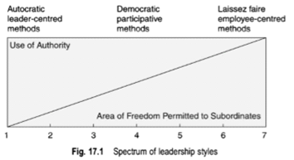
- This type can be a disaster if the leader does not know well the competence and integrity of his people and their ability to handle this kind of freedom.
Spectrum of leadership styles

Slide 13
Various points on the spectrum are described below.
1. The leader “tells” subordinates what his decision is.
2. The leader “sells” his decision i.e., persuades subordinates to accept it.
3. The leader invites questions from subordinates to give them a fuller explanation of his thinking.
4. The leader presents only a tentative decision subject to change.
5. The leader presents only the problem, invites solutions and then makes his decision.
6. The leader presents the problem and lets the group make a decision within certain limits of action.
7. The leader permits the group to make decision within limits defined by the situation.

Slide 14
Supervision
From the view of supervision leadership style can be either
1. Employee oriented or
2. Production oriented.
- An employee—oriented leader is one who cares more for the welfare of his subordinates than for production.
Similarly, a production—oriented leader is one who cares more for production than for the welfare of his subordinates.
There are two important studies under this category – these studies measures the leader behaviour in two dimensions i. Employee orientation ii. Production orientation.
1. Ohio State University Model
2. Managerial Grid Model

Slide 15
Ohio State University Model
- There are two factors (i). Initiating structure (ii) Consideration
- Initiating structure refers to the leader’s behaviour in structuring the job of the follower.
- Consideration is the leader’s behaviour showing mutual trust, respect and friendship towards the subordinates,
- These two types of leader behaviours are independent.
- Some leaders follow structure but provide little consideration;
- others are considerate, but provide little structure.
- Many leaders, however, do not fit into either of these two categories. They use a fairly even mix of structure and consideration.
- Still some leaders spend very little time using either structure or consideration behaviours.

Slide 16
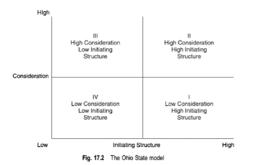
Figure : Ohio State University Model

Slide 17
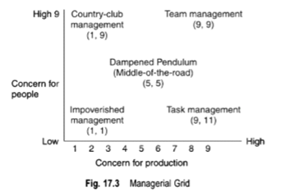
Managerial Grid model
Robert Blake and Jane Mouton use a chart called Managerial Grid to describe five types of managerial styles.
- They make use of the terms “concern for production” and “concern for people”.
- These two dimensions are plotted on a 9—point scale on two separate axes as shown in above figure

Slide 18
1. Task management - Here the management shows maximum concern for production and least concern for people. Therefore, it is also called “authority—obedience” approach.
2. Country-club management - This is reverse of task management. Here the management shows maximum concern for people and least concern for production. It is the “love conquers all” approach.
3. Impoverished management - Here the management shows least concern both for production as well as people. He also ignores human relationships. It is the “speak no evil, hear no evil, see no evil” approach.
4. Team management - Here the management shows maximum concern both for production as well as people. The assumption is “one plus one can add up to three”.
5. Dampened pendulum or the middle-of-road style - Here the management shows a balanced concern for production and people. Neither too much production is expected nor is too much concern for people expressed. The manager follows the middle position. “Get results but do not kill yourself.”

Slide 19
Contingency Approach
- The contingency approach of leadership attempts
(a)To identify which of the situational factors are most important under a given set of circumstances.
(b) To predict which leadership style will be most effective under those circumstances.
- Important models among contingency leadership are:
1. Fiedler’s model
2. Hersey and Blanchard’s model
3. Robert J. House’s model.

Slide 20
Motivation
“Motivation is the process of channelling a person’s inner drives so that a person can accomplish the goals of the organisation”
Motivation theories
Some important theories are
Content Theories
1. Maslow’s Need Hierarchy Theory
2. Herzberg’s Two Factor Theory
3. McClelland’s Achievement Theory
Process Theories
1. Victor Vroom’s Expectancy Theory
2. Adam’s Equity Theory
Reinforcement Theory
1. Skinner’s Behaviour Modification Theory.

Slide 21
Maslow’s Need-Hierarchy Theory
- All people have a variety of needs. At any given time, some of these needs are satisfied and others are unsatisfied.
- An unsatisfied need is the starting point in the motivation process.
- When a person has an unsatisfied need, he or she attempts to identify something that will satisfy the need. This is called a goal.
- Once a goal has been identified, the person takes action to reach that goal and thereby satisfy the need.
- According to A.H. Maslow, needs are arranged in a hierarchy or a ladder of five successive categories
1. Physiological needs
2. Security needs
3. Social needs
4. Esteem needs and
5. Self-fulfilment needs.

Slide 22
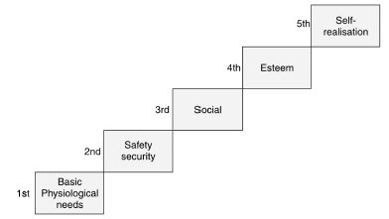
Figure: Order of priority of human needs
- Physiological needs are those which arise out of the basic physiology of life.
For example, the need for food, water, air, etc. These needs must be at least partially satisfied for continued survival.
- Security needs are the needs to feel free from economic threats and physical harm.

Slide 23
- Social needs are needs to associate with other people and be accepted by them, to love and be loved.
- Egoistic or esteem needs are those which relate to respect and prestige.
- A need for dominance may be thought as one of the egoistic needs.
- These are of two types: self-esteem and esteem from others.
- Self-esteem is an individual’s need to feel inside himself that he is worthy.
- Esteem from others is others also should think that he is worthy.
- Self-fulfilment needs – are needs for realising one’s potential. These include the need for realising one’s capabilities to the fullest for accomplishing what one is capable of accomplishing, for becoming what one is capable of becoming.
- A musician must make music, an artist must paint, and a poet must write if they want to be ultimately happy.

Slide 24
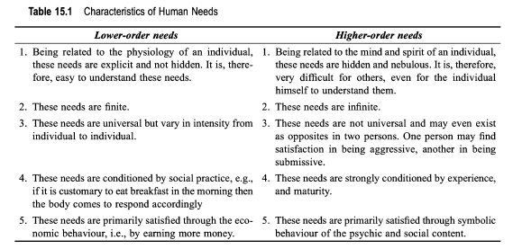
Characteristics of human needs:
- Human needs can also be classified as
(a) Lower order needs and (b) Higher order needs
- The first two needs of Maslow’s classification consist the lower order needs. (Physiological needs, Security needs)
- The other three are called higher order needs (Social needs, esteem needs, Self-fulfilment needs)

Slide 25
Merits of the Theory
1. The theory helps to explain why one man behaves differently from another in a similar situation.
2. The theory extends to all areas of man’s life instead of being limited to the work situation only.
3. The theory gives some insight into history and future trends.
4. The theory points out a fact which is ignored in the conventional approach.
Demerits of the Theory
1. The hierarchy of basic needs is not always fixed. Different people may have different orders.
2. It is difficult to know about the needs and motives of an individual from the analysis of their behaviour.
3. This theory is almost a non-testable theory.

Slide 26
Herzberg’s Two Factor Theory
- Maslow’s hierarchy of needs provides some basic needs of human life. Using this theory as a base Herzberg’s introduced two factor theory, he concentrated mainly on work situation.
In his study he and his associates interviewed 200 engineers and accountants.
- When talking about especially bad times the engineers and accountants brought up things like unfair company policies, poor relationship with their boss and co-workers, and low pay.
- When talking about especially good times they generally did not mention these factors. Instead, they talked about recognition they had received for a well done job, or the opportunity their jobs has given them for personal growth and development.
Finally Herzberg concludes
- When people are dissatisfied they are concerned about the working environment. He called this as Hygiene factors or maintenance factors.
- When people are satisfied they are concerned with work itself. He called this as motivation factor or motivators or satisfiers.

Slide 27
- There are ten maintenance factors
1. Fair company policies and administration
2. A supervisor who knows the work
3. A good relationship with one’s supervisor
4. A good relationship with one’s peers.
5. A good relationship with one’s subordinates
6. A fair salary
7. Job security
8. Personal life
9. Good working conditions
10. Status

Slide 28
- There are six motivation factors.
1. Opportunity to accomplish something significant
2. Recognition for significant accomplishments
3. Chance for advancement
4. Opportunity to grow and develop on the job
5. Chance for increased responsibility
6. The job itself
- In the absence of maintenance factors, for example, workers may feel dissatisfied. There may be more absences, more quits, and more grievances in union organisations.
But the presence of these factors does not motivate them.
- Similarly, in the presence of motivators, workers may feel motivated but their absence does not make them dissatisfied.

Slide 29
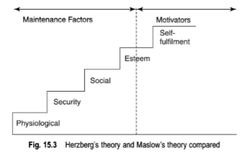
- Herzberg admits that it is depends upon individual who may be either a “motivation seeker” or a “maintenance seeker”.
- A motivation seeker (high nAch) is motivated primarily by the nature of the task and has high tolerance for poor environmental factors.
- Maintenance seeker (low nAch), on the other hand, is motivated primarily by the nature of his environment and tends to avoid motivation opportunities

Slide 30
McClelland’s Need for Achievement Theory
- According to McClelland, the three important needs are:
1. The need for Affiliation (n Aff)
2. The need for Power (n Pow) and
3. The need for Achievement (n Ach).
- A person with a high need for affiliation is concerned about social work and importance of personal relationship. It reflects a desire to interact socially with people.
- A person who has a high need for power concentrates on obtaining and exercising power and authority. And he is concerned with influencing others and winning arguments.
- A person who has a high need for achievement has three distinct characteristics.
i). Preference for setting moderately difficult but potentially achievable goals.
ii). Doing most things himself rather than getting them done by others. He wants to take personal responsibility for his success or failure and does not want to hold others are responsible for it.
iii). Seeking situations where concrete feedback is possible.

Slide 31
Victor Vroom’s Expectancy Theory
- According to Vroom, under conditions of free choice, an individual is motivated towards that activity, which he is most capable of rendering and which he believes has the highest probability of leading him to his most preferred goal.
Following are some basic concepts of this theory.
1. First and second-level outcomes
- There can be various job related goals before an individual, such as, promotion, increase in salary, recognition, and praise so on. These are second level outcomes.
- Each second level outcome holds some distinct value for the individual. This is called valence.
- The valence of any outcome may be positive, negative or zero.
- It is positive for an outcome which an individual prefers to attain (for example, promotion).
- It is negative for an outcome which he does not want to attain (for example, demotion).
- It is zero for an outcome toward which he is indifferent.( for example, No change)

Slide 32
- Each second level outcome can be achieved in a number of ways.
- For example, one can achieve promotion either by leaving the organisation or by joining some other organisation or by attending a training programme or by developing intimacy (good relationship) with his boss or by bribing somebody or by improving his performance and so on. These are called first level outcomes.
2. Instrumentality
- All first level outcomes do not have equal probability of leading the individual to the second level outcome.
- The individual has his own subjective estimates of these probabilities ranging from -1 to +1 these are called instrumentalities.
-1 indicates a belief that the second level outcome is certain without the first level outcome.
0 indicates a belief that the second level outcome is impossible with the first level outcome.
+1 indicates a belief that the second level outcome is certain with the first level outcome.

Slide 33
3. Expectancy
- Expectancy like instrumentality is also a probability estimate which joins the individual’s efforts to first level outcome.
- Expectancy values are always positive, ranging from 0 to 1.
4. Motivation
- Motivation is a multiplicative function of the valence for each first level outcome (V1) and the believed expectancy (E).
i.e M=f(V1 X E).

Slide 34
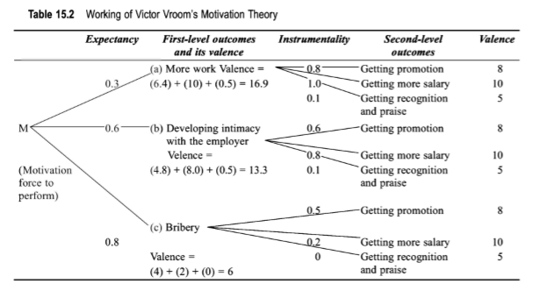
- Example of a worker faced with various first and second level outcomes, as shown in below figure.
- Thus, it can be easily predicted that the worker would be motivated toward developing intimacy with his employer (Boss). His motivation will depend not only on the valence of the first level outcome but also on the value of expectancy.

Slide 35
Communication
- According to Newman and Summer- it is an exchange of facts, ideas, opinions or emotions by two or more persons.
- Communication means the process of passing information and understanding from one person to another.
A proper understanding of information is very important aspect of communication. If the information is not understood by the receiver in the same meaning in which its sender wants him to understand it, the purpose of communication is defeated.
This may result in confusion, chaos and organisational inefficiency, leading to nonfulfillment of business goals.
- In short, communication is not only transmission of information from one person to another but also correct interpretation and understanding of the information.

Slide 36
Importance (or Purpose) of communication
1. Communication is needed in the recruitment process to hire the people and to educate them about company policies and procedures.
2. Communication is needed in the area of orientation to make employees used to company’s rules and regulations.
3. Communication is needed to enable employees to perform their functions effectively.
4. Communication is needed to acquaint (Aware) the subordinates with the evaluation of their contribution to enterprise activity.
5. Communication is needed to teach employees about personal safety on the job. This is essential to reduce accidents, to lower compensation and legal costs and to decrease recruitment and training cost for replacements.
6. Communication is importance in projecting the image of an enterprise in the society.
7. Communication helps the manager in his decision process.
8. Communication helps in achieving coordination. In a large organisation, working on the basis of division of labour and specialisation, there is need for coordination among employees of different departments.

Slide 37
9. Communication promotes cooperation and industrial peace. Most of the disputes in an enterprise take place because of either lack of communication or improper communication.
10. Communication helps the management to tell the subordinates about the objectives of the business and how they can help in achieving them.
11. Communication increases managerial efficiency. The success of a manager in the performance of his duties depends on his ability to communicate.

Slide 38
Coordination
- The management of a modem enterprise is based on the principle of specialisation or division of labour. Jobs are broken down into sub-tasks, each task is assigned to a team.
- There for to achieve the desire results coordination is important among team members and inter team members.
- It is the orderly synchronisation or fitting together of the interdependent efforts of individuals, in order to attain a common goal.
- Coordination is the management of interdependence in work situations.
- For example in a modem enterprise, which consists of a number of departments, such as production, purchase, sales, finance, personnel, etc. there is need for all of them to properly time their interdependent activities and to efficiently reunite the subdivided work.

Slide 39
In a well-coordinated enterprise, the following facts are to be observed
Each department works in harmony with the rest.
Each department, division and sub division knows the share it must take in the common task.
The working schedule of the various departments is constantly changes based on circumstances.
Importance of coordination
1. Division of Labour - managers divide work into specialised functions or departments, at the same time create a need for the coordination of these activities. Generally the greater the division of labour, the greater the need for coordination.
2. Interdependence of Units
- The need of coordination in an organisation also arises because of the interdependence of various units.

Slide 40
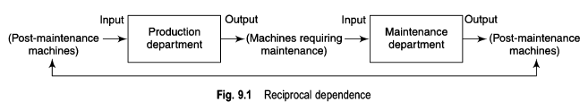
i). Pooled Interdependence
- Coordination among all the departments of an organisation at the same time.
ii). Sequential Interdependence
- One organisational unit must act before the other.
iii). Reciprocal Interdependence
The input of one unit becomes the output of the other and vice versa.
3. Unity in diversity - There are large number of employees each with different idea, views and opinions, this results into diversified activity in any organisation, So coordination bring all of them together to achieve common objective.

Slide 41
4. Specialisation - In modem industrial organizations, there is a high degree of specialization, Coordination plays an important role and in explaining the importance of each other’s activities.
5. Team work - Coordination promotes teamwork and avoid duplication of work.
6. Empire building - Empire building refers to top level of line organization. The line officers expect cooperation from staff officers but the line officers are not ready to extend their cooperation to Staff officers. This creates conflicts between line and staff officers. Therefore, coordination is necessary to avoid conflicts between line and staff officers.
7. Functional differences - The functions of organization are divided section wise. Each section performs different jobs. Each department tries to perform its function in isolation from others, Coordination is necessary to integrate the functions of the related department.
8. Recognition of goals - The are general goals of an organization. In addition each department has its own goals and the individual employees also have their own goals. Coordination plays important role to reconcile both the employee’s goals and departmental goals with organizational goals.

Slide 42
9. Communication - Coordination ensures the smooth flow of information one direction to other direction.
Controlling
- Control is one of the important functions of management. And it is the last function of management..
The main objective of controlling is to identify the variations between the standards set and actual performance and then take necessary steps to prevent the occurrence of such variations in future.
According to George R. Terry - “Controlling is determining what is being accomplished, that is by evaluating the performance and if necessary, applying corrective measures so that the performance takes place according to plans”.

Slide 43
Steps in control process
- There are three basic steps in a control process:
1. Establishing standards
2. Measuring and comparing actual results against standards
3. Taking corrective action
1. Establishing standards
- The first step in the control process is to establish standards against which results can be measured.
- Since entire operations cannot be observed, each organisation must first develop its own list of key areas for the purpose of control.

Slide 44
Some key areas in all business organisations are
- Profitability, market position, productivity, personnel development, employee attitudes and public responsibility etc.
- Standards need to be flexible in order to adapt to changing conditions.
- Standards may be qualitative or quantitative
- Standards like costs should be reduced, communication is to be faster and employees moral etc. are some of the examples of qualitative.
- Standards like number of units produced, profit percentage, total cost incurred, standard hours etc. are some of the examples of quantitative.

Slide 45
Standards can be of following types
i. Physical standards
- Such as labour hours per unit of output, units of production per machine per hour so on.
ii. Cost standards
- Such as direct and indirect cost per unit produced, material cost per unit, selling cost per unit of sale, etc.
iii. Revenue standards
- Such as average sale per customer, sales per capita in a given market area, etc.
iv. Capital standards
- Such as the rate of return on capital invested, ratio of current assets to current liabilities, etc.
v. Intangible standards
- Such as competence of managers and employees, success of a public relation programme, etc.
vi. Working practice standards
- Rules and regulations standards for an employees.

Slide 46
2. Measuring and comparing actual results against standards
- The second step in the control process is to measure the performance and compare it with the set standards.
- Measurement of performance can be done by personal observation, or by study of a various summaries of figures, reports, charts and standards.
- Comparison is easy if system is well defined.
- Some variations are desirable such as the output above the standard or expenses below the standard.
- But some variations are undesirable such as a variation in the delivery schedule, excess cost per product etc.

Slide 47
3. Taking Corrective Action
- After comparing the actual performance with set standards and finding the deviations. The next step that should be taken by the manager is to correct these deviations.
- Corrective action should be taken without wasting time so that the normal position can be restored.
The causes for deviation may be due to
- Inadequate communication
- Poor equipment and machinery
- Defective system of training and selection of personnel
- Negligence from workers
- Ineffective supervision

Slide 48
Methods of establishing control
Personal observation
Budgeting
Cost accounting and Cost control
Break-Even analysis
Standard costing
Return on investment (ROI)
Responsibility accounting
Management audit
Internal audit
External audit
Gantt milestone chart
Programme Evaluation and Review Technique (PERT)
Critical Path Method (CPM)

