Slide 1
Algorithms Analysis & Design
Chapter 1
The Role of Algorithms in Computing
Dr. Ahmed Awad

Slide 2
Algorithms
    Algorithm: A well-defined sequence of computational steps that takes a set of values at input and produces a set of values as output in a finite amount of time.
    A tool for solving well-specified computational problem.
    Describes a specific computational procedure for achieving the input/output relationship for all problem instances.
Input
Algorithm
Output

Slide 3
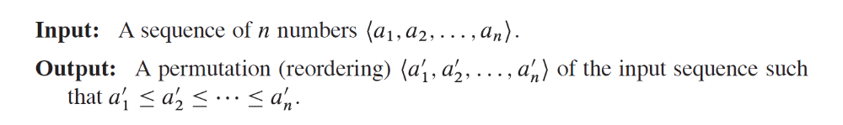
Problem Statement
    Terms the desired input/output relationship.
    Problem Instance: Consists of the input (satisfying the constraints imposed in the problem statement) needed to compute a solution to the problem.
    Example: Sorting problem
      Need to sort a sequence of numbers into increasing order.
      Formally defined as follows:
      Sorting Problem Instance: Given the input sequence (31, 41, -17, 41, 30)
      ➔ A correct sorting algorithm should output the sequence (-17, 30, 31, 41, 41)

Slide 4

The Problem-solving Process
Analysis
Problem specification
Design
Algorithm
Implementation
Program
Compilation
Executable (solution)

Slide 5
Correct Algorithm
    An algorithm for a computational problem is correct if:
      For every problem instance provided as input, the algorithm halts its computing in a finite time.
      outputs the correct solution to the problem instance.
    Incorrect algorithm might not halt at all on some problem instances or might halt with incorrect answer.
      Might be correct if you can control their error rate.

Slide 6
Writing an Algorithm
    An algorithm can be written in many ways:
      English or any other language.
      Pseudocode
    The only requirement is that the specification must provide a precise description of the computational procedure to be followed.
    Pseudocode: A way of writing program descriptions that is similar to programming languages but may include English descriptions and does not have a precise syntax.

Slide 7
Example: Finding the max of 3 numbers input=a,b,c. output=x.
Max(a, b, c){
x=a
//if b larger than x, update x
if(b>x) x=b
//if c larger than x, update x
if(c>x) x=c
Return x
}

Slide 8
Example: Finding the max value in an array.
Input: array s. output: max
Array_Max2(s[ ], size){
max=s[1]
for(i=2 to size){ // i<=size
if(s[i]>max) max=s[i];
}
return max }
}

Slide 9
Practical Problems to be Solved by Algorithms
    Biological problems (Identifying genes in human DNA,..)
      Dynamic programming is used for solving such problems with utilizing resources efficiently.
    Manage and manipulate large volumes of Internet data
      Using search engines to quickly find pages on which particular information resides.
      Routing algorithms are utilized.
    Electronic commerce (E- commerce)
      Depends on the privacy of personal information.
      Requires numerical algorithms and number theory
    Allocating scares resources in the most beneficial way
      Linear programming is effectively used.
    Finding the shortest path from one point to another.
      Shortest path algorithms (problem modeled as graph).
    Determine whether a medical image represents a cancerous tumor or benign.
      Use clustering algorithms.
    Compressing large files containing text with Huffman coding

Slide 10
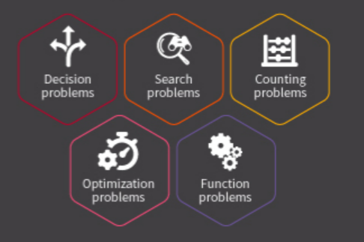
Characteristics of Algorithmic Problems
    Some problems have many candidate solutions and the task is to find the one that is the “best”.
    Some problems have practical applications such as finding the shortest path through a network to route message quickly.

Slide 11
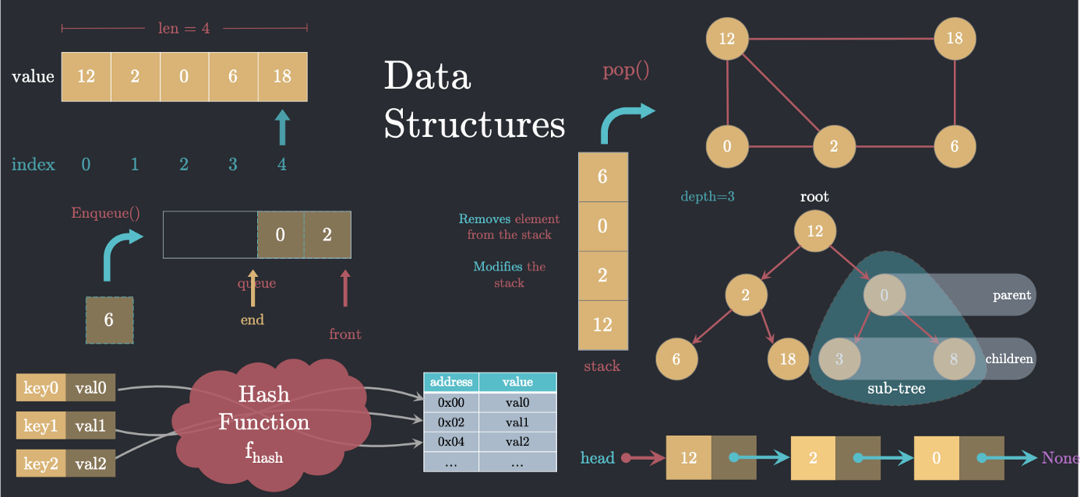
Data Structures
    A way to store and organize data in order to facilitate its access and modifications.
    Using the appropriate data structure is an important part of algorithm design.
    No single data structure works well for all purposes.

Slide 12
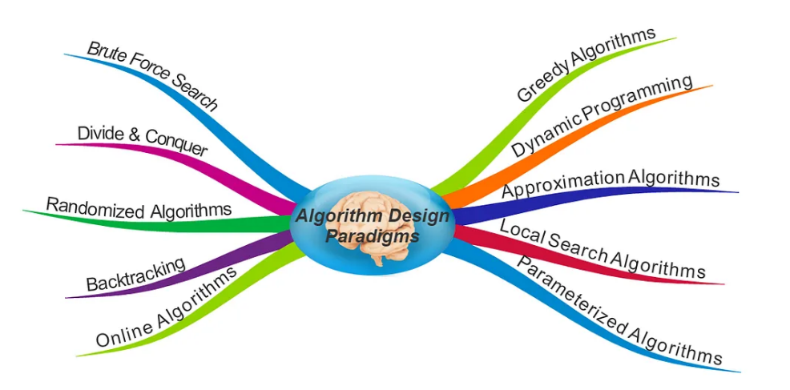
Techniques
    You need techniques of algorithm design and analysis so that you can develop efficient algorithms on your own.

Slide 13
Hard Problems
    Common Question: How long does an algorithm take to produce its result?
    Hard computational problem: A problem for which we know no algorithm that runs in a reasonable time.
    Hard decision problems (with yes/no answer) are said to be NP-complete.
    NP-complete problems are interesting because:
      No one knows whether efficient algorithms exist for such problems.
      If an efficient algorithm exists for any one of such problems, then efficient algorithms exist for all of them.
      Several NP-complete problems are similar, but not identical, to problems for which we know efficient algorithms.
      If you show that a problem is NP-complete, you can spend your time developing an efficient approximation algorithm (An algorithm that gives a good, but not necessarily the best possible solution).

Slide 14
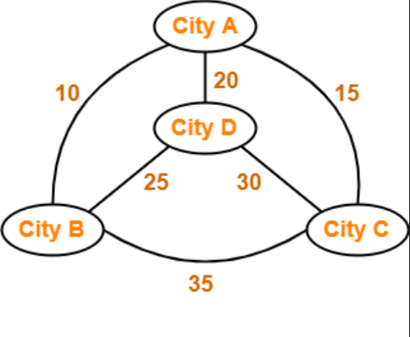
Traveling-Salesman Problem (TSP)
    A classic hard problem in computer science.
    Asks for the shortest possible route that visits a set of cities exactly once and returns to the origin city.
A → B → D → C → A

Slide 15
Alternative Computing Models
    Parallel algorithms
      Need to be designed to cope with multicore computers.
    Online algorithms
      Receive their input over time, rather than having the input present at the start.

Slide 16

Algorithms as a Technology
    If computers were infinitely fast and computer memory were free, we still need be certain that an algorithm terminates with the correct answer.
    However, computers are not infinitely fast.
        Computing time is a bounded resource.
    Memory is neither infinite nor free.
    ➔ We need to choose algorithms that use the resources of time and space efficiently.

Slide 17
Efficiency of Algorithms
    Different algorithms devised to solve the same problem often differ dramatically in their efficiency.
    Example:
      Insertion sort takes time equal to ≈ c₁n² to sort n items.
      Merge sort takes time equal to ≈ c₂nlgn
      c₁ and c₂ are two constants independent of n where c₁ < c₂
      Insertion sort running time ≈ c₁n.n
      Merge sort running time ≈ c₂n.lgn
      Merge sort has a factor of lgn which is much smaller than n.
      For n=1000, lgn≈10, for n=10⁶, lgn ≈ 20.
      Insert sort runs faster for small input sizes.
      Once the input size n becomes large enough, merge sort significantly outperforms insertion sort.

Slide 18
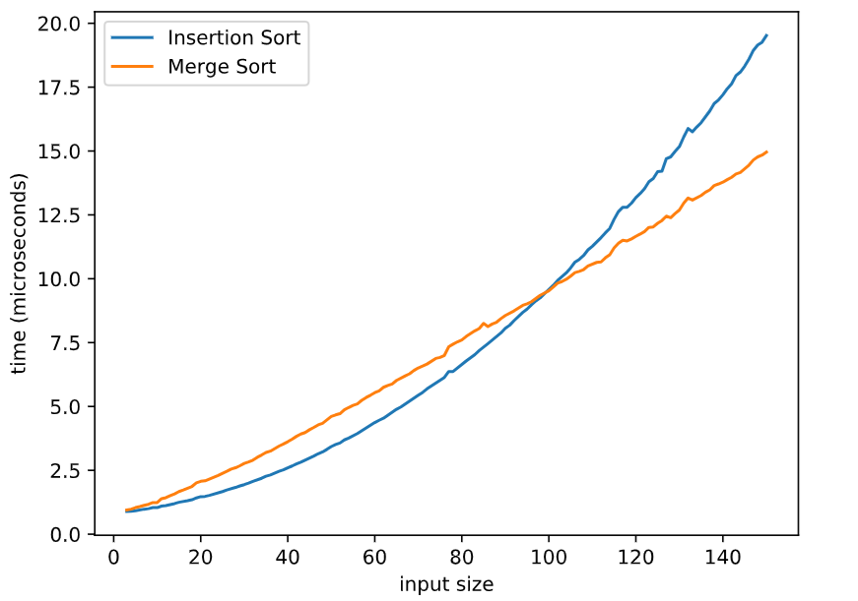

Efficiency of Algorithms

Slide 19
Efficiency of Algorithms- Motivating Example
    Two computers must sort an array of 10 million numbers.
    Computer A
      A fast computer
      Running insertion sort.
      Executes 10 billion instructions per second.
      Implements insertion sort in machine language and the resulting code requires 2n² instructions to sort n numbers.
    Computer B
      A slow computer.
      Running merge sort.
      Executes 10 million instructions per second.
      Implements merge sort using high-level language with an inefficient compiler with the resulting code takes 50nlgn instructions to sort n numbers.
      Which computer is faster?

Slide 20
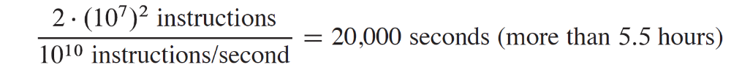
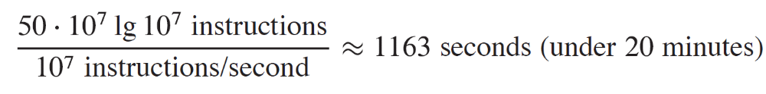
Efficiency of Algorithms- Motivating Example (2)
    To sort an array of 10 million numbers.
    Computer A takes
    While Computer B takes
By using a more efficient algorithm, even with poor compiler, computer B runs more than 17 times faster than computer A!

Slide 21
Algorithms & Other Technologies
    The total system performance depends on choosing efficient algorithms as much as on choosing fast hardware.
    Just as rapid advances are being made in other computer technologies, they are being made in algorithms.
    Algorithms are truly important in light of other advanced technologies including:
        Advanced computer architectures and fabrication technologies.
        Easy-to-use GUIs.
        Object-oriented systems.
        Integrated web technologies.
        Fast networking (wired and wireless)
        Machine learning.
        Mobile devices.
        .....

Slide 22
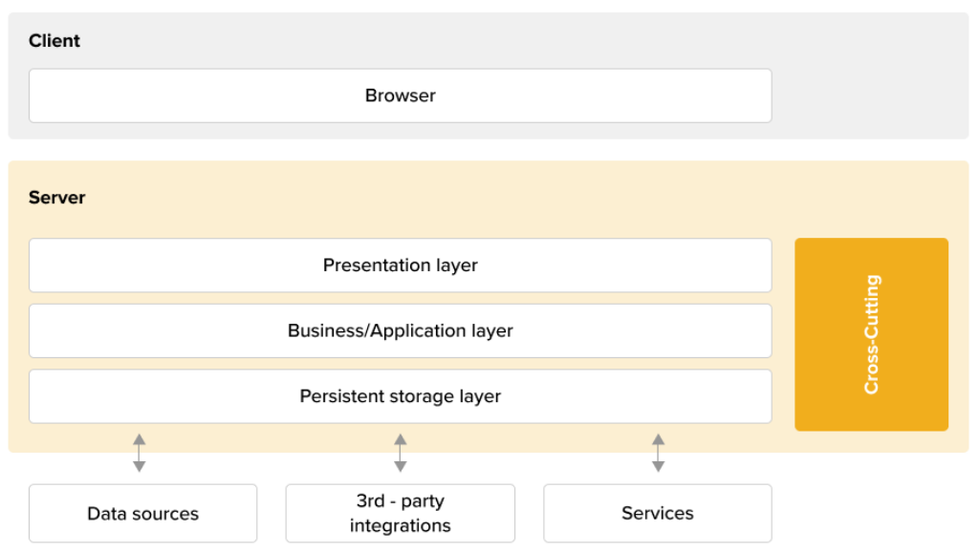
Algorithms & Other Technologies
    Applications do not explicitly require algorithmic content at the application level.
    Rely on fast hardware, GUI, networking, object orientation, but it requires algorithms for operations.

Slide 23
Algorithms & Other Technologies
    Application relies on fast hardware.
      Hardware design used algorithms.
    Application relies on GUI
      The design of any GUI relies on algorithms.
    Application relies on networking.
      Routing in networks relies heavily on algorithms.
    The application was written in a language.
      It was processed by a compiler, interpreter, and assembler, all of which make extensive use of algorithms.
      ➔ Algorithms are at the core of most technologies used in computers.

Slide 24
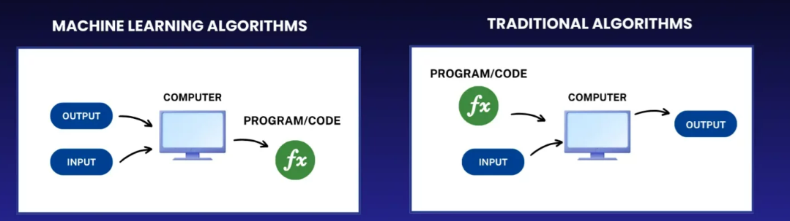
Algorithms & Machine Learning
    Machine learning can be thought as a method for performing algorithmic tasks without explicitly designing an algorithm.
    Machine learning itself is a collection of algorithms.
    The success of machine learning is mainly for problems for which we, as humans, do not really understand what the right algorithm is.
    Efficient algorithms designed to solve a specific problem are typically much more successful than machine learning approaches.

