Slide 1
Algorithms Analysis & Design
Chapter 2
Analysing Algorithms
Dr. Ahmed Awad

Slide 2
Algorithm Analysis
    Predicting the resources that the algorithm requires.
      Memory.
      Communication.
      Bandwidth.
      Energy consumption.
      …
    Most often, we are interested in computation time.
    Analyzing several candidate algorithms for a problem can identify the most efficient one.
      Similarly, can rule out several inferior algorithms in the progress.

Slide 3
Algorithm Analysis Requirements
    Need a model of the technology the algorithm runs on.
    Basic Assumption: Generic one-processor, Random Access Machine (RAM) model of computation.
    RAM Model:
      Instructions execute one after another.
      No concurrent operations.
      Each instruction takes the same amount of time as any other instruction.
      Each data access (read/write) takes the same amount of time as any other data access.
      ➔ Each instruction or data access takes a constant amount of time.

Slide 4
Algorithm Analysis- Basic Operations
    Arithmetic (add, subtract, multiply, divide, remainder,..)
    Data movement (load, store, copy).
    Control (conditional and unconditional branch, subroutine call, return)
    Examples:
    Arithmetic: (low + high)/2
    Control: if ( x > 0 ) …
    Data movement: temp = x
    Assumption: Each basic operation or memory access takes exactly one step.
    Loops and subroutine calls are not basic operations.

Slide 5
Algorithm Analysis- Example
int sum(int n){
result=0; c1
For(i=1 to n) c2(n+1)
result+=I c3(n)
Return result c4
}
Total runtime of the above algorithm
T(n)= c1+c2(n+1)+c3n+c4 = c1+c2n+c2+c3n+c4
= c1+c2+c4+n(c2+c3) = a+bn for some constants a and b

Slide 6
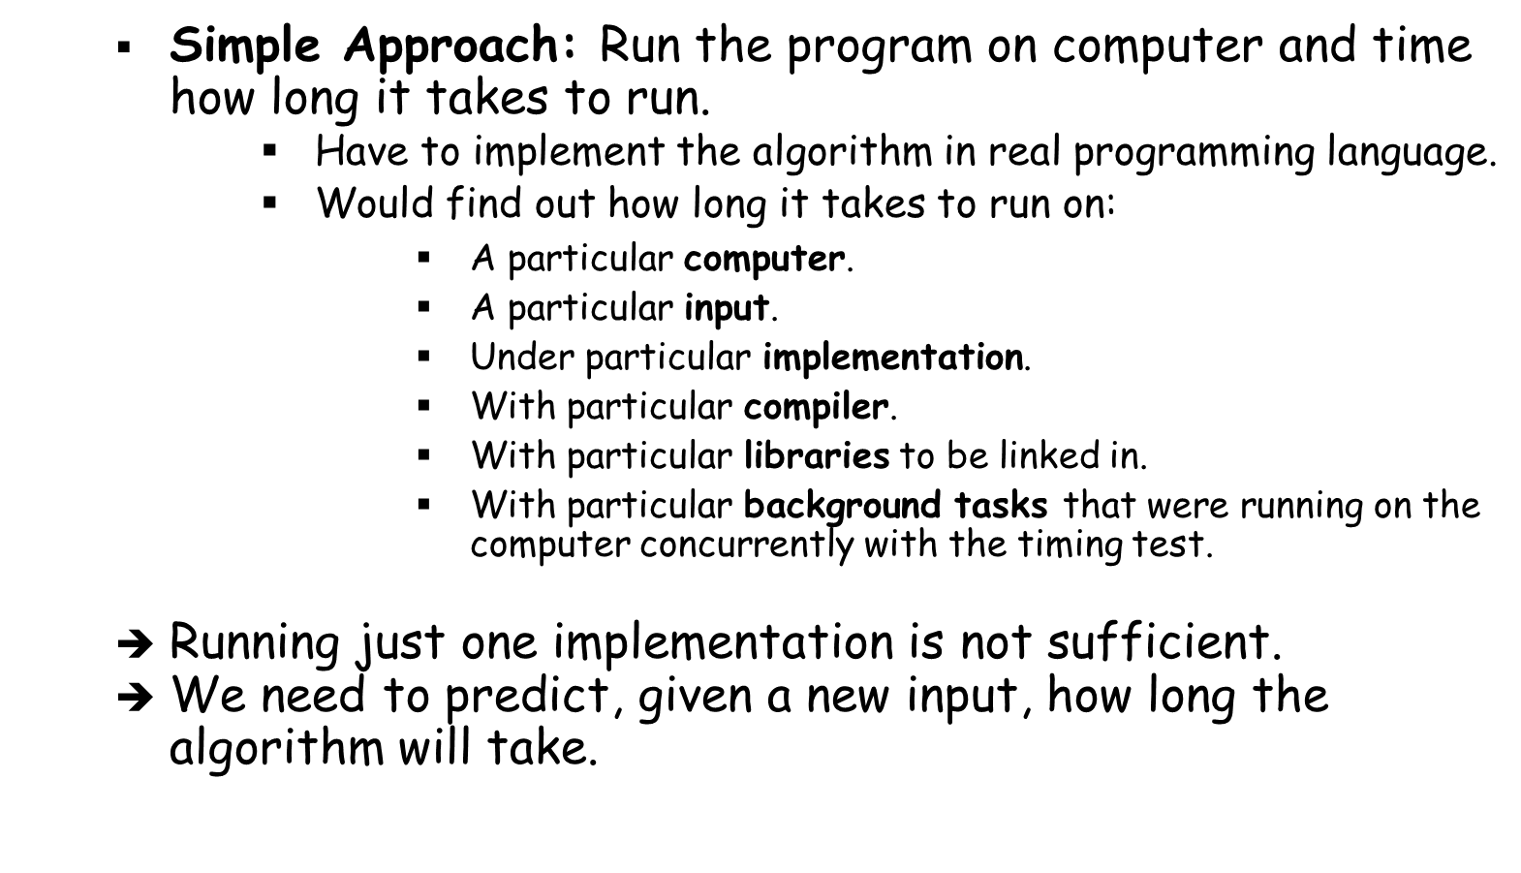
How to Calculate the Runtime of An Algorithm?

Slide 7
How to Calculate the Runtime of An Algorithm?
    Analyze the algorithm itself.
    Examine how many times the algorithm executes each line of the pseudocode and how long each line of psueducode takes to run.
    Result: Complicated formula for the running time.
    Then: Distill the important part of the formula.
    ➔ This will help compare the running times of different algorithms for the same problem.

Slide 8
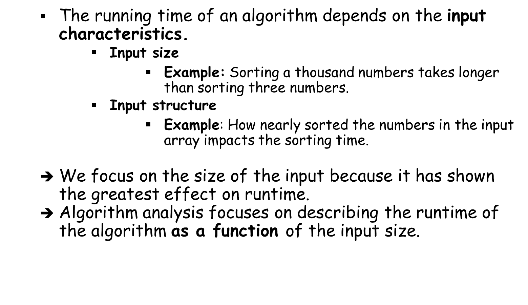
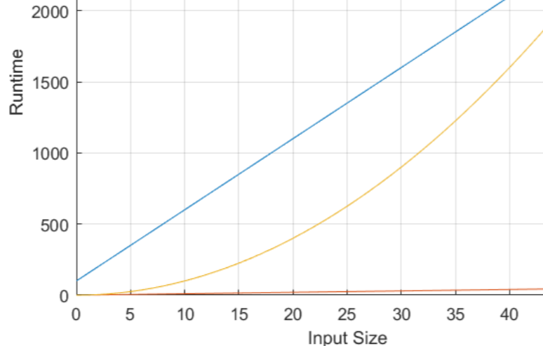
Runtime Versus Input

Slide 9
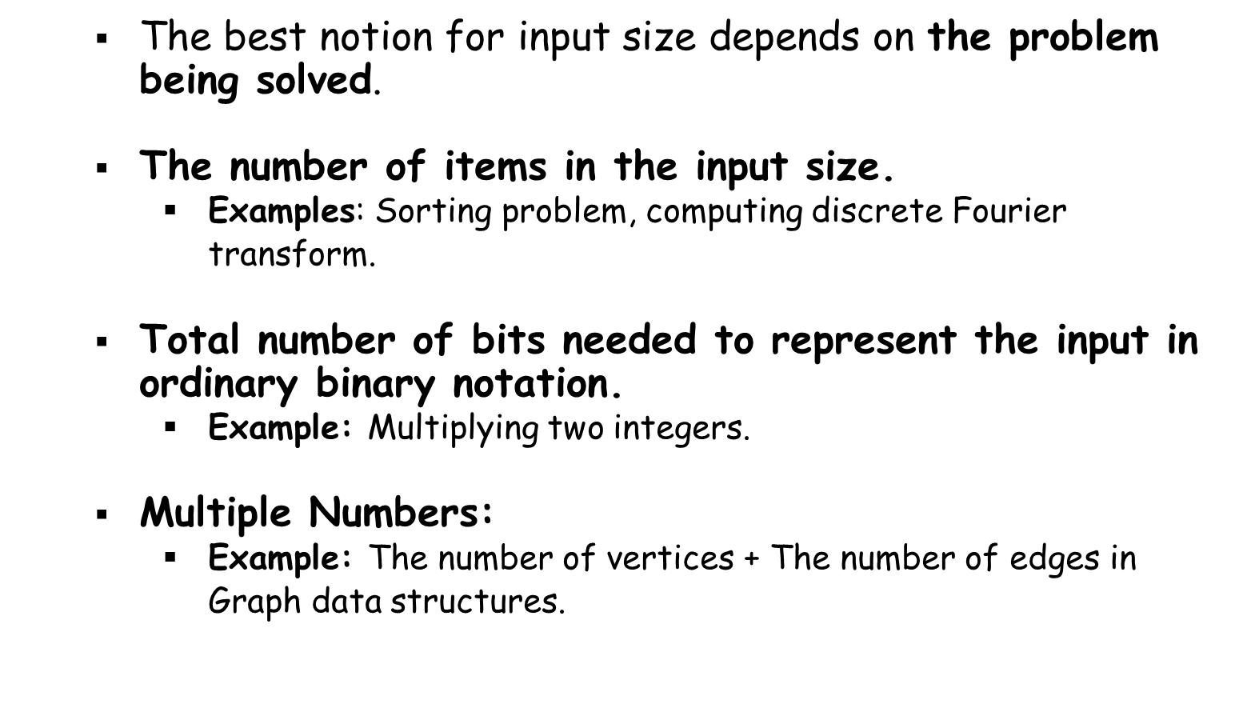


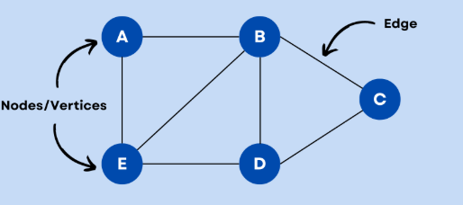
Input Size

Slide 10
Running Time of An Algorithm
    The number of instructions and data accesses executed.
    Accounting for the costs should be independent of any particular computer, but within the framework of the RAM model.
    Remember:
      A constant amount of time is required to execute each line of the pseudocode.
      One line might take more or less than another line. So, we assume that each execution of the kth line takes c_{k} time, where c_{k} is a constant.
      A statement that takes c_{k} steps to execute and executes m times contributes c_{k}.m to the total running time.
      The runtime of the algorithm is the sum of running times for each statement executed.
      The runtime of an algorithm of an input size of n, is denoted by T(n).

Slide 11
Example
Horner(int a[], n, x){
result=a[n] c1
for(i=n-1;i>=0,--i) c2(n+1)
result=result*x+a[i] c3n
return result c4
}
T(n)=c1+c2(n+1)+c3n+c4
T(n)=a+bn for some constants a, b that depend on the statement costs.
➔ Running time is a linear function of n

Slide 12
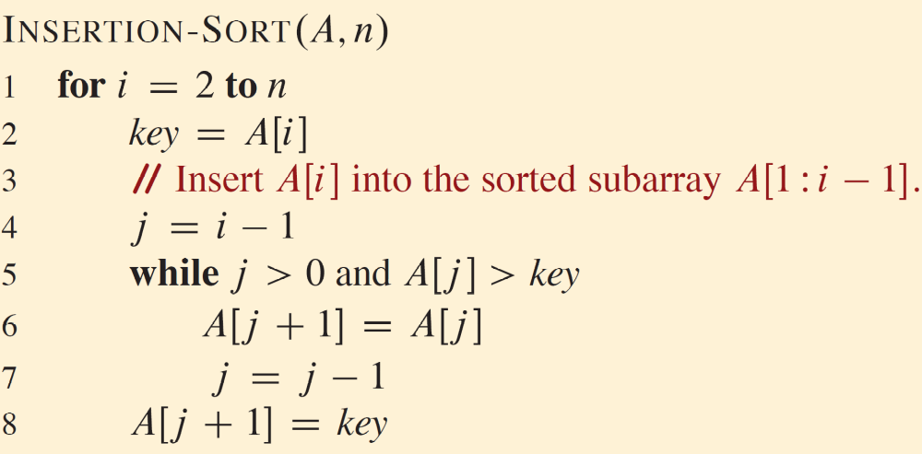
Example- Insertion Sort Algorithm
What is the running time of this algorithm?

Slide 13
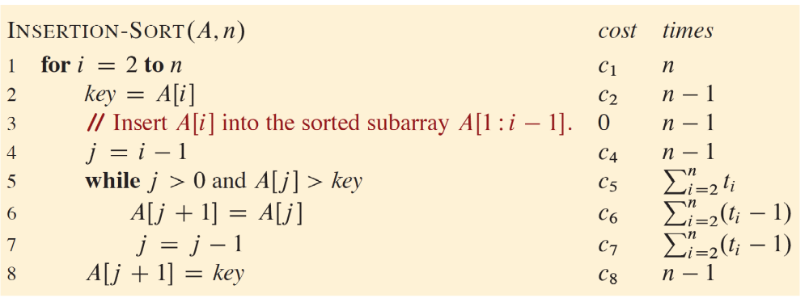
Example- Insertion Sort Algorithm
t_{i}: The number of times the while loop test in line 5
When a loop exits, the test statement of the loop is executed one time more than the loop body.
Comments take no time (Not executable statements).

Slide 14
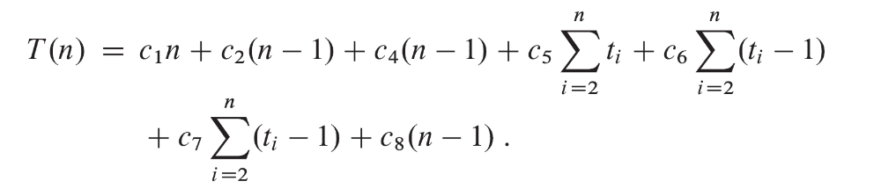
Example- Insertion Sort Algorithm

Slide 15
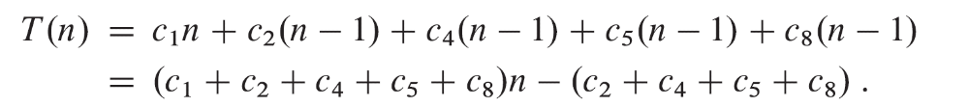
Example- Insertion Sort Algorithm – Best Case
The best case: The array is already sorted.
➔ While loop will always exit upon the first test in line 5.
T(n) = an+b (Linear function of n)

Slide 16
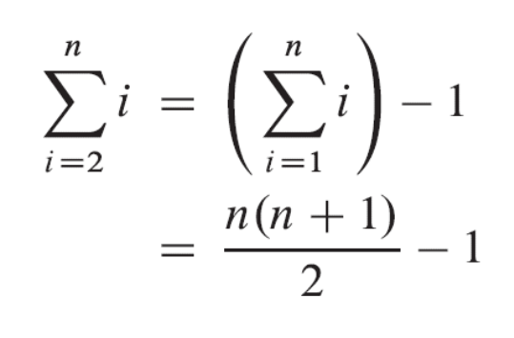
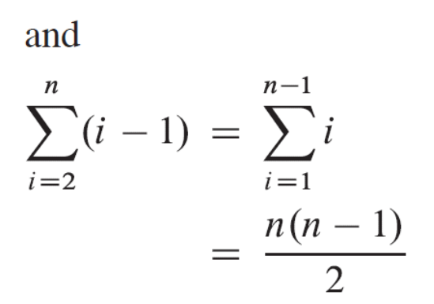
Example- Insertion Sort Algorithm – Worst Case
The worst case: The array is in reverse sorted order.
➔ ti=i for i=2,3,…,n

Slide 17
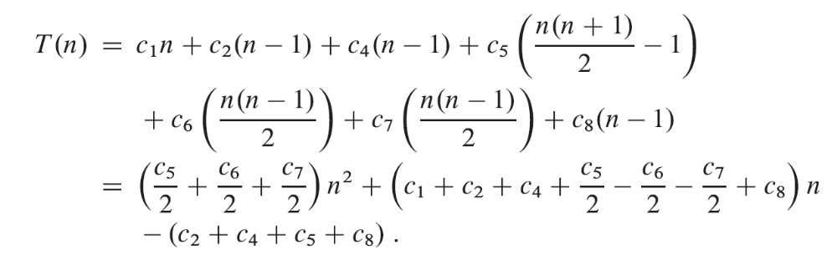
Example- Insertion Sort Algorithm – Worst Case
T(n) = an²+bn+c (Quadratic function of n)

Slide 18
Example- Insertion Sort Algorithm – Worst Case
T(n) = an²+bn+c (Quadratic function of n)

Slide 19
Worst-case and Average-case Analysis
    Worst-case Running Time: The longest running time for any input size.
    Best-case Running Time: The shortest running time for any input size.
    Average-case Running Time: The average running time over every possible type of input, assuming that all inputs of a given size, are equally likely (involves probabilistic analysis).
    ➔ We usually concentrate on finding only the worst-case running time. Why?

Slide 20
Worst-case Analysis
    The worst-case running time of an algorithm gives an upper bound on the running time for any input.
      If you know it, you have a guarantee that the algorithm never takes any longer.
      Important for real-time computing, in which operations must complete by a deadline.
    The worst case occurs fairly often.
      Example: Searching a database for a particular piece of information, the worst case occurs when the information is not present in the database, which may be frequent.
    The average case is often roughly as bad as the worst case.
      Example: For insertion sort, the resulting average-case running time turns out to be a quadratic function of the input size, just like the worst case.

Slide 21
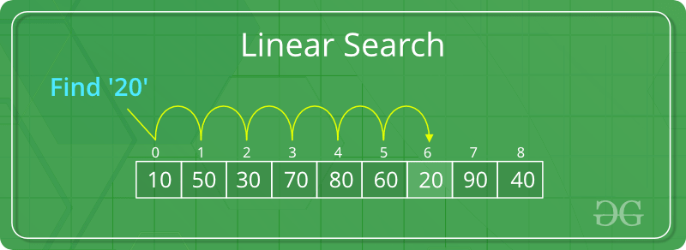
Example: Sequential Search
C1
??
??
C4
Seq_search (A[n], x){
i=0;
while(i<n && A[i] != x){
i++;}
return i;
}

Slide 22
Sequential Search: Best Case
C1
C2
C3
Seq_search (A[n], x){
i=0;
while(i<n && A[i] != x){
i++;}
return i;
}
X is the first element in the array (A[0])
T(n)=c1+c2+c3
The best case time is constant
T(n)=const.

Slide 23
Sequential Search: Worst Case
C1
C2(n+1)
C3(n)
C4
Seq_search (A[n], x){
i=0;
while(i<n && A[i] != x){
i++;}
return i;
}
x is not found in the array.
T(n)=c1+c2(n+1)+c3n+c4
NOTE: for simplification ignore the actual cost for each statement
The worst case time is a+bn for some constants a, b

Slide 24
Another Example
fun (int x, int n){
Sum=0;
For(i=0→n){
P=1
For(j=0; j < n ;++j)
P*=x
Sum+=p
}
}
What is the running time?

Slide 25
Another Example
fun (int x, int n){
Sum=0;
For(i=0→n){
P=1
For(j=0; j < n ;++j)
P*=x
Sum+=p
}
}
C1
C2 (n+2)
C3 (n+1)
C4 (n+1) (n+1)
C5 (n+1) (n)
C6 (n+1)
What is the running time?
T(n) = a + b n + c n²
for some constants a, b, c

