Slide 1
CSE 2200
Advanced Programming Laboratory
Project Name : Train Ticket Management System
Developed By
Omar Bin Sariffuzzaman
Roll : 1907026

Slide 2
Introduction
Train ticket management application is an platform for booking train ticket for desired trip

Slide 3
Objectives
To develop an easy and user friendly application for train ticket management
To develop an application for checking details of any trip
To develop an application for ticket booking of desired trip

Slide 4
Features
Search for tickets
Select Ticket for desired trip
See purchased tickets
See trip details

Slide 5
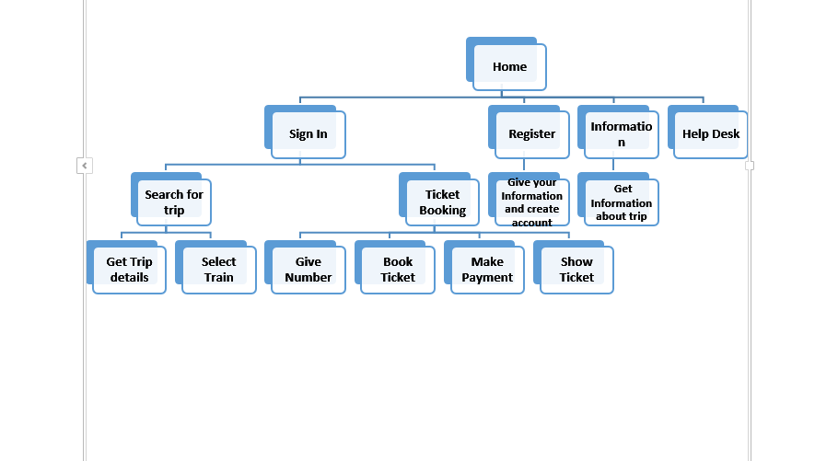
Sequence Diagram

Slide 6
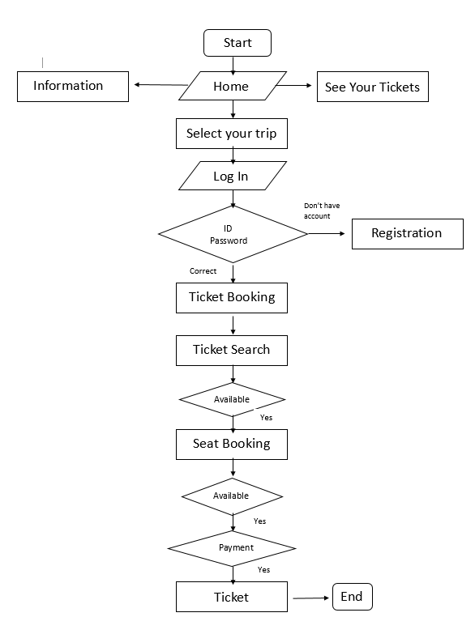
Flowchart

Slide 7
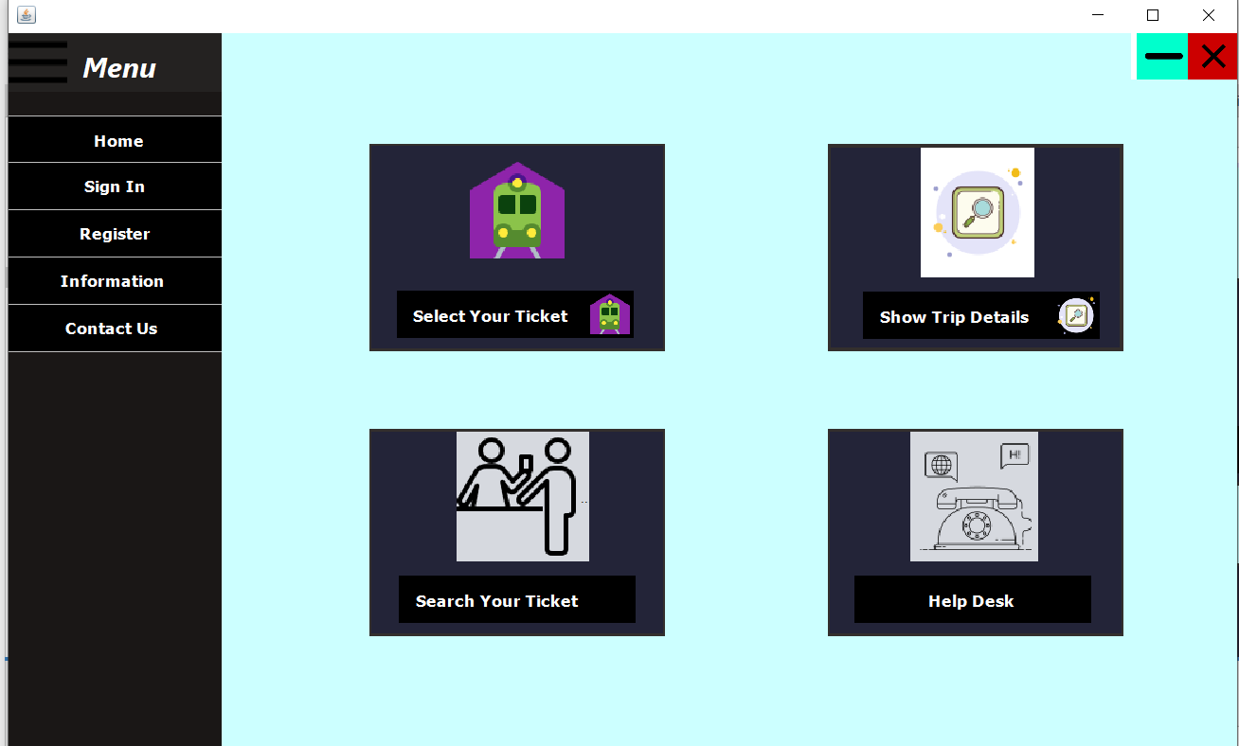
Visualization

Slide 8
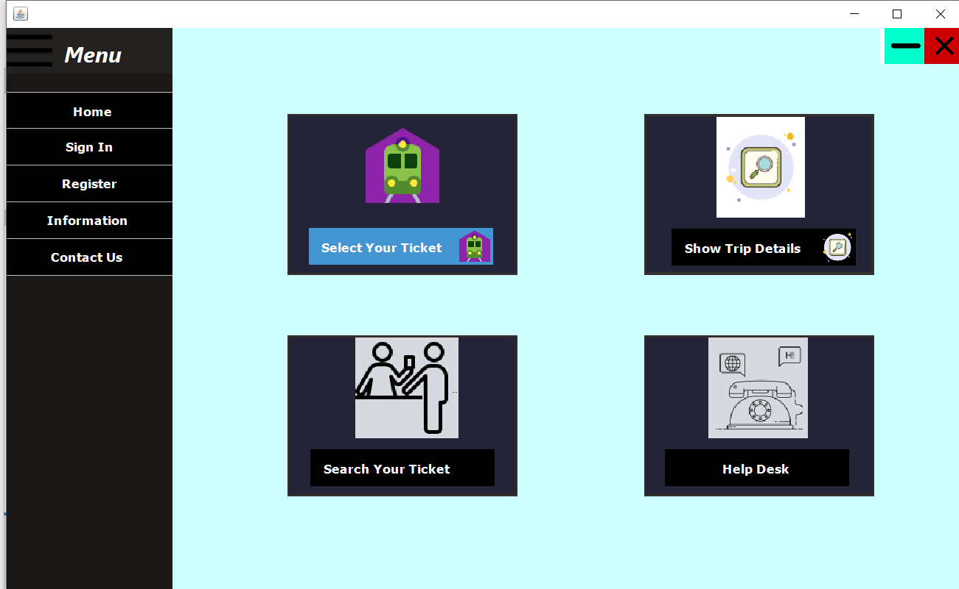
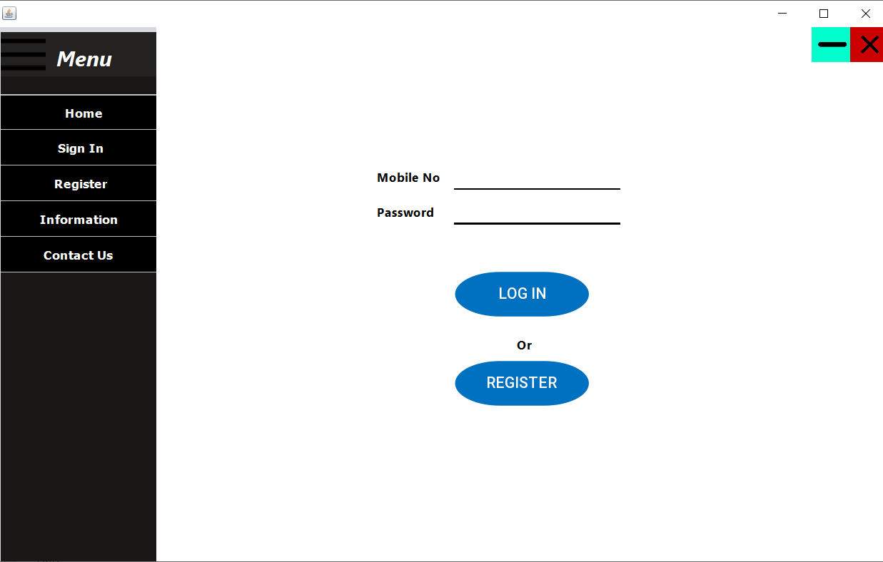
Visualization

Slide 9
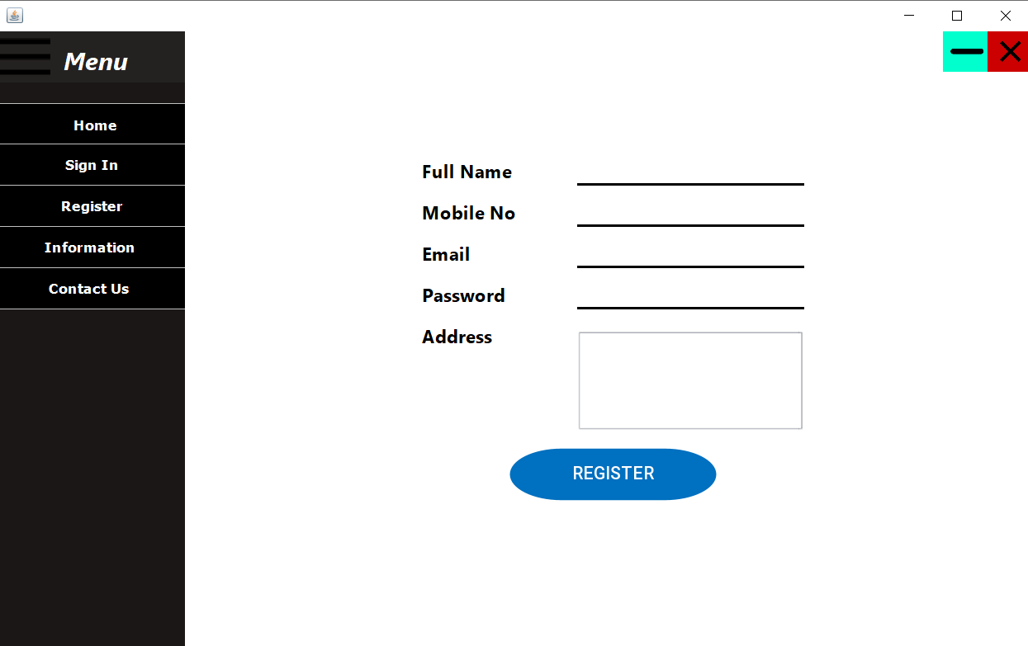
Visualization

Slide 10

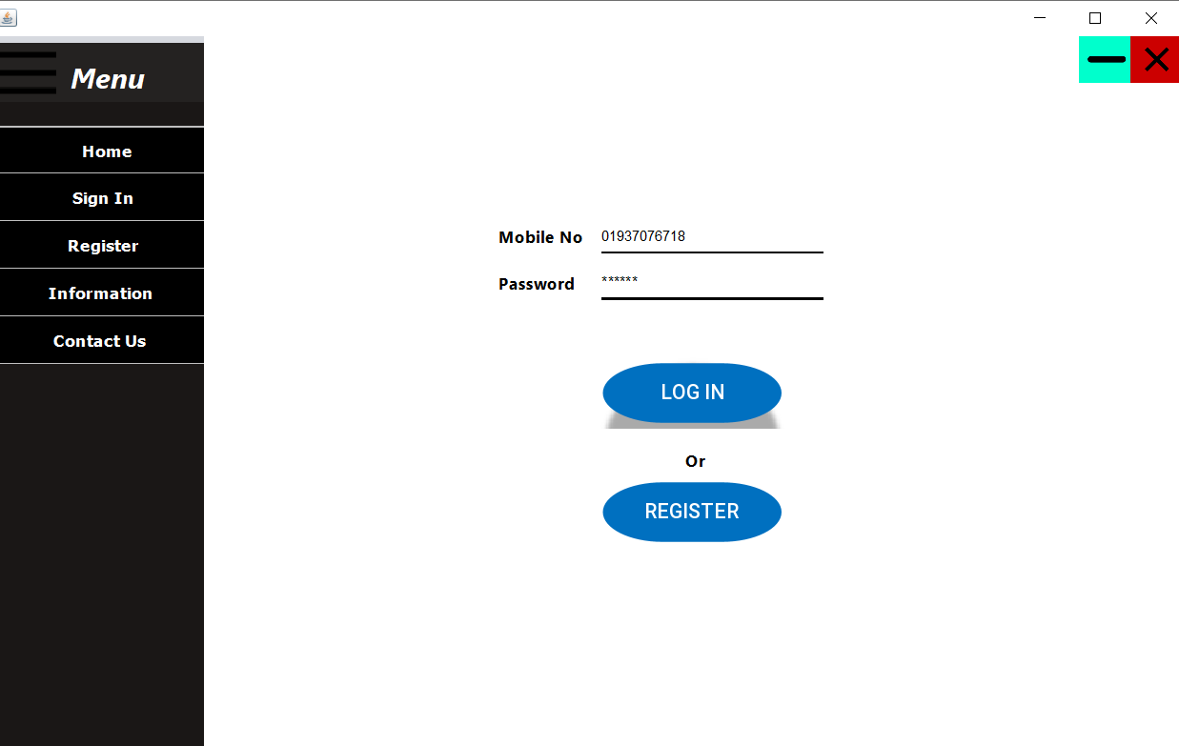
Visualization

Slide 11
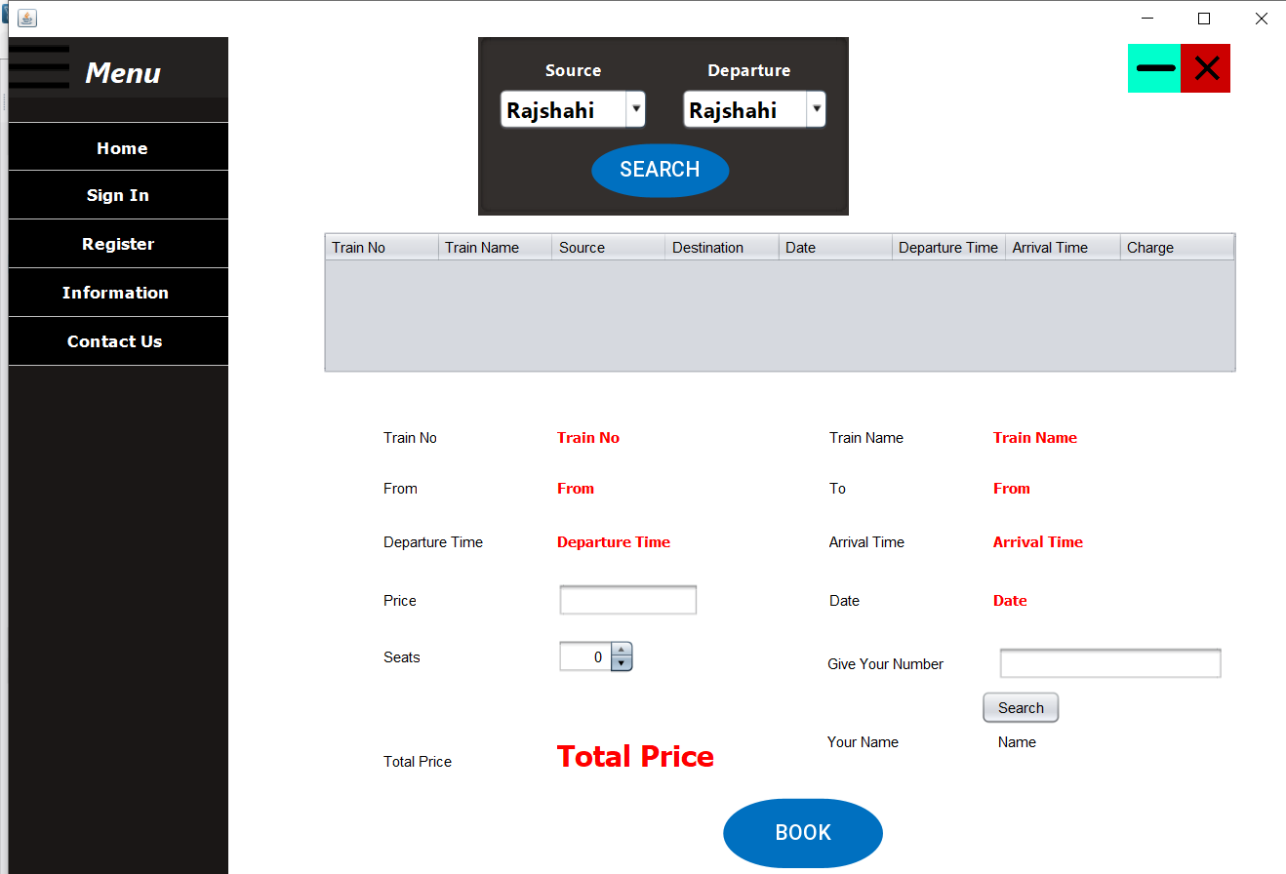
Visualization

Slide 12
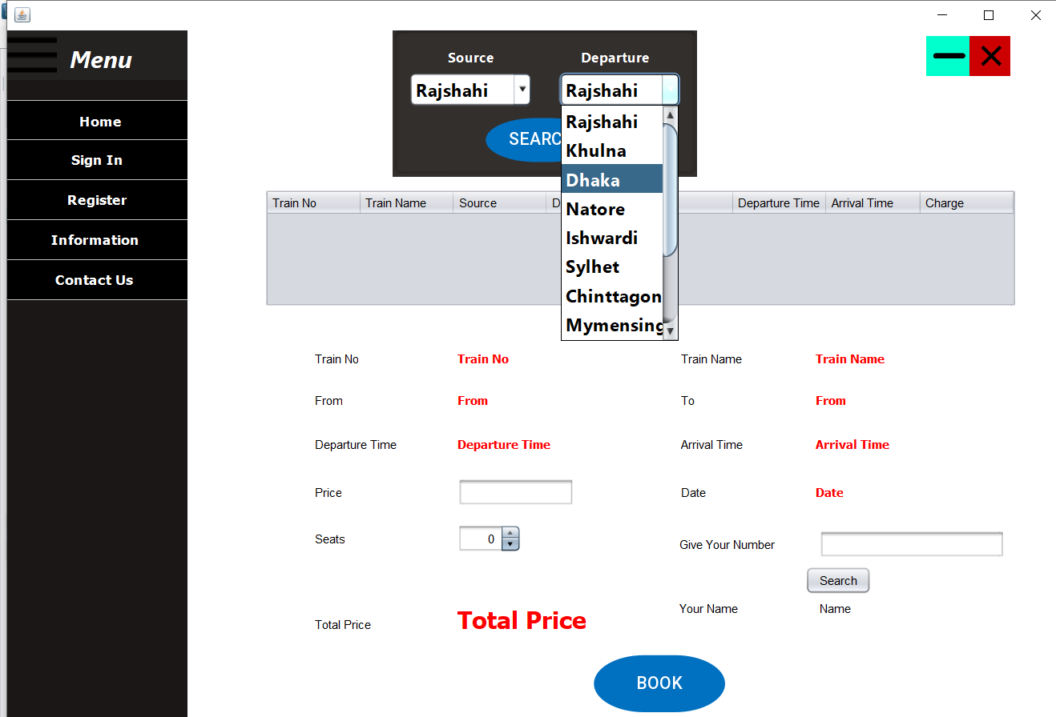

Visualization

Slide 13
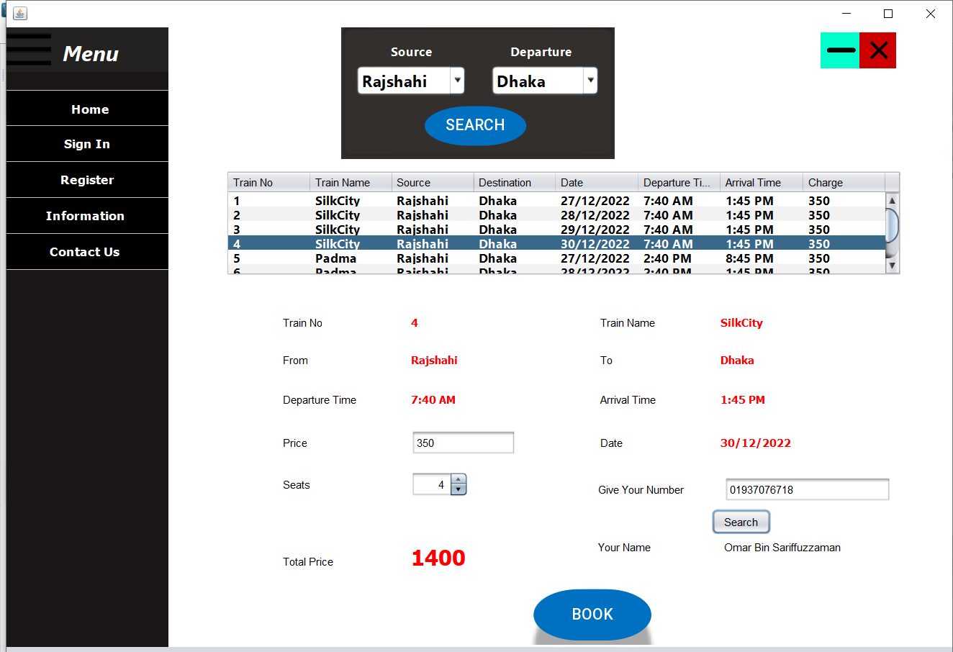
Visualization

Slide 14
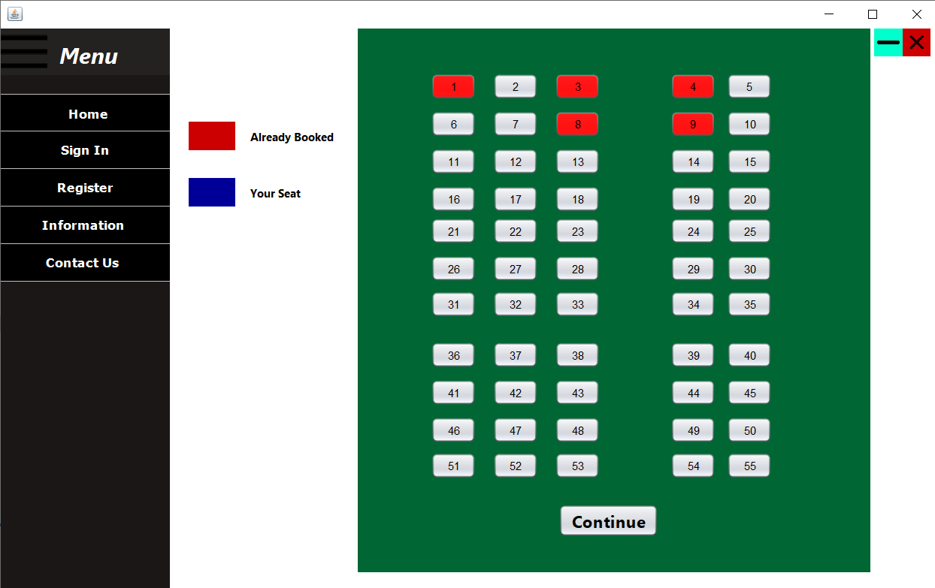
Visualization

Slide 15
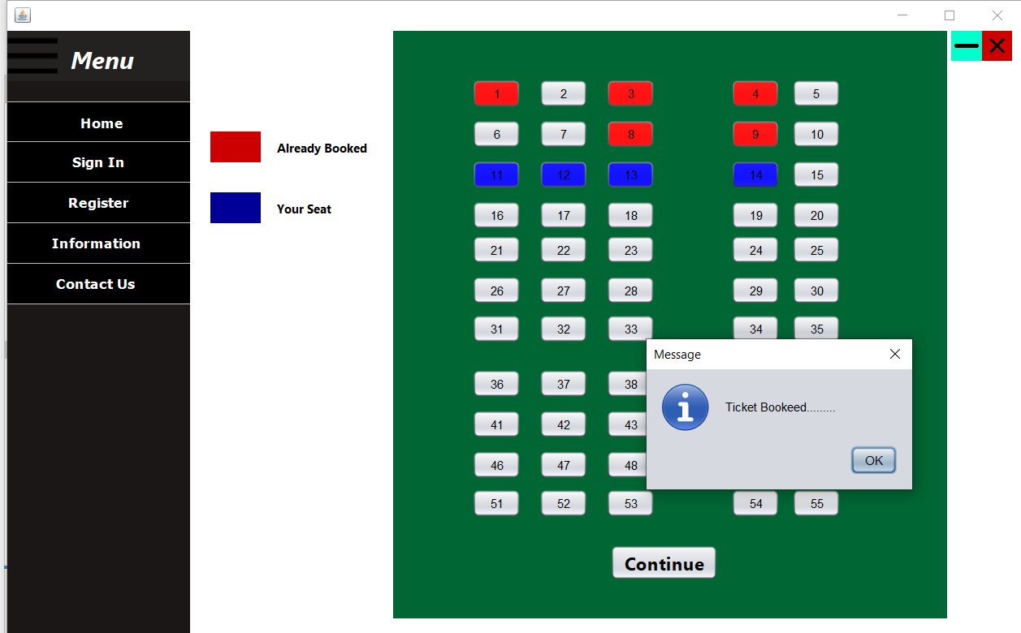
Visualization

Slide 16
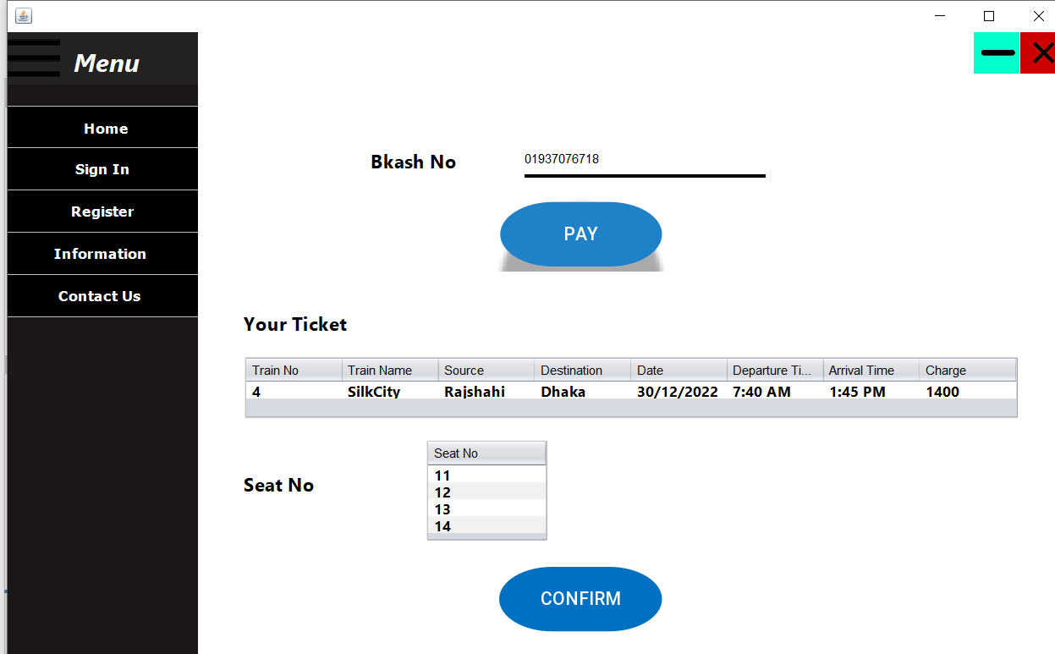
Visualization

Slide 17
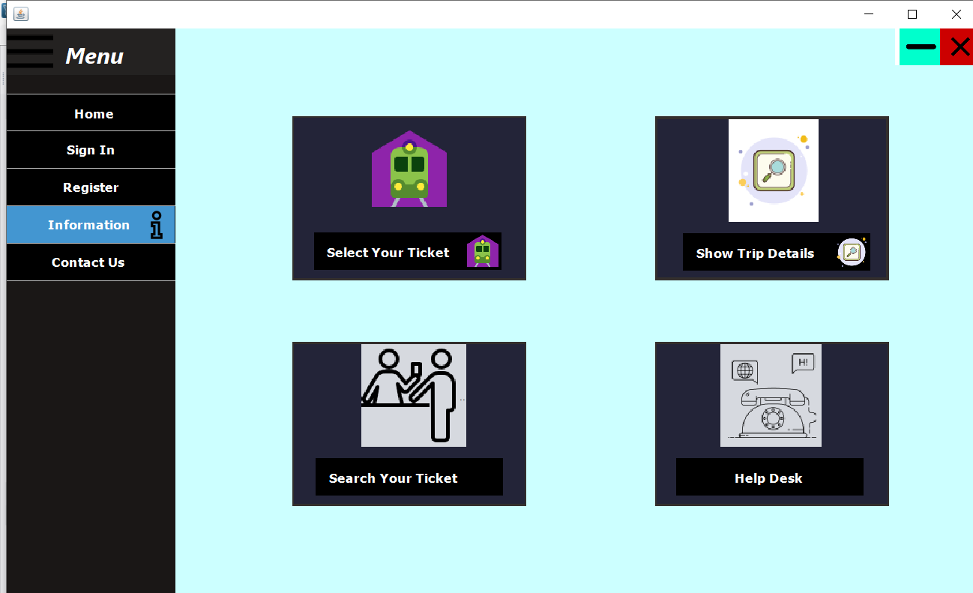
Visualization

Slide 18
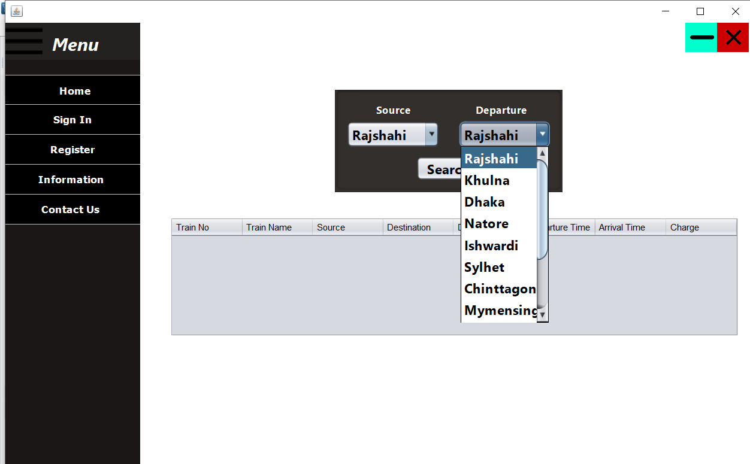
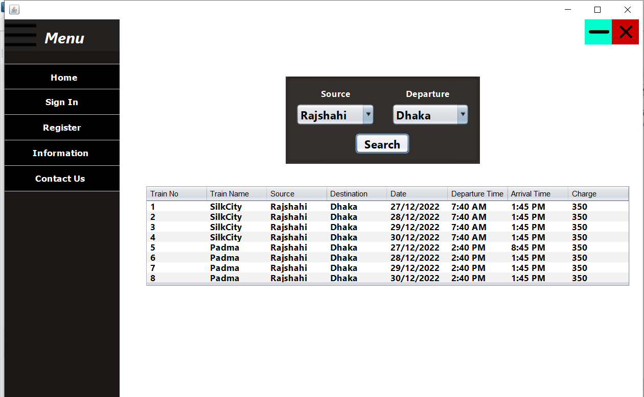
Visualization

Slide 19
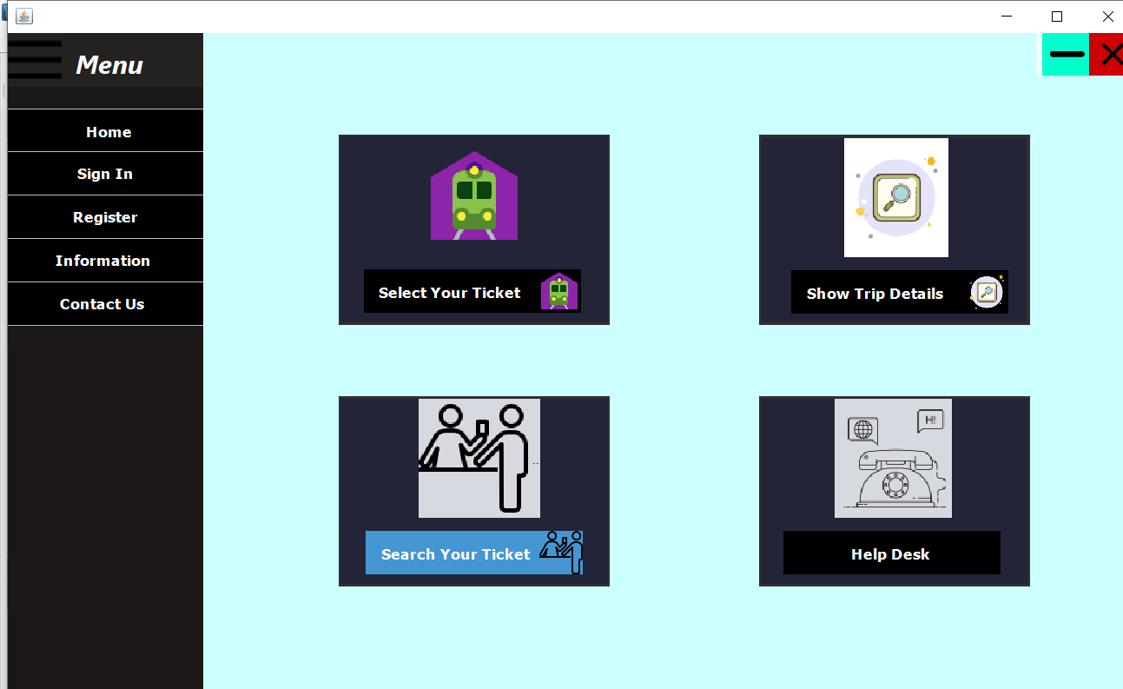
Visualization

Slide 20
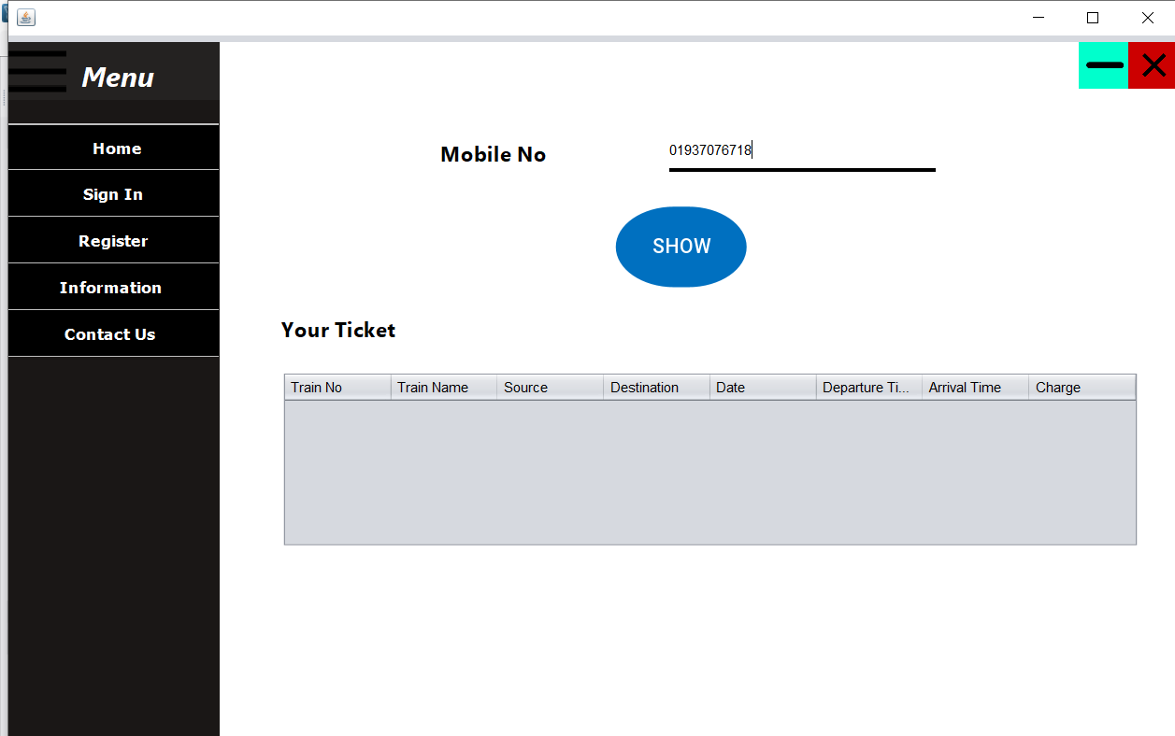

Visualization

Slide 21
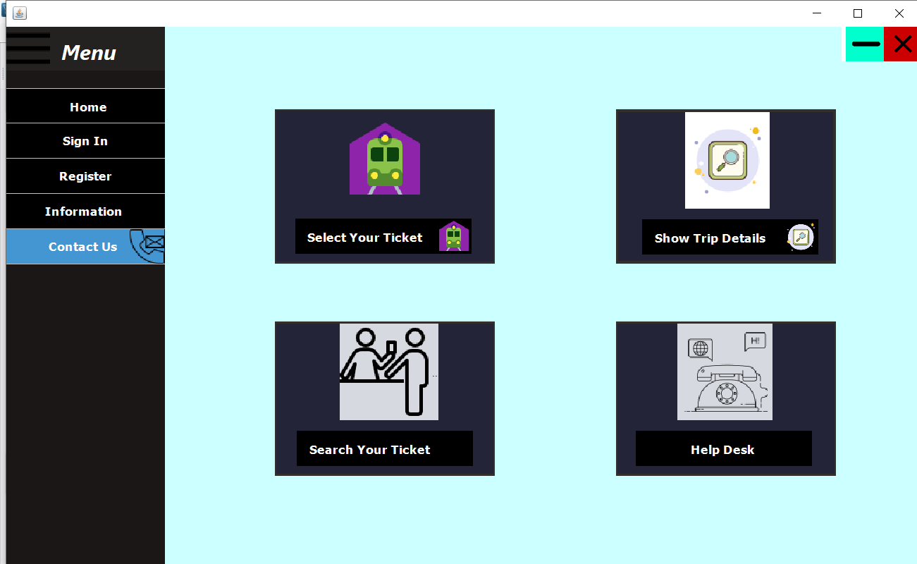
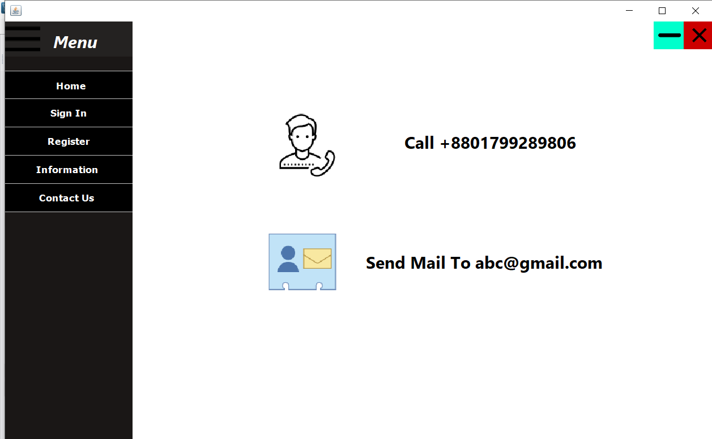
Visualization

Slide 22

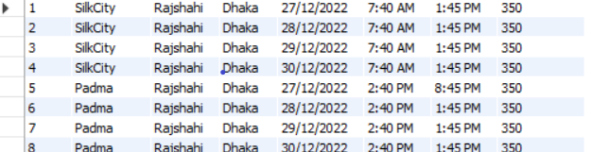
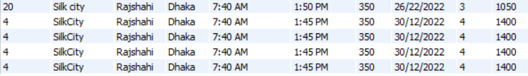
database
Table for storing registration information of user
Table for Train Information
Table for purchased ticket

Slide 23
Future plan
To add route of every train
To get current location of any train
To make real payment system

Slide 24
Thanks You

