Slide 1

الجمهوريــــــــــــــــــــــة الجزائريـــــــــــة الديمقراطيـــــــــة الشعبيـــــــة
وزارة التعليـــــــــــم العـــــــــــالي والبحـــــــــث العلـــــــمي
جامعة وهران للعلوم والتكنولوجيا محمد بوضياف
كلية الرياضيات والاعلام الالي
République Algérienne Démocratique et Populaire
Ministère de l’Enseignement Supérieur Et de la Recherche Scientifique Université des Sciences et de la Technologie d’Oran Mohamed BOUDIAF
Faculté des Mathématiques et Informatique
Département : Informatique
Étude comparative entre les R-CNN et l'algorithme YOLO pour
la reconnaissance de formes
Mémoire de fin d’études
Pour l’obtention du diplôme de Master
Jury
Nom et Prénom
Grade
Université
Domaine : Mathématiques – Informatique
Filière : Informatique.
Spécialité : IAA
Présidente
Encadrant
Examinatrice
Mme BENDELLA.F
Mme KINANE
DAOUADJI.A
Mme SELKA.S
Professeur
MCA
MCB
USTO-MB
USTO-MB
USTO-MB
Présenté le : 02/06/2025
Par :
BOUGUELTA Omar ElMokhtar
BENSLIMANE Bouchra

Slide 2
PLAN
Introduction
Froms recognition
Comparaison : YOLO vs Faster R-CNN
Conclusion

Slide 3



INTRODUCTION
Recent AI growth, driven by deep learning and computer vision, allows automatic object identification in images/videos. This powers diverse applications (e.g., autonomous vehicles, video surveillance) with fast, reliable solutions.
Our project focuses on object detection in diverse contexts for overall security and surveillance, explored through three distinct yet complementary case studies :
Scorpion Detection
Road Vehicle Detection
Satellite Vehicle
Detection
Prevents home/residential intrusions in high-risk regions to protect human health.
Monitors road/highway traffic for security, improved flow, and anomaly/violation identification.
For military, strategic, and urban planning applications.

Slide 4
FROMS RECOGNITION
Problematic
For the object detection in complex and diverse contexts there are: YOLO that offers speed and RCNN that provides precision, the challenge is to determine which one of these two algorithms is best in terms of accuracy, speed, and adaptability ?

Slide 5
FROMS RECOGNITION
Definition of
Forms recognition
Traditional Methods:
Learning-Based:
Form recognition is a field of artificial intelligence that identifies patterns (forms) from raw data to assign them to categories. These forms can be visual (e.g., faces, barcodes), auditory (e.g., speech), or medical/satellite images. The goal is to classify unknown forms based on learned or predefined features.
01. HOG
01. KNN
(Histogram of Oriented Gradients): Captures edge and gradient patterns.
Classifies based on the nearest neighbors in feature space.
02. SVM
02. HOUGH TRANSFORM
Separates data using optimal hyperplanes, effective with extracted features.
Detects geometric shapes like lines and circles.
03. SIFT
Finds scale and rotation-invariant keypoints for matching.

Slide 6
FROMS RECOGNITION
Deep Learning Contribution:
CNNs (Convolutional Neural Networks) automate feature extraction and improve accuracy.
LeNet-5: Early CNN for digit recognition.
AlexNet: Deep CNN that popularized deep learning for image classification.
ResNet: Introduced residual learning for very deep networks.
Faster R-CNN: Combines region proposal and object detection in a single network.
YOLO: Performs real-time detection in a single forward pass.

Slide 7
FROMS RECOGNITION
YOLO
Definition: You Only Look Once (YOLO) is one of the most popular object detection algorithms, widely used by researchers and industries globally. Developed by Joseph Redmon et al. and introduced in 2015, YOLO revolutionized object detection by enabling predictions in a single pass over the image—unlike region-based approaches like R-CNN and its variants

Slide 8
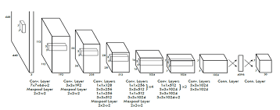
FROMS RECOGNITION
Architecture: YOLO processes the entire image at once, predicting bounding boxes and class probabilities simultaneously. This global approach allows YOLO to be extremely fast while maintaining high accuracy. The architecture is inspired by the GoogLeNet CNN, consisting of 24 convolutional layers followed by 2 fully connected layers.

Slide 9
FROMS RECOGNITION
YOLO workflow
Grid Division: The input image is divided into an S × S grid Each cell is responsible for detecting objects whose center falls inside it.
Bounding Box Prediction: Each cell predicts B bounding boxes. Each box includes 5 components: x, y, w, h, and confidence.
- (x, y): Center of the box relative to the cell
- (w, h): Width and height relative to the whole image
Confidence score reflects the Intersection over Union (IoU) between the predicted and ground truth boxes
Putting it all together:
For each grid cell, we output:
B bounding boxes x 5 values each = B*5
C class probabilities
So for each grid cell, the output size is:
(B*5)+C
And since there are S x S grid cells in the image, the total output shape is:
SxSx(B*5+C)

Slide 10
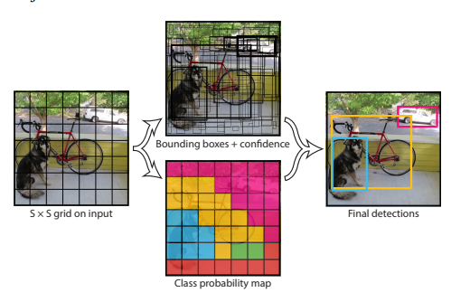
FROMS RECOGNITION
YOLO workflow

Slide 11
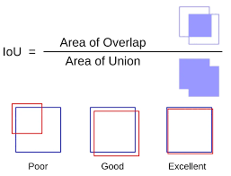
YOLO workflow
FROMS RECOGNITION
Intersection over Union (IoU): This is a score that shows how much the predicted box overlaps with the actual object box. A higher score means a better match
Anchor Boxes: Sometimes, multiple objects appear in one cell. To handle that, YOLO uses pre-made boxes of different sizes and shapes (called anchor boxes) to help find and separate each object correctly.
Non-Maximum Suppression (NMS): After predicting many boxes, YOLO uses a process called non-maximum suppression to remove extra boxes that overlap too much. It keeps only the best box for each object.

Slide 12
FROMS RECOGNITION
FASTER R-CNN
Definition: Faster R-CNN, a sophisticated evolution of region-based detection, significantly improved accuracy and efficiency. Introduced in 2015 with its integrated Region Proposal Network, it enables more precise object localization, leading to more accurate detection (compared to the single-pass YOLO) and a reliable results.
Architecture: The Faster R-CNN architecture features two main parts: the Region Proposal Network (RPN) and the Fast R-CNN detector. The RPN generates object proposals from the input image. These proposals are then processed by the Fast R-CNN detector for classification and bounding box refinement, utilizing shared features from a backbone CNN like VGG or ResNet for efficiency.

Slide 13
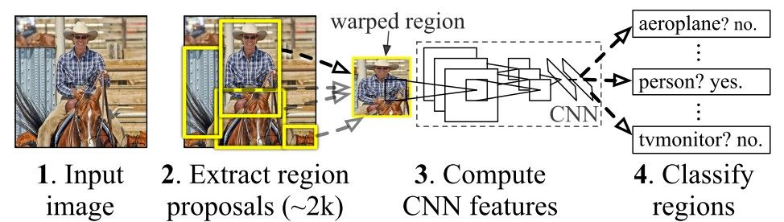
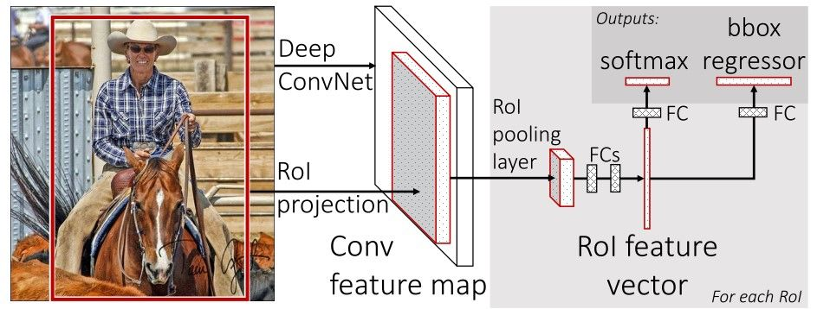
R-CNN Quick Overview : RPN's role in generating region proposals
FROMS RECOGNITION
Faster R-CNN
workflow
R-CNN architecture : https://doimages.nyc3.cdn.digitaloceanspaces.com/010AI-ML/content/images/2020/09/Fig02-2.jpg
Faster R-CNN Quick Overview : The proposals are then processed by the Fast R-CNN detector using RoI pooling, classification, and bounding box regression.
Faster R-CNN architecture : https://doimages.nyc3.cdn.digitaloceanspaces.com/010AI-ML/content/images/2020/09/Fig03-1.jpg

Slide 14
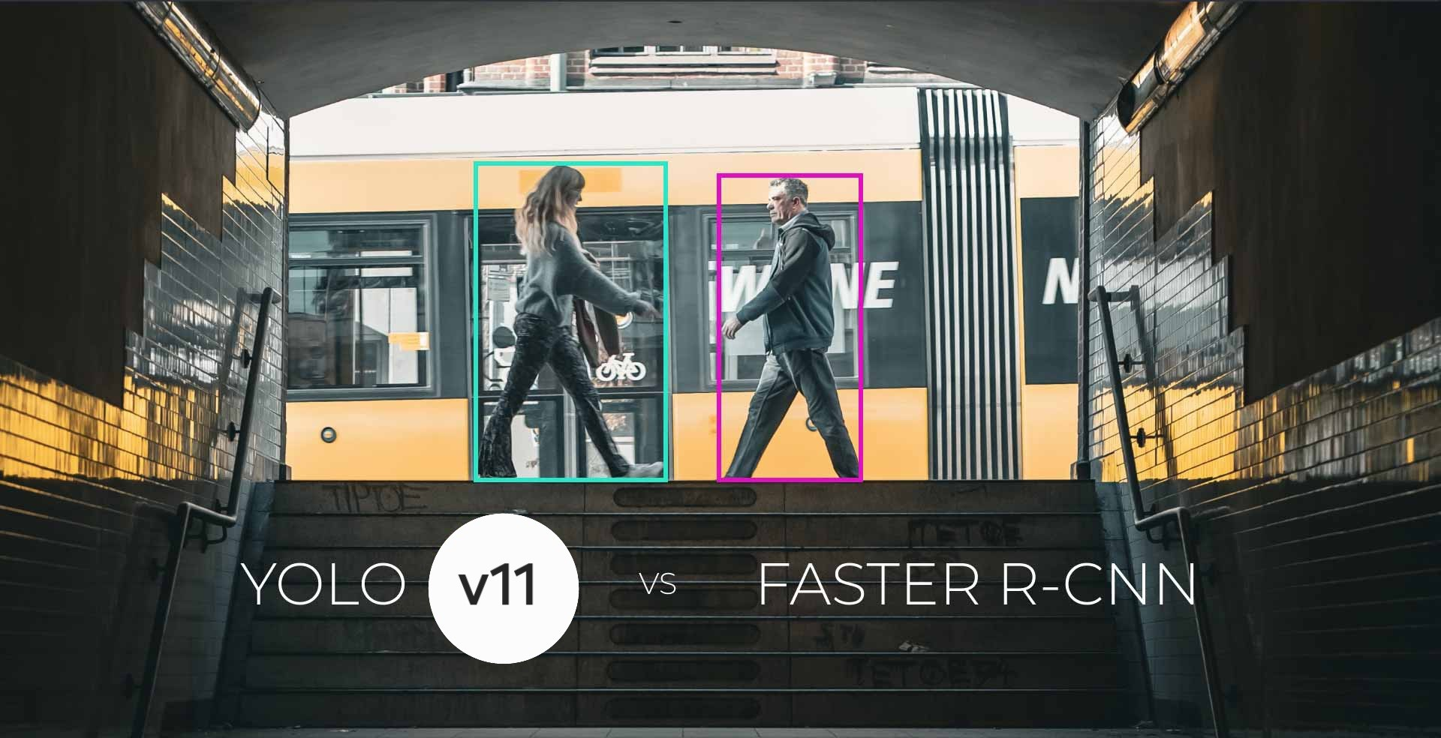
YOLO vs Faster R-CNN
YOLO vs Faster R-CNN results

Slide 15
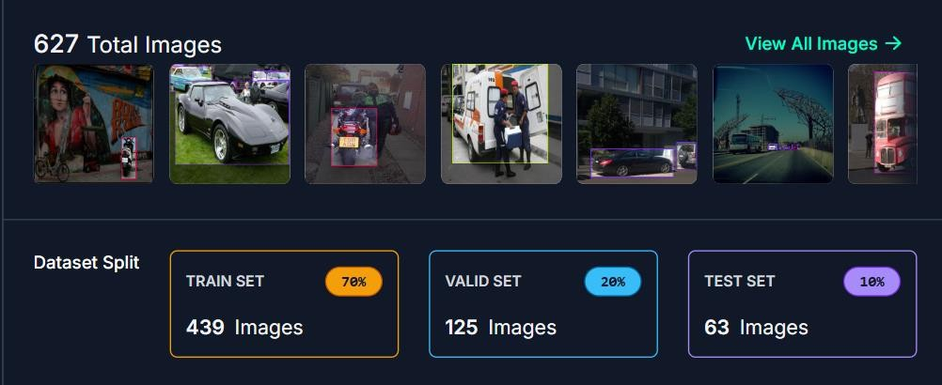
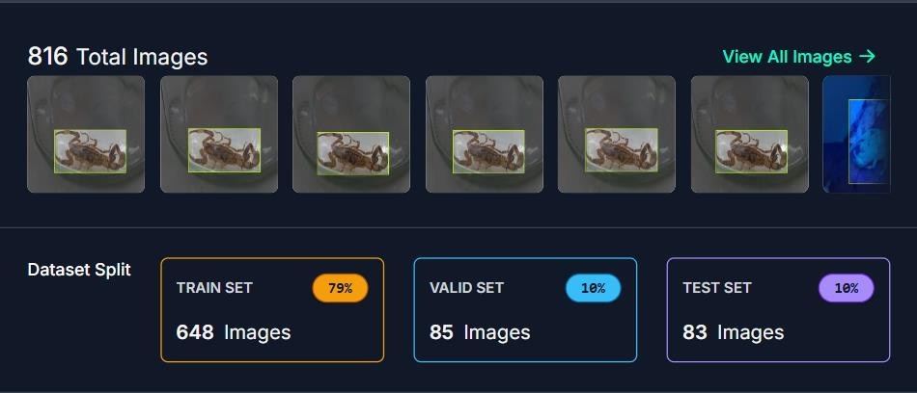

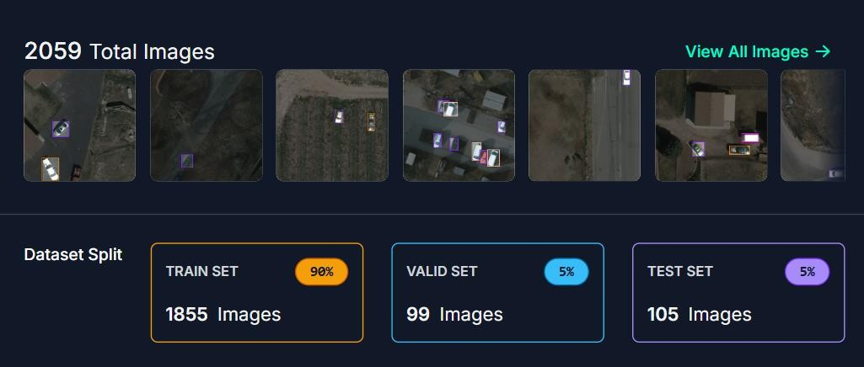
YOLO vs Faster R-CNN
DATASET

Slide 16
YOLO vs Faster R-CNN
Comparison of Speed:
Performance Comparison:
Criterion | YOLOv11 | Faster R-CNN
Preprocessing Time | 5.4 ms | 39.41 ms
Inference Time | 347.8 ms | 1513.32 ms
Post-processing Time | 2.1 ms | 0.98 ms
Total Detection Time | ~355.3 ms | ~1554 ms
Overall Speed | Faster | Slower
Criterion | YOLOv11 | Faster R-CNN
Detected Class | Scorpion | Scorpion
Accuracy | 76.53% | 98%
F1 Score (Scorpion) | 0.45 – 0.5 | 1.0
Precision | ~1.0 | ~1.0
Recall | ~0.5 | ~1.0
YOLOv11 is approximately 4 times faster than Faster R-CNN
Faster R-CNN is more accurate than YOLOv11
In terms of speed YOLOv11 is more preferable for tasks that needs fast detection
For accuracy Faster R-CNN is designed to be used in tasks that requires highest performance

Slide 17
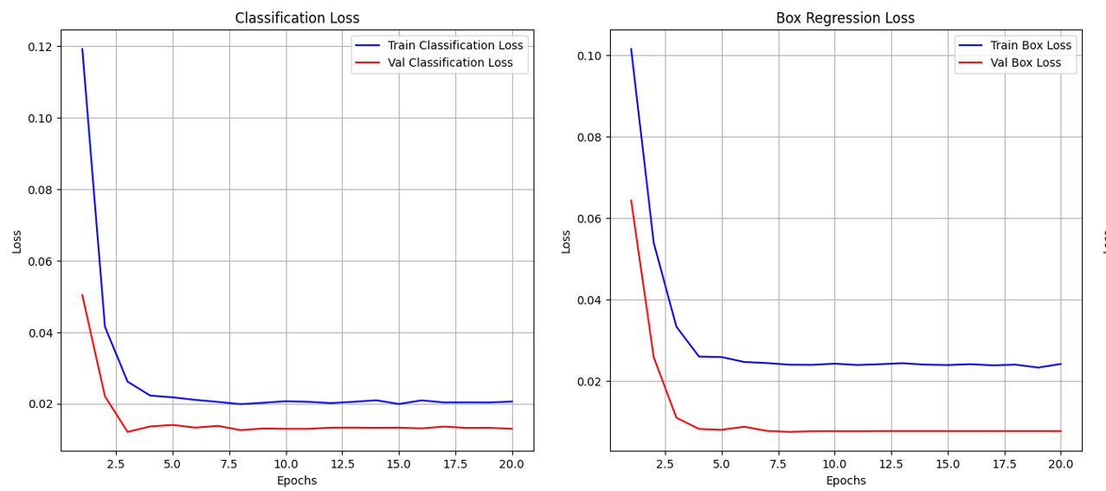
YOLO vs Faster R-CNN
Loss Function Analysis:
Faster R-CNN

Slide 18
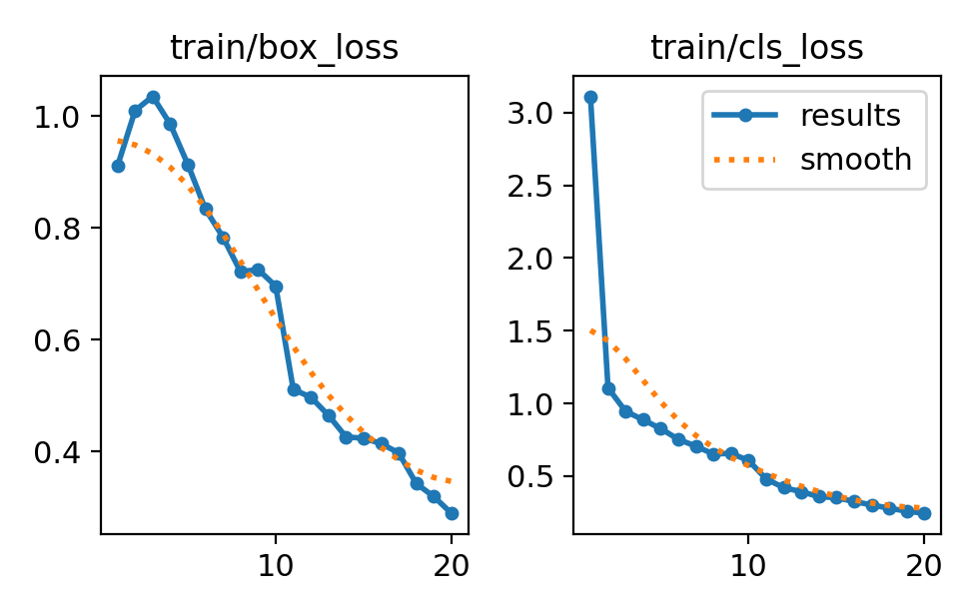
YOLOv11
YOLO vs Faster R-CNN
Loss Function Analysis:

Slide 19
YOLO vs Faster R-CNN
Classification loss (cls_loss)
Box regression loss (box_loss)
Criterion | Faster R-CNN | YOLOv11
Curve Shape | Quickly drops, stable | Drops further
Final Values | ≈ 0.02 - 0.04 | ≈ 0.3 (from 3.0)
Stability | Very stable | Slight early noise
Criterion | Faster R-CNN | YOLOv11
Curve Shape | Gradually decreases | Starts high, drops
Final Values | ≈ 0.02 - 0.03 | ≈ 0.3 - 0.4
Val/Train Gap | Small | Larger at first
Observation:
Faster R-CNN has lower and more stable loss curves for both classification and box regression.

Slide 20
YOLO vs Faster R-CNN
Scorpion Detection Discussion:
YOLOv11:
Fast and efficient, ideal for real-time detection where speed matters more than perfect accuracy.
Faster R-CNN:
Highly accurate with excellent precision and recall, best for offline tasks where accuracy is critical and speed is less important.

Slide 21
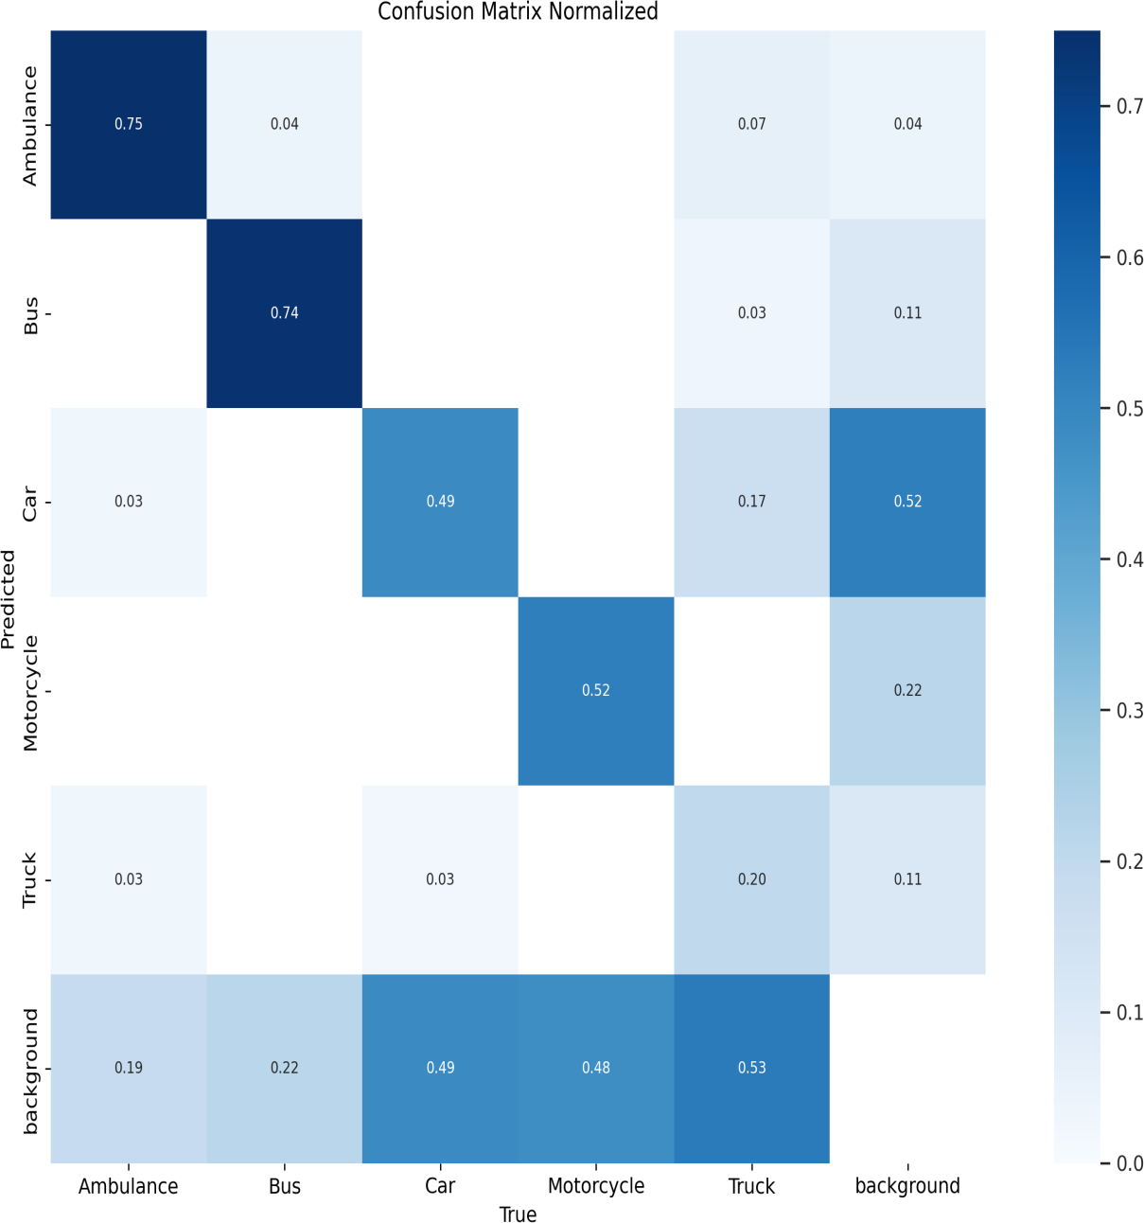
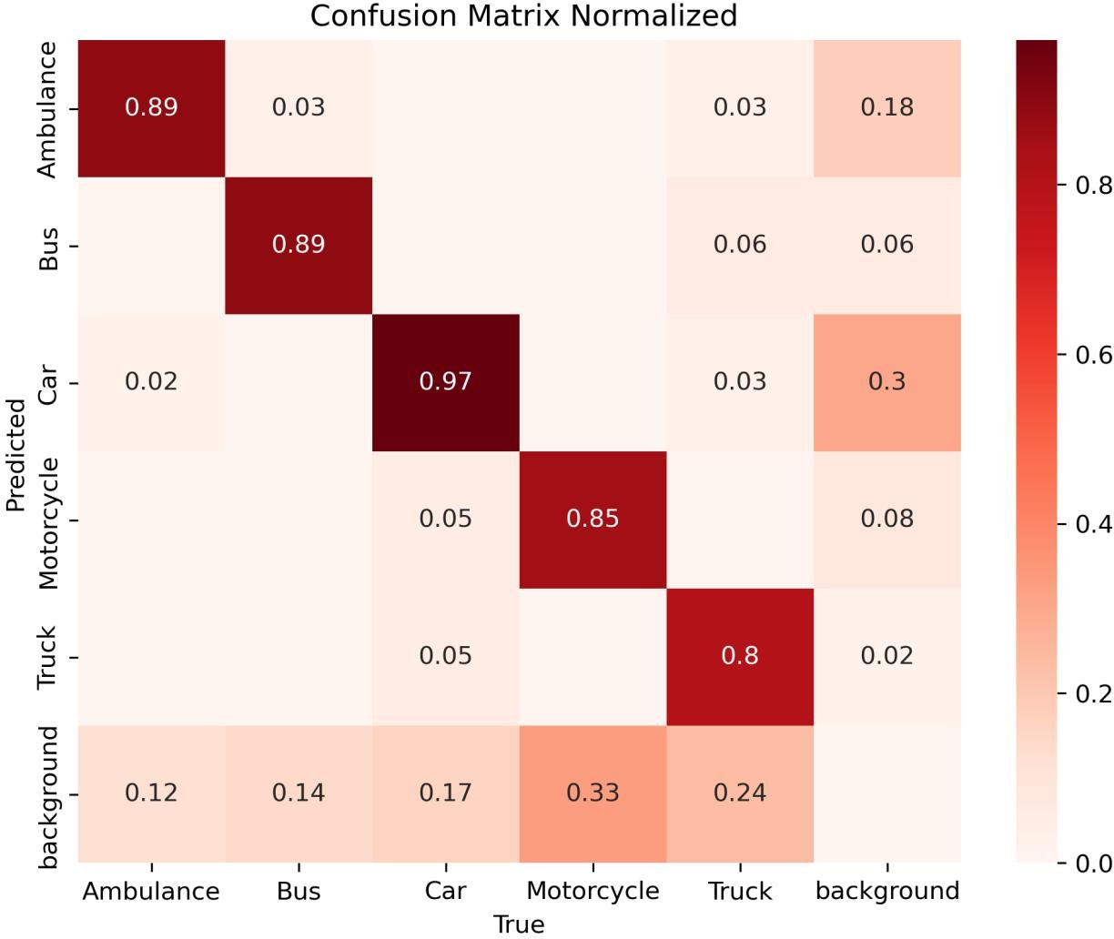
YOLO vs Faster R-CNN
Vehicle detection
normalized confusion matrix
YOLOv11
Faster R-CNN

Slide 22
YOLO vs Faster R-CNN
Class | Faster R-CNN (Precision) | YOLOv11 (Precision) | Comparative Analysis
Ambulance | 89% | 75% | Faster R-CNN detects ambulances better, with less overall confusion.
Bus | 89% | 74% | Faster R-CNN offers better stability and less confusion with the background.
Car | 97% | 49% | Significant gap: Faster R-CNN clearly outperforms YOLOv11.
Motorcycle | 85% | 52% | Despite a lower precision, Faster R-CNN still performs significantly better.
Truck | 80% | 20% | YOLOv11 shows very poor performance; Faster R-CNN is far superior.
Faster R-CNN demonstrates superior precision and better control over small or complex objects, making it highly suitable for tasks requiring high accuracy. It shows minimal confusion between object classes and the background.
YOLOv11, while much faster, suffers from high confusion, particularly for small or partially visible objects . It often misclassifies these as background or other vehicles, significantly lowering its precision.
In essence, Faster R-CNN reduces class confusion and improves reliability, while YOLOv11 trades precision for speed, making it more prone to errors in challenging detection scenarios.

Slide 23
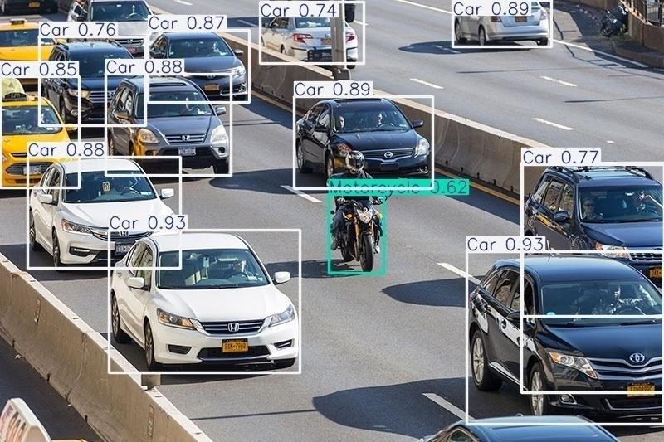
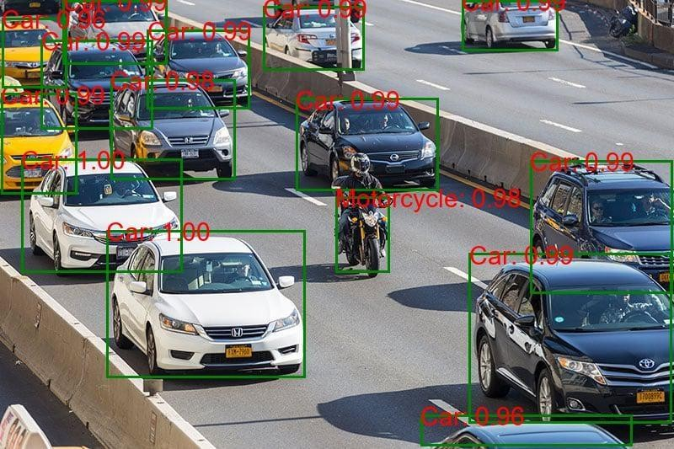
YOLO vs Faster R-CNN
Vehicule Detection Examples:
Vehicle detection by YOLOv11
Vehicle Detection by Faster RCNN

Slide 24
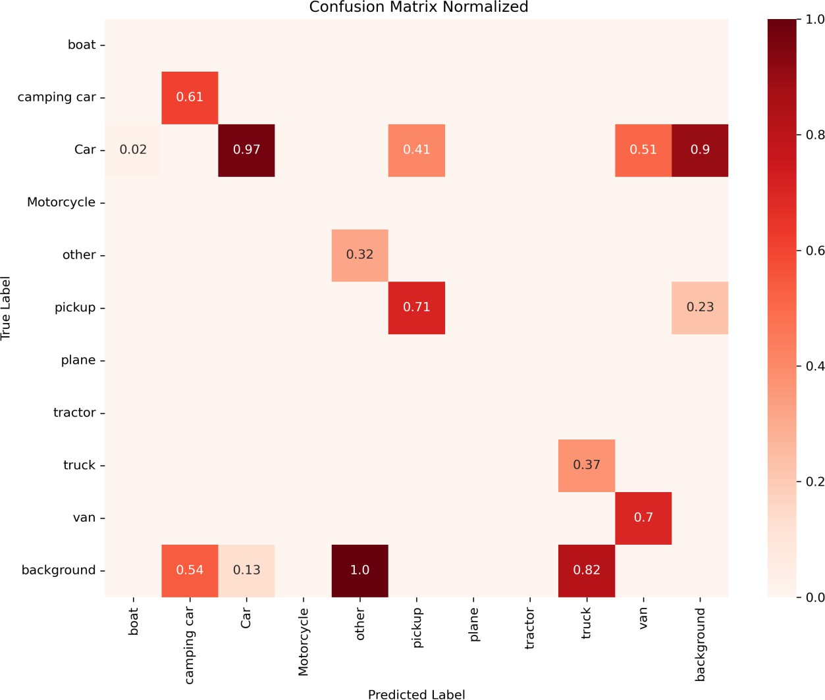
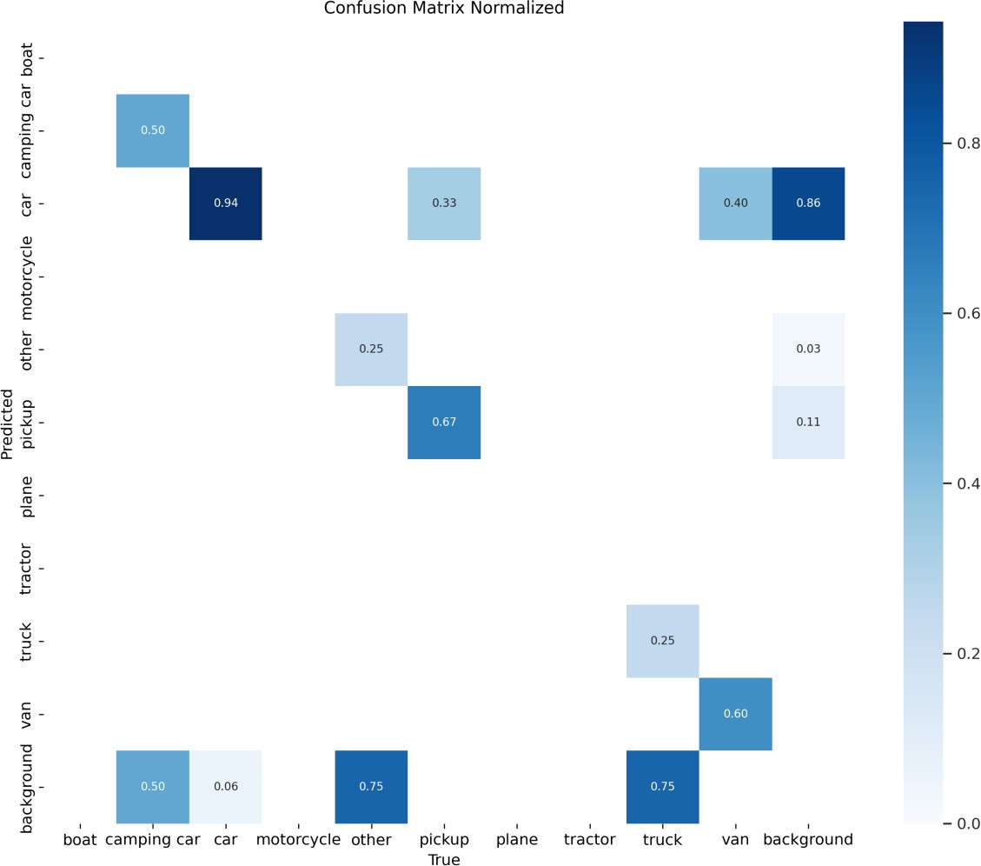
YOLO vs Faster R-CNN
satellite detection
normalized confusion matrix
YOLOv11
Faster R-CNN

Slide 25
YOLO vs Faster R-CNN
Criterion | Faster R-CNN | YOLOv11 | Comment
Small objects | Better detection | Less effective | Faster R-CNN benefits from its two-stage structure
False negatives / Background | High for truck, camper, motorcycle | High for truck, boat, camper, other | Both models struggle with low-salience objects
Confusion between similar classes | Present (van/pickup/truck) | Strong (van/pickup/camper/truck) | More pronounced in YOLOv11
Robustness on frequent objects | Good on cars and clear classes | Also good | Comparable
Robustness on rare objects | Moderate | Poor | YOLOv11 needs more examples or better tuning
For blurry and noisy images, Faster R-CNN is more robust and accurate, especially for small or rare objects, due to its two-stage detection.
YOLOv11 is more sensitive to noise and confusion between similar classes, making it less reliable in poor image conditions.

Slide 26
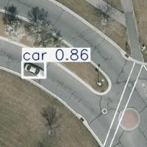
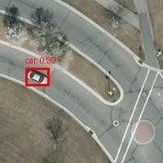
YOLO vs Faster R-CNN
Satellite Detection Examples:
Satellite detection by YOLOv11
Satellite Detection by Faster RCNN

Slide 27
CONCLUSION
Conclusion
In summary, the choice between YOLOv11 and Faster R-CNN for object detection depends on the balance between speed and accuracy:
YOLOv11 is fast and efficient, ideal for real-time applications where speed is crucial, but may sacrifice accuracy for small or complex objects.
Faster R-CNN provides high accuracy and is better for detecting small or complex objects, but is slower and less suitable for real-time tasks.
YOLOv11 is preferred for speed-focused tasks, while Faster R-CNN is best for tasks requiring high precision without strict time constraints.

Slide 28

THE END
Thanks for Listening with great patience
We are pleased we shared our experience and informations with you!

