Slide 1
SafetyEye

Slide 2
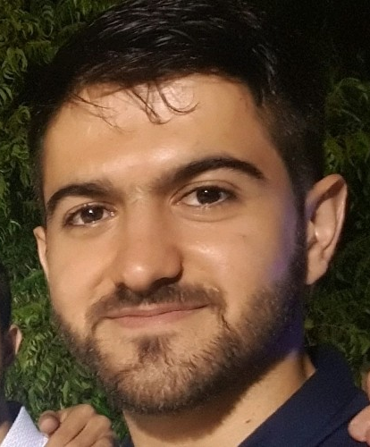
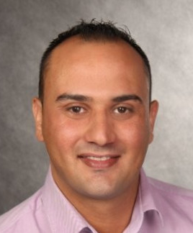
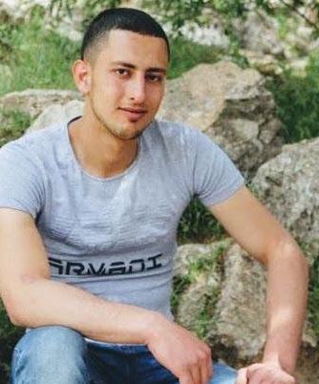
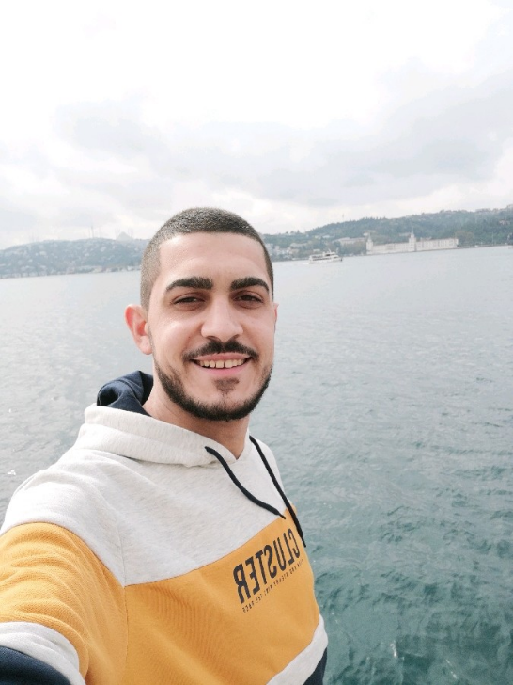
Team Members
Ahmad Amara
Kammel Heib
Montaser Jafrah
Omar Burqan

Slide 3
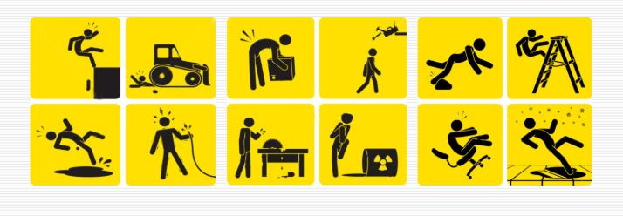
Problem
Health and safety is the key factor for all the industries in order to promote the wellness of both employees and employers. It is a duty and moral responsibility of the company to look after the employee’s protection.
Organizations appoint a safety officer role that is in charge of enforcing safety regulation among employees.
Obviously that who holds safety role cannot monitor at all time and placed.

Slide 4
Detect automatically the uses of Safety tools by analyzing the surveillance video streams.
Detect the object of interest and analyze whether an employer uses the correct safety wear. by using computer vision and deep learning
done at the raspberry pi without streaming data
Cost effective , private , efficient .
Solution

Slide 5
Tech Overview
Languages for programming
Libraries
Cpp11 – detect safety tools
Python – build the server and client UI
PyQt
Flask
Qt
OpenCV

Slide 6
Challenges
Deployment to raspberry
Debug the algorithm in the raspberry pi
Connections between cpp OpenCV/Qt and python/Qt
Build the server using REST-API

Slide 7

What’s Next ?
Detect more
safety tools.
Monthly reports.
Accuracy.
Extend to other platforms for notification and monitoring.

Slide 8
Thank You
Insert the Sub Title of Your Presentation

