Slide 1

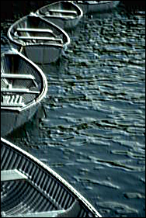



Original
Emboss
H-line
Gauss
Avg

