Slide 1




AUTONOMUS VEHICLES
THE FUTURE ON WHEELS
SALFORD & CO.
HOW SELF-DRIVING CARS ARE CHANGING TRANSPORTATION

Slide 2

SMART MOBILITY
REDEFINING ROAD TRAVEL
Autonomous vehicles are redefining how we navigate daily life. With advanced sensors, real-time data processing, and AI, they offer a safer and more efficient alternative to traditional driving. These vehicles can adapt to dynamic traffic environments, reduce human error, and optimize road usage, marking a transformative shift in how cities move and people connect through smart mobility solutions.
SALFORD & CO.

Slide 3
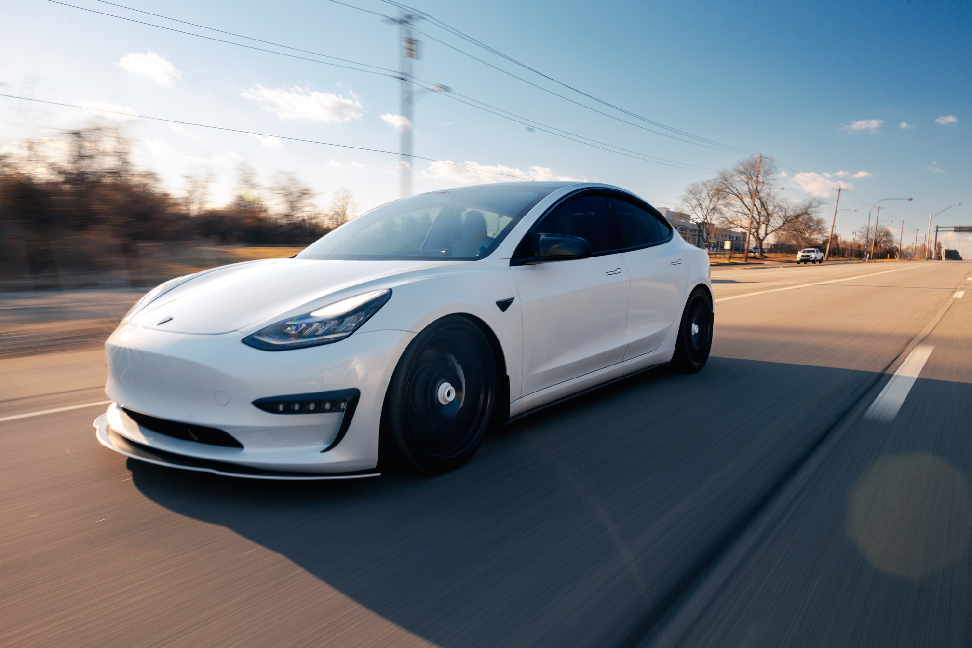
THE BRAINS BEHIND THE WHEEL
SENSOR INTEGRATION
Lidar, radar, and cameras work together to scan road conditions and detect nearby vehicles, obstacles, pedestrians, and road signs in real time.
AI ALGORITHMS
CORE TECHNOLOGY
SALFORD & CO.
Autonomous systems use deep learning models to predict traffic behavior, interpret surroundings, and make safe, dynamic driving decisions without human input.

Slide 4


SALFORD & CO.
REDUCING HUMAN ERROR
CRASH REDUCTION
By eliminating distractions, fatigue, and impaired driving, autonomous cars can significantly lower accident rates and reduce injuries on busy roadways.
RAPID RESPONSE
Computerized driving systems react instantly to sudden changes or dangers, enhancing road safety and avoiding accidents through continuous situational awareness.
PREDICTABLE BEHAVIOR
Autonomous vehicles consistently follow traffic rules and patterns, creating a more predictable and organized driving environment for all road users.
SAFETY BENEFITS

Slide 5
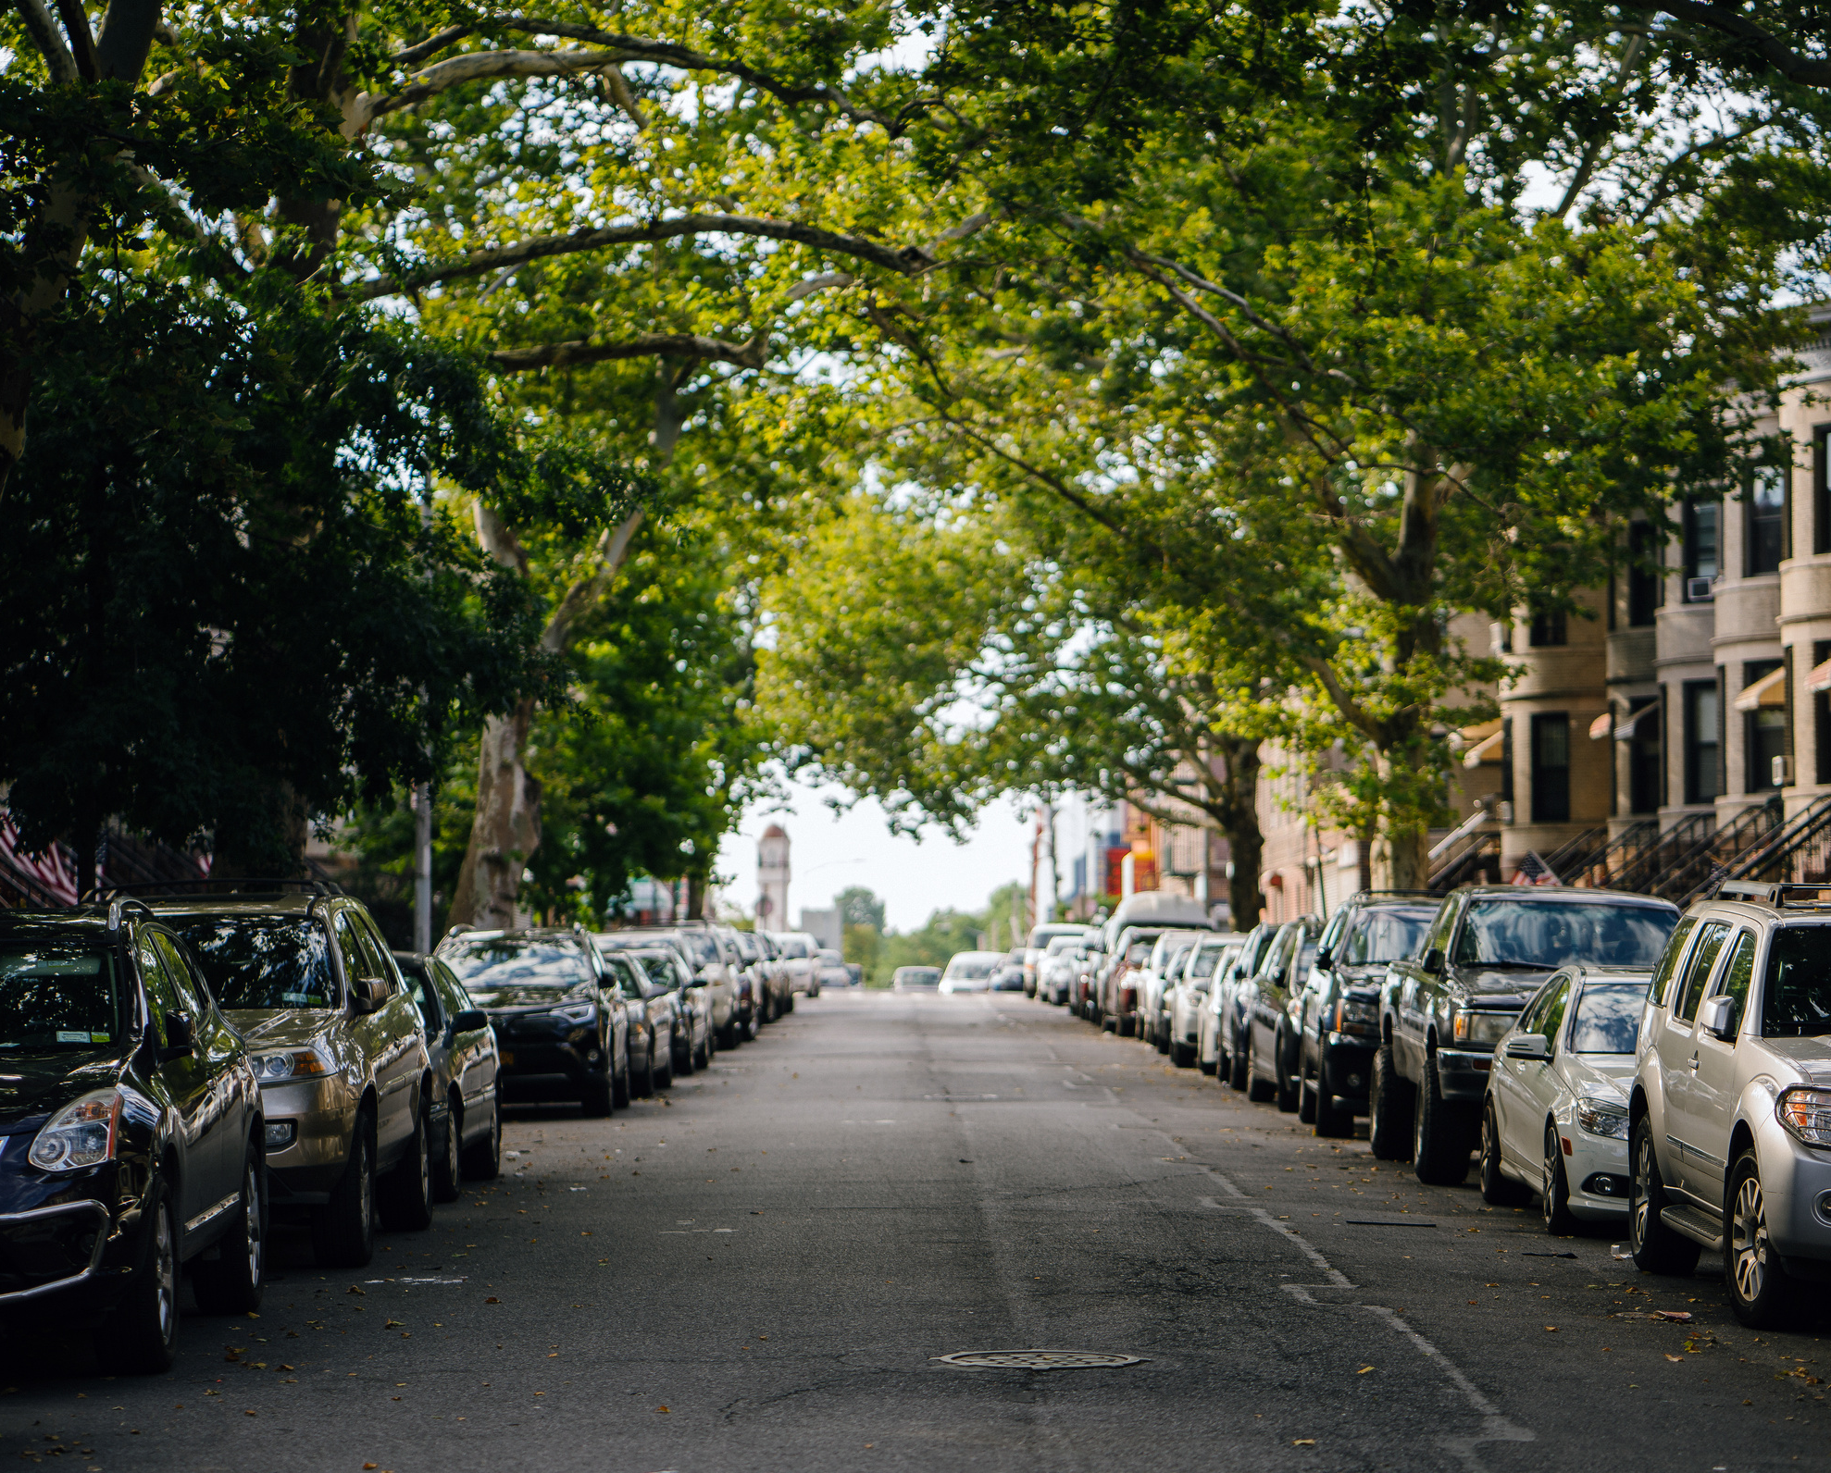
URBAN IMPACT
SALFORD & CO.
CHANGING CITY LIFE
Self-driving vehicles can reduce congestion by improving traffic flow and minimizing accidents. They may also lower emissions and reduce the number of personal vehicles on the road, encouraging ride-sharing and eco-conscious transportation habits in urban areas.
Cities might evolve with fewer parking lots, broader pedestrian zones, and greener infrastructure. Autonomous transport may reshape city planning, creating more space for parks, housing, and public services.

Slide 6
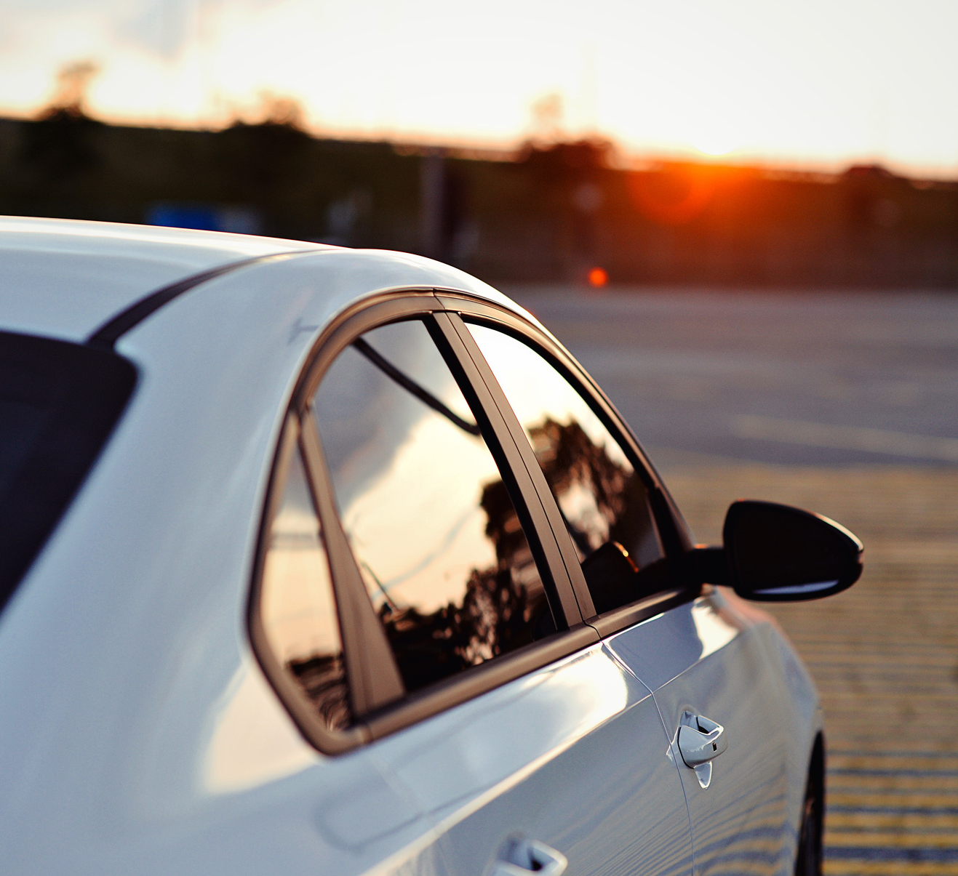
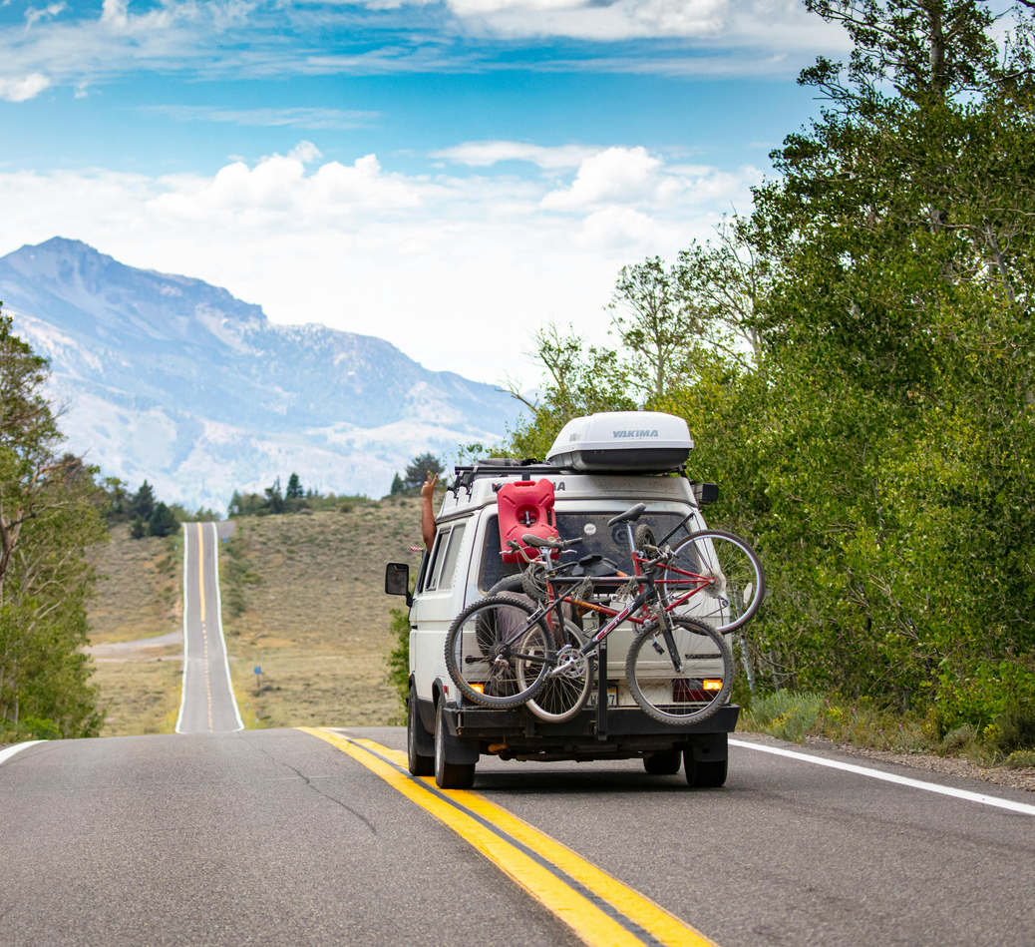
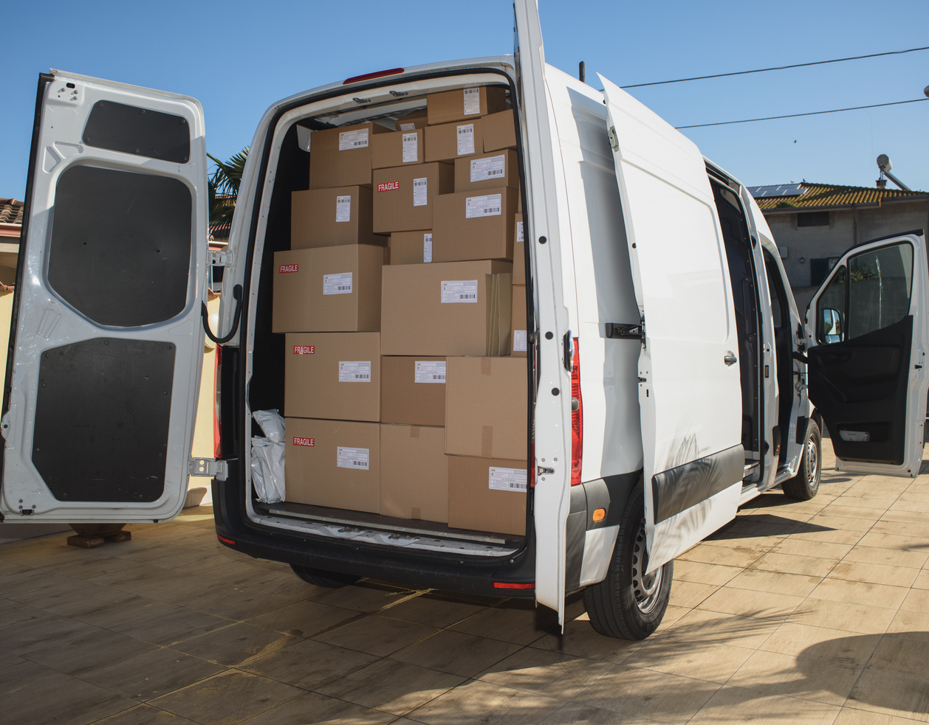
SALFORD & CO.
REVOLUTION IN DELIVERY
AUTONOMOUS FREIGHT
LAST-MILE SOLUTIONS
Driverless trucks offer continuous operation without rest periods, reducing labor costs and improving long-distance supply chain efficiency across industries.
Self-driving vans and robotic carts provide faster, contactless deliveries directly to consumers, streamlining e-commerce and retail fulfillment logistics.
LOGISTICS SHIFT

Slide 7


USER EXPERIENCE
SALFORD & CO.
COMFORT & ACCESSIBILITY
RELAXED JOURNEYS
ELDERLY INCLUSION
REAL-TIME NAVIGATION
ONBOARD CONNECTIVITY
Passengers can sleep, read, or work while the car autonomously navigates.
Improves independence for elderly or disabled individuals.
Automatically adjusts routes based on live traffic.
Entertainment and productivity options built into vehicle systems.

Slide 8
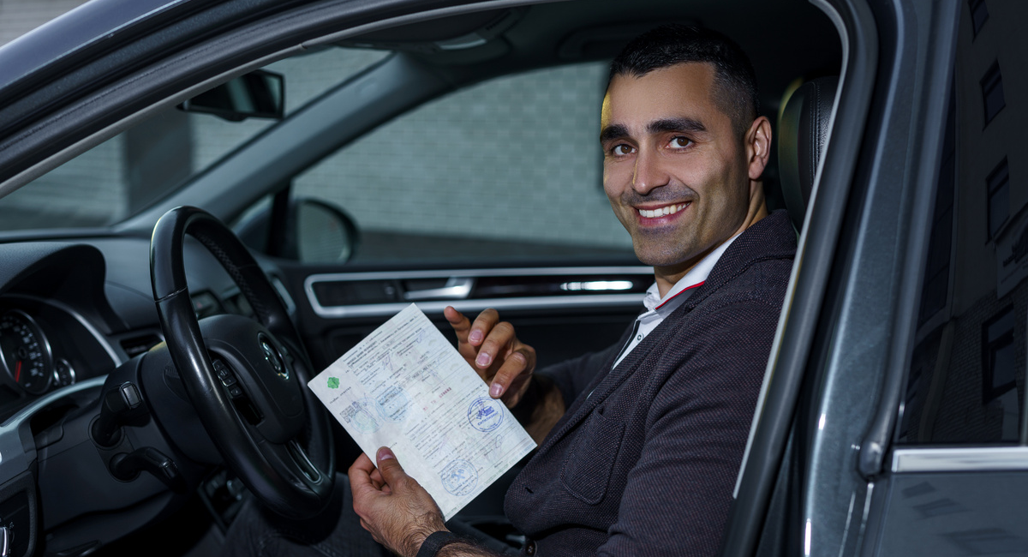
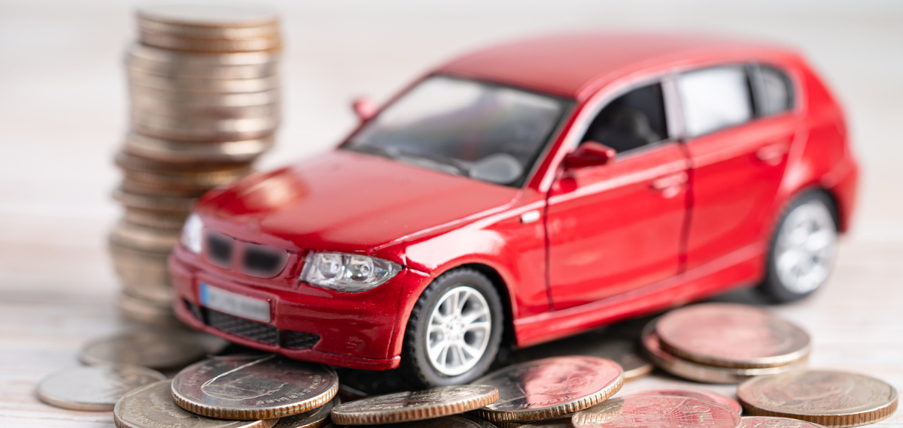
LAWS AND COMPLIANCE
New driving codes must be developed to regulate how autonomous vehicles behave and interact with traditional traffic environments and emergency scenarios.
REGULATION NEEDS
DATA HANDLING
Privacy policies should protect personal and location data gathered through sensors, navigation logs, and vehicle communication systems.
LIABILITY ASSIGNMENT
In case of accidents, determining fault between the user, vehicle software provider, and manufacturer must be clarified through legislation and industry standards.

Slide 9

PUBLIC CONCERNS
TRUST & TRANSITION
Self-driving systems could displace millions of jobs, particularly in commercial driving, ride-hailing, logistics, and related transportation sectors.
EMPLOYMENT RISKS
Many still doubt the ability of machines to handle unpredictable situations, especially in extreme weather or complex driving conditions.
TECH RELIABILITY

Slide 10

FUTURE OUTLOOK
TOWARDS FULL AUTONOMY
The path to full autonomy is progressive, with semi-autonomous stages gaining traction. While challenges remain, innovation and investment are steadily driving the technology toward mainstream adoption across industries and regions.
Breakthroughs in AI, edge computing, and 5G connectivity will make autonomous vehicles more capable and reliable. As infrastructure adapts, these vehicles will become a core part of modern transit systems.

Slide 11
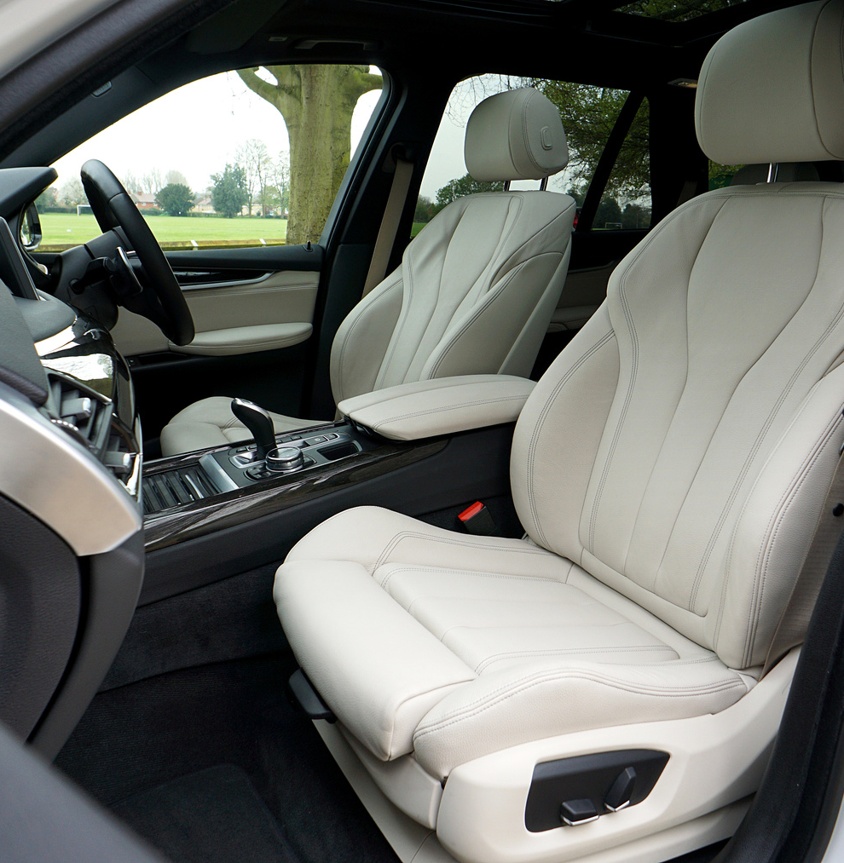





THANK YOU
GET IN TOUCH
Thank you for exploring the world of autonomous vehicles. Let’s build a smarter transport system together.
+123-456-7890
www.reallygreatsite.com
hello@reallygreatsite.com
123 Anywhere St., Any City, ST 12345

