Slide 1
Cyclistic Google Data Analytics Capstone Project
Analysis by: Omar Dissouki

Slide 2
Company Overview
Cyclistic Bike-Share Company
Location: Chicago, IL
Operation
Over 5,800 bikes.
600 docking stations.
Users:
Residents
Visitors
Usage:
Convenient way of transportation.
Communing and leisure.

Slide 3
Task Overview
Lily Moreno, the director of marketing, aims to convert casual riders into annual members to ensure the company’s steady growth.
My role: Junior Analyst
My task: Understand user behavior.
Goal: Develop targeted marketing strategies.

Slide 4
Data Collection and Cleaning
Historical bike trip data was collected from Divvy Trip Data for the period from July 2022 to June 2023 (latest 1 year data available at the time of the analysis).
Data cleaning process involved:
Standardizing data format using Excel and R.
Correcting inconsistencies using R.
Removing null and duplicate entries using R.
Combining months data using R, to be exported for data visualization in Tableau.

Slide 5
User Behavior Analysis
Analyzing Cyclistic’s user behavior reveals key insights into:
Trip frequency by user type
Ride length
Peak usage times
Seasonality
Station popularity

Slide 6
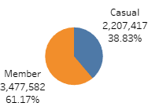
Trip Frequency by user type
Annual members had more trips compared to casual riders.
Number of Trips taken by each user during the analyzed period

Slide 7
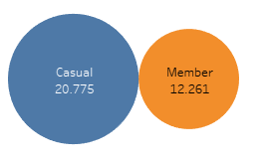
Ride Length
Casual riders generally have longer ride durations compared to annual members.
Average Ride Length in mins

Slide 8

Peak Time Analysis
Casual riders prefer weekends.
Annual members ride consistently throughout the week.
Number of Trips per day of the week

Slide 9

Seasonality Analysis
Warmer months show higher usage for both users.
Noticeable decrease in winter.
Number of Trips per Season

Slide 10
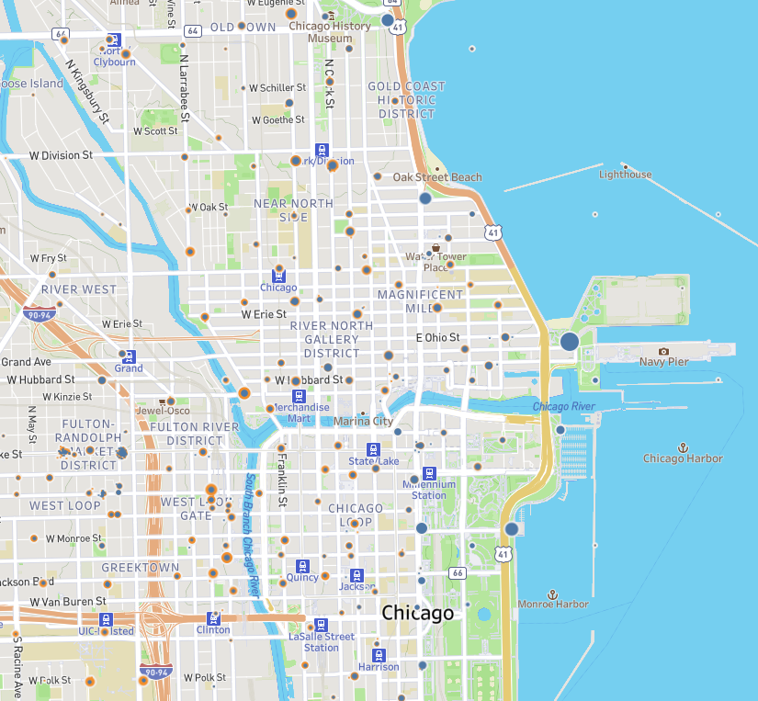
Station Popularity
Casual riders prefer stations near tourist attractions such as:
Navy Pier
Millennium Park
Annual members prefer areas around social settings and business offices, such as
The Riverwalk
The visualization presents a map displaying the density of user trips by station, with dot sizes representing the frequency of trips and colors indicating user type

Slide 11
1st Marketing Recommendation
Developing advertisements using digital media, aimed at casual riders during summer and peak times, emphasizing:
Cost savings, by:
Sending personalized emails to casual riders showing how much they would have saved, if they had an annual membership.
Convenience of having the annual memberships such as:
Ability to prebook bikes during peak hours.
Exclusive benefits of annual memberships, such as:
Free rides.
Access to special events.
Cyclistic merch.

Slide 12
2nd Marketing Recommendation
Incentive for conversion, by:
Providing a free trial to casual riders allowing them to experience the benefits of membership.
Offer new members discounts on local attractions such as museums and the pier.
Implementing a referral program where existing members can earn rewards for bringing in new annual members.

Slide 13
3rd Marketing Recommendation
Improving user experience by:
Including more electric bikes in high demand areas such as the Streeter Dr & Grand Ave area near the Pier.
Removing unused docked bikes which accounts for 2.4% of the total number of trips.

Slide 14
Conclusion
To conclude, this study shows how data analytics can be used to understand customer behavior and develop effective marketing strategies. By identifying differences between the usage of casual riders and annual members, Cyclistic’s marketing team would be able to implement successful targeted marketing that would result in an increase in membership and overall growth.

Slide 15
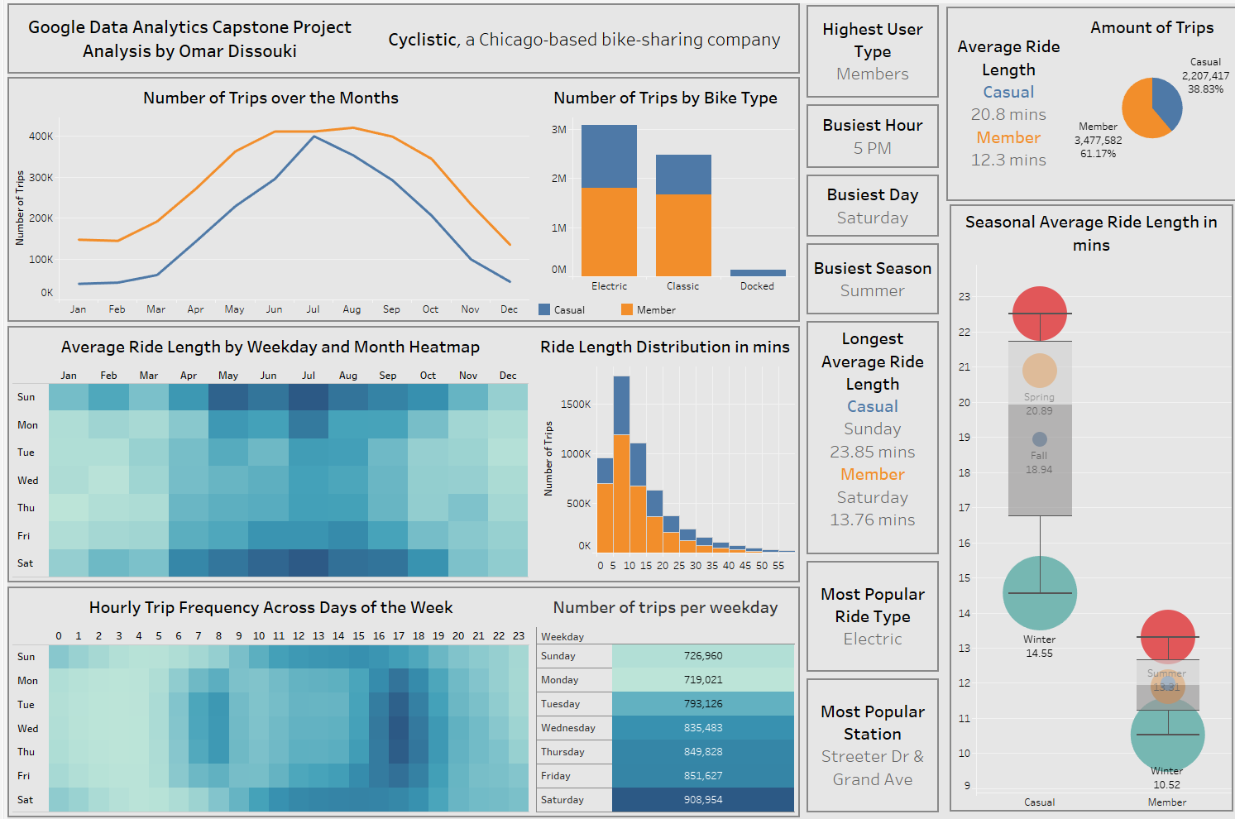
Tableau Dashboard
The interactive dashboard can be found on Tableau Public, Click here

Slide 16
Thank you for your time
For more information, email omardissouki@gmail.com

