Slide 1
AI-Powered Email Summarizer & Auto-Responder
A Simple Automation for Smarter Communication

Slide 2

📧 What Is This Project?
This system fetches emails, summarizes their content using AI, and drafts smart replies automatically.

Slide 3
⚙️ How It Works – 6 Simple Steps
1. Connect to Outlook securely via Microsoft Graph API
2. Extract email subject, sender, date, and body
3. AI summarizes content and drafts a response
4. All data saved into MySQL database
5. MS Teams notification with summary and reply"
6. Reply appears in Outlook drafts with receiver name"

Slide 4
📊 Before vs After
Before:
Manual email review
Delayed replies
Missed details
After:
Instant summaries
Smart replies ready
Everything logged

Slide 5
🚀 Next Steps
Expand to project updates and meeting summaries
Local ai model trained to match company tones

Slide 6
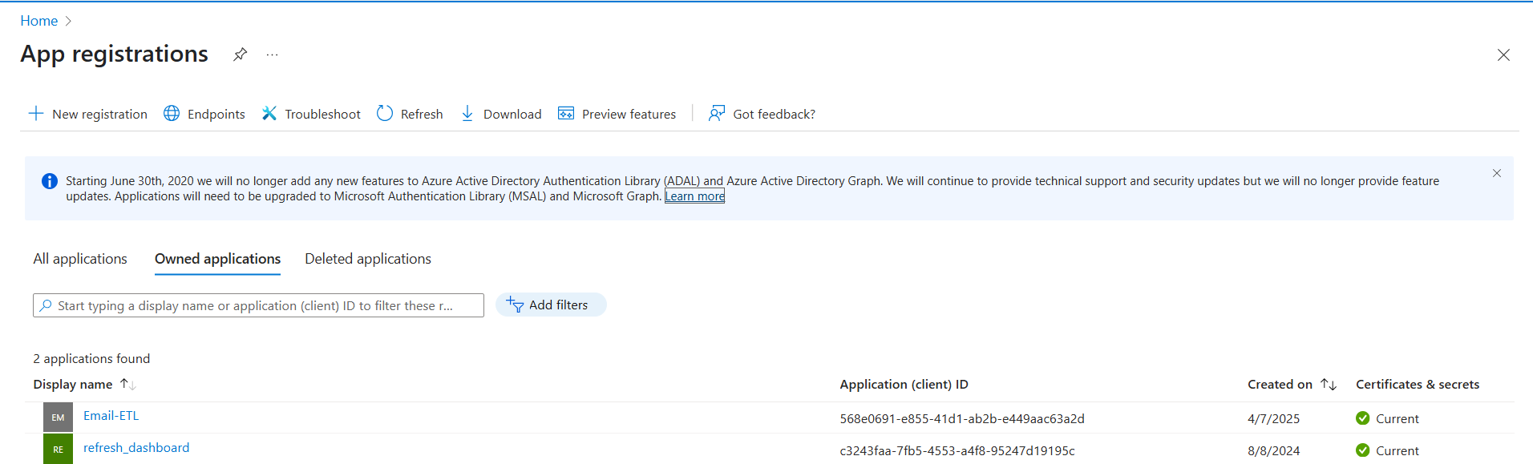

Slide 7
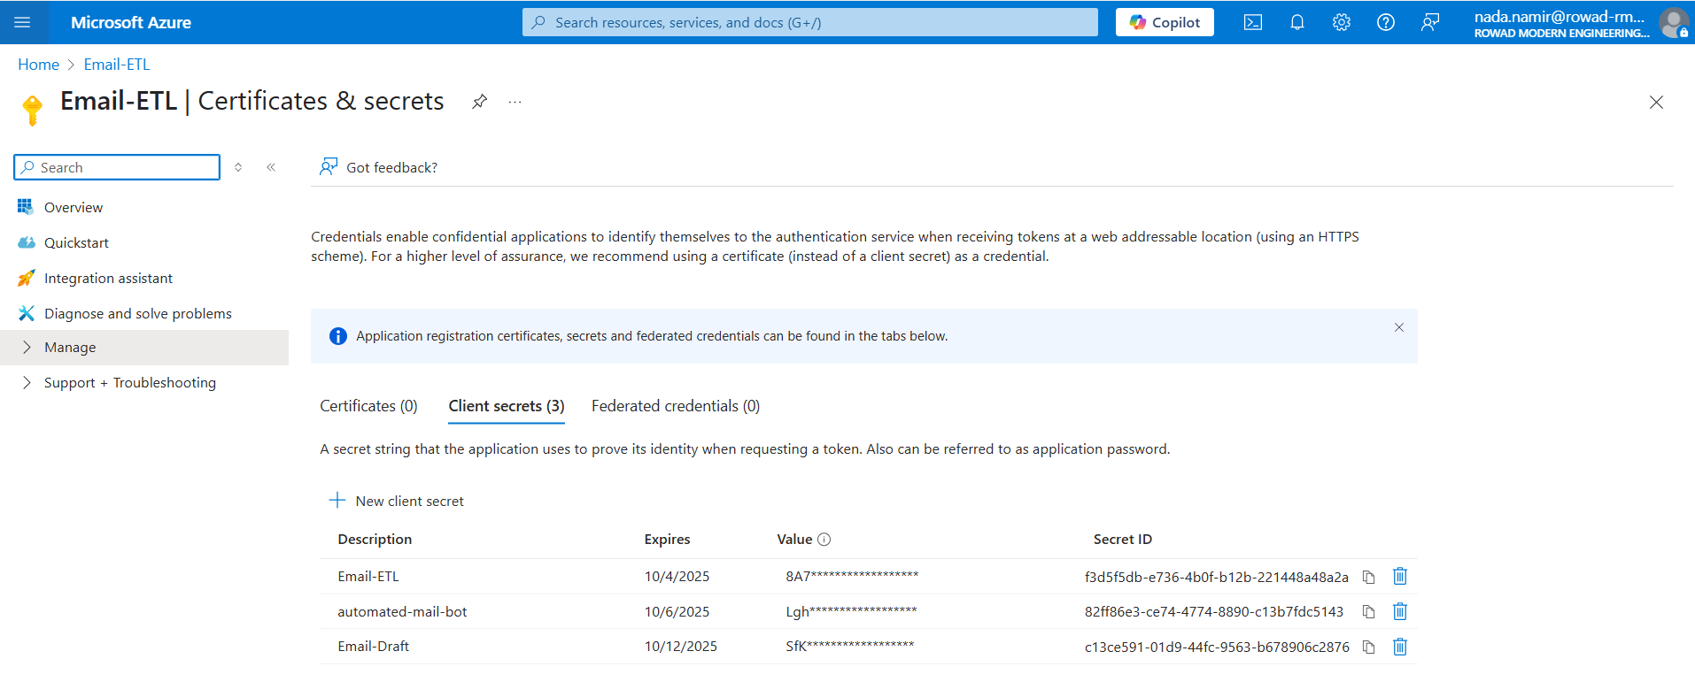

Slide 8
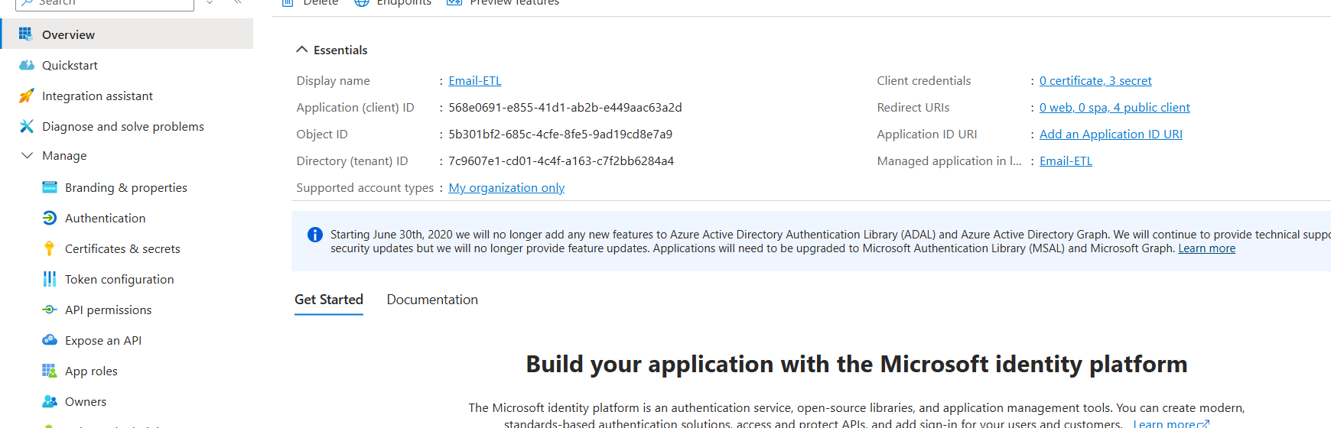

Slide 9
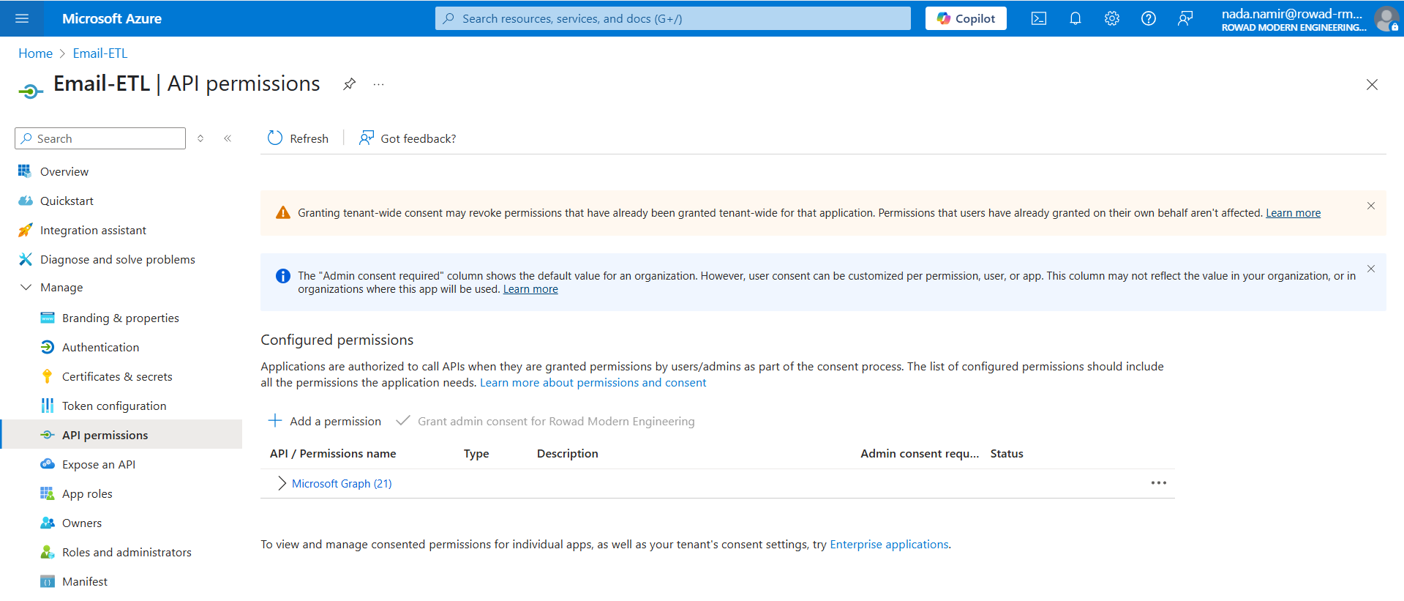

Slide 10
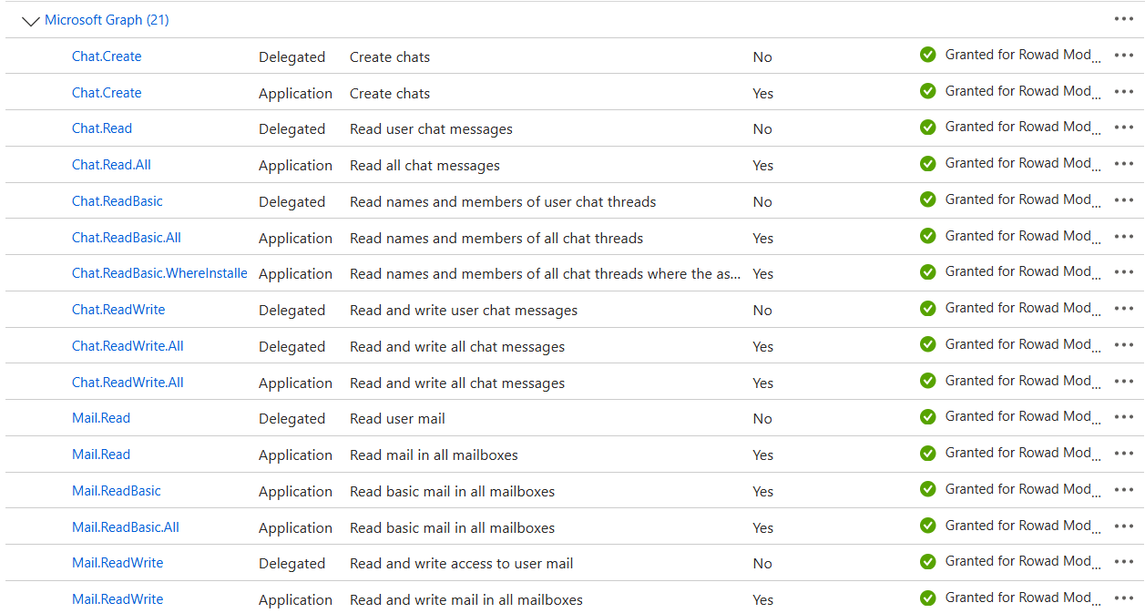

Slide 11
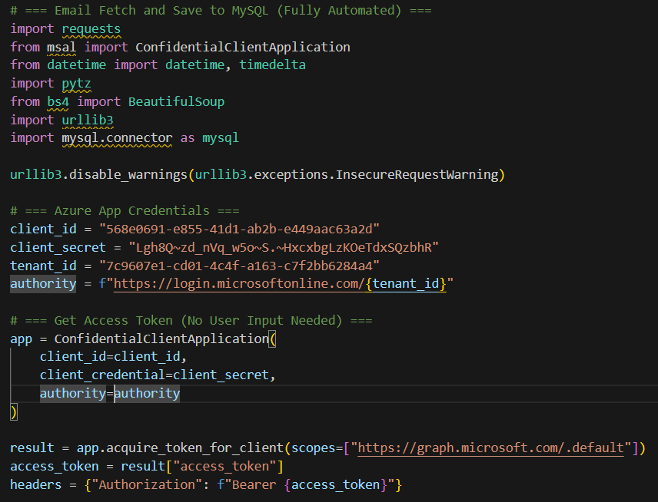
Credentials & Token acquire

Slide 12
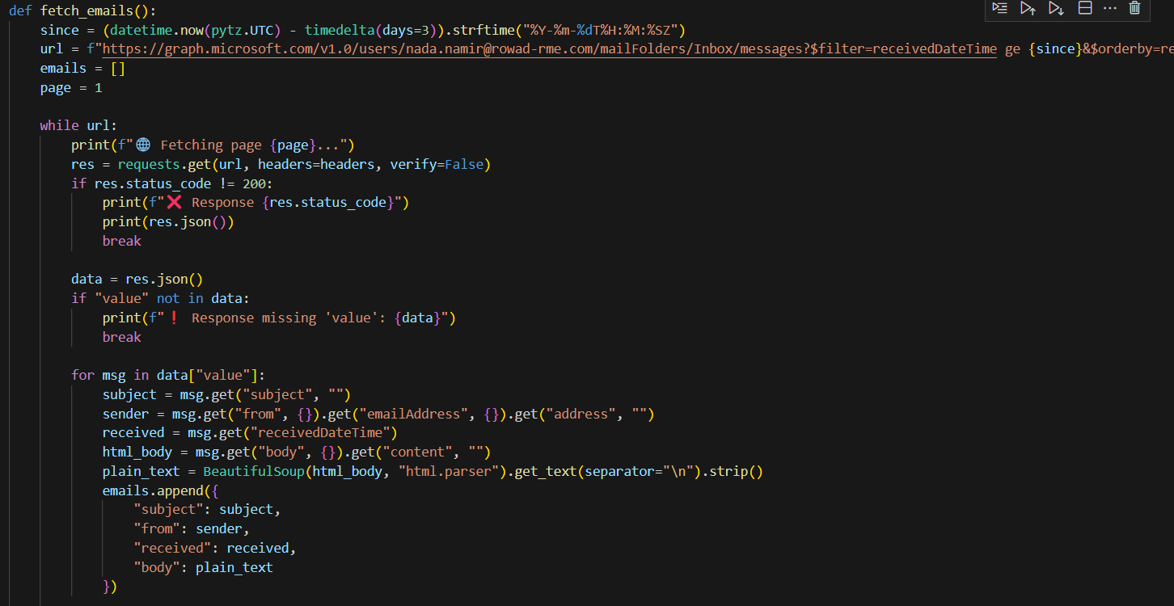
Email Fetching

Slide 13
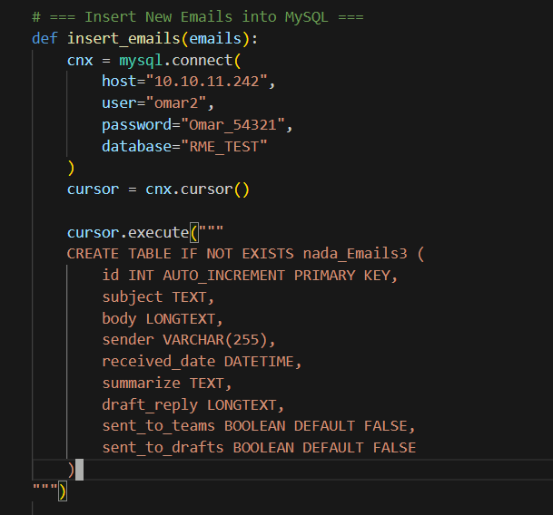
Email Database insertion

Slide 14
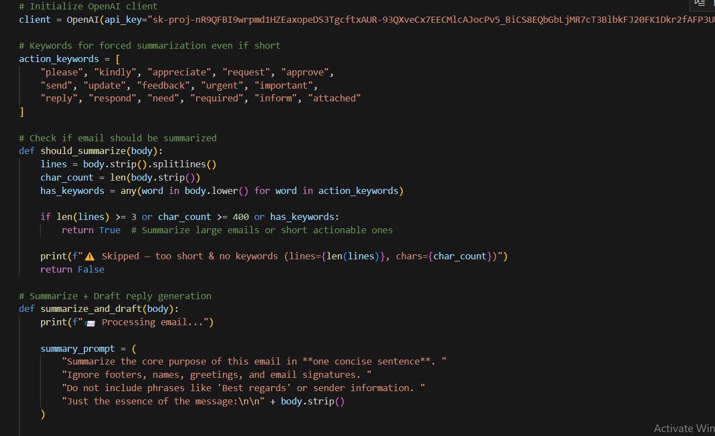
AI Summarization & draft

Slide 15
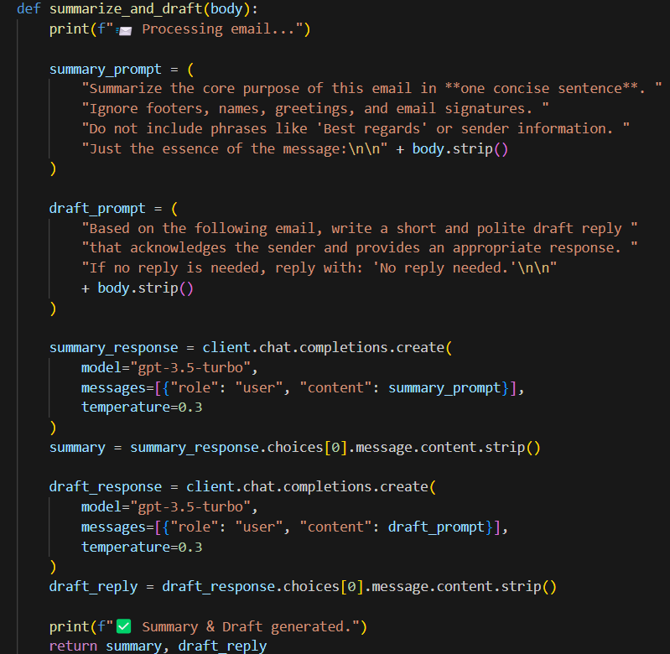
Prompts

Slide 16
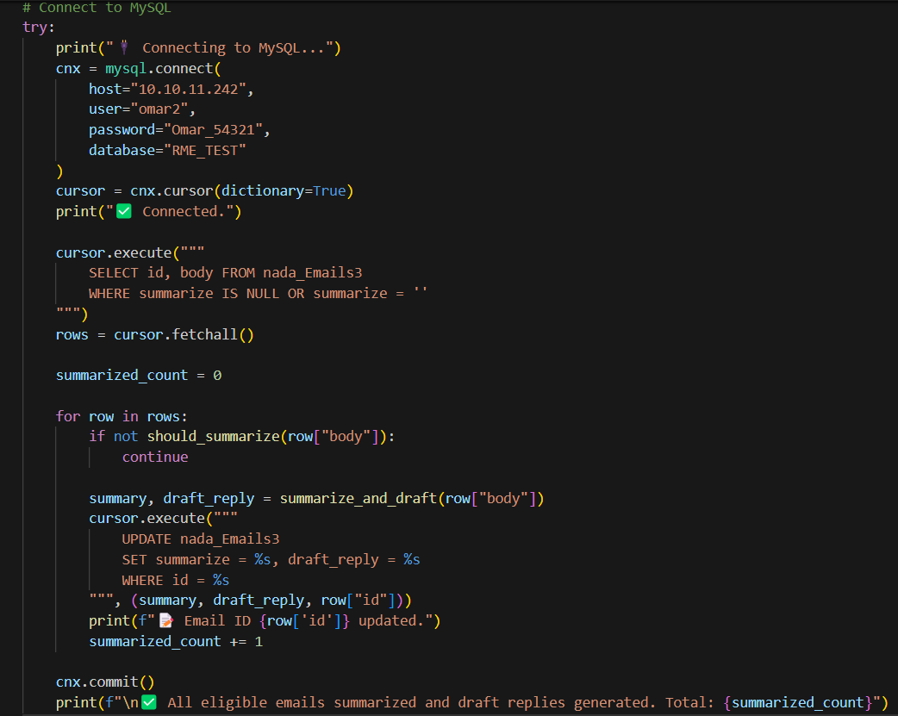
Insert into database

Slide 17
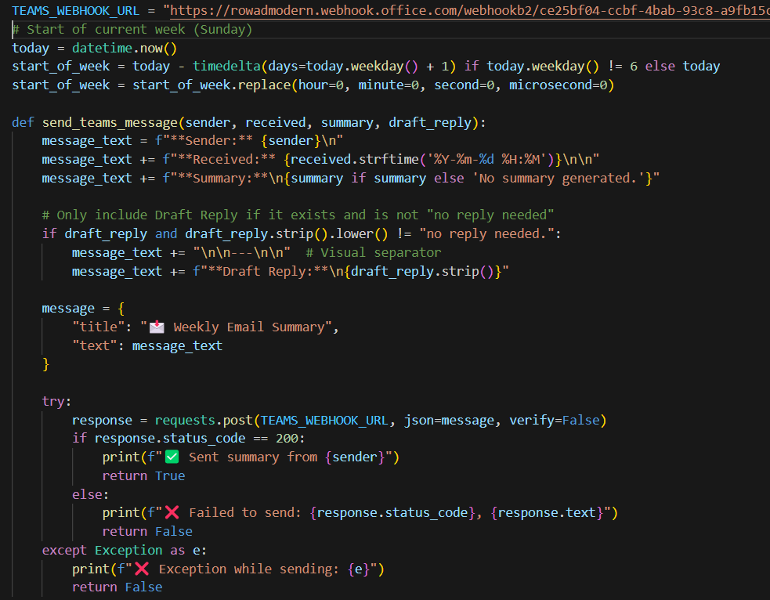
Send to teams

Slide 18
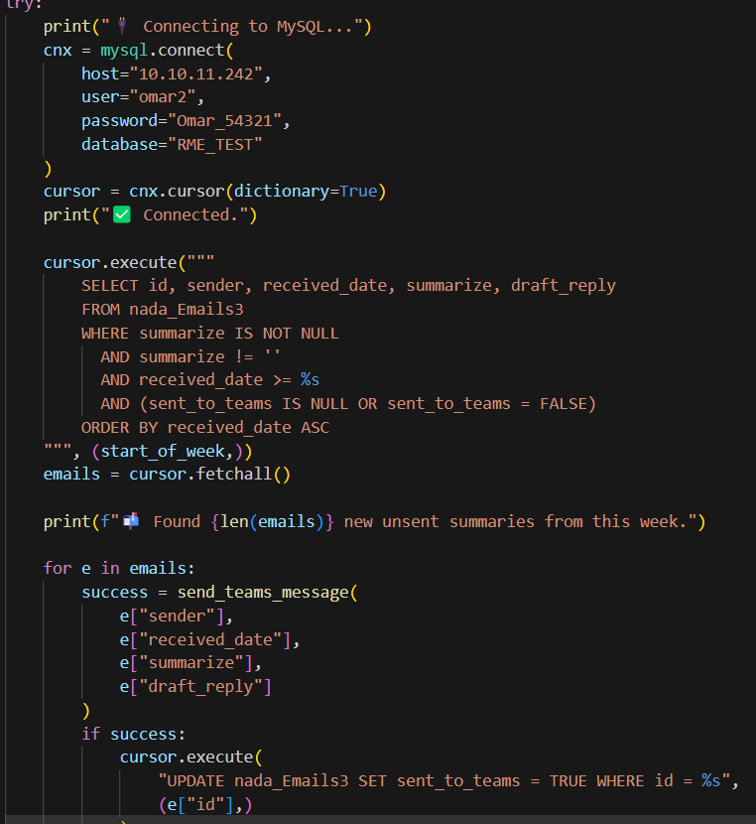
Mail info

Slide 19
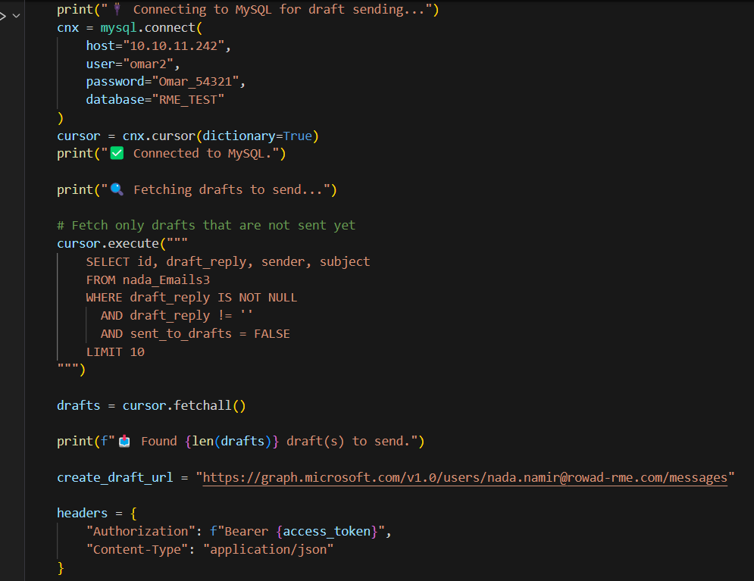

Slide 20
