Slide 1
Bioinformatics Final Project
The Human Body Recipe
Team 5:
Ahmed Osama 1190415
Mona Mohsen 1190540
Omar ElAnsary 1190332
Yara Ihab 1200452

Slide 2
• Table of contents
01
04
02
03
Introduction
Alignment Visualization
Project Description
GUI
05
MSA Assessment
Sequence Alignment

Slide 3
Introduction •
Our project is to develop a GUI software that takes a number of biological sequences and calculates the best sequence alignment for them. It visualizes the result to the user. Also, an assessment is done for the MSA using more than one method.

Slide 4
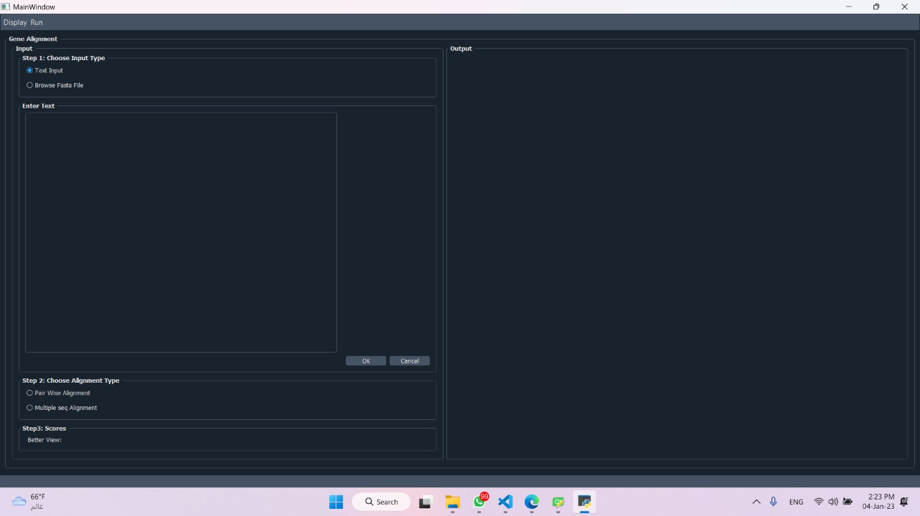
GUI

Slide 5
Sequence Alignment
Global
Local
Multiple

Slide 6
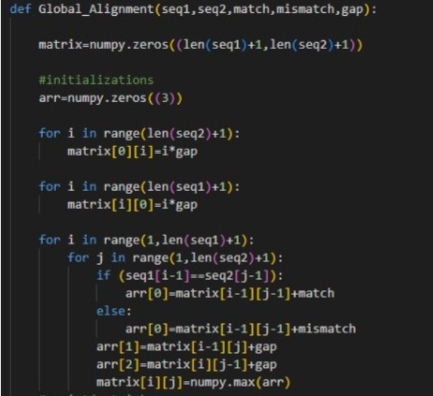
Global Alignment
1.Initialization:
Initialization and Filling
2.Matrix Filling:
For each cell, check all the possible
combinations of the score that it can take,
Options can be:
Diagonal + Match/Mismatch
Upper + Gap
Left + Gap
3.Traceback:
For showing the indices in the array that
Correspond to the best alignment of the
Sequences and where each element comes
From.
Choose Max Num

Slide 7
Local Alignment
1.Initialization
2.Matrix Filling: Filled Matrix does not contain Negatives
3.Traceback
No –ve number
Take Care

Slide 8
Multiple Sequence Alignment
Finding the best alignment for multiple sequences with each other.
Ex:
AAAAGGTTTTT
ATTTTTTTTTTT
TTTTTTTTTTTT
GCTTTASATTA

Slide 9
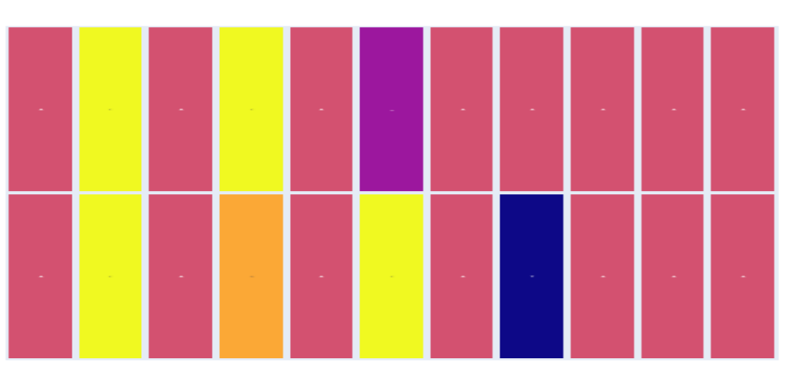
Visualization-Pairwise

Slide 10
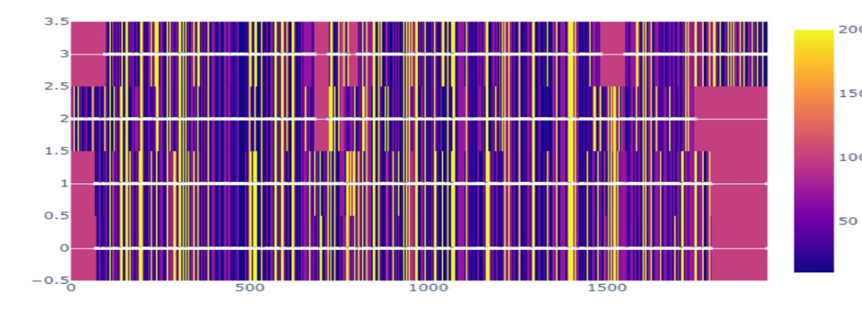
Visualization-MSA

Slide 11
MSA-Assessment
Sum of Pairs
PercentIdentity
Mutual Information

Slide 12
Thanks!

