Slide 1

Human-Centered Computing: applications in natural language processing, network science, machine learning, and AI (IN0012, IN2106, IN4906_8)
CLARITY
Unmasking Political Question Evasions

Slide 2
28. Oktober 2025

Slide 3
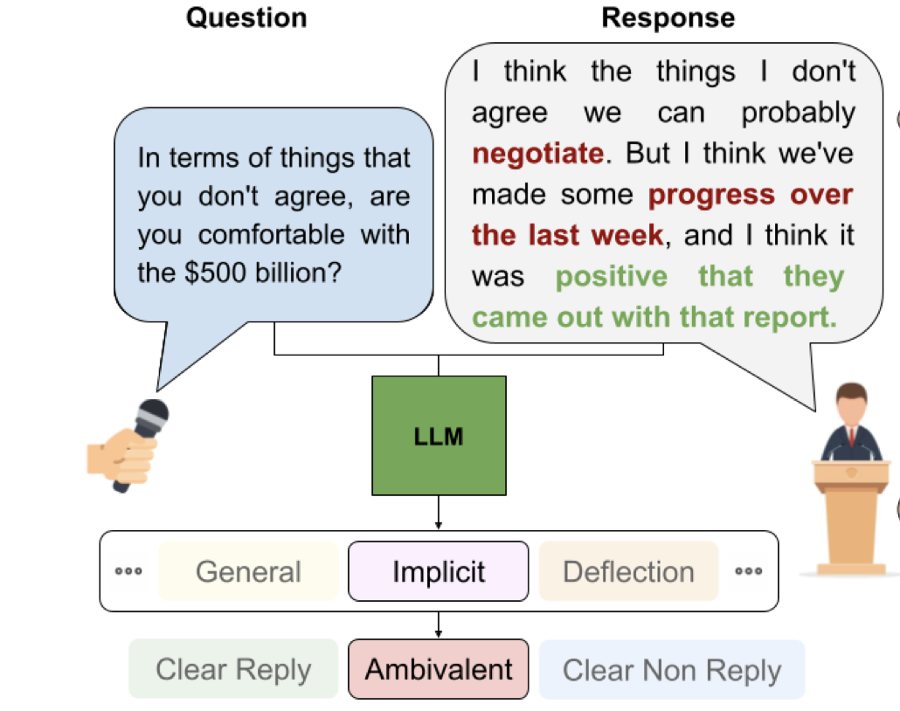
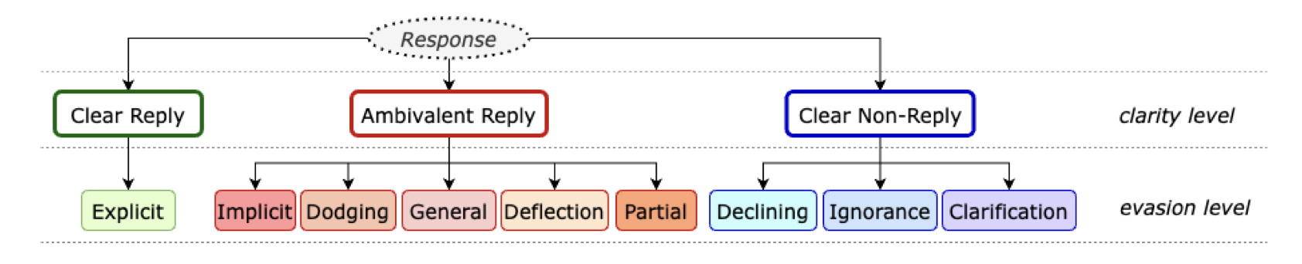
Refresher
Problem: Unmasking political ambiguity - classification problem
Classes: Clear Reply, Clear Non-reply, Ambivalent

Slide 4
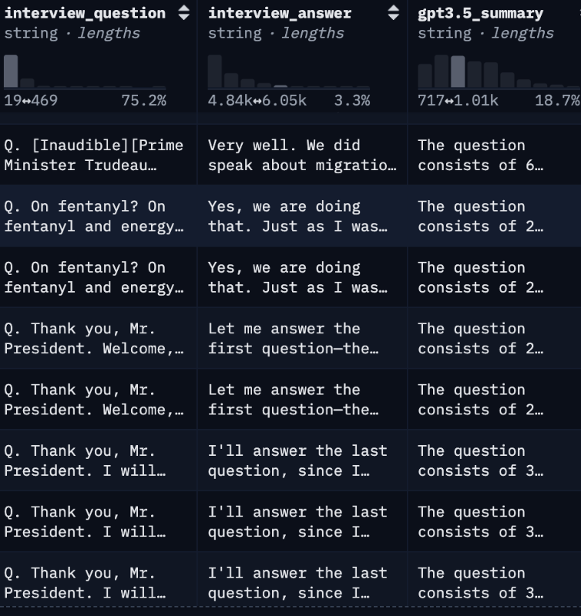
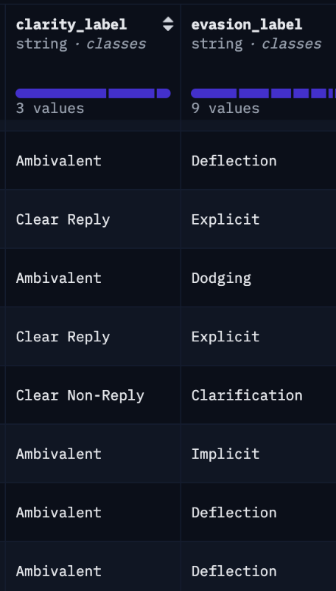
Dataset

Slide 5
Dataset - Problem
Provide more accurate context to our classifier model

Slide 6
Dataset - Versions Documentation
VX.Y - Single column manipulation
VX - Combined columns manipulation

Slide 7
Dataset - Manipulation
V1.1 - Summary generation using BERT

Slide 8
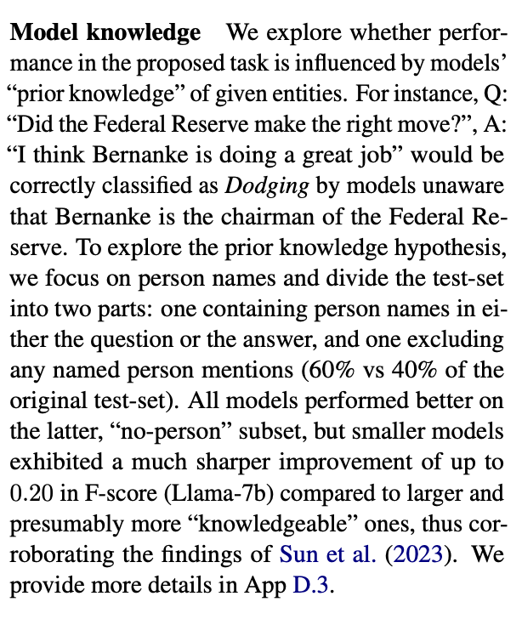
Dataset - Manipulation
V1.2 - Identity hiding

Slide 9
Dataset - Manipulation
V1.3 - Filler words removal

Slide 10
Summary
V1 - Same columns, different intermediate generation methods

Slide 11
Next step
V2. Removal of existing columns, addition of new columns

Slide 12
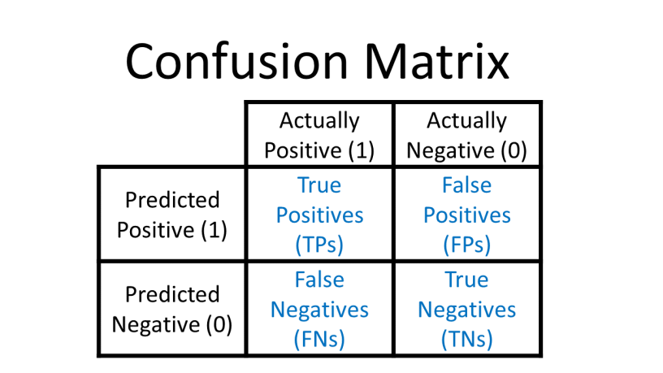
Evaluation Metrics
Measure and compare model performance quality of the classification
Confusion Matrix
A table showing predicted vs. actual classes
Count how many examples fall into each combination
Basis for most metrics
Metrics reduce the confusion matrix into interpretable numbers

Slide 13
Commonly Used Metrics
Accuracy
Proportion of all correct predictions (TP+TN / total)
Misleading with imbalanced data (accuracy paradox).
Precision
Share of predicted positives that are correct (TP / (TP+FP))
Ignores false negatives, overestimates models that avoid risk
Recall
Share of actual positives that are correctly found (TP / (TP+FN))
Ignores false positives, overestimates models that predict positive too often
F1-Score
Mean of precision and recall, balances both
Still biased by class imbalance
Informedness
Probability the model makes a decision better than random chance
Less commonly known, best in capturing the models characteristics

Slide 14
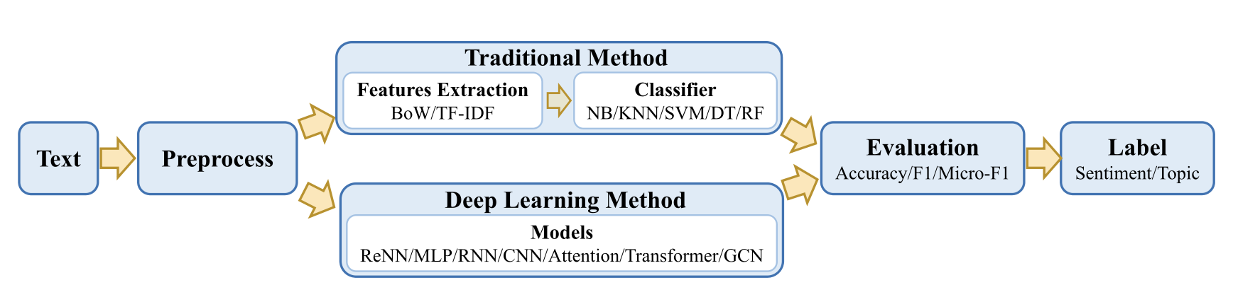
Models for Classification

Slide 15
Outdated Technologies
Traditional Machine Learning (Naïve Bayes, KNN, Decision Trees)
Rely on manual feature engineering
Can’t capture context or semantics
Early Deep Learning (CNNs, RNNs, LSTMs)
Automatic feature learning from raw text
Limited to word patterns
Computationally heavy compared to newer Transformers

Slide 16
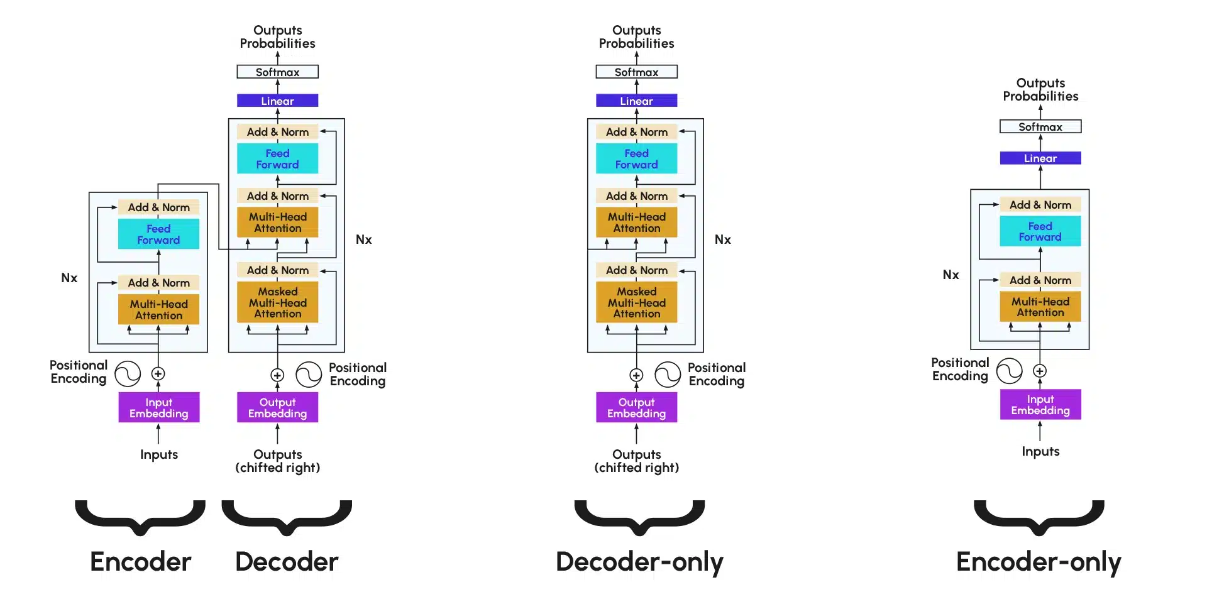
Transformer Models
Based on self attention: every token looks at every other token in input
Model learns relationships between all words in a sequence simultaneously

Slide 17
Architectures for Classification
Encoder-only Models (e.g. BERT, RoBERTa, DistilBERT, …)
Pretrained encoders, fine-tune end to end with train data set
Fine-tuned LLMs with LoRA
Use big models (GPT, LLaMA, …) but only train small adapter layers
LLMs with Prompting
Use frozen LLM, give task instructions + examples in the prompt

Slide 18
Methods to Enhance Classification
CARP (Clue And Reasoning Prompting)
Breaks classification into 3 steps: find clues → reason → decide label
Handles tricky cases like better than a single step classification
EASE (Data Augmentation)
Creates extra training samples
Stable and effective for Transformer models than older augmentation methods
Useful when only small datasets are available

Slide 19
PAG: Paraphrase and Aggregate
Problem
LLMs perform well on classification but are still prone to misclassifications and hallucinations
Solution
1. Paraphrase the input into multiple variations
2. Classify original + paraphrases
3. Aggregate predictions
Results
Error reduction: 22.7% (CLINC), 15.1% (Banking)

Slide 20
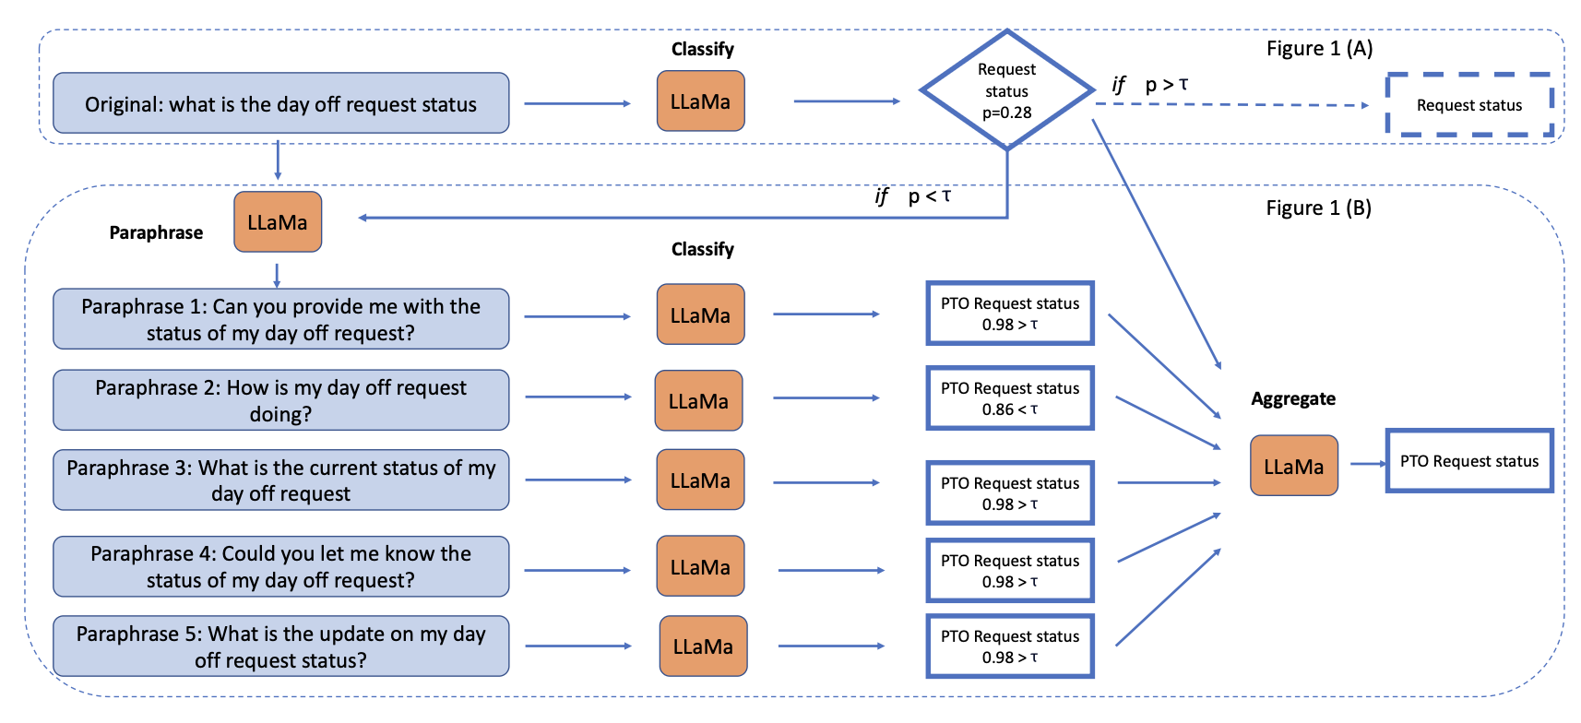
Paraphrase and Aggregate

Slide 21
Selective Question Answering under Domain Shift (Kamath et al., 2020)
Real‐world QA systems must handle questions outside their training scope → risk of error increases.
The authors propose: instead of always answering, allow the system to abstain when unsure.
Core challenge: model confidence (its “top probability”) is not reliable when domain shifts.
Solution: Train a separate calibrator that predicts “model will err?” → if yes → abstain.

Slide 22
Selective Question Answering under Domain Shift (Kamath et al., 2020)
Key result: System answers 56% while keeping 80% accuracy, vs baseline ~48% at same accuracy.
Practical implication for our challenge: We can build a “confidence/abstention” mechanism to recognise evasive or out‐of‐domain answers → improves reliability of labels.
Bonus: Using a small bit of “out‐of‐domain” data to train the calibrator helps—even if we don’t know the exact future domain.
Takeaway: It’s better to say “I don’t know / abstain” than to confidently output a wrong classification.

Slide 23
Deceiving QA Models: Hybrid Word-Level Attacks (Li et al., 2024)
Modern QA systems are good but fragile: small word-level changes can derail them.
Focuses on adversarial attacks (= how can one trick QA Models at the world-level, so that the answer becomes wrong or irrelevant)
introduce „QA-Attack“, which alters questions/context at word level (synonyms, insertions, deletions) to fool models.
Key finding: many models are not robust to these word-level attacks -meaning, when an answer is slightly manipulated, the system’s performance drops significantly

Slide 24
Deceiving QA Models: Hybrid Word-Level Attacks (Li et al., 2024)
Implication for our challenge: Evasive answers in political contexts can act like adversarial attacks: superficially plausible but semantically different.
Therefore: Our system should not only detect explicit evasion, but also be sensitive to subtle meaning shifts.
Takeaway: We must build robustness checks (word‐level/hyper‐subtle feature inspection) and confidence calibration (flagging probable “trick” answers) in our classifier pipeline.
Even though confidence is high, answer might be wrong when context is subtly altered
Robustness is harder than simply achieving high accuracy on „normal“ data! -> Models must be tested on „harder“ data (adversarial)

Slide 25
Measuring Answer Quality in Political Question Time (Morrier et al., 2025)
Content: measure the quality of political answers automatically by using language-model embeddings rather than subjective human ratings. (like us ☺)
Goal: Evaluate how well a politician’s answer matches the question.
Method: Use a semantic similarity model (a type of AI embedding) to see if the model can correctly pair each question with its real answer among many “distractor” answers.
Instead of asking humans whether an answer is “good,” they test how easily an AI can link questions to their corresponding answers. The harder it is, the weaker the link.

Slide 26
Measuring Answer Quality in Political Question Time (Morrier et al., 2025)
Key findings:
On average, answers are semantically closer to their questions than to random distractors but quality varies widely.
Sensitive topics (e.g., scandals, immigration) yield lower semantic match scores → more evasive or off-topic answers.
Institutional context matters: majority governments tend to give lower-quality (less directly relevant) answers.
Answer length correlates positively but weakly with quality: longer ≈ slightly clearer.

Slide 27
Measuring Answer Quality in Political Question Time (Morrier et al., 2025)
Why it matters for us:
The paper offers a quantitative way to detect evasiveness without manual annotation.
Semantic similarity between a question and an answer is a powerful, domain-neutral signal:
High similarity → clear reply
Low similarity → possible evasion / non-reply
This can serve as a feature or sub-module in our clarity-classification system.
we can pre-train our model on this “matching” task before fine-tuning on labeled clarity data

