Slide 1
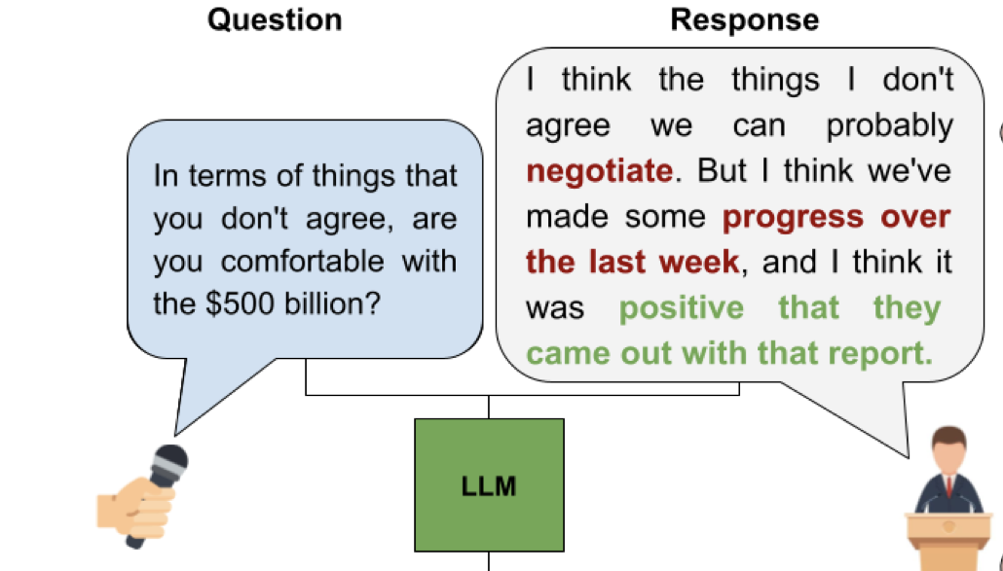
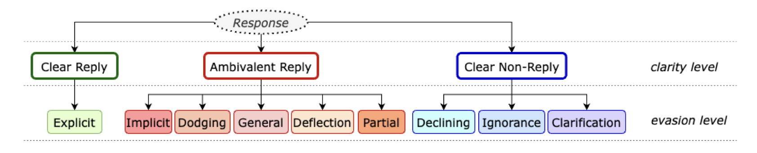
Retro
Based on a Question and Answer classify the Answer Type
Task 1
Classify the answer as Clear Reply, Ambiguous or Clear Non-Reply
Task 2
Classify the answer into one of the 9 evasion techniques

Slide 2
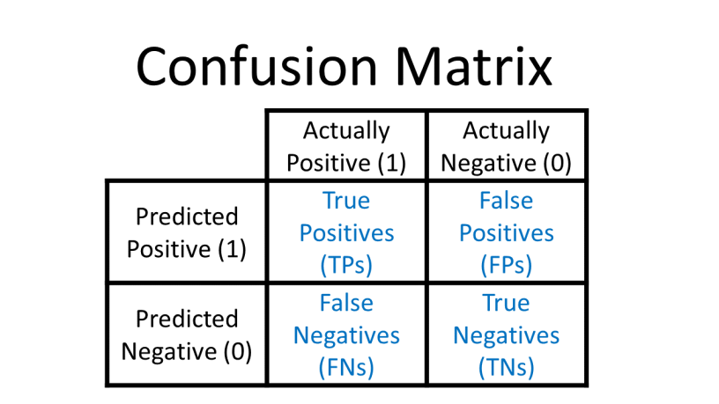
Evaluation Metrics
Measure and compare model performance quality of the classification
Confusion Matrix
A table showing predicted vs. actual classes
Count how many examples fall into each combination
Basis for most metrics
Metrics reduce the confusion matrix into interpretable numbers

Slide 3
Commonly Used Metrics
Accuracy
Proportion of all correct predictions (TP+TN / total)
Misleading with imbalanced data (accuracy paradox).
Precision
Share of predicted positives that are correct (TP / (TP+FP))
Ignores false negatives, overestimates models that avoid risk
Recall
Share of actual positives that are correctly found (TP / (TP+FN))
Ignores false positives, overestimates models that predict positive too often
F1-Score
Mean of precision and recall, balances both
Still biased by class imbalance and depends on which class is “positive.”
Informedness
Probability the model makes a decision better than random chance
Less commonly known, best in capturing the models characteristics

Slide 4
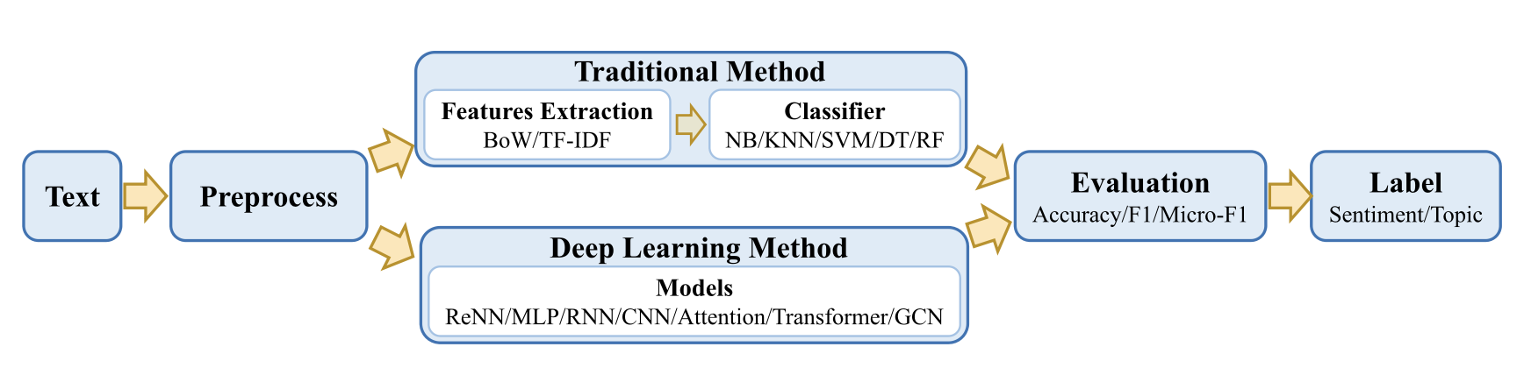
Models for Classification

Slide 5
Outdated Technologies
Traditional Machine Learning (Naïve Bayes, KNN, Decision Trees)
Rely on manual feature engineering
Can’t capture context or semantics
Performance drops with large, unstructured data
Early Deep Learning (CNNs, RNNs, LSTMs)
Automatic feature learning from raw text
Limited to word patterns and relatively slow
Computationally heavy compared to newer Transformers

Slide 6
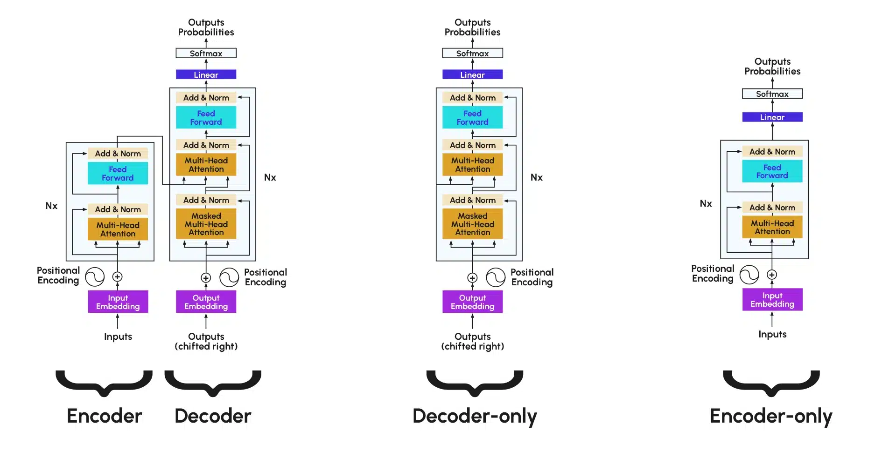
Transformer Models
Based on self attention: every token looks at every other token in input
Model learns relationships between all words in a sequence simultaneously

Slide 7
Architectures for Classification
Encoder-only Models (e.g. BERT, RoBERTa, DistilBERT, …)
Pretrained encoders, fine-tune end to end with train data set
Fine-tuned LLMs with LoRA
Use big models (GPT, LLaMA, …) but only train small adapter layers
LLMs with Prompting
Use frozen LLM, give task instructions + examples in the prompt

Slide 8
Methods to Enhance Classification
CARP (Clue And Reasoning Prompting)
Breaks classification into 3 steps: find clues → reason → decide label
Handles tricky cases like better than a single step classification
EASE (Data Augmentation)
Creates extra training samples
Stable and effective for Transformer models than older augmentation methods
Useful when only small datasets are available

Slide 9
Paraphrase and Aggregate
Problem
LLMs perform well on classification but are still prone to misclassifications and hallucinations
Solution
1. Paraphrase the input into multiple variations
2. Classify original + paraphrases
3. Aggregate predictions
Results
Error reduction: 22.7% (CLINC), 15.1% (Banking)

Slide 10
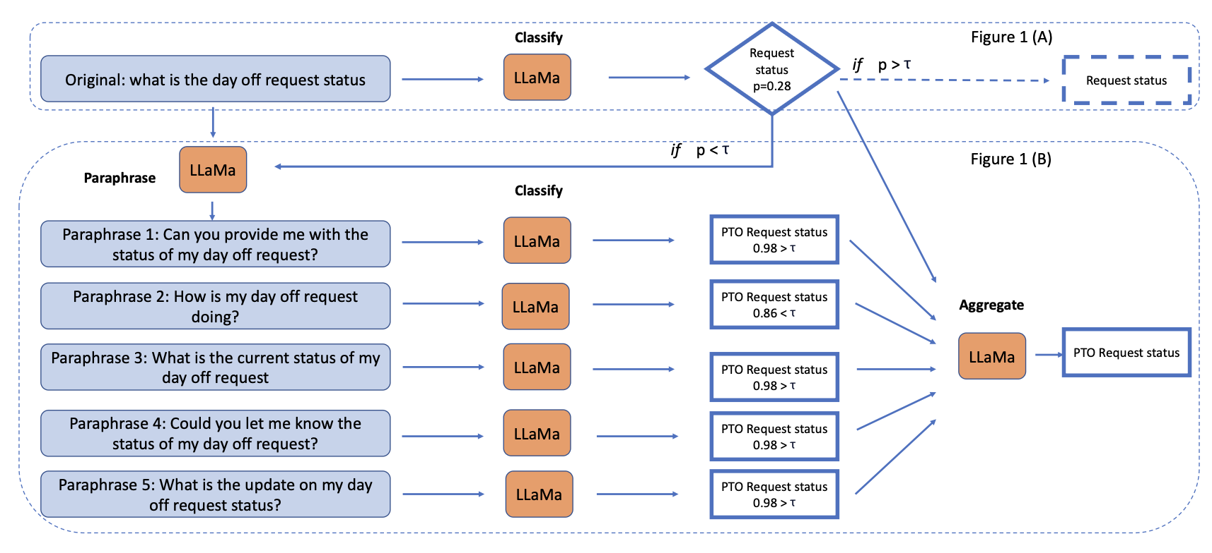
Paraphrase and Aggregate

