Slide 1
TLDR Summary
### TLDR Summary for estheroche, Oshioke-Salaki, manoahLinks, Joy-Adah, 0xkyng, Calebux, princeibs, CollinsC1O, vibenedict, estherbreath, Immanuelolivia1, muheebyusufbaba1, Enenche23, aji70
**Commit Activity from partipants in the program:** GREAT! Significantly higher after the program.
**New Developers:** 4
New developers
**Comparison with Other Developers:** NOTHING SPECIAL: No significant difference in the number of commits.
**Growth Rate in number of commits:** NOTHING SPECIAL: No significant difference in the average growth rate.

Slide 2
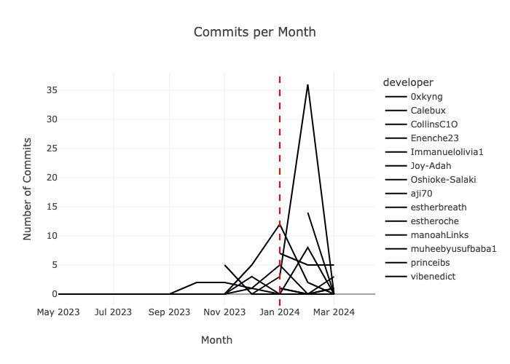
Commits per Month

Slide 3
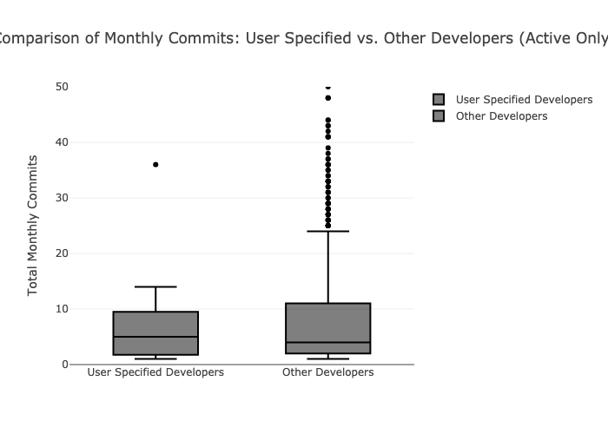
Box Plot Comparison (Last 3 Months)

Slide 4
Which developers are the most active?
0xkyng: Always been inactive
CollinsC1O: Always been inactive
estherbreath: Always been inactive
muheebyusufbaba1: Always been inactive
Enenche23: Always been inactive
aji70: Always been inactive
Oshioke-Salaki: Highly involved (20+ commits)
Immanuelolivia1: Moderately active (10-19 commits)
princeibs: Moderately active (10-19 commits)
Calebux: Low-level active (<10 commits)
manoahLinks: Low-level active (<10 commits)
Joy-Adah: Low-level active (<10 commits)
estheroche: Low-level active (<10 commits)
vibenedict: Low-level active (<10 commits)

Slide 5
Are these developers committing more code after the program than before the program?
Mann-Whitney U test statistic: 126.500, P-value: 0.073
CONGRATULATIONS! The commit activity from the builders taking part in this program is statistically higher after the program.Difference in commit activity before and after the program is considered significant.

Slide 6
Do we have new developers after the program?
Number of new developers committing code within 2 months after the program: 4
New developers: princeibs, 0xkyng, Immanuelolivia1, estherbreath

Slide 7
Do the developers of this program commit more code than other Starknet developers?
Mann-Whitney U test statistic: 19222.500, P-value: 0.526
NOTHING SPECIAL! There is no significant difference in the number of commits between user-specified developers and other developers since the program end date.

Slide 8
Is the increase rate in commits from these developers higher than that of other Starknet developers?
Mann-Whitney U test statistic: 2116.500, P-value: 0.327
NOTHING SPECIAL! There is no significant difference in the average growth rate of commit activity between user-specified developers and other developers.

