Slide 1

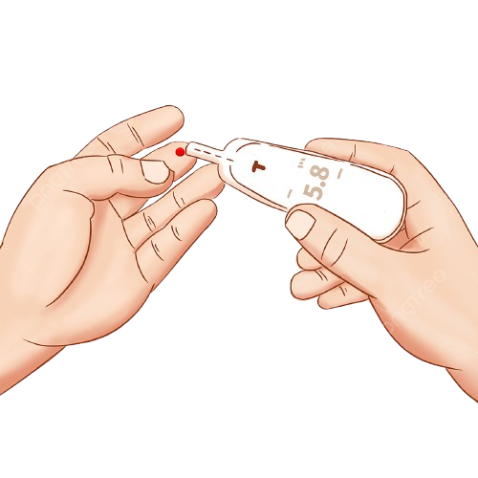
Healthcare Diabetes
Prepared By:
Heba Allah Tarek
Omar Mohamed
Omar Saad
Eslam Ayman

Slide 2
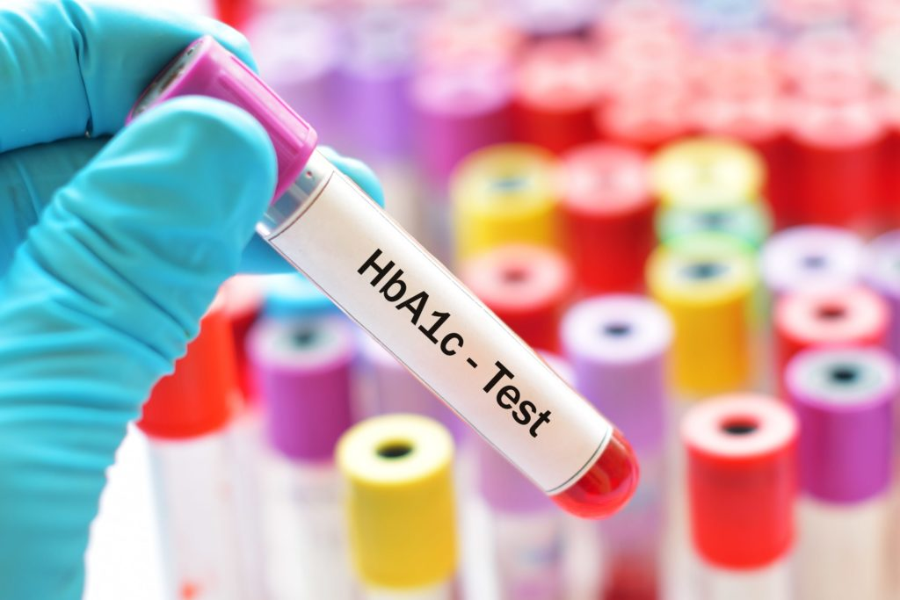
Problem Definition
-The goal is to predict whether a patient is likely to have diabetes based on health indicators like:
Age
Glucose level
Blood pressure
BMI (Body Mass Index)
Skin thickness
Insulin level
Number of pregnancies
Diabetes pedigree function (family history)
-Doctors might not always be able to predict diabetes accurately from medical checkups alone.
-Problem Type: Classification (Predicting diabetes status: Yes or No)
-Our Solution: Build a data-driven system that analyzes patient health data and predicts the likelihood of diabetes.

Slide 3

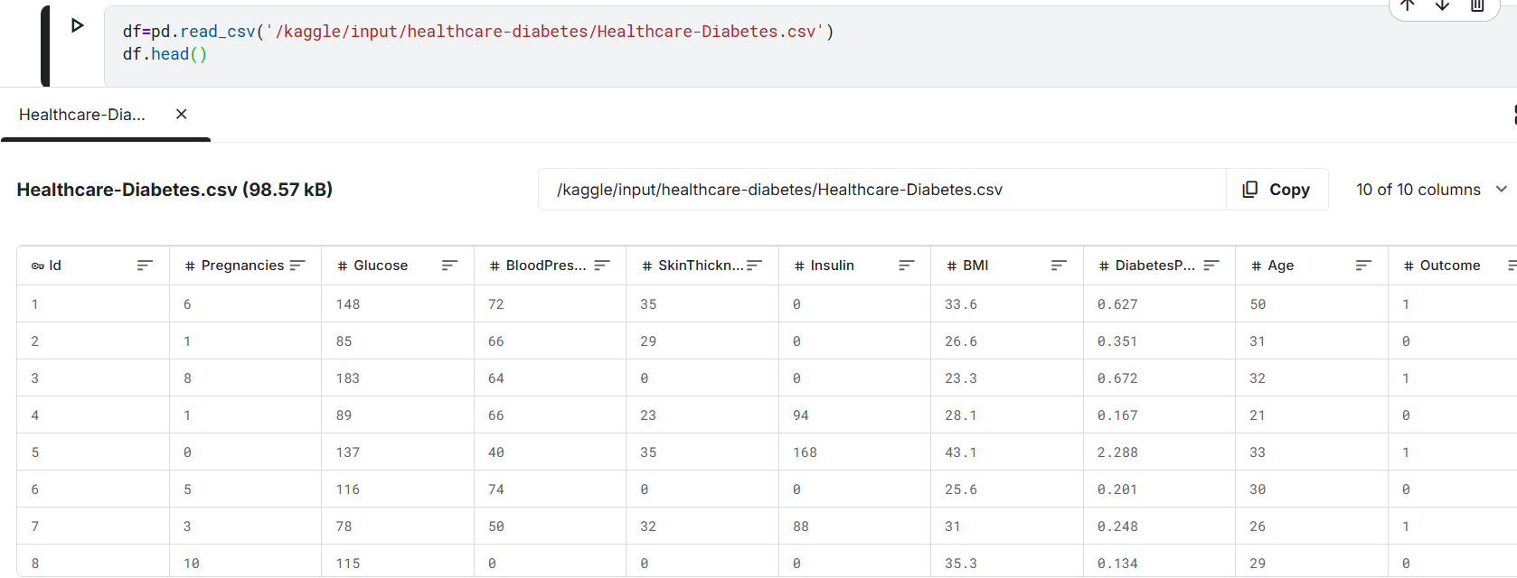
-Data Collection
We collected from Kaggle, Dataset is provided in a structured tabular format, stored in a comma-separated values (CSV) file. It consists of a collection of health-related attributes that can be utilized for diabetes risk assessment and prediction. Each row in the dataset represents an individual, and the columns contain various health measurements and characteristics. Below is a detailed description of each column.
🔗 Dataset Link: Healthcare - Diabetes Dataset

Slide 4
-Data describtion
- The dataset contains 768 rows and 9 columns.
- Each row represents a medical record for an individual, including various health-related measurements and characteristics. The features include: Pregnancies, Glucose, Blood Pressure, Skin Thickness, Insulin, BMI, Diabetes Pedigree Function, and Age. The final column is Outcome, which is the target variable
Non-diabetic=0
Diabetic=1
This dataset is used to train a machine learning model to predict the likelihood of diabetes based on a person's medical data.

Slide 5
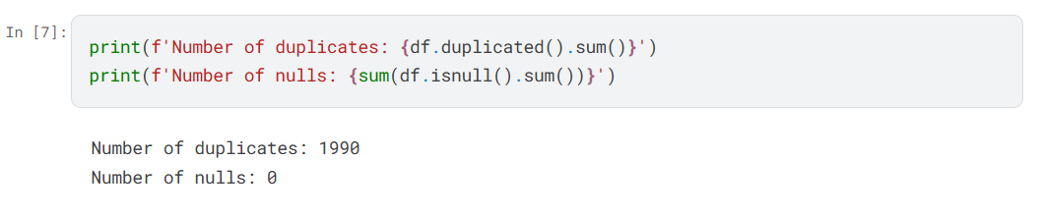
-Data Analysis
we performed data analysis to explore patterns, distributions, and detect missing or abnormal values. The goal of the analysis is to better understand which health features are most related to diabetes
Check Missing values or duplicates
Checked for missing values using isnull().sum()
Checked for missing values using duplicated().sum()

Slide 6
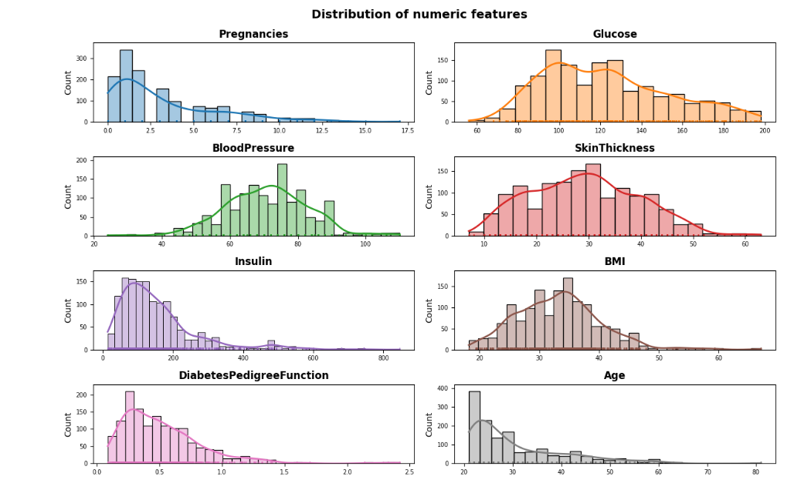
Bar Chart Representation of Features
We used bar charts to represent the distribution of each feature in the dataset. Bar charts provide a simple visual overview of the frequency of different values in each column.
This helps identify which values occur more often, spot unusual distributions, and understand how each variable behaves

Slide 7

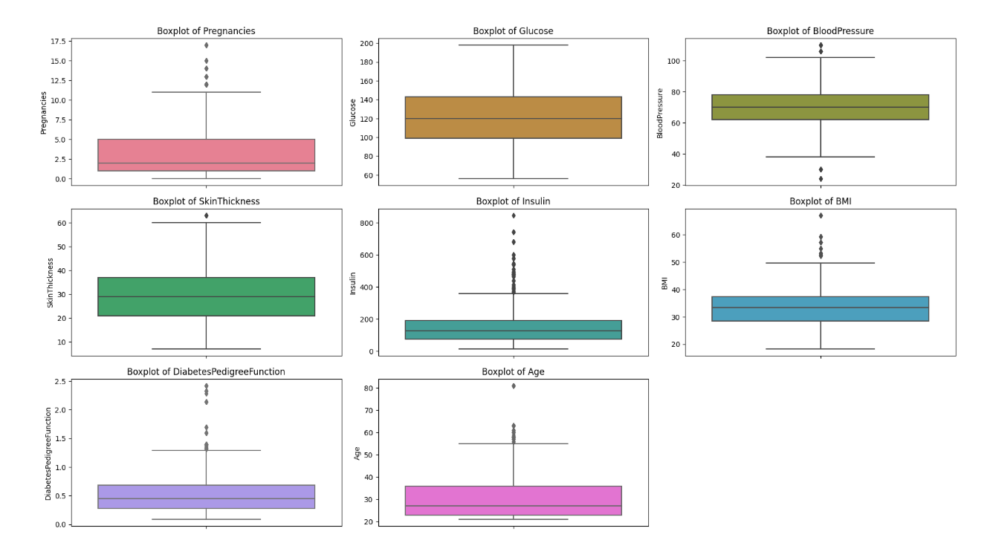
Outlier Detection

Slide 8
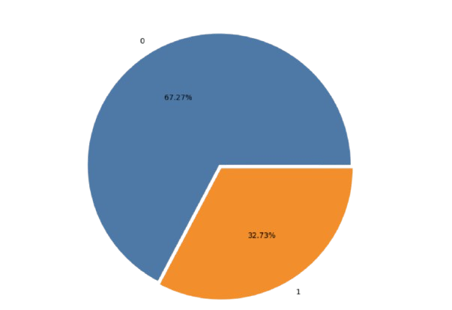
Diabetes Precentage
which is the target variable
Non-diabetic=0
Diabetic=1

Slide 9
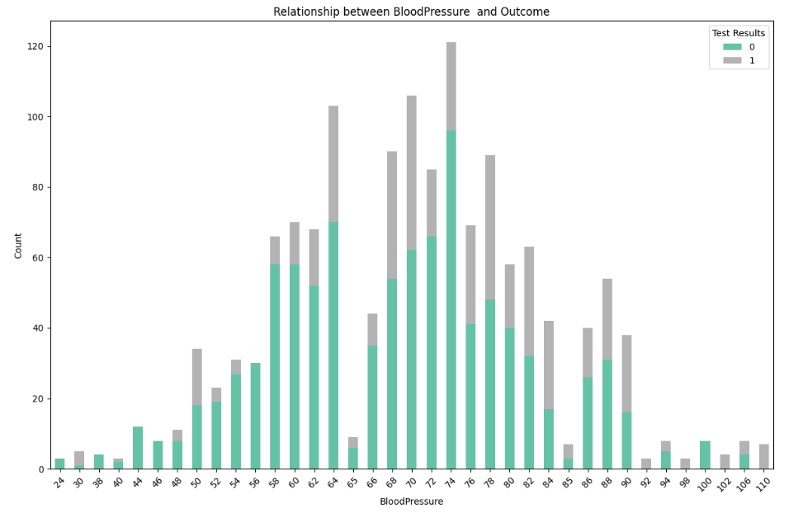
Target distribution

Slide 10
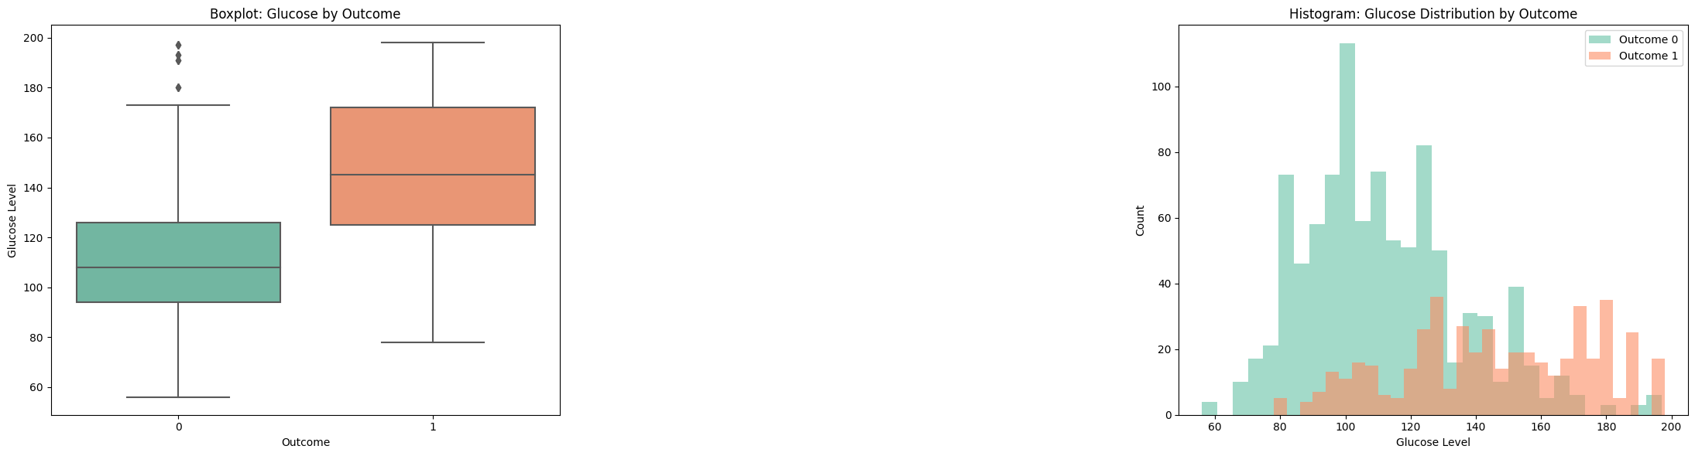
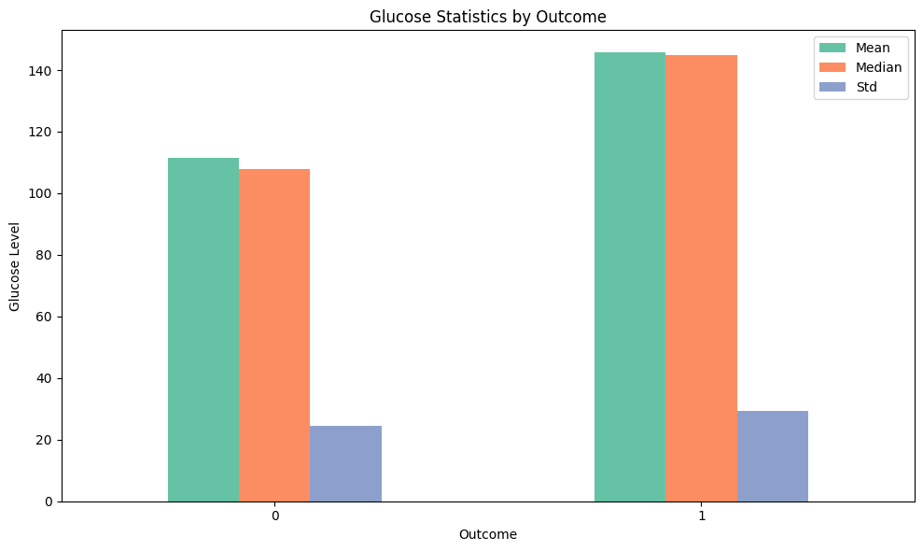
Glucose correlation

Slide 11
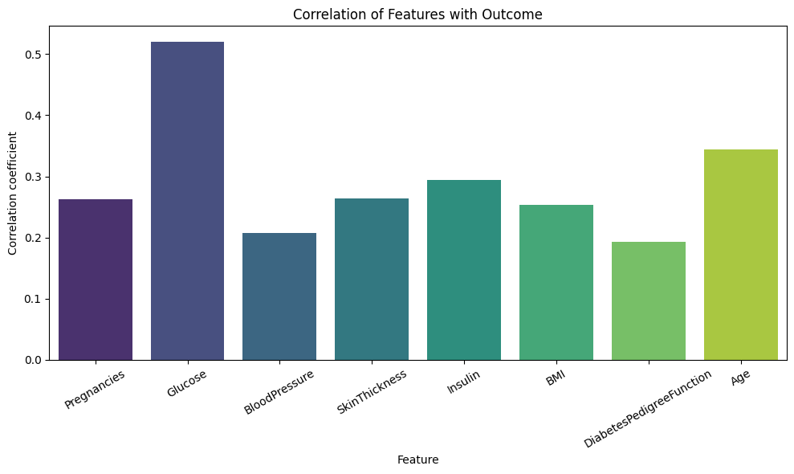
Statistical significance:

Slide 12
Data modeling
In this stage, we used machine learning algorithms to build a model that can predict whether a person is diabetic based on medical features.
-Split the data into training and testing sets
-Applied classification algorithms ( Logistic Regression, Random Forest, Decision Tree)
-Evaluated models using accuracy, confusion matrix, and classification report

Slide 13
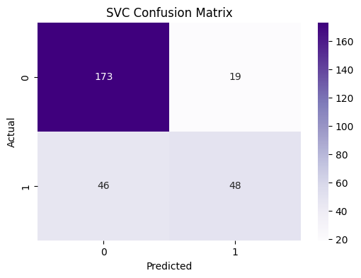
SVC Confusion Matrix

Slide 14
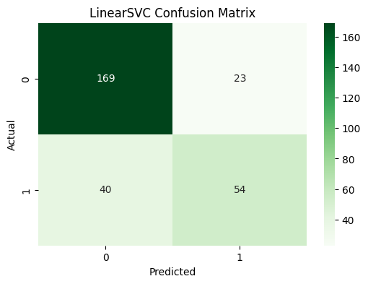
Linear SVC Confusion Matrix

Slide 15
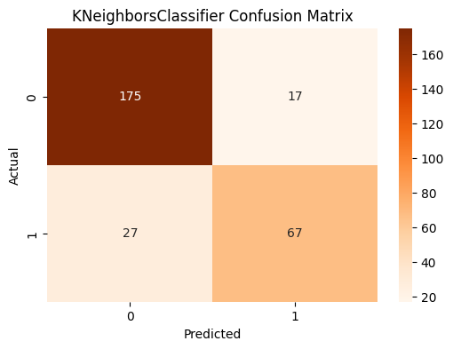
KneighborsClassifier Confusion Matrix
KneighborsClassifier Validation Accuracy= 0.8462

Slide 16
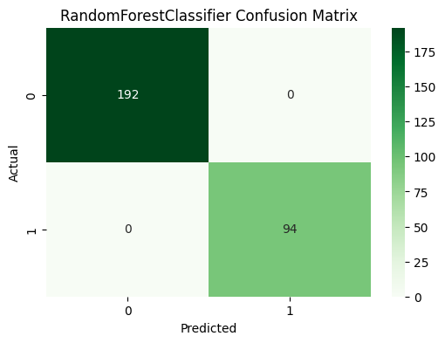
RandomForestClassifier Confusion Matrix
RandomForestClassifier Validation Accuracy= 1.0000

Slide 17
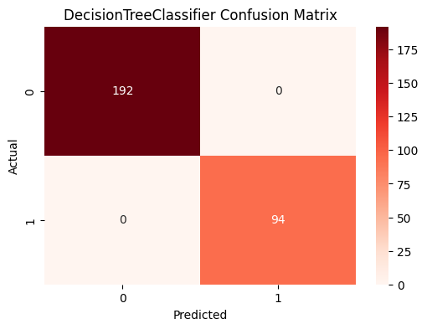
DecisionTreeClassifier Confusion Matrix
DecisionTreeClassifier Validation Accuracy=1.0000

Slide 18
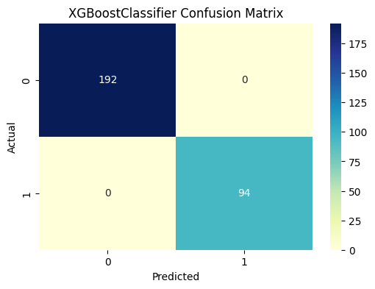
XGBoostClassifier Confusion Matrix
XGBoostClassifier Validation Accuracy= 1.0000

Slide 19
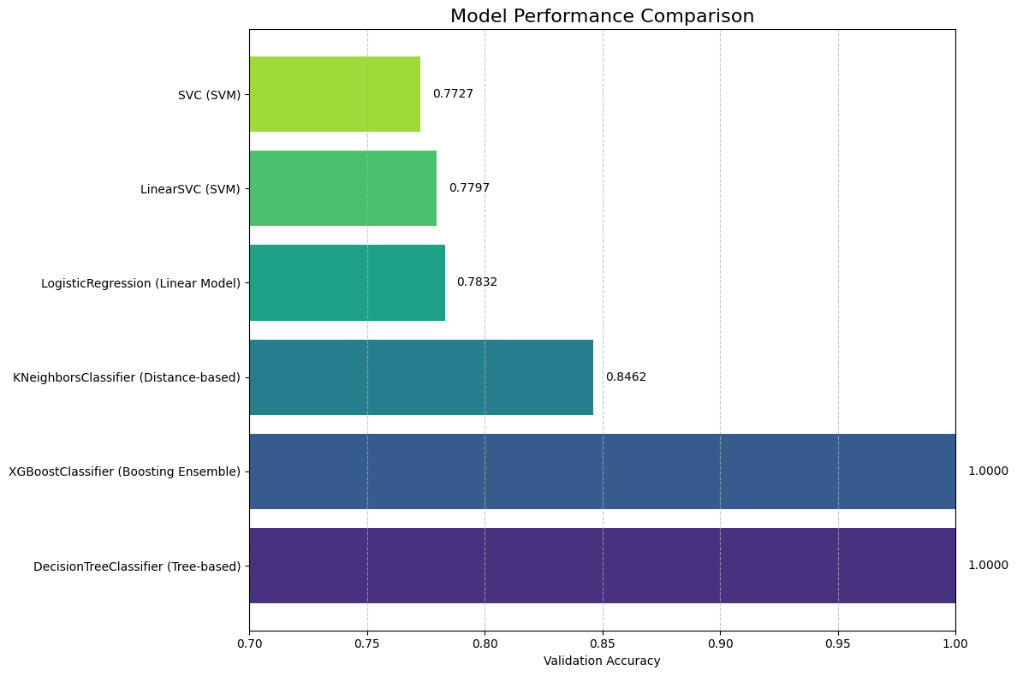
Visualize model performances

Slide 20
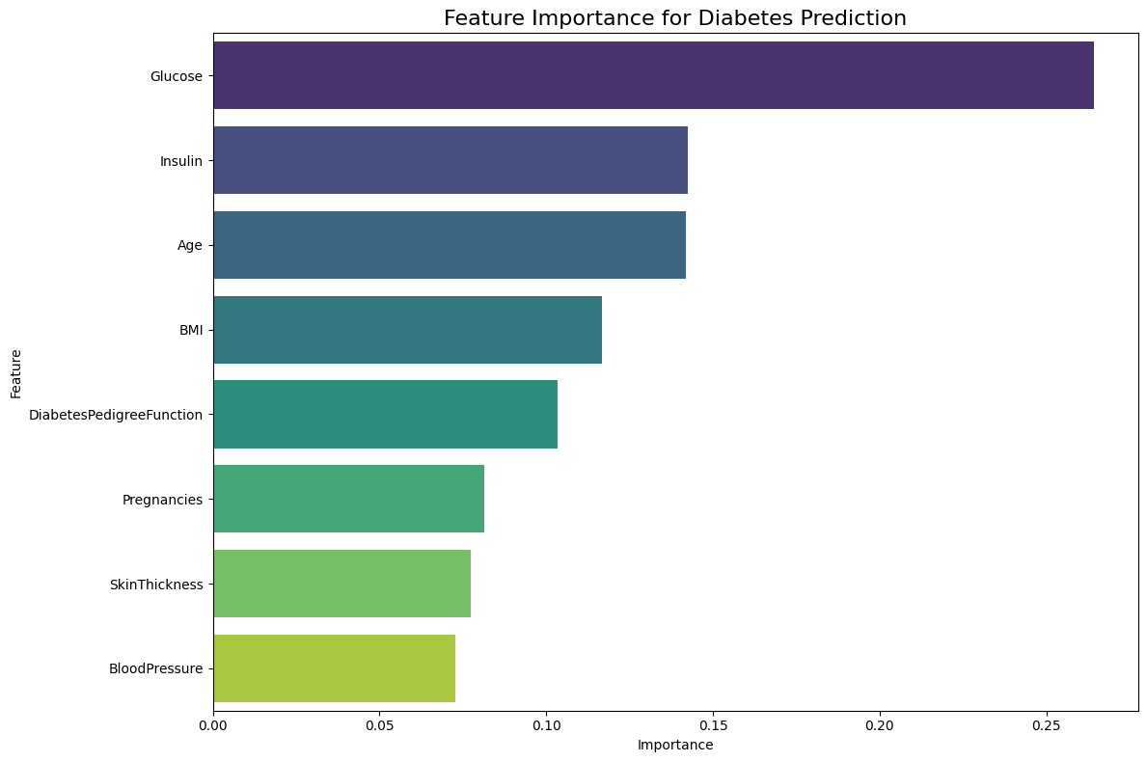
Feature Importance Analysis

Slide 21
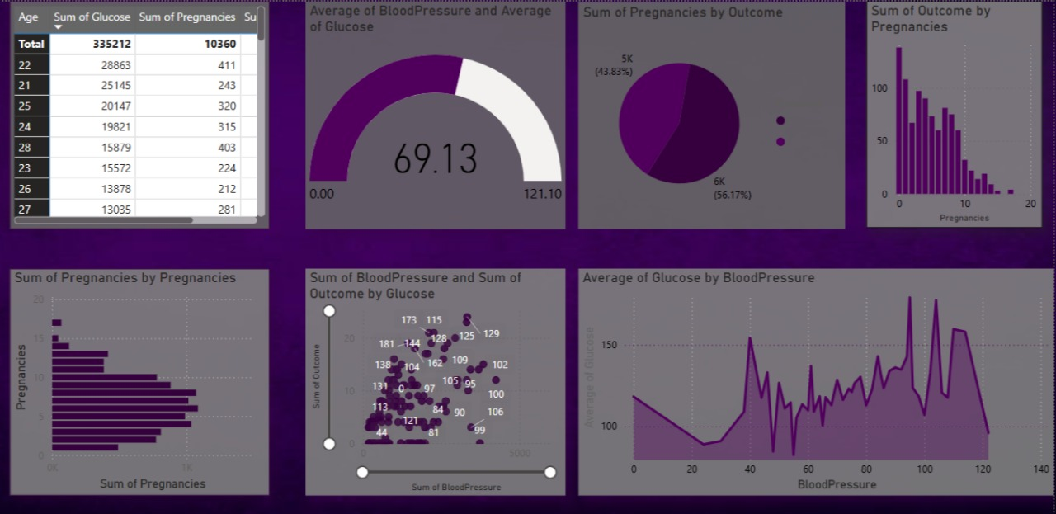
Dashboard about analysis

Slide 22
Conclusion
Project Summary
This project focused on developing a machine learning model to predict diabetes risk based on health metrics.
WePerformed thorough data cleaning, removing unnatural zero values that would skew the analysis
Conducted exploratory data analysis to understand feature distributions and relationships
Implemented and compared multiple machine learning models
Identified the most important features for diabetes prediction
Created a deployable model with an interactive web interface
Thank you

