Slide 1
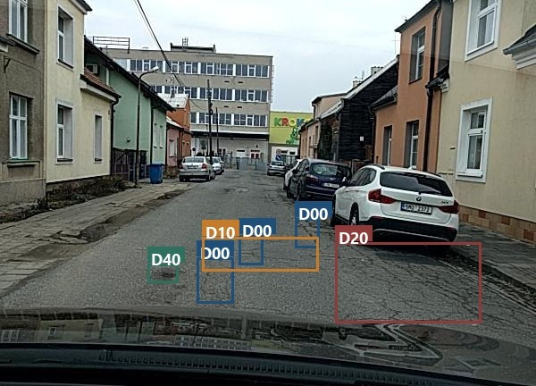
GERMAN UNIVERSITY IN CAIRO · MET DEPARTMENT
DMET 901 Computer Vision · Dr. Mohamed Karam
MILESTONE 1
Road Damage
Detection
Cracks and potholes in one dashcam frame.
Object detection on RDD2022 with YOLOv8s.
Real training frame Czech_003072.jpg, ground-truth boxes.
Presenter: Ziad Ehab Team number : 14
Notes:
≈15 s. One sentence: a road photo goes in, labelled boxes come out, four damage types. Milestone 1 fixes the problem, the dataset and the starting model. Fill in the name placeholders.

Slide 2
3.1 PROBLEM
One RGB frame in, labelled boxes out
Task
Object detection — several objects, four classes
Output classes
D00
Longitudinal crack
Input
One RGB image from a camera on a moving car
D10
Transverse crack
D20
Alligator crack
Output
A box + class for every damage; empty if the road is fine
D40
Pothole
Not classification (a frame can hold many damages), not segmentation (the labels are boxes, not masks).
DMET 901 · Milestone 1 · Road damage detection on RDD2022
2 / 12
Notes:
≈30 s. Say the task type: object detection. Output format: (class, xmin, ymin, xmax, ymax, confidence), zero or more per frame. No severity, no masks — the labels do not contain them. Frame-by-frame; tracking is out of scope.

Slide 3
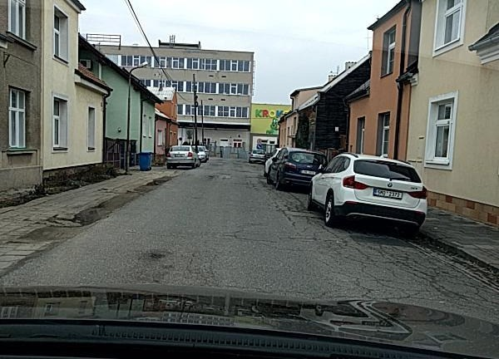
3.1 INPUT → OUTPUT
What goes in, what must come out
INPUT
OUTPUT
600 × 600 JPEG, smartphone on the windscreen
3× D00
1× D10
1× D20
1× D40
DMET 901 · Milestone 1 · Road damage detection on RDD2022
3 / 12
Notes:
≈30 s. Frame Czech_003072.jpg from the Czech training set; the boxes are the dataset's ground truth drawn by our code — the exact format the detector must produce. Six boxes, all four classes in one frame; boxes overlap, which is fine for detection. Top of the frame cropped for display only (windscreen glare).

Slide 4
3.1 MOTIVATION
Why, and for whom
Why
Potholes wreck wheels and cause crashes; cracks become potholes if missed.
Who
Drivers (in-car warning) and road authorities (automatic damage reports).
Today
The driver spots it by eye — too late in traffic, at night or in glare.
Framing: a driver-assistance feature that turns any dashcam into a damage detector.
DMET 901 · Milestone 1 · Road damage detection on RDD2022
4 / 12
Notes:
≈25 s. Concrete user: a driver with a dashcam, secondary: the municipality receiving geotagged detections. Human baseline: eyesight and manual inspection routes — slow, subjective, and blind at night. Cairo is the target deployment.

Slide 5
3.2 DATASET
RDD2022 — 47,420 images, 6 countries, CC BY 4.0
Country
Train
Test
Boxes
Resolution
• Source: Arya et al., figshare (2022)
• Camera: smartphone on a car (most), Street View, drone
• Files: JPEG + one Pascal VOC XML per image
• Label: class + pixel box. No mask, no severity
• On disk: Czech subset, audited by our code
Japan
10,506
2,627
16,470
600 × 600
India
7,706
1,959
6,831
720 × 720
Czech Republic
2,829
709
1,745
600 × 600
Norway
8,161
2,040
11,229
3650 × 2044
United States
4,805
1,200
11,014
640 × 640
China (bike + drone)
4,378
500
7,718
512 × 512
Total
38,385
9,035
55,007
—
DMET 901 · Milestone 1 · Road damage detection on RDD2022
5 / 12
Notes:
≈40 s. Counts are Figures 4–5 of the RDD2022 data article; row sums verified in code. Full archive 12.4 GB; Czech (≈300 MB) is local. Test images have no public labels, so validation will be a held-out slice of train. 62 % of Czech training XMLs have zero boxes. Licence CC BY 4.0 — usable with attribution.

Slide 6
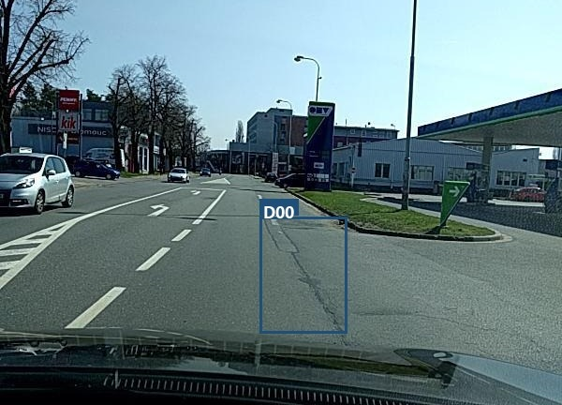
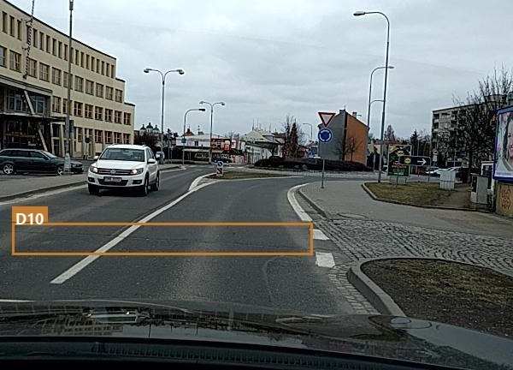
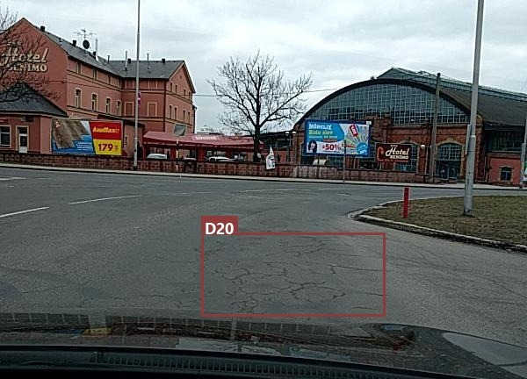
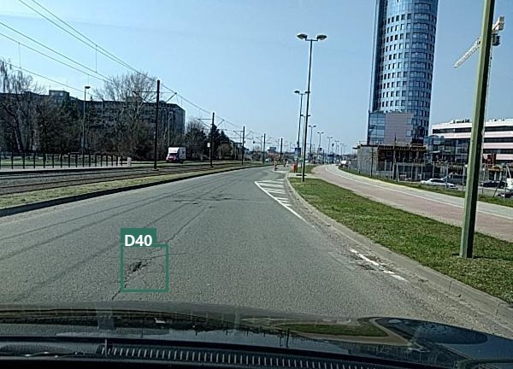
3.2 SAMPLES
One real training image per class
D00
Longitudinal crack
D10
Transverse crack
Along the driving direction
Across the lane
Czech_000279.jpg
Czech_001494.jpg
D20
Alligator crack
D40
Pothole
Mesh of cracks, whole patch
A hole; smallest class
Czech_000803.jpg
Czech_002634.jpg
DMET 901 · Milestone 1 · Road damage detection on RDD2022
6 / 12
Notes:
≈25 s. Czech training frames, boxes drawn from the XML by analysis/build_figures.py, tops cropped for glare. A crack is a thin line inside a big rectangle — that is why tight IoU is hard for D00/D10.

Slide 7
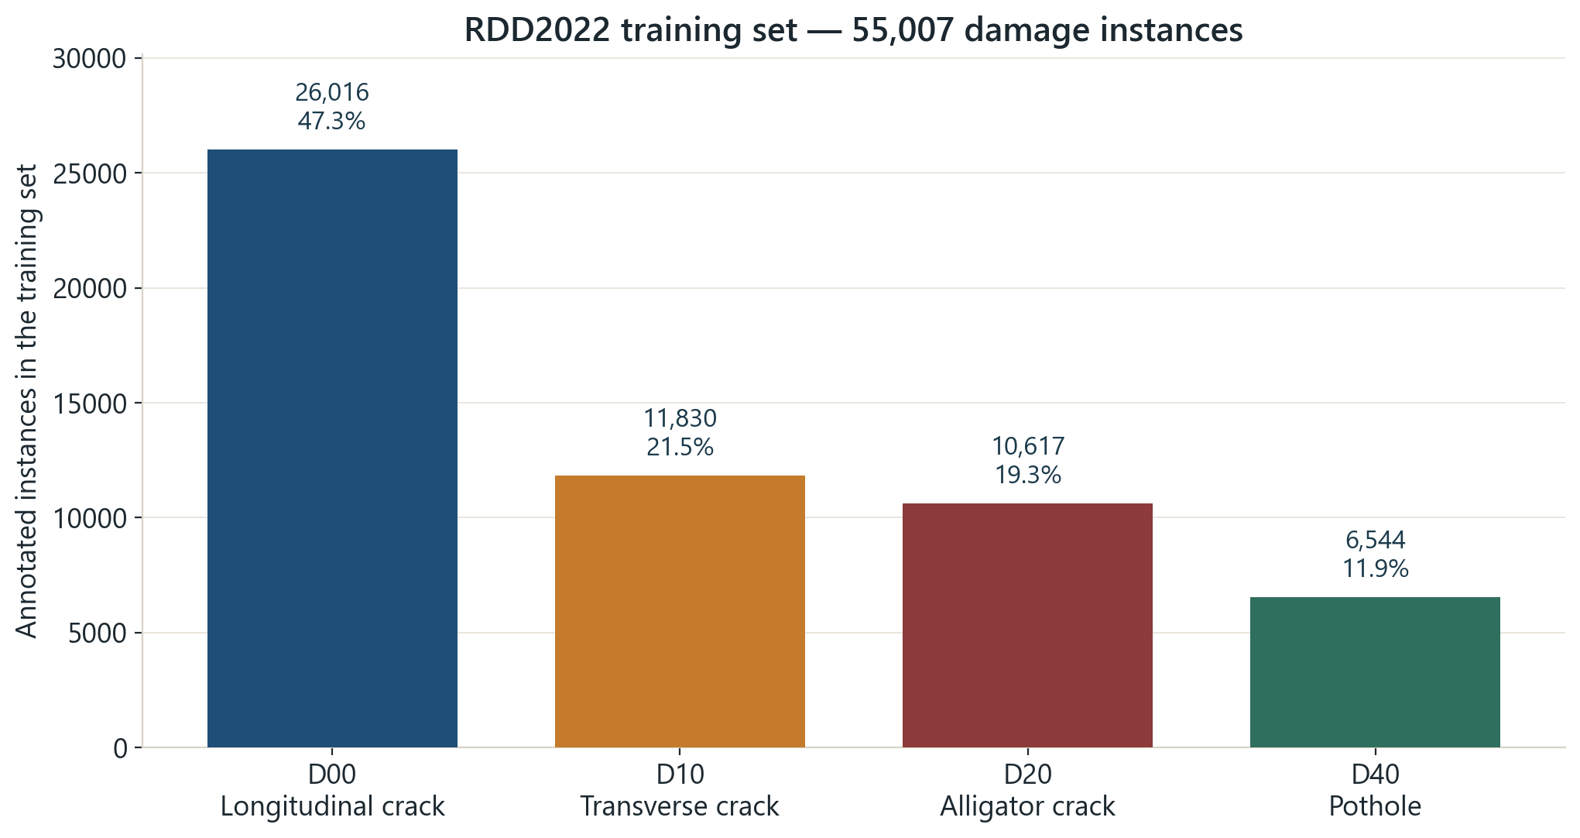
3.2 CLASS DISTRIBUTION
Longitudinal cracks are almost half of all boxes
D00
26,016 (47%)
D10
11,830 (22%)
D20
10,617 (19%)
D40
6,544 (12%)
• 4 : 1 between largest and smallest class
• Potholes are the rarest — and the most dangerous
• → report per-class AP, not one average
DMET 901 · Milestone 1 · Road damage detection on RDD2022
7 / 12
Notes:
≈30 s. Training split only (test labels private). Imbalance also differs by country: India has 3,187 potholes but 68 transverse cracks; the US is the reverse (135 potholes). That is why validation is stratified per country.

Slide 8
3.2 CHALLENGES
What will make the detector fail
Class imbalance
Small objects
D00 is 47 % of boxes, D40 only 12 %
median pothole = 0.4% of the frame
Mostly empty frames
Domain shift
62% of Czech frames have no damage
5 camera types, 512² to 3650×2044, six countries
blur photos
Near-duplicates
consecutive frames — split by sequence, not at random
DMET 901 · Milestone 1 · Road damage detection on RDD2022
8 / 12
Notes:
≈40 s. Every line is a measured number. The blur frame is Czech_002611.jpg, the lowest Laplacian variance over the road region in the Czech training set — an underpass shot from a moving car. Also: windscreen glare and dashboard in every frame, parked cars hiding the kerb lane, label noise (crack extent is a judgement call), no night images. D10 boxes are 5.3× wider than tall vs 0.77 for D00 → no rotation augmentation, it would swap the classes.

Slide 9
3.2 JUSTIFICATION
Right task, wrong geography
Why it fits
Where it falls short
• The pictures look like what our camera will see: a phone on a car, pointed at the road ahead.
• It marks exactly what we want to find — a box around every crack and pothole, sorted into four types.
• None of the roads are in Egypt, so Cairo streets will look unfamiliar to the model at first.
• A hairline crack and a wheel-breaking pothole get the same label — the data says nothing about how bad the damage is.
So: train on RDD2022 first, then check the gap with a small set of Cairo dashcam frames later.
DMET 901 · Milestone 1 · Road damage detection on RDD2022
9 / 12
Notes:
≈25 s. Extra points if asked: it is the largest public set with a permissive licence; six countries let us measure generalisation; labels are boxes not masks, so thin cracks are coarsely captured; frames are daytime only; official test labels are private.

Slide 10
3.3 MODEL & TOOLS
YOLOv8s, fine-tuned from COCO weights
Architecture
YOLOv8s — boxes + classes, real-time, 11 M params fits a 4 GB GPU
Training
Fine-tune all layers from COCO; 38k images is too few to train from scratch
Recipe
640 px, batch 8, ≤100 epochs, early stop on val mAP50; h-flip + mosaic, no rotation
Tools
PyTorch, Ultralytics, OpenCV · VOC → YOLO converter · RTX 3050 4 GB, Colab fallback
Rejected: Faster R-CNN (slow, two-stage), DETR/ViT (data-hungry), U-Net (no masks in the labels).
DMET 901 · Milestone 1 · Road damage detection on RDD2022
10 / 12
Notes:
≈40 s. Why YOLO: labels are boxes, many per frame, and an in-car warning needs real time. Why fine-tune: 38k images is medium — enough to adapt, not to learn from random init. Why no rotation: a quarter turn turns a transverse crack into a longitudinal one. 4 GB VRAM is the reason for the small variant; YOLOv8n is the fallback. Start on Czech to verify the pipeline, then add countries.

Slide 11
3.4 EVALUATION
Metrics that survive a 4 : 1 imbalance
mAP@0.5
Primary. Standard for detection, averaged over classes
mAP@0.5:0.95
Localisation quality — will be low for thin cracks
Per-class AP
So D00 cannot hide a weak D40
Precision / Recall / F1
At one confidence threshold — the driver's operating point
Per country
To expose domain shift instead of averaging it away
Not used: plain accuracy — meaningless with 62 % empty frames.
DMET 901 · Milestone 1 · Road damage detection on RDD2022
11 / 12
Notes:
≈30 s. mAP because it is detection; per class because of imbalance; per country because of domain shift; F1 at a fixed confidence because a warning system has one threshold and F1 was the official CRDDC'2022 metric.

Slide 12
REFERENCES
Sources
▪ Arya, D., Maeda, H., Ghosh, S. K., Toshniwal, D., & Sekimoto, Y. (2024). RDD2022: A multi-national image dataset for automatic road damage detection. Geoscience Data Journal, 11(4), 846–862.
▪ Arya, D., et al. (2022). RDD2022 dataset. figshare. https://doi.org/10.6084/m9.figshare.21431547 — CC BY 4.0.
▪ Maeda, H., et al. (2018). Road damage detection and classification using deep neural networks with smartphone images. Computer-Aided Civil and Infrastructure Engineering, 33(12).
▪ Jocher, G., Chaurasia, A., & Qiu, J. (2023). Ultralytics YOLOv8. https://github.com/ultralytics/ultralytics
DMET 901 · Milestone 1 · Road damage detection on RDD2022
12 / 12
Notes:
Dataset counts are from the 2024 data article (Figures 4–5); Czech-specific numbers are from our own XML audit.

