Slide 1
GERMAN UNIVERSITY IN CAIRO
Media Engineering and Technology · Dr. Mohamed Karam
DMET 901 — COMPUTER VISION
Detecting road damage
in a single camera frame
Milestone 1 · Object detection on RDD2022, starting from YOLOv8s
Presenter: your name
26 September 2026
Notes:
Open with the task in one sentence: one road photo in, a set of boxes out, four kinds of damage. Say that Milestone 1 fixes the problem, the dataset, and the starting model, and that the rest of the talk defends those three choices. Put your name on this slide before you present.

Slide 2
3.1 PROBLEM
One frame in, damage boxes out
Task
Object detection. In one road image, find every longitudinal crack, transverse crack, alligator crack, and pothole, and return each as a bounding box.
Input
One RGB image
Output
Each damaged part of the road, marked with a box and its type: longitudinal crack, transverse crack, alligator crack, or pothole.
DMET 901 · Milestone 1 · Road damage detection
2 / 11
Notes:
Be precise if someone asks about video. This milestone detects damage in one frame. A clean road is a valid output: the set of boxes can be empty. Pixel masks and a severity grade are outside this task, because the labels do not contain them.

Slide 3
3.1
Motivation
Feature
A camera in the car finds damaged parts of the road ahead.
Driver
The driver is warned in time to steer around them.
Result
The car avoids the damage instead of hitting it.
DMET 901 · Milestone 1 · Road damage detection
3 / 11
Notes:
This is a driver-assistance feature, not a repair schedule. The camera sees the damage early. The driver steers around it and does not hit it. Mention Cairo as the place you would want to deploy this. RDD2022 has no Egyptian roads.

Slide 4
3.2 DATASET
RDD2022
Source: Arya et al. 2024, Figshare · License: CC BY 4.0 · Files: JPEG and XML
Country
Train
Test
Resolution
Camera
Japan
10,506
2,627
600 × 600
Phone on a car
India
7,706
1,959
720 × 720
Phone on a car
Czech Republic
2,829
709
600 × 600
Phone on a car
Norway
8,161
2,040
3650 × 2044
Two survey cameras
United States
4,805
1,200
640 × 640
Street View
China, motorbike
1,977
500
512 × 512
Motorbike, ~30 km/h
China, drone
2,401
0
512 × 512
Drone, top-down
Total
38,385
9,035
JPEG + XML
47,420 images
DMET 901 · Milestone 1 · Road damage detection
4 / 11
Notes:
CC BY 4.0 means the images can be used in this course as long as Arya et al. are cited. The full archive is 12.36 GB. These counts are Figure 4 of that paper. India was shot at 960 by 720 and resized to 720 by 720. China drone images are training only. Files are JPEG. Training labels are XML. Test images have no public XML.

Slide 5
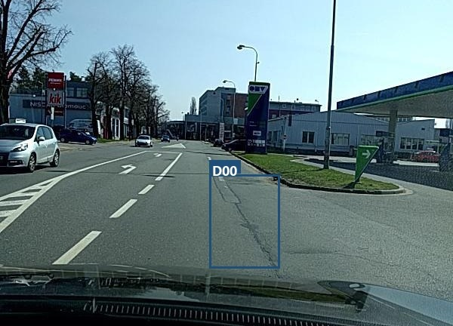
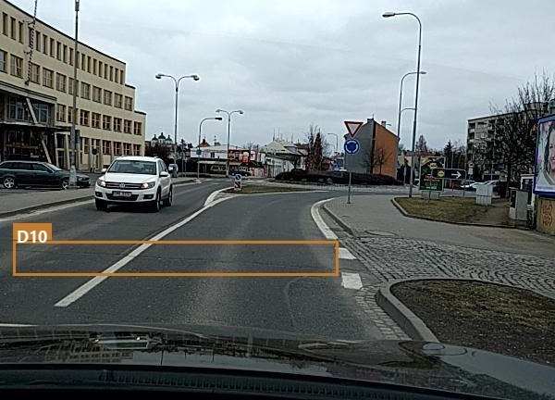
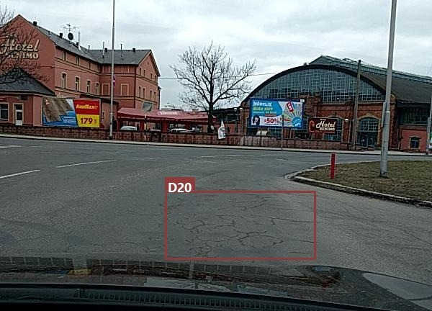
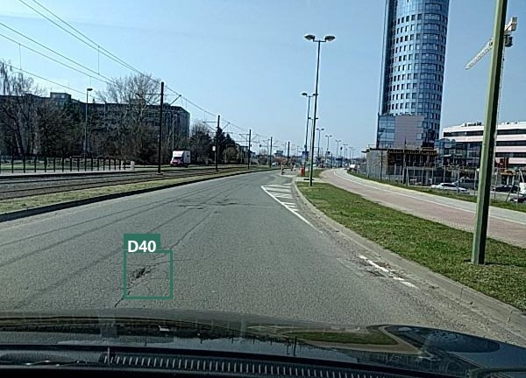
3.2 DATASET
Four classes, one image each
Ground truth: a class and a box, in Pascal VOC XML. No mask and no severity.
D00
D10
Longitudinal crack
Transverse crack
D20
D40
Alligator crack
Pothole
DMET 901 · Milestone 1 · Road damage detection
5 / 11
Notes:
These are training images from the Czech zip, not diagrams. The rectangles are the dataset boxes, not model predictions. Point out that a crack is a thin mark inside a much larger rectangle. That is why a high IoU is a hard target. Filenames: Czech_000279.jpg, Czech_001494.jpg, Czech_000803.jpg, Czech_002634.jpg.

Slide 6
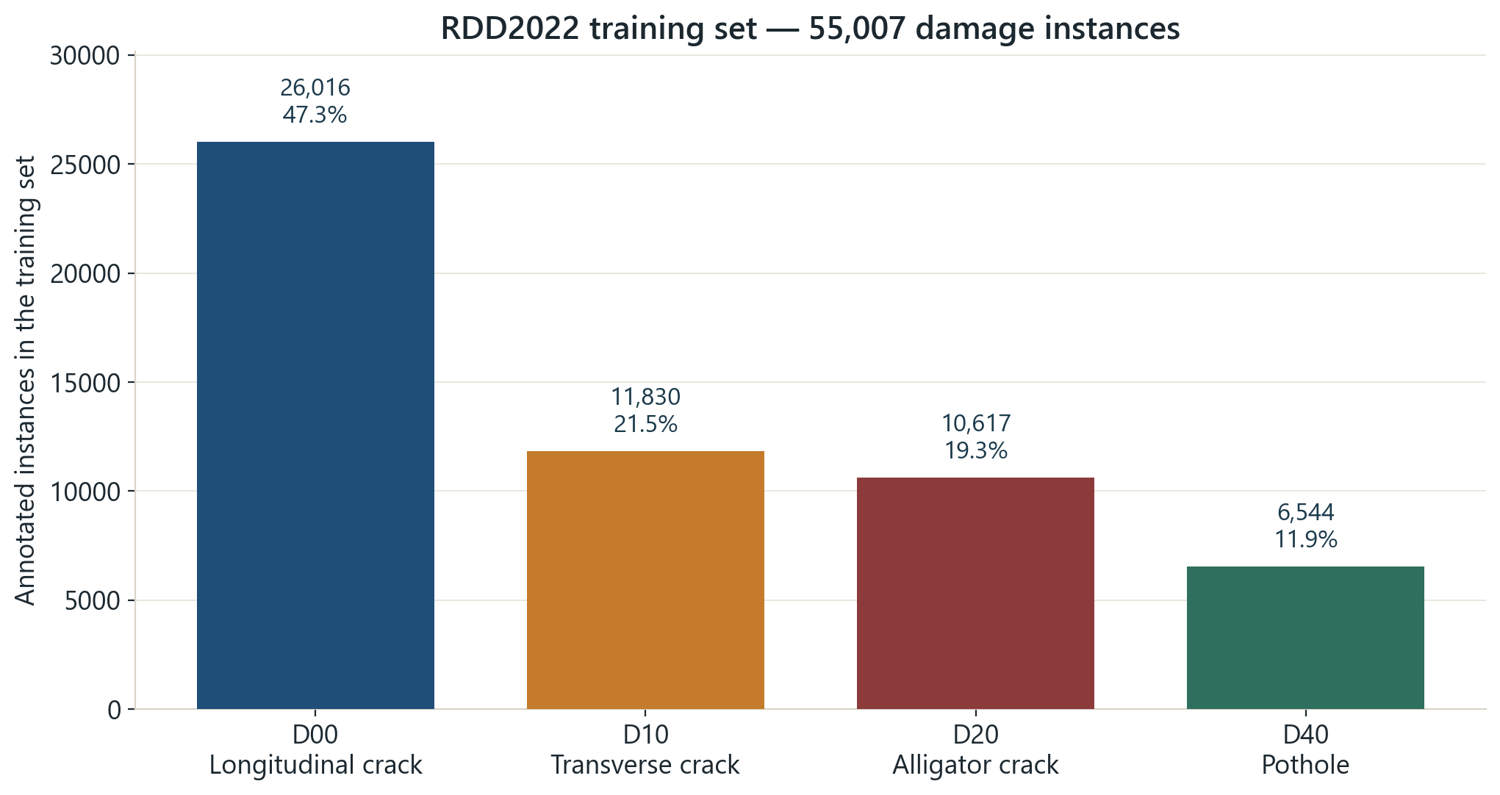
3.2 DATASET
D00 is 47% of the boxes
55,007 training boxes. 4 classes.
D00 longitudinal — 26,016
D10 transverse — 11,830
D20 alligator — 10,617
D40 pothole — 6,544
DMET 901 · Milestone 1 · Road damage detection
6 / 11
Notes:
The chart is the training split only. Test labels were not released, so they are not in this plot. Read the four numbers. Then say you will report per-class AP later, because the average will be pulled by D00. The counts are Figure 5 of Arya et al. The country rows sum to 55,007, which matches Figure 4.

Slide 7
3.2 DATASET
What will make the detector fail
Class imbalance
Small objects
D00 is 47% of the boxes.
A typical pothole is 0.4% of the frame.
Occlusion
Motion blur
Vehicles and shadows cover the pavement.
Cars and motorbikes are moving.
Lighting
Domain shift
Sun, shade, wet pavement, and snow.
Six countries and five camera types.
Label noise
Duplicate images
Crack edges are a judgment.
Neighboring frames repeat the same road.
DMET 901 · Milestone 1 · Road damage detection
7 / 11
Notes:
India has thousands of potholes and only 68 transverse cracks. The United States is the reverse. Validate inside each country, or a pooled model hides that. The 53% figure is filename adjacency in the Czech training set, which is evidence of repeated road, not a pixel-duplicate count. The split still has to keep a sequence together. The Japan-to-India drop is the finding in Arya et al. that motivated RDD2020 and then RDD2022. Occlusion is part of capture conditions: vehicles, shadows, and lane paint sit on top of the pavement.

Slide 8
3.2 DATASET
Justification
Fits
Same task: one RGB image, and a box for each of the four damage types.
Does not fit
No Egyptian roads. No severity. No pixel mask.
DMET 901 · Milestone 1 · Road damage detection
8 / 11
Notes:
RDD2022 matches the detection task. It is a weak stand-in for Cairo streets, because the set has no Egyptian roads, dust, or local pavement practice.

Slide 9
3.3 MODEL
YOLOv8s
Weights
Fine-tune COCO. Do not train from scratch.
Layers
Update every layer.
Split
Hold out 20% inside each country.
Augmentation
Flip and mosaic. No rotation.
Metrics
mAP50, mAP50–95, per-class AP.
DMET 901 · Milestone 1 · Road damage detection
9 / 11
Notes:
The model line is only the name. If asked why this family: the labels are boxes, and one frame can contain several damages. If asked about U-Net: there are no masks. If asked about a larger model: the GPU is 4 GB. YOLOv8n is the fallback if YOLOv8s runs out of memory. Rotation stays at zero because a quarter turn would swap D00 and D10. Czech median width/height is 0.77 for D00 and 5.33 for D10. Horizontal flip is safe. Learning rate starts near 0.001, for up to 100 epochs, with early stopping on validation mAP. Input size 640 for the first run.

Slide 10
3.3 TOOLING
Tools
Libraries
PyTorch, Ultralytics, OpenCV
Labels
Pascal VOC XML → YOLO text
Hardware
RTX 3050, 4 GB · 640 px · batch 8
Where
Local. Colab only if 4 GB is not enough.
DMET 901 · Milestone 1 · Road damage detection
10 / 11
Notes:
Milestone 1 did not train the detector. It fixed the stack so the next milestone can. Say the GPU name and the 4 GB limit out loud. That limit is the reason the starting model is YOLOv8s and the starting image size is 640. The Czech subset used for the figures is already on disk. The other country archives can be pulled from the same Figshare zip.

Slide 11
REFERENCES
Sources
Arya, D., Maeda, H., Ghosh, S. K., Toshniwal, D., & Sekimoto, Y. (2024). RDD2022. Geoscience Data Journal, 11(4), 846–862.
Arya, D., et al. (2022). RDD2022. figshare. https://doi.org/10.6084/m9.figshare.21431547. CC BY 4.0.
Jocher, G., Chaurasia, A., & Qiu, J. (2023). Ultralytics YOLOv8. https://github.com/ultralytics/ultralytics
DMET 901 · Milestone 1 · Road damage detection
11 / 11
Notes:
The image counts, resolutions, and class totals come from the 2024 data article, which is the journal version of arXiv:2209.08538. The license and the DOI come from the figshare record. The 2018 and 2021 papers are there if someone asks where the four class codes, or the cross-country failure, came from.

