Slide 1


Digital Freelancer:
Managing Freelancing Projects
Project: Working with a Mock Client

Slide 2
Part 1
Project Listing

Slide 3
Sample Project Listing #1: Web Development
Web application development support needed for healthcare application.
Posted 2 hours ago
Hourly: $35.00 - $65.00 Based on experience.
Project Time: 3 months, 25 hours a week.
Project Description:
We are a web development company working with a healthcare client looking to connect patients directly with their doctors. We need someone to be able to take PSD mockup files from our designer and convert them into custom code using HTML, CSS, and JavaScript. We have not decided on which JavaScript library to use, but will be open to working with the one you’re most familiar with. We have the designs for 10 pages and will need them to be completed in 3 months. We are open to working with all levels of experience, but the pay will be adjusted based on your experience.

Slide 4
Part 2
Expression of Interest

Slide 5
Expression of Interest
Hi Leo messi, I hope you are doing well. I am writing to express my interest to be part of this job. And I will be happy to help you. I am a software engineer in Ecommerce and medical software with solid experience for more than 2 years. I have been working on PSD mockup files using HTML for 2 years now and have been converting files exactly like the above. During that time, I've developed more than 4 websites. After reviewing your project description, it’s clear that looks like you are looking to someone to be able to take PSD mockup files from your designer and convert them into custom code using HTML. .

Slide 6
I have one nanodegree from Udacity in web development Using HTML and Java language. Also, I suggest you if we can use matrix chart to just add and organize the constructor. As I mentioned previously with my experience in this field for more than 2 years, I’m certain I’ll be a great fit to this role, as you saw from my profile, and I have developed strong skills in my previous role and I have a good review in my profile form other clients for projects like yours. So, I will offer to you a good quality with good price. Working on your project will take less than 3months of working and less than 25 hours per week, which is within the time frame mentioned in your description. Let me know if you like to chat.
Omarhamdy671@gmail.com

Slide 7
Part 3
Project Management Process

Slide 8
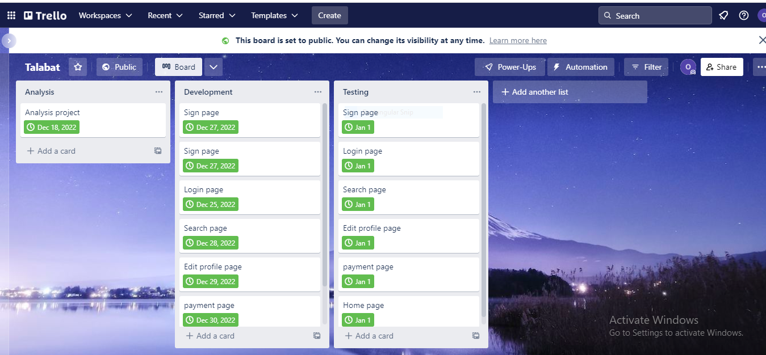
Trello Board
https://trello.com/b/1o27LjiW/talabat
Paste screenshot here

Slide 9
Part 4
Invoice and Payment Options

Slide 10
[Your Full Name or Your Company Name]
[Your Address or Address Your Company is Registered to]
Invoice
Recipient:
[poos/leo messi]
[Cairo,Egypt]
Invoice #: [3371]
Date issued: [15/12/2022]
Date due: [20/12/2022]
Service | Description of Work Done | Hours Spent | Amount Per Hour | Total
design | Create a design for all application | 20$ | 20 | 400$
analysis | Analysis the design | 20$ | 20 | 400$
development | Build all features mentioned in SRS | 20$ | 20 | 400$
testing | Test all app and find and fixing bugs | 20$ | 20 | 400$

