Slide 1

Presentation

Slide 2
1-Architecture used in paper .
1- used 5 CNN layer
2- RNN layer
3- CTC
4- SpellChecker

Slide 3
2- Dataset Details .
SVHN is a real-world image dataset for developing machine learning . It can be seen as similar in flavor to MNIST (e.g., the images are of small cropped digits), but incorporates an order of magnitude more labeled data (over 600,000 digit images) and comes from a significantly harder, unsolved, real world problem (recognizing digits and numbers in natural scene images). SVHN is obtained from house numbers in Google Street View images .

Slide 4
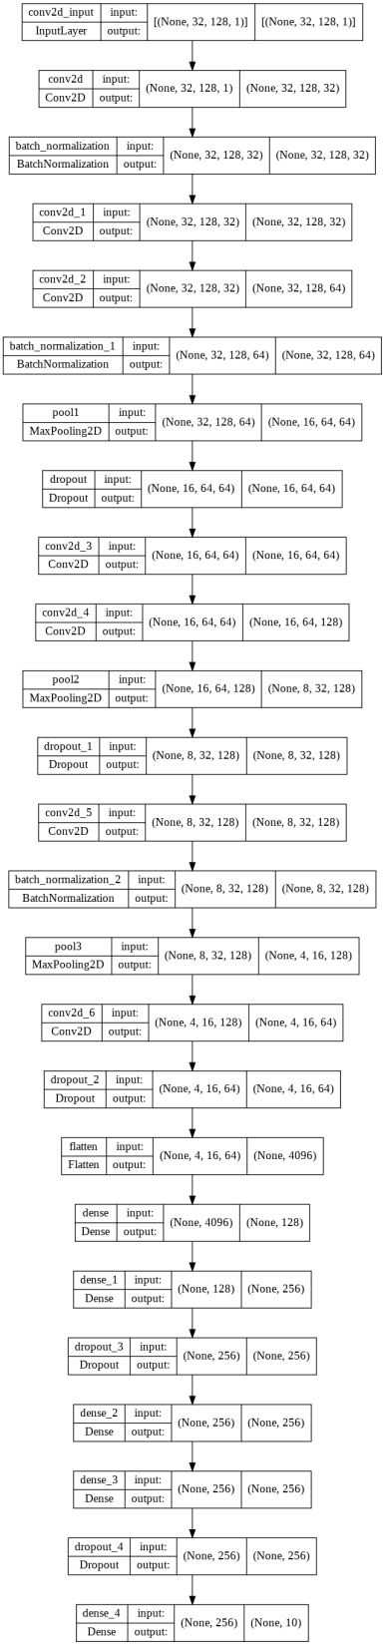
3- Implementation Details .

Slide 5
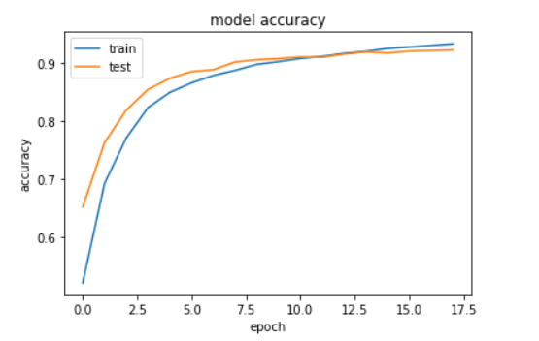
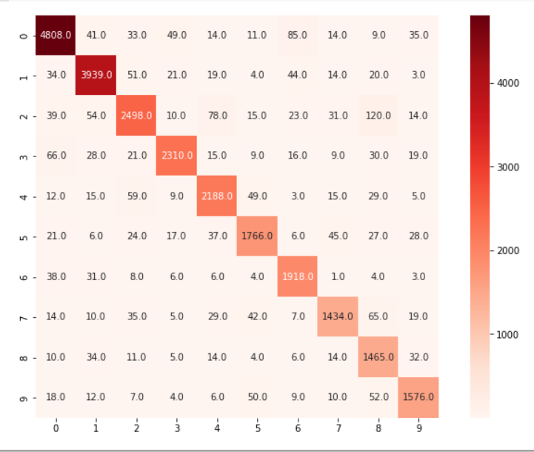
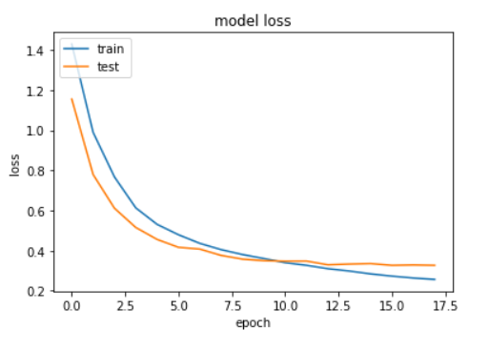
4- Results && Visualization .
Result visualization :
Training (54942)
Validation(18315)
Testing (26032)

