Slide 1
AUTOSAR Application & RTE
By: Hassan Farahat

Slide 2
Agenda
Intro to RTE
SWC Design
RTE Deep Dive (SR, CS, MS)
RTE Configuration & Generation

Slide 3
Tasks
Task 1: High Level Design
Task 2: Sender Receiver
Task 3: Client Server
Task 4: Types of SWCs
Task 5: Mode Switch
Task 6: RTE Configuration & Generation
Sprints AUTOSAR
Authoring Tool (SAAT)

Slide 4
Get in Touch
Contact
LINKEDIN PROFILE
https://www.linkedin.com/in/hassan-farahat-77289477/
PHONE (WhatsApp)
+201092439690
EMAIL
hassan.m.farahat@gmail.com

Slide 5
Virtual Function Bus
Intro to AUTOSAR Application
Virtual Functional Bus (VFB)
VFB Quiz

Slide 6
AUTOSAR Layers
Application
RTE
BSW

Slide 7
Application Layer
- The top layer in AUTOSAR software architecture
- Many Applications drive the Vehicle System
- Examples
- OBC (On Board Charger)
- ADAS (Automated Driving and Driver Assistance)
- V2X (Vehicle-to-everything) applications

Slide 8
ECU 1
ECU 2
ECU N
SWC
SWC
SWC
SWC
SWC
SWC
. . . .
SWC
SWC
SWC
SWC
SWC
SWC
CAN/LIN/Eth/FlexRay
Application is a group of components, interacting together to achieve specific feature
Software components of the same application can be distributed over different ECUs in the Vehicle System

Slide 9
Challenges
1. Application must fit in different Vehicle hardware and systems for the same OEM or even for different OEMs
Application shall be hardware and system independent

Slide 10
Challenges
2. Application development is time consuming, containing the main software (Logic / Algorithms)
Application development shall be accelerated as much as possible

Slide 11
Challenges
3. Application features shall be adapted based on OEM requirements
Application shall be maintainable/scalable
So AUTOSAR introduced
Virtual Function Bus (VFB)

Slide 12
Virtual Function Bus
Intro to AUTOSAR Application
Virtual Functional Bus (VFB)
VFB Quiz

Slide 13
What is VFB?
SWC
SWC
SWC
SWC
VFB_Write_CarSpeed
VFB_GetSensorValue
VFB_NvMWrite_CarSpeed
VFB_Read_CarSpeed
VFB_Schedule(10ms)
Virtual Functional Bus Layer
System
MCU
BSW
Hardware (i.e., Sensors)

Slide 14
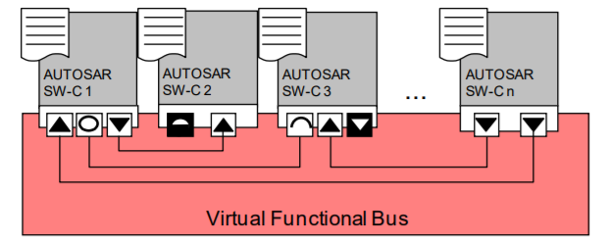
What is VFB?
- VFB is a modeling for application components to interact together through Virtual Connections
- Thanks to the virtual connections, the application components are strictly separated from the infrastructure (hardware, sensors, system .. etc.)

Slide 15
VFB Description
Through VFB, you can describe:
- Communication with other SWCs in the System
- Communication with Sensors and Actuators
- Communication with Standard services (i.e., Writing and Reading from NvM)
- OS Scheduling (i.e., Cyclic Functions)

Slide 16
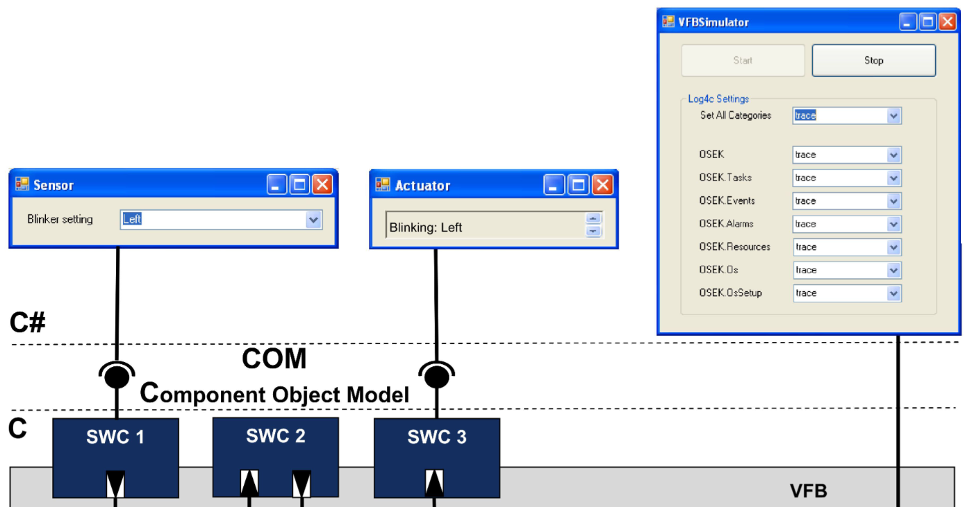
VFB Simulation
VFB simulation tools provides application development and testing env on PC
https://www.yumpu.com/en/document/read/11123332/virtual-functional-bus-simulator-autosar

Slide 17
More about VFB
Read more about VFB concept in AUTOSAR:
https://www.autosar.org/fileadmin/standards/R20-11/CP/AUTOSAR_EXP_VFB.pdf

Slide 18
Virtual Function Bus
Intro to AUTOSAR Application
Virtual Functional Bus (VFB)
VFB Quiz

Slide 19
VFB Quiz
Test the real time behavior
Do unit testing for SWCs
Using VFB Simulation, the App Developer can:
Test memory consumption (stack, ram, rom)
Test external bus communication
Simulate Intra-ECU communication
Simulate Inter-ECU communication

Slide 20
VFB Quiz: Solution
Test the real time behavior
Do unit testing for SWCs
Using VFB Simulation, the App Developer can:
Test memory consumption (stack, ram, rom)
Test external bus communication
Simulate Intra-ECU communication
Simulate Inter-ECU communication

Slide 21
Run Time Env (RTE)
What is RTE?
Development Workflow

Slide 22
VFB Deployment
On deployment of VFB model description into new System:
- Virtual connections between SWCs has to be mapped either to local connections (same ECU) or network connections (i.e., through CAN/LIN on different ECUs)
- VFB Sensors/Actuators are mapped to the real hardware
- Standard Services are mapped to the BSW Services
- Windows Threads Scheduling are mapped to AUTOSAR Tasks

Slide 23
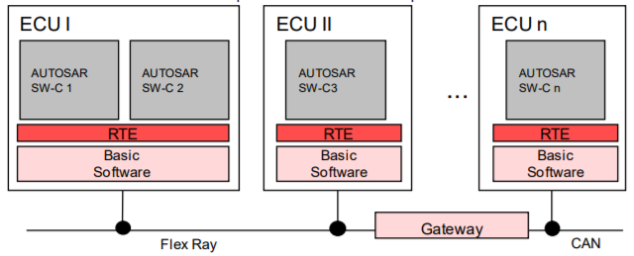
VFB Deployment
That mapping is done through RTE
RTE modules on all ECUs represents the VFB layer deployment on the vehicle system

Slide 24
RTE (Run Time Environment) is the AUTOSAR Layer that implements the VFB Concept
The entire communication of SWCs is based on the VFB
So, SWCs are independent of the ECU hardware/System
So, SWCs can be reused across different systems/platforms
C# impl for:
VFB_GetSensorValue
VFB_Read_CarSpeed
VFB_Write_CarSpeed
VFB_NvMWrite
….
Rte C impl for:
Rte_GetSensorValue
Rte_Read_CarSpeed
Rte_Write_CarSpeed
Rte_NvMWrite
….
The VFB is implemented for a specific vehicle by supplying a specifically configured RTE

Slide 25
Why RTE?
1. Application must fit in different Vehicle hardware and systems for the same OEM or even for different OEMs
Application is hardware/system independent as it is abstracted by the RTE APIs,
For each System, it is the same App Code, but different RTE,
AUTOSAR Application shall use only RTE for any types of communication

Slide 26
Why RTE?
2. Application development is time consuming, containing the main software (Logic / Algorithms)
Application development and testing can be done even before developing the Vehicle System
Interaction with the real hardware, interaction with the BSW, interaction with other ECUS .. etc. all handled by the RTE
Application run time behavior is managed by the RTE (Scheduling, Variables protection .. etc.)
Application developer shall only think about writing the application logic

Slide 27
Why RTE?
3. Application features shall be adapted based on OEM requirements
SWCs can be added/removed without affecting the other software components / other features in the Vehicle

Slide 28
Run Time Env (RTE)
What is RTE?
Development Workflow

Slide 29
Workflow
VFB Tools are usually used by OEM for complete system design and simulation
In the next slides, we will start with RTE Workflow directly, which is the common case in Tier 1,2 suppliers

Slide 30



RTE Workflow
App Design
Arxml Files
App Templates
App Code
Application Description
Contract Phase
Develop

Slide 31
- Description for the application components, that defines the application needs/interfaces from the RTE
- Description is created using Authoring Tools and saved in AUTOSAR XML file (.arxml)
- The xml schema used to create the arxml file is called Software Component Description “SWCD”, and can be found on autosar.org
App Design
Arxml Files
Application Description

Slide 32
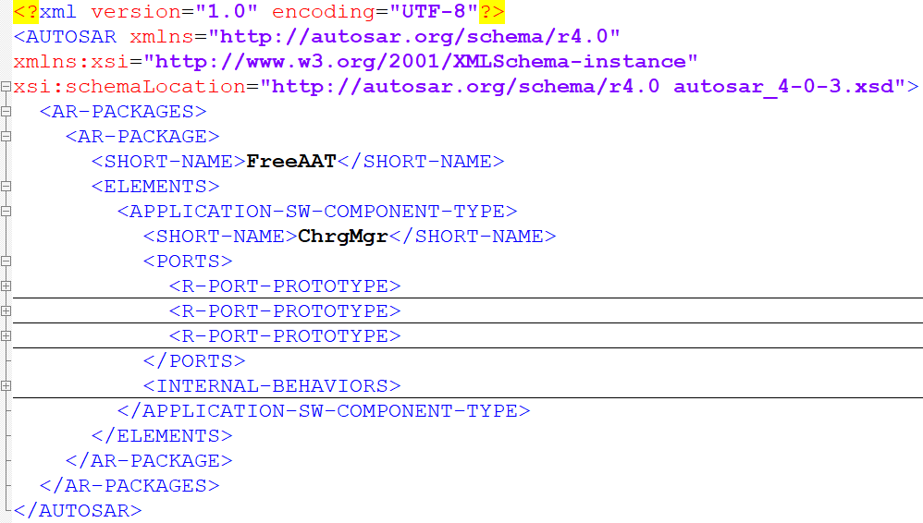
Application Description
AUTOSAR Schema
XML hierarchy and elements as defined by the Schema

Slide 33
Application Description
Example: Create SWCD for “ChrgMgr” component
ChrgMgr shall control the electric charging for the Vehicle
Software Component Description: ChrgMgr shall need the following interfaces:
Interface to read the current battery level
Interface to read the max power that can be provided from the charging station
Interface to start/stop charging
Authoring Tool
BatteryLevel
ChrgMgr
Invoke Charge(start/stop)
MaxPower
ChrgMgr.arxml

Slide 34
- Application templates with prototype of the standard interfaces that will be provided from the Rte
- Templates are generated from Authoring Tool
- App Developer shall base app code on these templates
- Thanks to the standard interfaces, the application code will be the same regardless the Vehicle System
Arxml Files
App Templates
Contract Phase

Slide 35
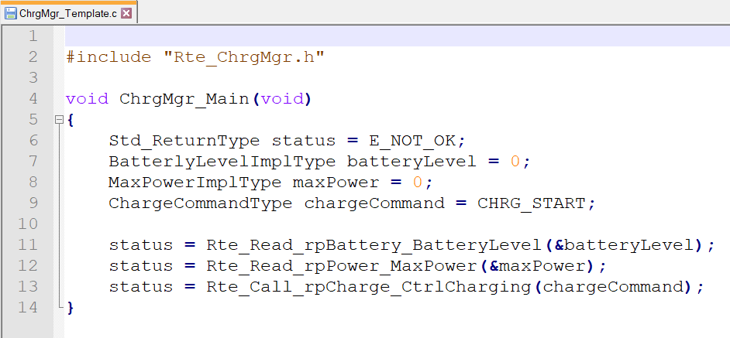
Contract Phase
Contract Phase for ChrgMgr_Template.c
RTE Interfaces Provided to ChrgMgr SWC, as per the SWCD

Slide 36
- Use the generated templates to develop the
code for all software components
App Templates
App Code
Develop

Slide 37
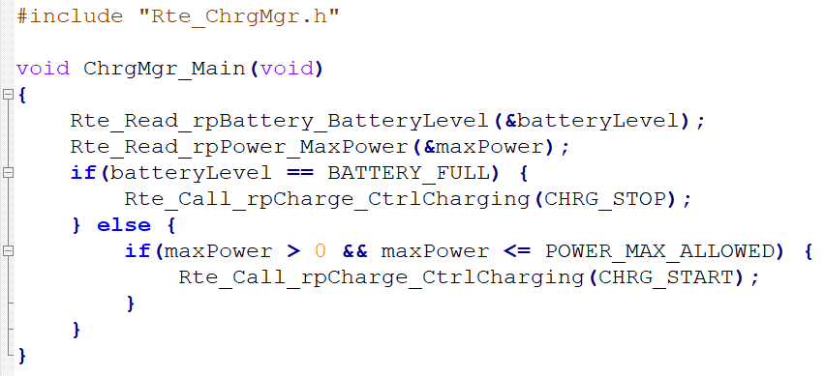
Develop
ChrgMgr Code (ChrgMgr.c)
SWC Logic

Slide 38
Reusable Application!
Reuse on different systems

Slide 39
Reuse
Same Application on Different Systems
New System
ChrgMgr.c
Same ChrgMgr.c, Different Rte.c
ChrgMgr.arxml
ECU 1
RTE Generator
Rte.c
Compile
HEX
ECU 2
RTE Generator
Rte.c
Compile
HEX
ECU N
RTE Generator
Rte.c
Compile
HEX

Slide 40
SWC
ChrgMgr
SWC
SWC
ECU 1
ECU 2
ECU N
SWC
ChrgMgr
SWC
SWC
Rte
Rte
. . . .
Rte
BSW
BSW
BSW
CAN/LIN/Eth/FlexRay

Slide 41
SWC Design
SWCD High Level Design – Task 1
SWCD Impl Level Design
SWCD Data Types
SWCD Conclusion

Slide 42
- AUTOSAR Application is described to the Rte in the format of “.arxml” file
- The schema used to create the arxml file is called “SWCD”, and can be found on autosar.org
- Application arxml file(s) shall contain the SWCD for all application software components
SWCD
Software Component Description

Slide 43
- Authoring Tools provide Graphical User Interface (GUI) to create arxml files and also generating the SWC templates
- Most common Authoring Tools
- DaVinci Developer (Vector)
- System Desk (dSpace)
- AUTOSAR Builder (3ds)
- SAAT (Sprints)
SWCD
Authoring Tools

Slide 44
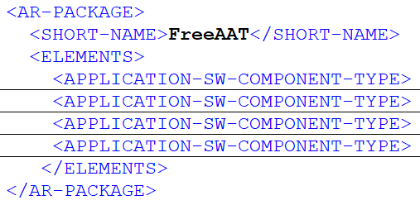
Atomic Components
- AUTOSAR Application is organized in Units called Atomic Software Components “SWC”
- Each SWC encapsulates the implementation of its functionality and behavior
- “Atomic” as the software component can’t be distributed on multiple ECUs
- SWC can communicate with the outside world using Ports
Application Components

Slide 45
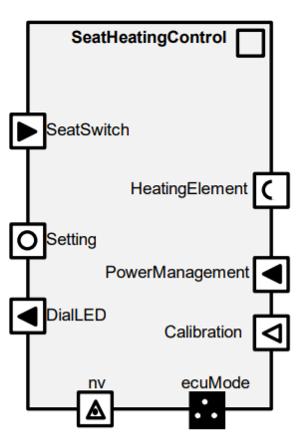
Ports
- Each Software component define its inputs from other components and outputs to other components using Ports
- Port can be either Provided Port (Output) or Required Port (Input)
- Provided Port: SWC is providing a service or data
- Required Port: SWC is requires a service or data
- Each Port is typed by “instance of” Port Interface

Slide 46
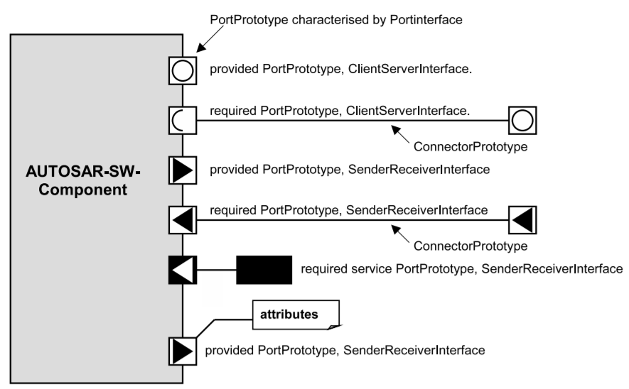
Port Interface
- Port Interface define the type of communication between SWCs
- Common types of communication: Sender Receiver Communication and Client Server Communication
- Sender Receiver: Data exchange between SWCs
- Client Server: Operation “function” exchange between SWCs

Slide 47
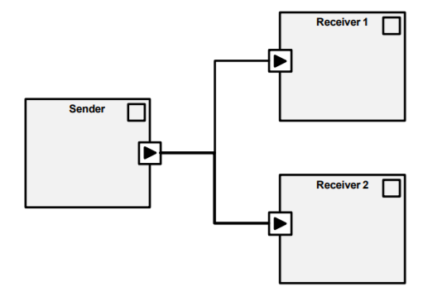
Sender Receiver
- Sender Receiver Interface is used to share data between SWCs
- Sender :: SWC providing the data (Provided Port)
- Receiver :: SWC requires the data (Required Port)
Sender Receiver Interface:
Data Elements “Type, Name”

Slide 48
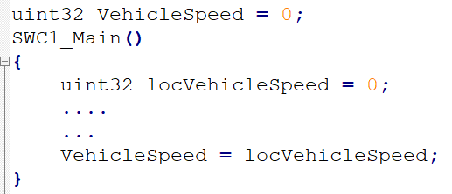
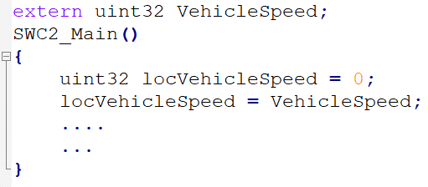
SWC1
SWC2
ppVehicleData
rpVehicleData
Rte_Write_ppVehicleData_VehicleSpeed(uint32 VehicleSpeed);
Rte_Read_rpVehicleData_VehicleSpeed(uint32* VehicleSpeed);
SrIf_VehicleData
uint32 VehicleSpeed

Slide 49
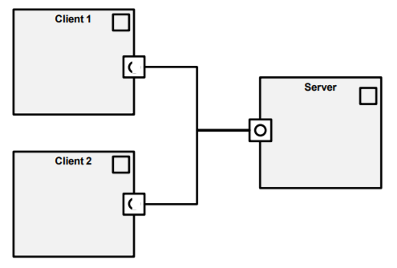
Client Server
- Client Server Interface is used to share operation “function” between SWCs
- Client :: SWC requires “invokes” the operation (Required Port)
- Server :: SWC providing the operation (Provided Port)
Client Server Interface:
Operation Prototype “Name, Args, Return”

Slide 50
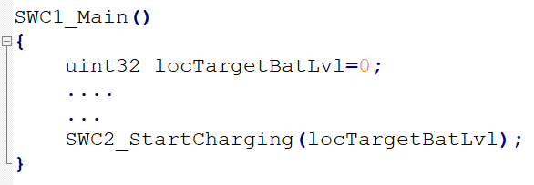
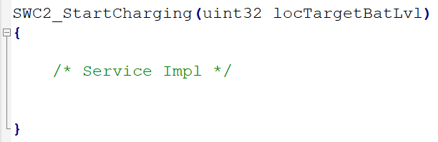
Client
Server
rpChrgCtrl
ppChrgCtrl
Rte_Call_rpChrgCtrl_StartCharging(uint32 TargetBatLvl);
Client Server Interface:
void StartCharging(uint32 TargetBatLvl)

Slide 51












Port Interfaces Types
RPort
PPort
Sender Receiver
Data Exchange: A sender distributes information to one or several receivers, or one receiver gets information from several senders
Client Server
Operation Exchange: The server is provider of operations, and several clients can invoke those operations
Mode Switch
Mode Exchange: The mode manager provides modes (states) that can be used by mode users to adjust the behavior according to these modes
Parameter Interface
Constant Exchange: A parameter interface allows software components access to constant data
Nv Interface
Non-Volatile Data Write/Read: Provide element level access (read only or read/write) to non-volatile data
Trigger Interface
The trigger interface allows software components to trigger the execution of other software components

Slide 52
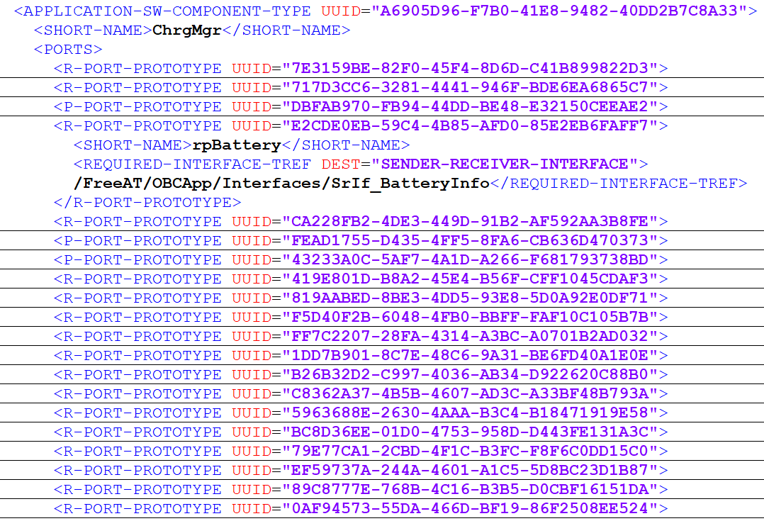
SWCD Example
Application Component Name
Ports
Port Interface Reference

Slide 53
Compositions
- Composition allows encapsulation of specific functionality by grouping of software components
- Compositions reduces complexity when viewing or designing application software architecture
- At least one Composition must be created “Top Level Composition”
- Compositions can be nested
TopLevelComposition
DiagComposition
OBCComposition
SWC
SWC
ErrHndlComposition
SWC
SWC
SWC
SWC

Slide 54
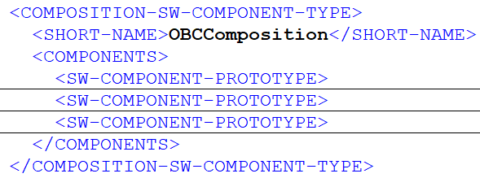
Compositions

Slide 55
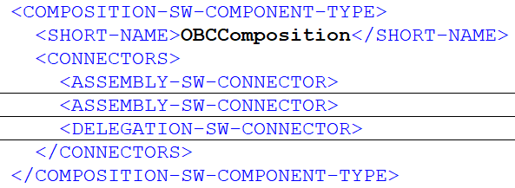
Compositions
- SWCs of the same composition are connected via Assembly Connectors
- SWCs of different compositions are connected via Delegation Connectors
TopLevelComposition
DiagComposition
OBCComposition
Asm
SWC
SWC
Delg
SWC
Asm
SWC
Asm
SWC
SWC

Slide 56
Top Level Composition
R
R
P
R
SWC
SWC
SWC
SWC
P
P
R
SWC
P
P
SWC
SWC
R
SWC
SWC
SWC
Assembly Connector (SWCs or Compositions at the same level) - P to R
Delegation Connector (SWCs or Compositions at different level) - P to P or R to R

Slide 57
Task 1: Application Design
Seat Control
Design Vehicle Application to control Driver Seat

Slide 58
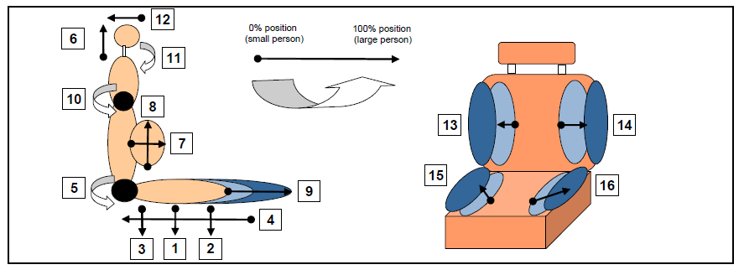
Task 1: App Design
Needed Features:
Seat Height (1)
Seat Slide (4)
Seat Inclination (5)
Auto/Manual Setting
https://www.autosar.org/fileadmin/standards/R21-11/CP/AUTOSAR_EXP_AIBodyAndComfort.pdf

Slide 59
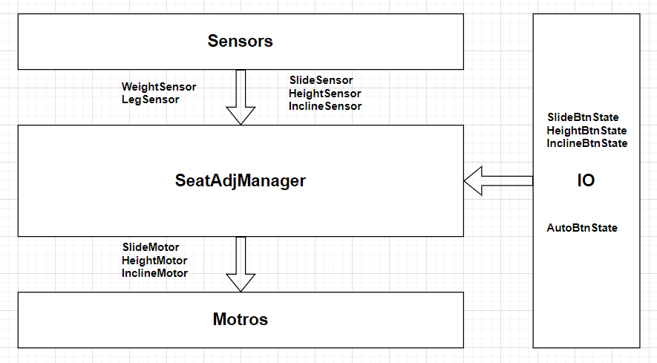
Task 1: Solution

Slide 60
Questions

Slide 61
Feedback

