Slide 1
PRJ-04-DASHBOARD
Vehicle Instrument Cluster
Speedometer · Tachometer · Gauges · Warning cluster · Diagnostics
ATmega32A @ 8 MHz · SimulIDE 2.0.0
Omar Hesham Elsayed · Ahmed Khaled Mohamed
Omar Abdelaziz Elsaid Elaraby · Abdelrahman Hesham Abdullah
Final defence — 17 September 2026
Notes:
Project 04 of the Embedded Systems Projects Book. Four students, five days, ATmega32A in SimulIDE.

Slide 2
What the cluster does
Six sensor inputs, four output channels, one 8-bit CPU holding it all together
1
Measures
2
Displays
Road speed by pulse period, engine RPM by pulse count, four analogue channels
16×2 LCD over I2C with five pages, refreshed every 250 ms, changed characters only
3
Warns
4
Sequences
Eight cluster lamps through a 74HC595, resolved by a nine-level priority scheme
Ignition FSM: OFF → ACC → IGN → BULB → CRANK → RUN, plus stall and limp home
5
Records
6
Reports
Odometer and trip meter integrated from pulses, read atomically, never torn
9600 8N1 console: 5 s telemetry frame, async events, 20 commands
Notes:
Scope of the build in six lines. Everything after this slide is one of these six in detail.

Slide 3
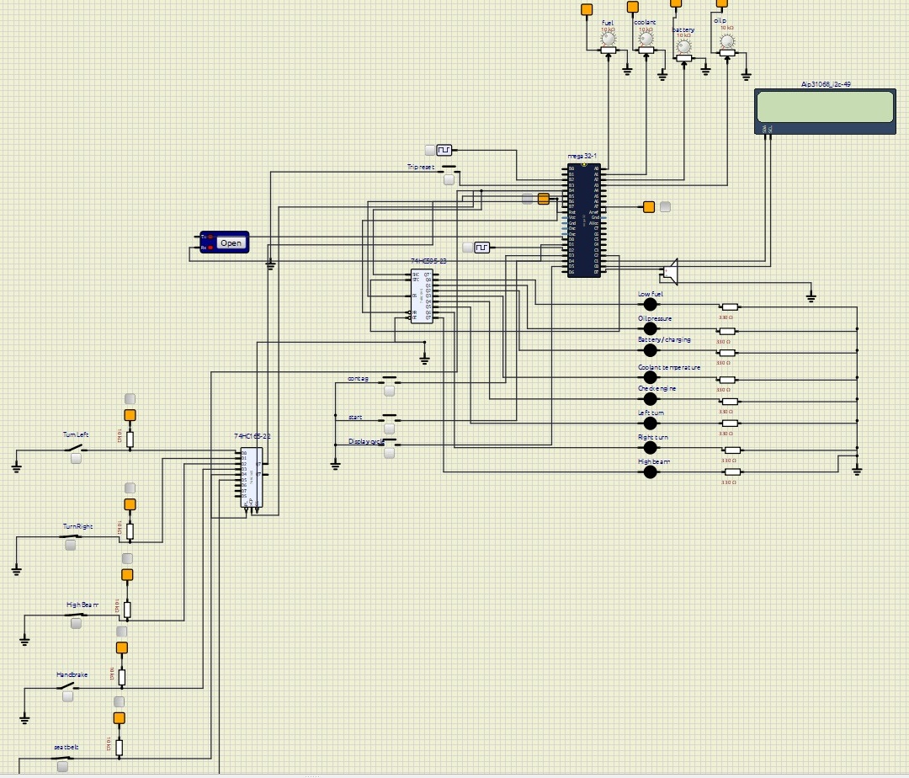
The circuit
SimulIDE schematic — ATmega32A, 74HC595 lamps, 74HC165 switches, PCF8574 LCD, four sensor pots
Top right
Four 10 kΩ pots → ADC0–ADC3: fuel, coolant, battery, oil pressure
Right
74HC595 → eight LEDs with 330 Ω series resistors
Lower left
74HC165 reading six body switches back in over the same SPI wires
Far right
PCF8574-backed 16×2 LCD on I2C at address 0x27
Left
Serial terminal on PD0 / PD1 for telemetry and the command console
Notes:
Walk the board clockwise from the pots. Point out that the 595 and the 165 share MOSI/MISO/SCK.

Slide 4
Software architecture
Only MCAL touches registers. Nothing reaches down more than one layer.
APP
cluster_fsm · warnings · trip & odometer · display pages · console — scheduler (10 ms)
Concurrency contract
ISRs store raw ticks only — no division, ever
Overflow and tach ISRs increment one counter and return
Every 32-bit shared value read inside ATOMIC_BLOCK
No SPI transaction is ever started from an ISR
HAL
speedo.c · tacho.c · gauges.c · lamps595.c · lcd_i2c.c · shiftreg.c · bodysw.c · chime.c
MCAL
dio.c · adc.c · timer.c · icu.c · exti.c · usart.c · spi.c · i2c.c
LIB
STD_TYPES.h · BIT_MATH.h · ring_buffer.c
Notes:
The layer rule is a graded item. Any HAL file touching a register directly loses the architecture marks.

Slide 5
Three problems that define this build
Each one fails silently. None produces an error message anywhere.
1
2
3
Two pulse inputs,
two opposite methods
Two chips,
one SPI bus
A 32-bit counter
an ISR is writing
Speed is measured by period, RPM by counting. Measure speed by counting and the needle jumps 0 → 7 → 14 km/h with nothing in between.
74HC595 drives lamps out on MOSI, 74HC165 reads switches in on MISO. Overlap and both transfers are wrong, with nothing flagged.
Four byte loads on an 8-bit CPU. An update between two of them displays a distance the car never travelled.
A fourth problem arrived uninvited: SimulIDE does not implement the Timer1 Input Capture unit.
Notes:
This is the roadmap slide. Problems 1-3 are in the spec; problem 4 is the one we found ourselves.

Slide 6
Period or count? The rule that decides
Both signals are pulses. Measuring them the same way breaks one of them.
ROAD SPEED — measure the period
ENGINE RPM — count the pulses
A car in traffic gives 0, 1 or 2 pulses in a 250 ms window
Counting would show 0, 7 or 14 km/h and nothing between
But the gap between edges is tens of milliseconds — long
A 16-bit timer at 8 µs resolves it to better than 1 part in 1000
Capture the timer at each edge, subtract, divide outside the ISR
An idling engine already gives hundreds of pulses per second
RPM changes slowly, so a 250 ms window is plenty
Counting costs one increment per pulse — almost nothing
Measuring each gap would make the needle jitter on every cylinder
Counter read and zeroed atomically at the window boundary
speed_kmh = 1 800 000 / period_us
at 100 km/h : 2250 ticks
+-1 tick : 0.089 km/h -> PASS
RPM = count x 120
at 6000 RPM : 50 pulses per window
held in uint16_t, not uint8_t -- see notes
Slow signal → measure the period. Fast signal → count the pulses.
Notes:
uint16_t not uint8_t: sized for the failure case. A noisy tach line or SET TPR 8 pushes the count past 255 and an 8-bit counter wraps silently into a plausible-looking wrong RPM.

Slide 7
Speed maths and why 32 bits are needed
Timer1 prescaler 64 at 8 MHz gives a 125 kHz clock — one tick is 8 µs
Wheel sensor : 4 pulses per revolution
Wheel circumference : 2.000 m
Distance per pulse : 500 mm
500 mm / period_us = 500 000 / period_us m/s
= 1 800 000 / period_us km/h
period_us = delta_ticks x 8
16-bit range = 65 536 ticks = 524 ms
Below ~3.4 km/h a single capture WRAPS.
-> extend to 32 bits with a TIMER1_OVF counter
-> handle the race: TOV1 pending AND capture small
means the overflow happened first.
Speed | period_us | Ticks | Fits 16-bit?
200 km/h | 9 000 | 1 125 | Yes
60 km/h | 30 000 | 3 750 | Yes
10 km/h | 180 000 | 22 500 | Yes
3.5 km/h | 514 000 | 64 300 | Yes (just)
2 km/h | 900 000 | 112 500 | NO — extend
1 km/h | 1 800 000 | 225 000 | NO — extend
Low speed is the whole point. 2 km/h is where a counting speedometer has already failed and the 32-bit extension earns its keep — TC-07.
Notes:
The resolution arithmetic FR-01 asks for is on the previous slide; this one is range, not resolution.

Slide 8
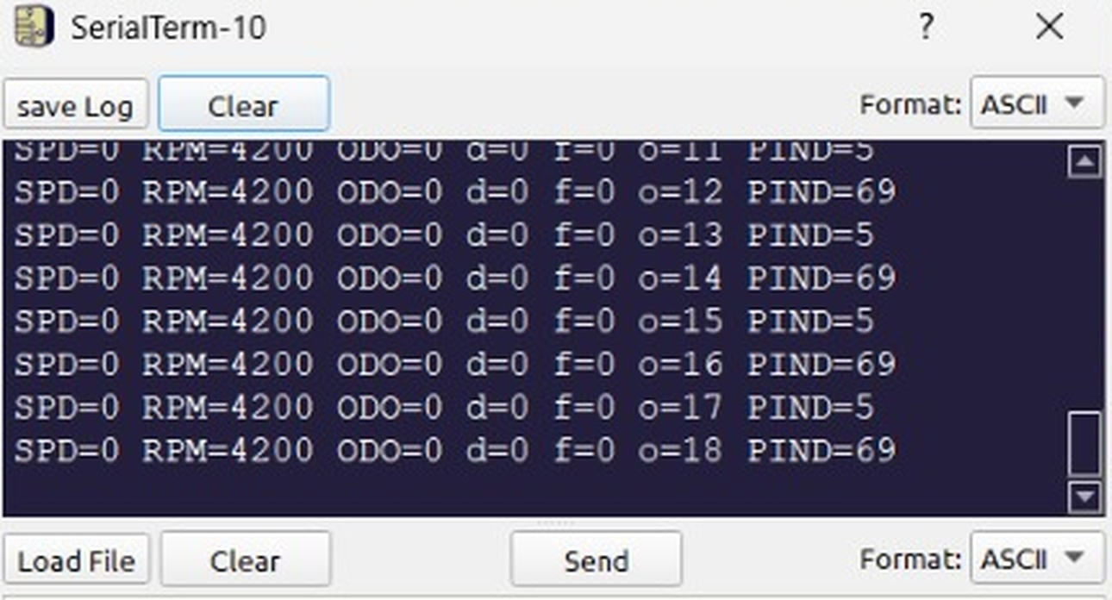
THE PROBLEM WE HIT
Speed read zero. Forever.
Wheel clock wired to PD6 / ICP1 exactly as the pin map specifies
Read the fields against each other
PIND alternates 5 ↔ 69 → bit 6 toggling. The clock IS reaching the pin.
o = 11, 12, 13 … → Timer1 runs, TOV1 fires, the prescaler is right.
d = 0 forever → no period was ever computed.
f = 0 forever → TIMER1_CAPT_vect never executed, not once.
RPM = 4200 → the INT0 path is fine. The fault is the capture unit.
SimulIDE serial terminal — instrumented telemetry, PD6 / ICP1 wiring
Notes:
This is the slide the defence will ask about. The point: the diagnosis came from four fields printed together, in one run.

Slide 9
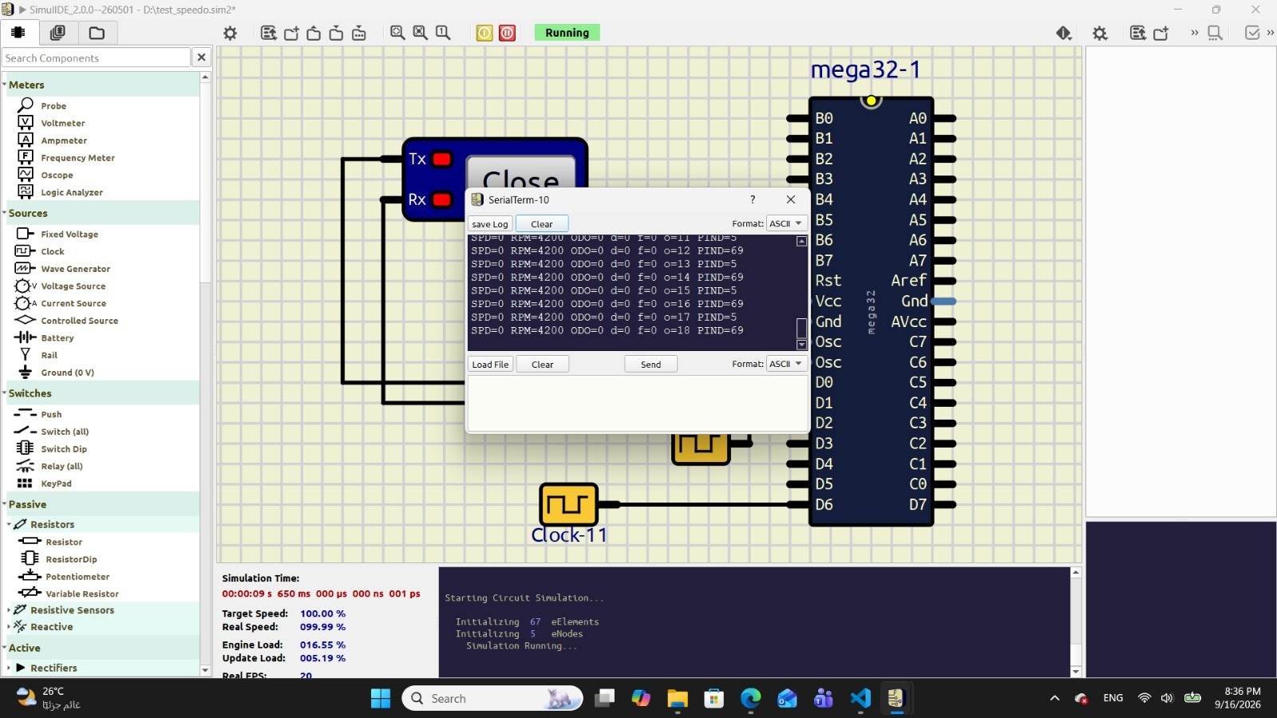
SimulIDE does not implement the ICP1 capture latch
Pin toggles · timer runs · overflow vector fires · capture vector never does
What we ruled out
ICES1, ICNC1, ICIE1 and TIMSK all verified
DDRD bit 6 confirmed as input
Wiring confirmed by PIND toggling
Pulse source confirmed by the same PIND trace
No software configuration is consistent with that combination.
The capture latch is absent from the simulator's ATmega32 peripheral model. The specified hardware path cannot be demonstrated under any wiring.
Clock-11 on pin D6 of mega32-1, simulation running at 99.99 % of real time — not a timing artefact
Notes:
Emphasise that this is a simulator limitation, not a design error. On real silicon the ICP1 path works.

Slide 10
The fix: software capture on INT2 / PB2
The algorithm does not change. Only where the timestamp comes from changes.
/* SPECIFIED — not available in SimulIDE */
ISR(TIMER1_CAPT_vect) {
uint16_t now = ICR1; /* hardware latch */
SPD_OnCapture(now);
}
/* AS BUILT */
ISR(INT2_vect) {
uint16_t now = TCNT1; /* software read */
SPD_OnCapture(now);
}
Property | Hardware ICP1 | Software INT2 | Impact
Timestamp latency | 0 — hardware latch | 2 – 4 µs ISR entry | Cancels in the subtraction
Jitter | 0 | ≤ ±1 µs | ≤ 0.02 % at 200 km/h
Noise canceller | ICNC1, 4 samples | Not available | Software min-period reject
32-bit extension | Overflow counter | Identical | None
TOV1 race | Must be handled | Identical | None
ISR cost | ≈ 18 µs | ≈ 21 µs | Inside the 30 µs budget
/* IDENTICAL in both cases */
void SPD_OnCapture(uint16_t now) {
uint16_t ovf = cap.ovfCount;
if ((TIFR & (1<<TOV1)) && (now < 0x8000u))
ovf++; /* the race */
cap.deltaTicks = ((uint32_t)ovf << 16)
+ now - cap.lastIcr;
cap.lastIcr = now; cap.ovfCount = 0;
cap.fresh = 1; /* no division in ISR */
}
INT2 rather than polling: the edge still timestamps inside an ISR microseconds after it arrives, so jitter stays two orders of magnitude below the measurement resolution.
Notes:
One #define switches back to ICP1 for real hardware. Both versions are in the repository.

Slide 11
Two chips, one SPI bus, opposite directions
Only one may drive the bus at a time — a violation corrupts both transfers with no error anywhere
Chip | Direction | Wire | Strobe
74HC595 | OUT — 8 warning lamps | MOSI / PB5 | RCLK on PC2 latches
74HC165 | IN — 6 body switches | MISO / PB6 | SH/LD on PB4 samples
Never assert a second CS while another is low — TC-27 scopes both.
1
2
The 595 has no MISO. Never read SPDR expecting data from it.
static volatile uint8_t busOwner = SPI_BUS_FREE;
uint8_t SPI_TryAcquire(SpiSlave_t s) {
uint8_t ok = 0;
ATOMIC_BLOCK(ATOMIC_RESTORESTATE) {
if (busOwner == SPI_BUS_FREE) {
busOwner = s; ok = 1;
}
}
if (ok) SPI_Acquire(s);
return ok; /* caller skips this cycle if 0 */
}
3
The 595 latch is pulsed after SPI_Release(), never between bytes.
4
A lamp refresh spans several ticks; the switch scan waits a tick rather than stealing the bus.
5
Both slaves use Mode 0, so no mode switch is needed — stated explicitly, not left implicit.
A skipped lamp refresh is invisible: the 595 latches and holds its outputs, so 50 → 100 ms delays a state change, it does not blink the lamps.
Notes:
The dangerous case is the interrupted one: a refresh starts, a scan fires mid-transfer, and both are silently wrong.

Slide 12
The torn 32-bit read
One bug, four byte loads, and 65 kilometres of error
Before update : 0x0000FFFF (65 535 m)
After update : 0x00010000 (65 536 m)
Reader loads bytes 0,1 -> 0xFFFF (old low half)
... ISR fires, counter updates ...
Reader loads bytes 2,3 -> 0x0001 (new high half)
Displayed : 0x0001FFFF = 131 071 m
The odometer jumps 65 km, then jumps back.
uint32_t ODO_GetTotal(void) {
uint32_t snapshot;
ATOMIC_BLOCK(ATOMIC_RESTORESTATE) {
snapshot = odoMetres; /* 4 loads, uninterrupted */
}
return snapshot;
}
Three lines
Disable interrupts, copy four bytes, restore. That is the whole fix.
Why it is the expensive kind of bug
RESTORESTATE, not FORCEON
It appears once every few thousand updates — too rare to catch in a five-minute demo, too common to survive a product. It is found by reasoning about the code, not by testing it.
The function may be called with interrupts already disabled. Forcing them on there is a worse bug than the one being fixed.
8 cycles — 1 µs
Two orders of magnitude below the 9 ms gap between wheel edges at 200 km/h, so no edge can be missed.
TC-19 proves it
1000 reads during updates, first with the block commented out, then with it in place.
Notes:
The carry across a byte boundary is the worst case. Any carry gives a wrong value; this one gives a wrong value that is 65 km out.

Slide 13
Odometer persistence — designed, not built
SimulIDE has no non-volatile part, so the odometer starts at zero on every power-up
Write throttling
WRITE BUDGET
8 slots x 100 000 cycles = 800 000 writes
at one write per 100 m = 80 000 km
A car driven 20 000 km/year uses
200 000 writes/year -> budget gone in 4 years.
=> 8 slots meets the 100 m accuracy rule,
but NOT a 15-year service life.
A real unit needs a larger slot ring, external
FRAM (10^12 cycles), or a 1 km cadence with a
supercapacitor-backed final write on power loss.
1
EEPROM is rated 100 000 cycles per cell. Writing every metre exhausts a cell in two hours. Limit to one write per 100 m or 60 s.
Wear levelling
2
Rotate through 8 slots so each cell sees one eighth of the traffic and array life multiplies by eight.
Sequence numbers
3
At boot, scan all 8 slots, validate magic and checksum, adopt the valid slot with the highest sequence number.
Atomic slot update
4
Write the slot in full and verify its checksum before committing the sequence number. A power cut mid-write leaves the previous slot winning.
The honest conclusion: the specified scheme is sufficient for accuracy and insufficient for endurance. The report says so.
Notes:
SET ODO is refused because altering an odometer is fraud. A diagnostic port should read everything and write almost nothing.

Slide 14
Warning lamps and priority
Nine warnings, eight lamps, one banner — the banner is a summary, not a filter
# | Warning | Condition | Class
1 | WARN_OIL | Oil < 1.0 bar, engine running | Critical → limp home
2 | WARN_BATT | Battery < 12.0 V running, or > 15.0 V | Critical
3 | WARN_COOLANT | Coolant > 110 °C | Critical → limp home
4 | WARN_CHECK | Any sensor implausible | Warning
5 | WARN_FUEL | Fuel < 10 % | Warning
6 | WARN_OVERSPEED | Speed > limit | Warning
7 | WARN_SEATBELT | Unbuckled ∧ > 10 km/h | Info
8 | WARN_DOOR | Door open ∧ > 5 km/h | Info
9 | WARN_HANDBRAKE | Handbrake ∧ > 5 km/h | Info
Every threshold has a dead band
Fuel trips at 10 % and clears at 13 %. Without hysteresis a reading on the boundary chatters at the sample rate.
Critical warnings latch
They clear only at the next key cycle. A driver who has seen an oil light must not un-see it because pressure recovered at idle.
Bulb check: 3 s ±100 ms
All eight lamps on entering ignition, so a burnt-out warning bulb is visible. Legally required in most markets.
Turn signals: 450 ms / 450 ms
Phase comes from the scheduler tick, never a delay loop. Hazard = both lamps from the same phase bit, so they cannot drift.
Notes:
Q0 fuel, Q1 oil, Q2 battery, Q3 coolant, Q4 check engine, Q5/Q6 turn, Q7 high beam.

Slide 15
Ignition state machine
Eight states, fourteen transitions, one forced odometer save on every exit
CS_OFF
CS_ACC
CS_IGNITION
CS_BULBCHECK
Dark · odometer 10 s
Dark · odo + trip
Warnings only
All 8 lamps · 3 s
CS_CRANKING
CS_RUNNING
CS_STALLED
CS_LIMP_HOME
Oil + battery · 5 s limit
Active warnings
Oil + battery
Cause + check engine
From | Event / guard | To
CS_IGNITION | Start button | CS_CRANKING
CS_CRANKING | RPM > 500 for 500 ms | CS_RUNNING
CS_CRANKING | 5 s elapsed | CS_IGNITION · !EVT,CRANK,FAIL
CS_RUNNING | RPM < 300 for 1 s | CS_STALLED
CS_RUNNING | Critical warning (prio 1–3) | CS_LIMP_HOME · latched
any ≠ CS_OFF | Key held 2 s | CS_OFF · forced odometer save
Notes:
Limp home is latched for the rest of the key cycle even if the sensor recovers. Oil pressure that returns at idle has not fixed anything.

Slide 16
Scheduling and CPU budget
Ten tasks dispatched on the 10 ms tick, offsets staggered so heavy tasks never collide
Task | Period | Offset | Budget | Work
Task_Inputs | 10 ms | 0 | 200 µs | Buttons, body switches, debounce
Task_FSM | 10 ms | 0 | 200 µs | Cluster switch
Task_Lamps | 50 ms | 1 | 400 µs | Warning eval + 595 shift + latch
Task_Speed | 100 ms | 2 | 600 µs | Capture delta → km/h, odo carry
Task_Tacho | 250 ms | 3 | 150 µs | Close RPM window
Task_LCD | 250 ms | 5 | 4 ms | Page repaint
Task_Gauges | 500 ms | 4 | 1 ms | 4 ADC channels + filters
Task_1Hz | 1 s | 6 | 400 µs | Trip timers, chime schedule
Task_Report | 5 s | 8 | 2 ms | Diagnostics frame
Task_Console | 20 ms | 7 | 500 µs | Parse one line
Measured duty on PC6: 48 % — inside the 60 % NFR-11 budget. The interrupt load is not the constraint; the LCD repaint is.
Notes:
At 200 km/h the capture ISR takes 21 us every 9 ms — 0.23 % of the CPU.

Slide 17
Diagnostics console
9600 8N1 — a telemetry frame every 5 s, asynchronous events, and twenty commands
$VD,S=62,R=2450,F=78,C=92,B=14200,O=34,
ODO=123456,TRP=42700,MX=118,W=0021,
ST=RUN,UP=2650*4B
Command | Response | Effect
STATUS | diagnostics frame | Immediate report
SPEED? RPM? ODO? | SPEED=62 … | Live values
TRIP? TRIPRESET | TRIP=42700,58,2640 | Trip distance, avg, seconds
WARN? | WARN=0021,FUEL,OVERSPEED | Mask plus names
CFG? | CFG=120,10,110,… | All calibration values
SET LIMIT / PPR / CIRC | OK / ERR RANGE | Live recalibration
SET ODO <n> | ERR PROTECTED | Always refused
PAGE <0-4> LAMPTEST | OK / ERR ARG | Display and bulb check
!EVT,ENGINE,START !EVT,CRANK,FAIL
!EVT,WARN,OIL,SET,O=6 !EVT,ENGINE,STALL
!EVT,LIMP,COOLANT,C=113 !EVT,OVERSPEED,132
!EVT,ODO,SAVE,SLOT=4 !EVT,SENSOR,CHECK,ADC2
Parser robustness
Unknown verb → ERR CMD
Overlong line → ERR LONG, discard to the next terminator
Bad argument → ERR RANGE, nothing applied
RX ISR fills a ring buffer; Task_Console drains it, so console traffic can never block the cluster
SET ODO is refused because altering an odometer is fraud. A diagnostic port reads everything and writes almost nothing.
Notes:
The bonus B8 guards SET ODO behind UNLOCK <code>, once per boot, logged loudly — which is how manufacturer service tooling handles a cluster replacement.

Slide 18
Verification
52 test cases; three are named explicitly by the rubric
52
test cases specified
3
named by the rubric:
TC-07 · TC-19 · TC-26
2
not executable —
they need non-volatile storage
ID | Test | Method | Pass criterion
TC-07 | Low-speed capture extension | Inject 1.1 Hz (≈ 2 km/h) | Reads 2 ±1 km/h, not garbage
TC-09 | Zero speed | Stop the pulse source | Reads 0 within 1.1 s
TC-15 | Odometer accuracy | 2000 pulses at 500 mm | Exactly +1000 m
TC-19 | Atomic 32-bit read | 1000 reads during updates | Never a torn value
TC-26 | SPI arbitration | Lamp refresh during a switch read | No corruption on either device
TC-27 | CS exclusivity | Scope PB4 and PC2 | Never both active
TC-44 | SET ODO refused | Send SET ODO 0 | ERR PROTECTED, odometer unchanged
TC-48 | CPU load at speed | 200 km/h, PC6 duty | ≤ 60 % — measured 48 %
TC-51 | No heap linked | avr-nm main.elf | grep -i malloc | Prints nothing
TC-52 | No recursion | Inspect the call graph | Acyclic, depth 9 frames, 105 B peak stack
Notes:
TC-07 and TC-08 cannot pass at all on the ICP1 wiring. Both pass on the INT2 software capture.

Slide 19
Limitations and deviations
Reported rather than hidden — the alternatives were all worse
# | Item | Cause | Resolution
1 | Timer1 Input Capture not used | SimulIDE's ATmega32 model has no ICP1 capture latch | Wheel input on PB2 / INT2, TCNT1 captured in software, algorithm unchanged
2 | ICNC1 noise canceller unavailable | Same missing peripheral block | Software minimum-period reject at the 250 km/h equivalent
3 | High-beam switch relocated | PB2 is now the wheel-speed input | Moved onto the 74HC165 with the other body switches
4 | Odometer not persistent | SimulIDE provides no non-volatile part | Design and write budget documented; odometer starts at 0
5 | TC-17 and TC-20 not executable | Depend on non-volatile writes | Marked not-executable, not passed
Why the third option was chosen
Leave the speedometer reading zero and claim the specified design · switch to pulse counting, which the spec forbids and which fails at low speed · or keep the period-measurement algorithm exactly as specified and change only where the timestamp comes from. The third preserves LO-2, LO-3 and LO-7 untouched and loses only the hardware latch of LO-1, which the simulator cannot demonstrate under any wiring.
Notes:
On real silicon the code reverts to ICP1 by changing one ISR vector and one register read, selected by a single #define.

Slide 20
Three things worth taking away
The method matters more than the peripheral
1
When the capture unit turned out to be missing, the algorithm — timestamp each edge, extend to 32 bits, subtract, divide outside the ISR — moved to a different interrupt source without one change to the maths.
Silent corruption is the expensive kind
2
The shared bus and the torn 32-bit read both fail with no error indication, at a rate low enough to survive a demo and high enough to destroy a product. Neither is found by testing.
Diagnose before you fix
3
Printing d, f, o and PIND together turned an unexplained zero into a precise statement about which peripheral block was missing — in one run. Guessing at register settings would have burned the remaining days.
PRJ-04-DASHBOARD · ATmega32A @ 8 MHz · SimulIDE · September 2026
Notes:
Close here, then take questions. Expect the period-vs-counting question and the ICP1 question.

