Slide 1
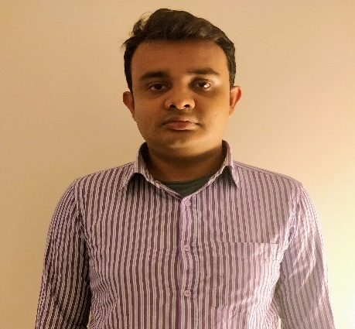

Omar Hossain
Relevant Experience
Company/Date: Infosys Ltd. Sep 2018 – till date
Role : Trainee
Responsibilities:
Full-Stack Developer – As a Full-Stack developer, I was responsible for creating RESTFUL Web Services
using Spring REST & Angular 4. which Called the Restful web services using POST, PUT, DELETE
and GET methods and with micro services. Developed the back-end of the application using Hibernate, which communicates with Oracle DB. Three Tier client/server Application in J2EE technology for the complete MVC solution. Implemented server side programs by using Servlets and JSP. Designed, developed and
validated User Interface using HTML, Typescript, XML and CSS.
Academic Projects
Junior Front/Back-end Developer Training/Intern- I have worked on a variety of technologies both in my studies and throughout the duration of training. During my time at CUNY, I had the opportunity to work on a variety of object oriented projects including project using Java core and SQL/CRUD technology to build business management system such as Customer/Employee Management that featured adding, updating and removing via JDBC to database. Through out my training , I worked few projects using Spring core, Spring Dao, spring MVC/Rest for backend. Building software such as cab rental application which enable user to register, make booking ,cancel booking and get discount for monthly rides etc.
Database Design and implementation Project: [MySQL]
Designing and implementing a relational database system to support the operations of an online reservation system. Implementing all phase of Database development life cycle such as Data modeling ,cardinality,ER -diagram, normalization etc.
HTML is used for the interface, MySQL for the database server and Java, JavaScript and JDBC for connectivity between the user interface and database server.
Omar Hossain
Omar.Hossain@Infosys.com
Professional Background
Excellent skills of implementing core JAVA concepts like Inheritance, Polymorphism, Strings- StringBuffer, Exception Handling, Multithreading, JDBC, Garbage Collection, generics, Serialization, and many others to make high efficient application.
Full Stack Web developer training for two months at Infosys.
Experience in software development and database designing
Excellent interaction skills and experience in working independently as well as in a team
Education:
Bachelor in information system
from The City University Of New York, New York
Areas of Expertise
Frameworks: Spring core,DAO,MVC/REST,Hibernate,Angular,JAX-WS,JAX-RS.
Languages: JAVA, SQL,PL-SQL, Java Script, Type Script.
Operating Systems: Windows, Linux, Unix etc.
Database: MySQL, Postges Sql , Oracle etc.
Methodologies: Waterfall, Agile Scrum.
Web Development: HTML5, CSS, JavaScript, XML, Angular 4
Tools: Eclipse, MySQL, MySQL Workbench, Apache Tomcat 8, Visual Studio Code, Git.

