Slide 1
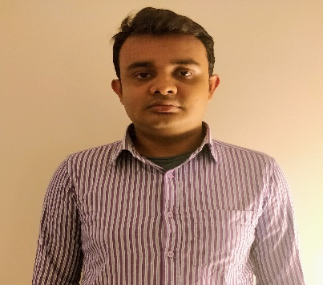
<Omar Hossain> – Associate Software Developer
Skills
Email:omar.hossain@Infosys.com
Mobile: +1-(929) 231-7389
Skills & Expertise:
Full Stack application Developer
Framework: (Angular 4 ,Spring MVC,Spring REST, Spring DAO, Hibernate etc.)
Programming Languages: (Core Java, JavaScript, Typescript etc.)
Built Single Page Application and design pattern.
Excellent Communication and Interpersonal skills
Software/Tools: Eclipse, MySQL, Tomcat, Postman, Junit etc.
Key Strength Areas: Team Building & Collaboration, Issue Resolution & Problem Solving, Object-Oriented Programming, Data Structures, Algorithms, Functional programing etc.
Photo
Experience Summary
Project Summary
Full stack developer with overall one year of experience in developing full stack application.
Primary languages used: JavaScript, typescript, Java, Angular 4.
Experienced in writing application level code to interact with APIs, Restful Web Services using AJAX, JSON.
Excellent knowledge on Object Oriented Programming
Strong Problem solving Business and Application analysis skills with excellent communication skills.
Ability to work individually or in a team and good learner to adapt fast changing technologies that tends to business development.
Academics:
Bachelor in information system from The City University Of New York, New York
Full-Stack Developer – As a Full-Stack developer, I was responsible for creating RESTFUL Web Services using Spring REST & Angular 4. which Called the Restful web services using POST, PUT, DELETE and GET methods and with micro services. Developed the back-end of the application using Hibernate, which communicates with Oracle DB. Three Tier client/server Application in J2EE technology for the complete MVC solution. Implemented server side programs by using Servlets and JSP. Designed, developed and validated User Interface using HTML, Typescript, XML and CSS.
Junior Front/Back-end Developer Training/Intern- I have worked on a variety of technologies both in my studies and throughout the duration of training. During my time at CUNY, I had the opportunity to work on a variety of object oriented projects including project using Java core and SQL/CRUD technology to build business management system such as Customer/Employee Management that featured adding, updating and removing via JDBC to database. Through out my training , I worked few projects using Spring core, Spring Dao, spring MVC/Rest for backend. Building software such as cab rental application which enable user to register, make booking ,cancel booking and get discount for monthly rides etc.

